Slide 1
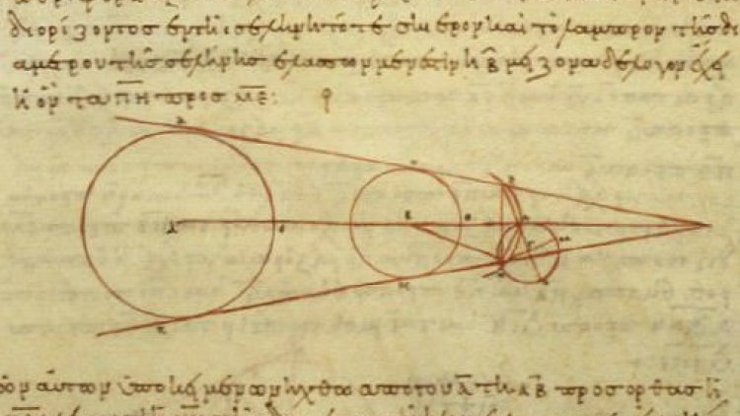
Through the lens of the Van Hiele Theory of Geometric Thought
Warren McIntyre
@WarrenMaths

Slide 2
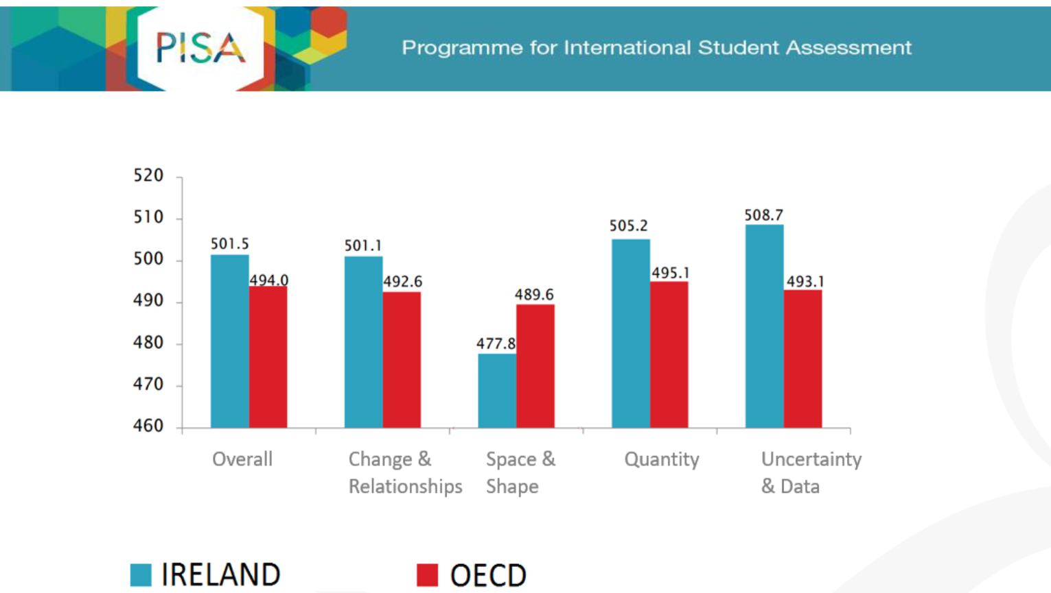
Mean Score

Slide 3

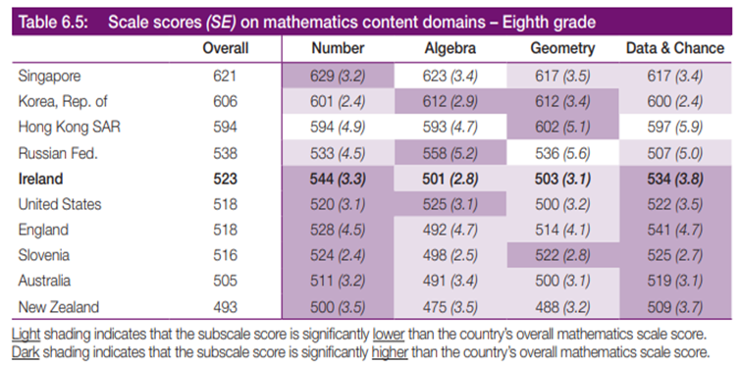


Slide 4
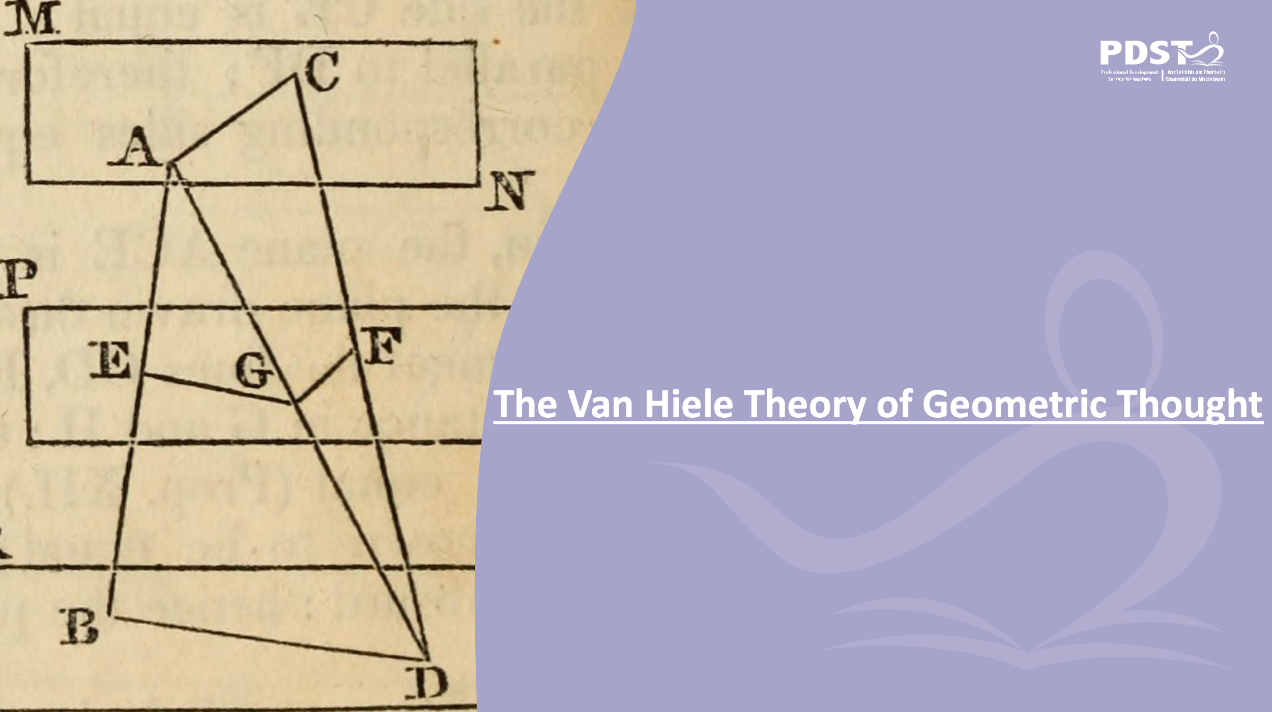


Slide 5
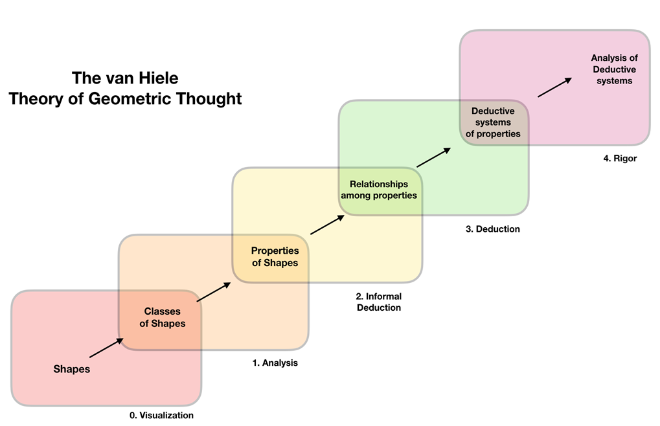

Slide 6
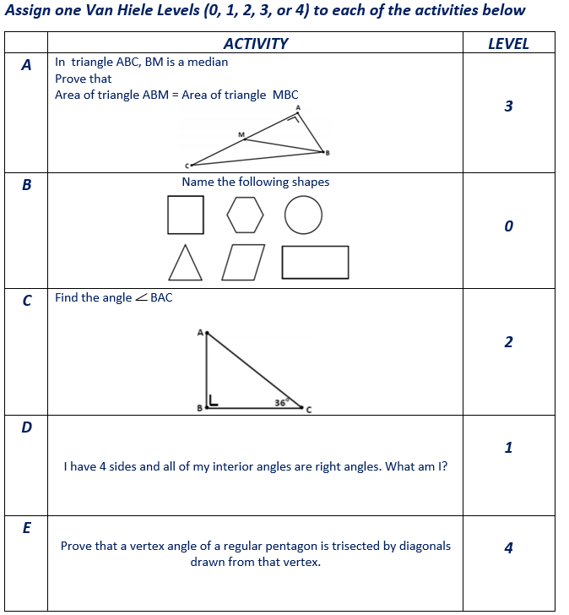



Identifying Van Hiele Levels

Slide 7
Proof at Junior and Senior Cycle

Slide 8
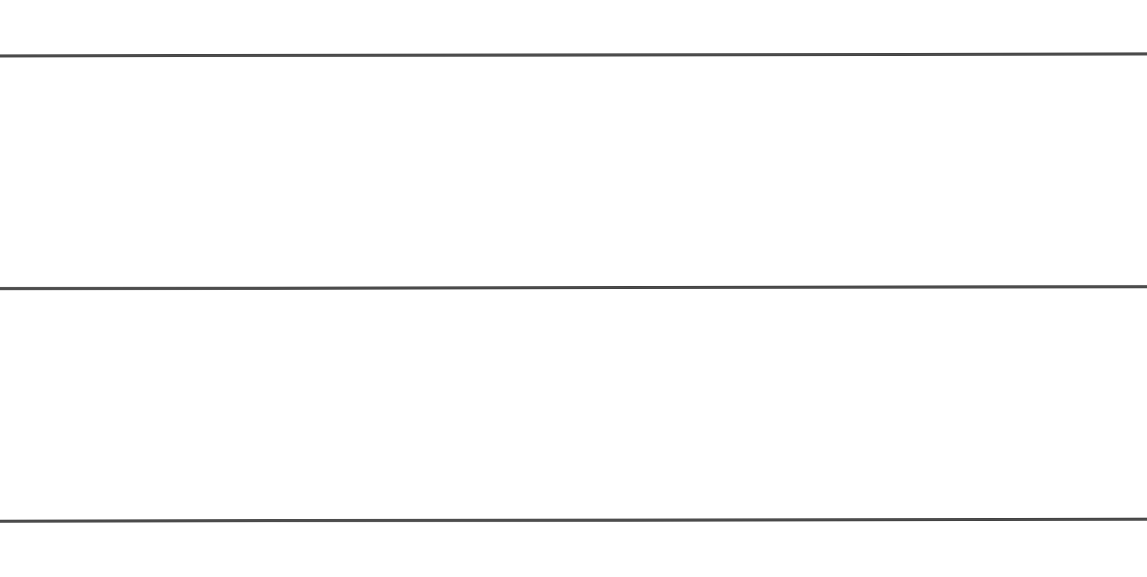
Investigation
Draw a line crossing all 3 parallel lines.
With the aid of your ruler do you notice anything interesting?
Repeat with different lines if needed

Slide 9
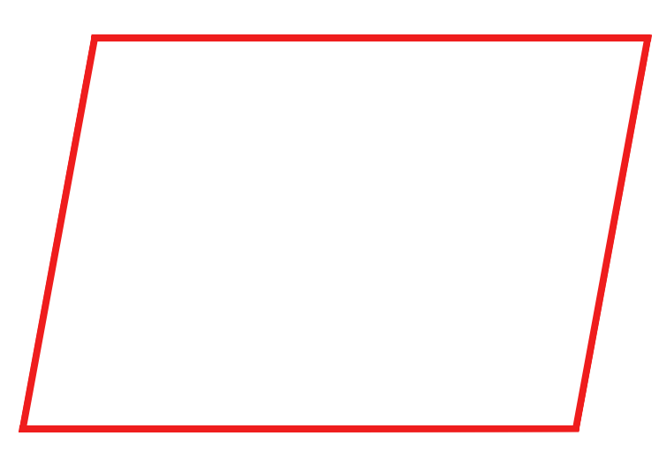
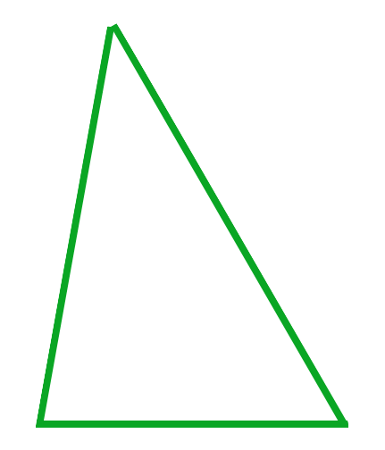
What are these?

Slide 10
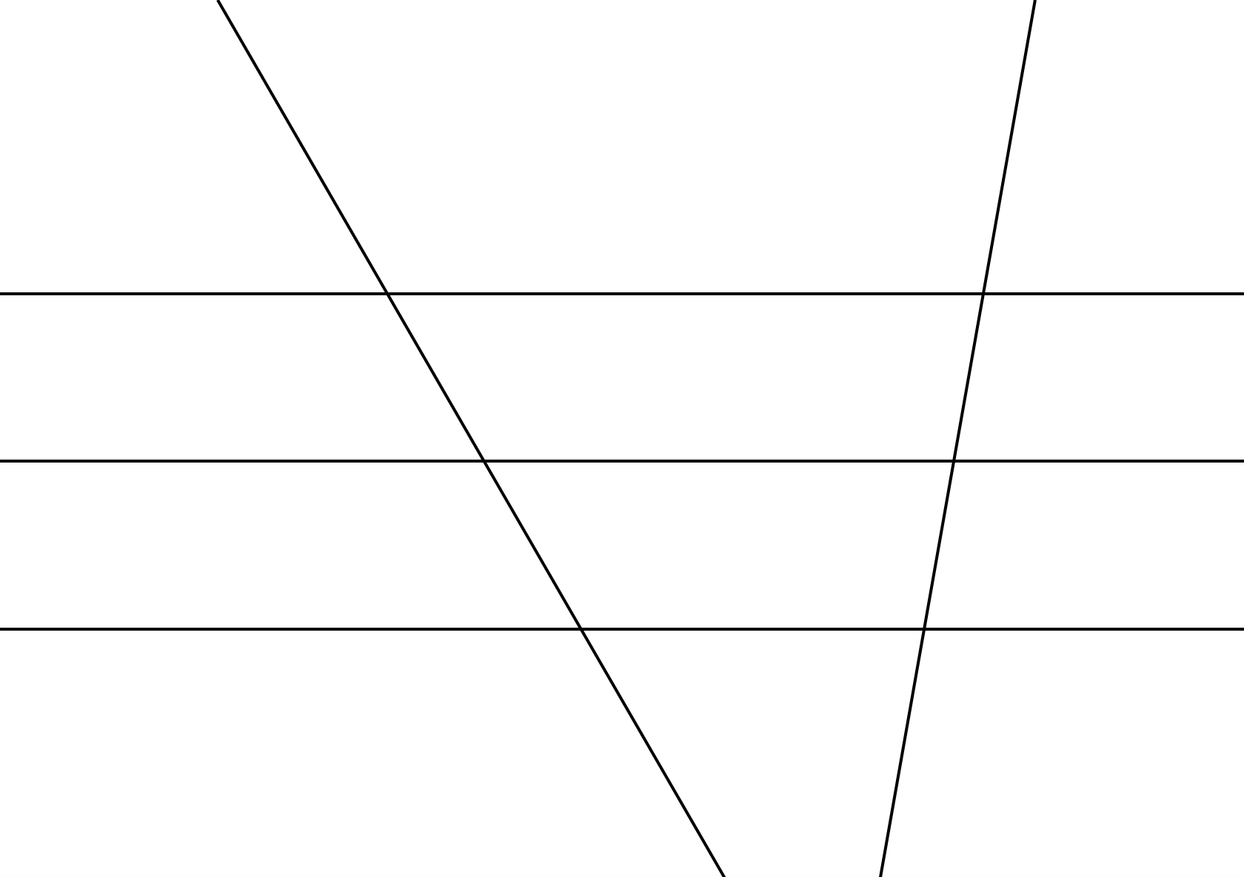
Space as a series of shapes

Slide 11
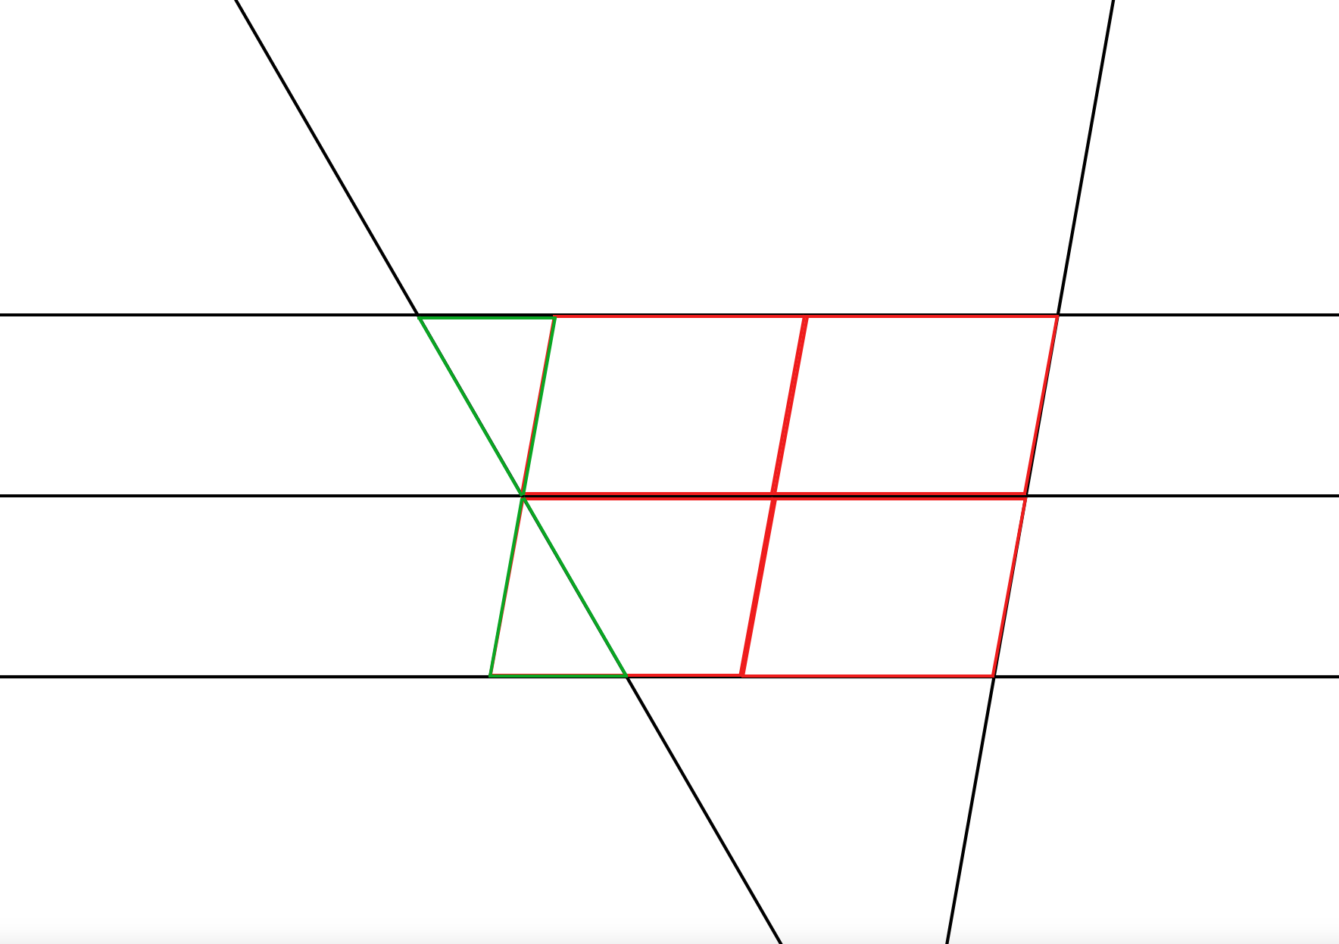
Possible Solutions
Now that we can visualise some of the shapes present in this diagram:
Can we identify as many properties and relationships as possible in the diagram?
Using some of those relationships, can we investigate if the fact we noticed earlier on will always be true?

Slide 12
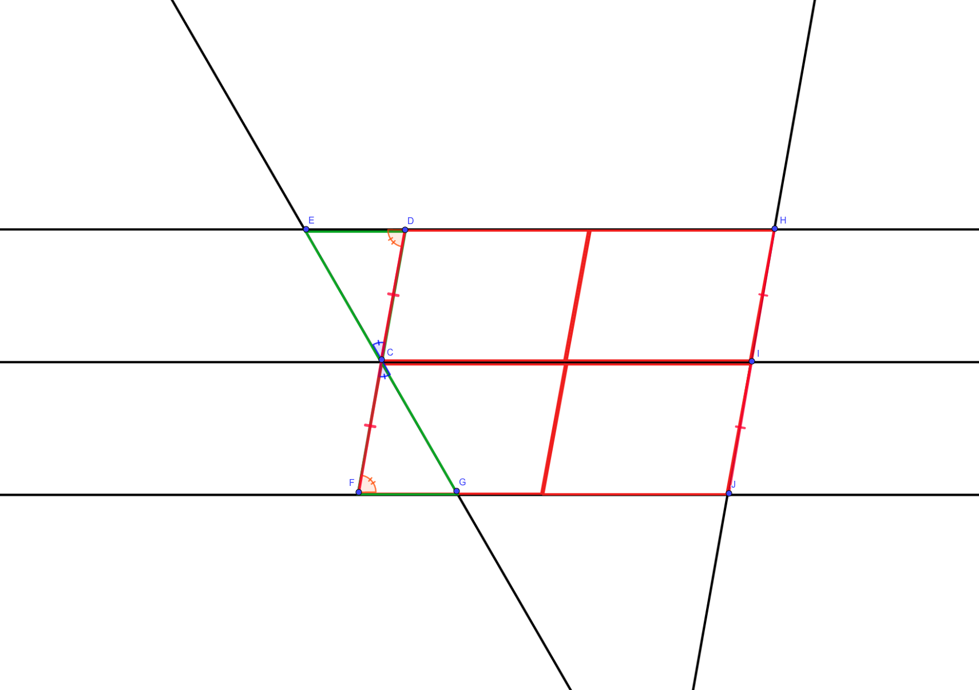
Solution

Slide 13
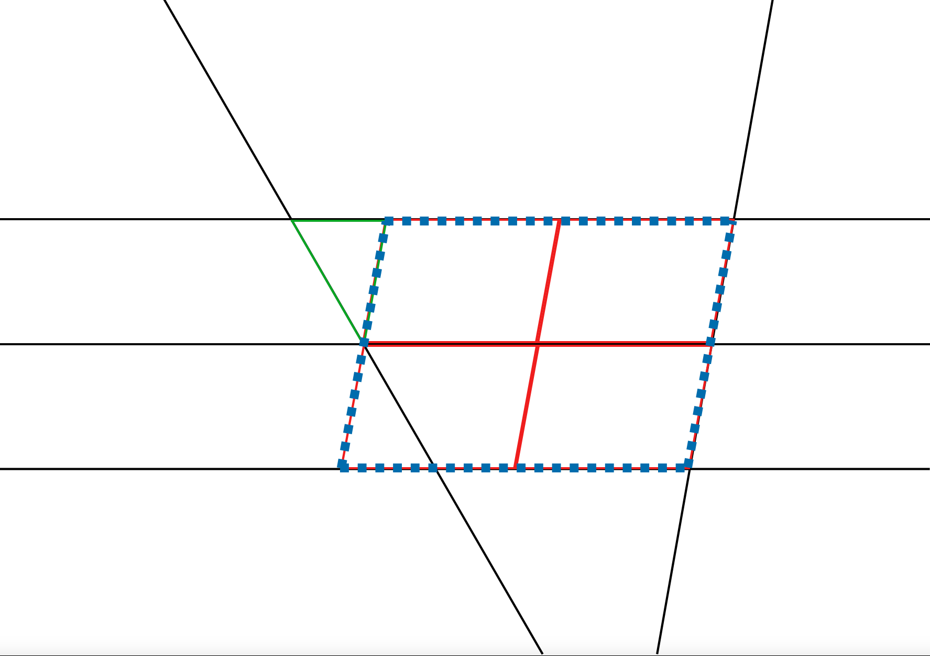
Explaining the mystery
Larger Parallelogram
Construction Line

Slide 14
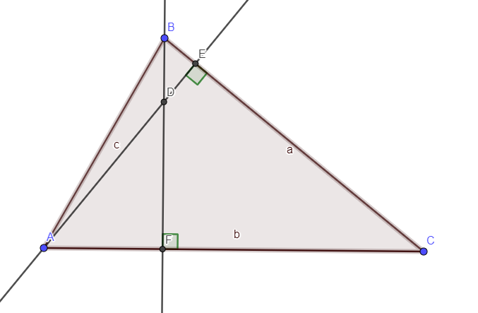
What observations can you make about this triangle?

Slide 15
What are the properties of this quadrilateral?

Slide 16
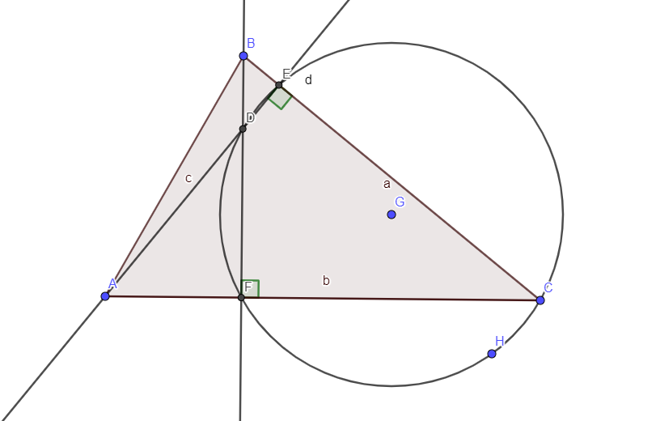
What are the properties of this circle?

Slide 17
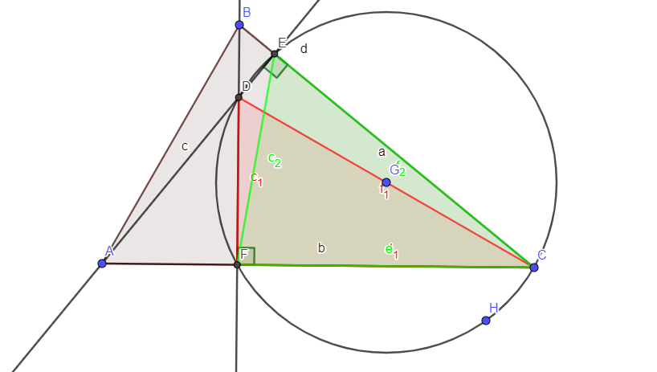
Prove that the measure of the angle fdc and fec are equal.

Slide 18
The van Hiele Theory of Geometric Thought

Slide 19
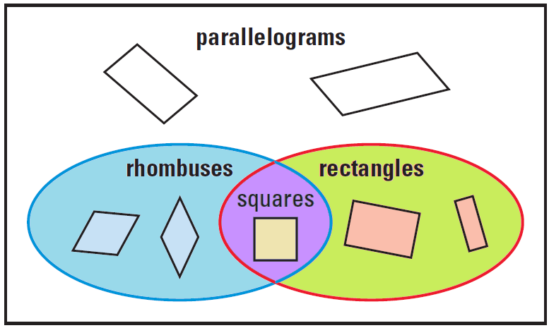
Junior Cycle Specification
Why?

