Slide 1
GeoGebra: The Dynamic Digital Manipulative.
Notes:
It is for a 40min presentation on GeoGebra as a dynamic digital manipulative, focusing on recognizing the effective use of digital technologies with reference to key policy documents. Task 1 uses the constructivist approach to explore the updated version of GeoGebra Suite, its bank of existing activities readily available, how to modify and publish already existing activities to suit the needs of our own students. Participants will then engage with a student learning experience using a Live GeoGebra Classroom(Task 2). Participants will have the agency to choose between two learning experiences as one is taken from an Online GeoGebra Course from last year’s team (the tent task) and a new task created exploring the relationship between the centroid, orthocenter and the circumcenter depending on the triangle type and the Euler Line (if case anyone has already seen the tent task or might want to try Senior Cycle content). Both tasks are connected and are extended to real-life contexts. The workshop will close with a reflection piece on where participants could bring any or if any learning from the workshop to the classroom.
Introduction (5mins)
(Key message, learning intentions, success criteria and effective use of digital technologies with reference to key policy documents)
Task 1(10mins)
Explore Updated version of GeoGebra Suite and its readily made activities using a constructivist approach and learner agency. (Participants will have their own devices).
For this task participants will get the opportunity to either explore/complete and modify already existing activities or to practice creating their own GeoGebra files using the Learn Calculator Suite Online Tutorial Page
Task 2 (15mins +5mins (effective questions, quick demo and making connections)
Purpose: Learner agency and the constructivist approach to learning key concepts in Geometry while using a Live GeoGebra Classroom to explore GeoGebra as a dynamic digital manipulative. Participants will engage with a student learning experience using a Live GeoGebra Classroom. Participants will have the agency to choose between two learning experiences as one is taken from an Online GeoGebra Course from last years team and a new task created exploring the relationship between the centroid, orthocenter and the circumcenter depending on the triangle type and the Euler Line (if case anyone has already seen the tent task or might want to try Senior Cycle content). Both tasks are connected and are extended to real-life contexts.
Reflection and School Support (5mins)

Slide 2
Key Message
Digital technologies offer deep learning opportunities for students when used with a constructivist approach.
Notes:
Purpose: Make explicit the key messages for participants

Slide 3
Learning Intention
We are learning how the effective use of GeoGebra in a Maths classroom deepens students' conceptual understanding.
Notes:
Purpose: Make explicit the learning intentions.

Slide 4
Success Criteria
Participants will
recognize the effective use of digital technologies with reference to key policy documents.
explore an overview of GeoGebra, its bank of existing resources and GeoGebra Classroom.
engage with a student learning experience using GeoGebra Classroom to explore Geometric concepts.
reflect on the key learning from this event.
Notes:
Purpose: Make explicit the intended learning for participants
Key Message: Success Criteria
Script:
We will discuss the effective use of digital technologies making reference to key policies and frameworks. We explore why GeoGebra is such a useful and beneficial digital technology and a great option of a digital manipulative for learner experiences. We are focusing on a constructivist approach to exploring the updated version of GeoGebra, the huge amount of readily available activities, how to access, publish and alter these activities to suit the needs of our own students. We will also explore the amazing addition of the Live GeoGebra Classroom for learner agency.

Slide 5
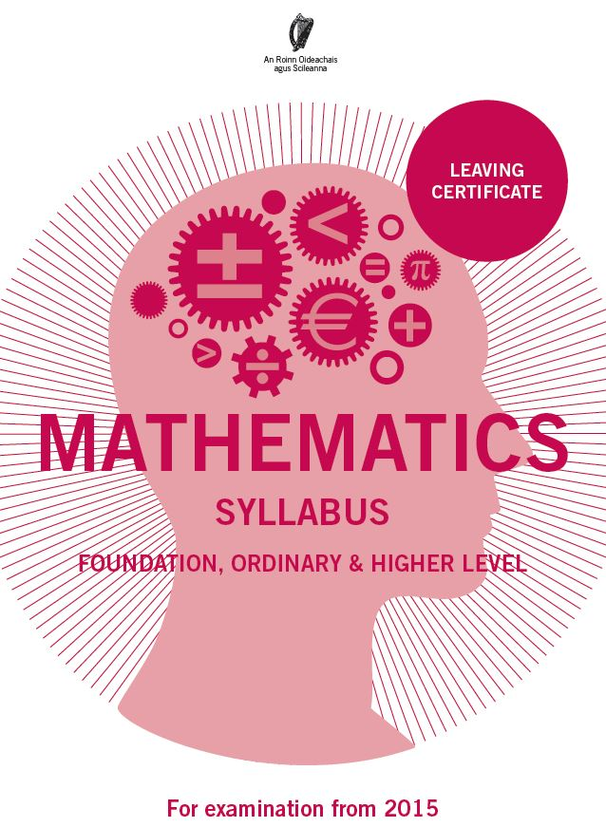
Key Documents
It is intended that ‘at all levels, learners will engage with a dynamic geometry software package... learners should first encounter the geometrical results below through investigation and discovery’.
This strand builds on the relations-based approach of junior cycle where one of the main objectives was ‘to use appropriate graphing technologies (graphing calculators, computer software) throughout the strand activities’.
Leaving Certificate Syllabus Pages 23 & 35
Notes:
Purpose: Draw attention to the requirement to engage with digital technologies as per syllabus recommendations.
Key Message: The syllabus intended teachers would use dynamic software in the classroom. GeoGebra is an appropriate choice of software.
Script:
The syllabus states that it was intended that students would engage with dynamic geometry software during their engagement with Geometry. It also highlights that students should investigate and discover their Geometrical results. GeoGebra is a free dynamic software package that allows students to investigate and discover Geometrical concepts at their own pace.

Slide 6

Key Documents
SOL 24 Examples of possible relevant learning
Students engage with digital technology to analyse and display data numerically and graphically; to display and explore algebraic functions and their graphs; to explore shapes and solids; to investigate geometric results in a dynamic way; and to communicate and collaborate with others.
JC Specification pages 6 & 7
Notes:
Purpose: Draw attention to the requirement to engage with digital technologies as per specification recommendations.
Key Message: The specification overtly states that students should engage with dynamic software in the classroom. GeoGebra is an appropriate choice of software.
Script:
The JC Specification SOL 24 states that ‘The student uses technology and digital media tools to learn, communicate, work and think collaboratively and creatively in a responsible and ethical manner’. The example given is displayed above. Note the use of the words analyse, explore and investigate highlighting that students engage with dynamic software and goes beyond simply displaying .
In the descriptors for the 8 key skills for junior cycle the use of digital technology is mentioned in 7 of them.

Slide 7
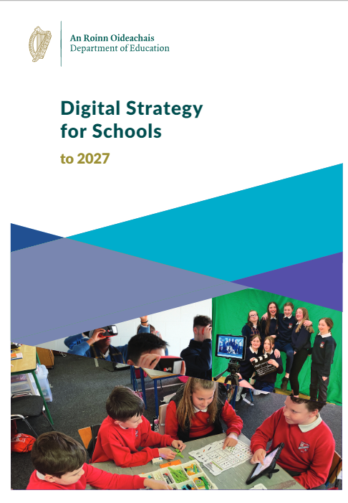
Key Documents
Using digital technologies actively and working with other learners promotes and encourages active learning, problem solving, critical thinking and communication skills, all of which are vital for the world we live in.
Digital Strategy for Schools to 2027 page 23
Notes:
Purpose: Draw attention to the requirement to engage with digital technologies as per specification recommendations.
Key Message: The specification overtly states that students should engage with dynamic software in the classroom so GeoGebra is a suitable software.
Script:
There are many useful tools that can support student learning. When considering a choice of technology it is important to ask yourself what you and your students will gain from the technology before implementing it. If it adds nothing to the learning, we may be better to stick to pen and paper. A learning experience is redefined when it integrates technology seamlessly and meaningfully to open new doors for student learning regardless of how sophisticated that technology might be.
In this workshop we are going to explore the use of GeoGebra as a digital manipulative. If used effectively, this has the potential to encourage active learning with our students. GeoGebra is a useful tool for supporting students by providing access to a digital manipulative.

Slide 8
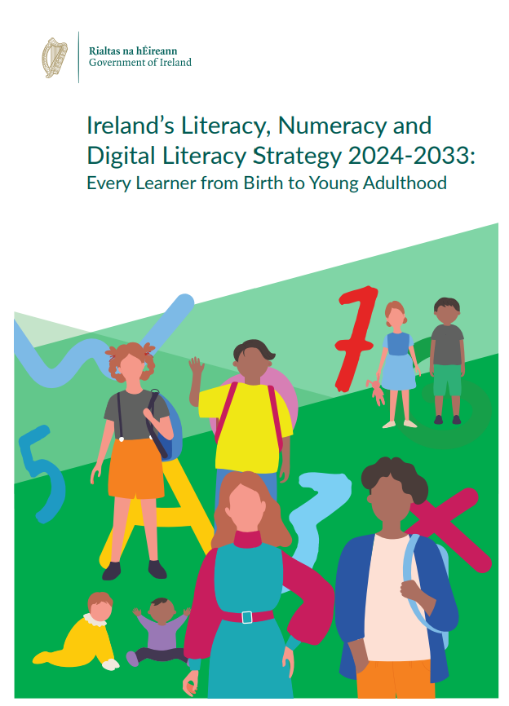
Literacy, Numeracy and Digital Literacy Strategy (2024)
“Numeracy is the ability to observe, explore and manipulate objects, and hear mathematical language. It involves using mathematical understanding and skills in a variety of contexts to describe, predict and explain phenomena, recognising the role that mathematics plays in the world”.
Pillar 4: Improving the learner experience through curriculum, pedagogy and assessment
Pillar 5: Supporting diverse learners to achieve their potential
DES (2024) page3 28, 42, 43
8
Notes:
Purpose: Highlight recent launch of Lit, Num &DL strategy
Message: Part of new LNDL strategy targets the learner experience, explicitly mentioning active learning and the use of physical and digital manipulatives.
Notes:
Diverse learners is an intentionally broad term to capture all learners at risk of educational disadvantage. The strategy identifies that diverse learners have unique strengths, challenges, and learning styles and need different levels of support. We will also look today at how to support diverse learners by providing open tasks and the use of effective questioning to challenge or scaffold students as appropriate. ‘Teaching age­ appropriate concepts that advance with learners is essential’
Numeracy is the ability to observe, explore and manipulate objects, and hear mathematical language. It involves using mathematical understanding and skills in a variety of contexts to describe, predict and explain phenomena, recognising the role that mathematics plays in the world. A numerate learner applies mathematical skills and makes the well founded judgements and decisions needed by constructive, engaged, and reflective members of society.
LNDL Strategy – five-year implementation plan will help equip learners from early childhood through postprimary education with the knowledge, skills and competences necessary for success in an increasingly interconnected and information driven world.
Pillar 4: Improving the learner experience through curriculum, pedagogy and assessment
Objective 4.5: Provide learner experiences that address gender differences in attitudes, confidence and achievement, identified areas of focus in mathematics and literacy.
4.4.1 Ensure that learner experiences in literacy, numeracy and digital literacy promote experiential learning opportunities including play, problem solving, inquiry, critical thinking and projectbased learning.
Pillar 5: Supporting diverse learners to achieve their potential

Slide 9
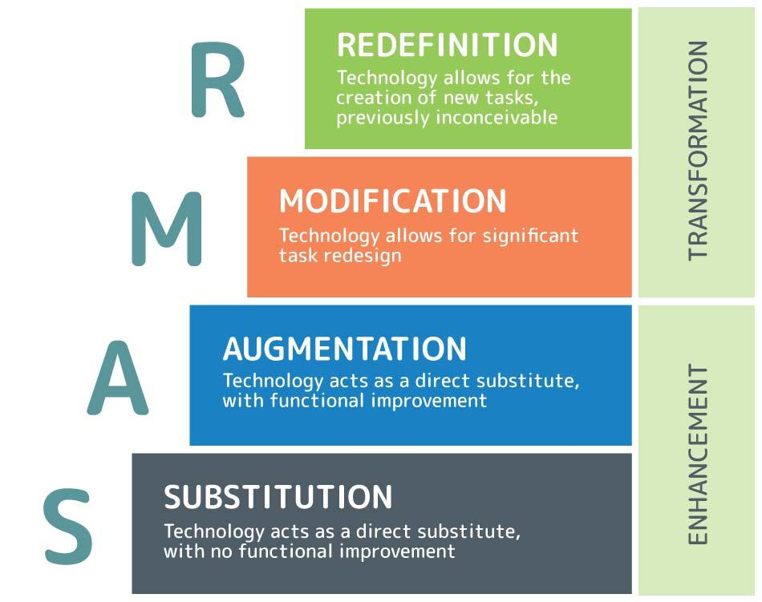
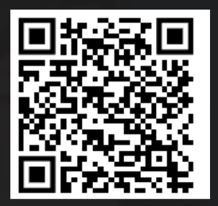
https://www.3plearning.com/blog/connectingsamrmodel/
Notes:
Solution File: https://www.geogebra.org/classic/bcpvucan
Purpose: Highlight the theory underpinning the choice of tasks to support reflection on how we use technology.
Facilitation Notes
Substitution and augmentation strategies use technology to enhance learning and add value, whereas modification and redefinition stages see technology transforming learning to make new things possible.
The effectiveness of any of these four strategies depends on when and how it is used.
Additional Notes from website referenced in slide:
Substitution
direct substitute for traditional practices.
save you time and space by cutting back on laborious pen and paper tasks and saving paper.
opportunity for students to get comfortable with new technology
Examples of substitution
students type their work
using online quizzes and programs
uploading a worksheet in PDF instead of photocopying
using a digital interactive whiteboard as opposed to a traditional whiteboard and saving the results as a document.
Remember: Substitution strategies do not change the learning process or outcome. Ask yourself what you and your students will gain from the technology before implementing it. If it adds nothing but hassle, stick to pen and paper.
Augmentation
technology adds something to the learning process beyond just convenience.
Gives students a clearer understanding of a complex topic
making content engaging in a way that traditional methods can’t.
allows for the introduction of more independent and student-centric learning
students can start actively learning without requiring constant teacher-led instruction.
Examples of augmentation
Students give oral presentations accompanied by a PowerPoint or Prezi containing multimedia elements.
Students use the internet to independently research a topic, as opposed to relying on teacher input.
Students use technology that gamifies curriculum content for student engagement and allows students to track progress in an accessible way.
Teacher instruction is supplemented with a video that clarifies a particularly hard to explain concept.
Modification
technology is used to design interactive and dynamic tasks that go beyond the limitations of a traditional classroom.
For example, students can
collaborate on shared documents
work in large groups, allowing for seamless collaboration and knowledge sharing.
allow students to generate inspired and innovative work that isn’t confined to paper. Some students will jump at the opportunity to get in front of a camera, while others will do anything to make it onto the global Mathletics leaderboard.
Examples of modification
Students produce podcasts summarising a topic, which can then be accessed by other students as a revision resource.
Students create an informative video presentation in place of a standard oral presentation. They can use their voice alongside a broader variety of creative multimodal components.
Students use a technological tool that makes an abstract concept visible in a hands-on, responsive way (e.g. voyaging on Google Earth to better understand measurement and geography).
Redefinition
The most sophisticated stage of SAMR, redefinition sees you using technology to make entirely new learning opportunities possible.
Redefining learning has the potential to connect learning with the real world and produce authentic outcomes. It also gives students strong technological soft skills such as digital collaboration, communication, technological literacy, and the ability to adapt to new systems and processes.
Most importantly, using technology to redefine learning in your classroom translates to vibrant and engaged students who embrace a growth mindset.
Examples of redefinition
connecting your students with other people around the world as part of the learning journey
having students publish their work online where it can be viewed by peers and the broader community
recording students as they deliver a presentation or practice a physical skill, then using this recording to prompt student reflection
experimenting with tasks that use extensive multimodal elements (e.g. producing documentaries or short films, webpages, print documents with creative layouts).
Note: redefinition isn’t the same as ‘high tech’. A learning experience is redefined when it integrates technology seamlessly and meaningfully to open new doors for student learning – regardless of how sophisticated that technology might be.
Students might look at data represented through amazing visuals and get inspired to create their own.

Slide 10
Task 1
Exploring GeoGebra.
Notes:
Purpose: Placeholder
Task 1

Slide 11
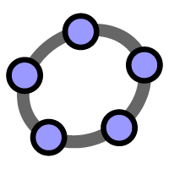
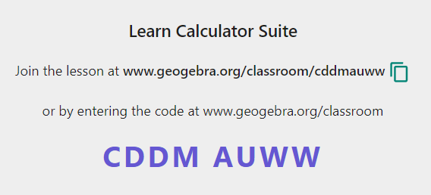
Task 1
Learn Calculator Suite – GeoGebra.
Notes:
Purpose: Explore Updated version of GeoGebra Suite and its readily made activities using a constructivist approach and learner agency. (Participants will have their own devices).
Key Message: New Updated GeoGebra Suite Link – Mention updated version briefly commenting that all the tools are still there just requires a few minutes to study the interface and where the tools are but not too different from the popular GeoGebra Classic 6. Demonstrate the endless readily made activities available to us and the brilliant addition of the live GeoGebra Classroom. Demo how to create, publish and copy an already existing activity to suit the needs of our own student in our classes. Comment that we will be modelling a GeoGebra Classroom learner experience in the next task. For this task participants will get the opportunity to either explore/complete and modify already existing activities or to practice creating their own GeoGebra files using the Learn Calculator Suite Online Tutorial Page Learn Calculator Suite – GeoGebra.
GeoGebra - the world’s favorite, free math tools used by over 100 million students and teachers
Script:
It can be quite tempting to fall into a transmissive space when presenting how to use technology but learners learn best when discovering for themselves and when they have agency in deciding what to learn. Here is an example of activities that you can use with your students to introduce different elements of GeoGebra. Log into GeoGebra using the link provided and complete as many GeoGebra activities as you can from the perspective of your students or participants can use this time to modify existing activities how they see fit for their own students. If participants, depending on their level of experience may want to learn how to create their own GeoGebra files, if so, they will be given a link to a self-directed learning suite in GeoGebra The emphasis is on learner agency here depending on their own learning intention from the workshop.
Facilitation Notes:
Each participant will have different experience and a different ability level.
Each participant will work on their own to complete or modify as many GeoGebra activities as they can in the time allowed.
Participants can support each other through these tasks.
From the information we collect, we can assess the level of the participants.

Slide 12
Task 2
Exploring relationships in Geometry
Notes:
Purpose: Placeholder

Slide 13
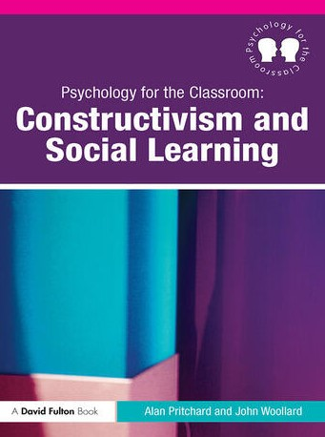
Principles of Constructivism
The learner constructs his or her own knowledge and understanding.
Learning does not occur when the learner passively receives information.
Learners are the makers of meaning and knowledge, not simply the receivers.
Psychology for the Classroom: Constructivism and Social Learning page 52
Notes:
Purpose: Highlight the Principles of Constructivism.
Note:
Reminder of constructivist principles
Prompt participants to note occurrences of constructivism in next task

Slide 14
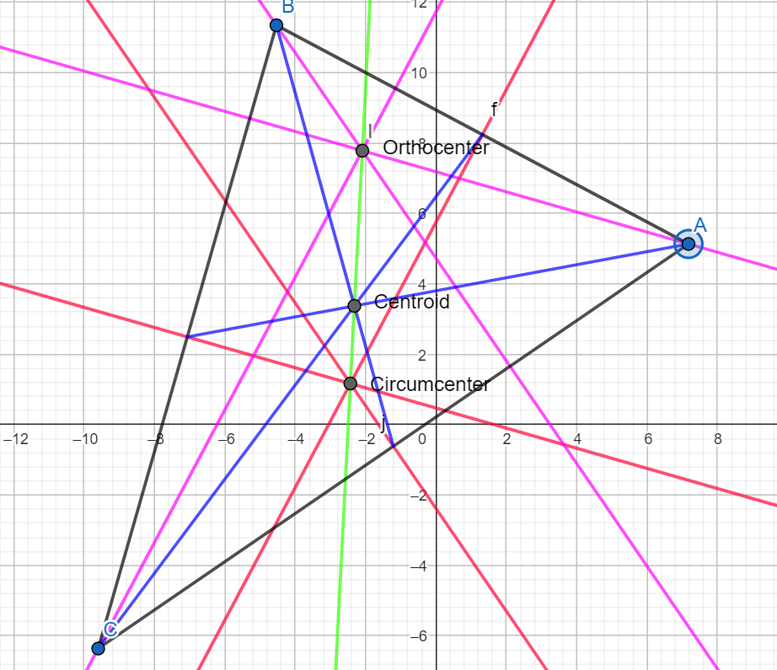
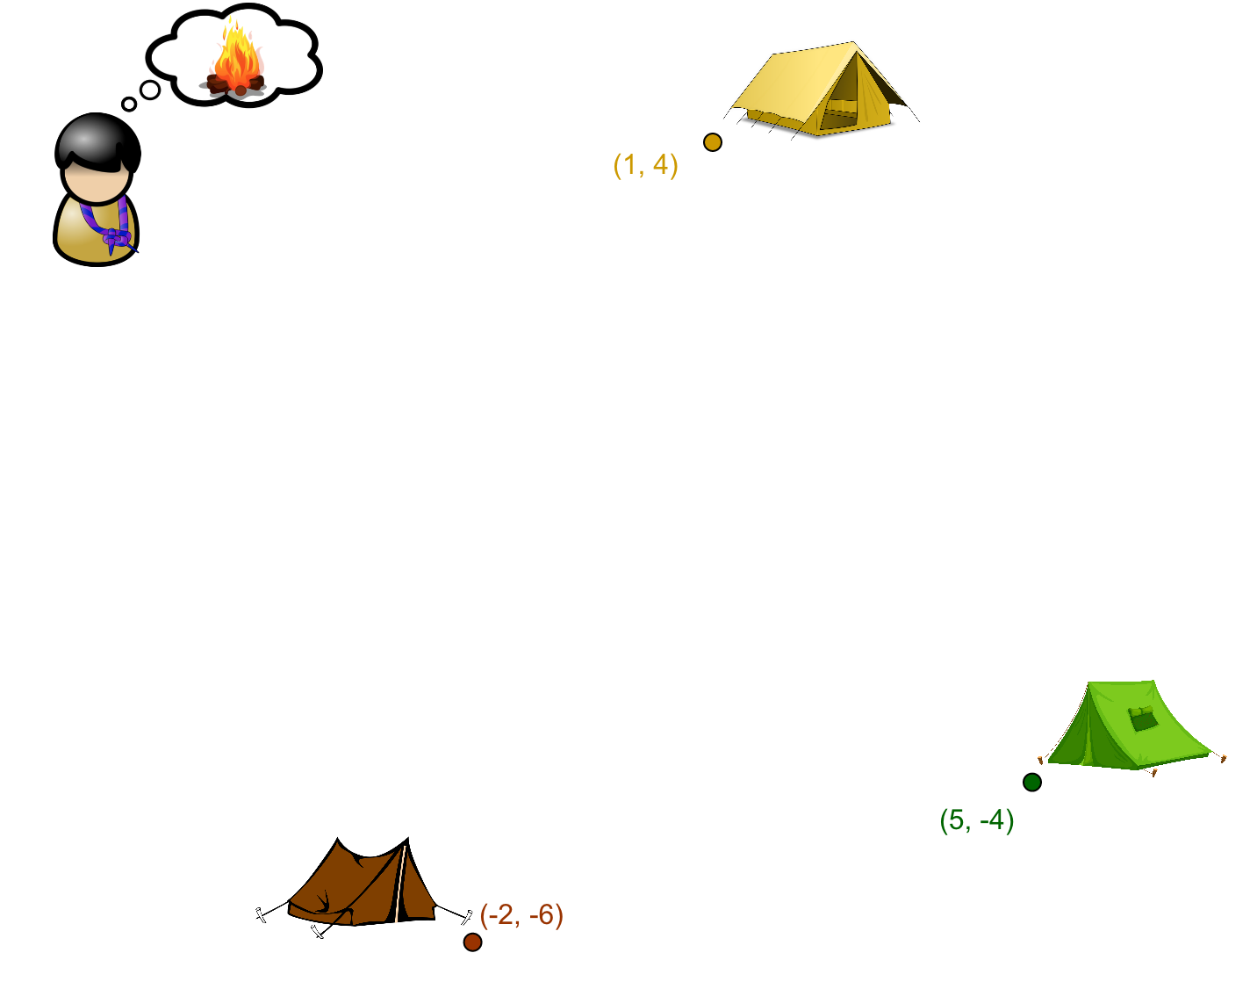
Task 2(A or B)
Notes:
Purpose: Modelling a leaner experience using GeoGebra Classroom as a dynamic digital manipulative and the use of effective questioning
Key Message: Depending on which task most of the participants picked, demonstrate either task A or B, highlighting the use of effective questioning and how each task can be scaffolded, and accessed (Possibly connection here with Van Hiele Levels of Geometric thought from Cluster Day). Rich tasks supported by an effective question can allow students to apply their discoveries and make new connections.
Script: TASK A
Demo Support Questions at appropriate intervals during this 5 min period:
How do we ensure this is the fairest location, can we verify? (For students who just drop a point) (We can measure the distances to each end point).
What do we mean by fair? ( Prompting for ‘same distance from each tent’ or equidistant)
Can you find the fairest point between 2 of the tents? (Requires an understanding of the midpoint)
Is there any other point which is equidistant from both tents? (Prompting for points along the bisector - drawing on prior knowledge)
How can I find the fairest point between 3 tents? (Must apply understanding of bisecting lines)
Plot the points on a coordinate grid and investigate the solution.
Additional Notes – Locating the Circumcenter
The solution we are hoping students will reach is to draw on their prior knowledge of the perpendicular bisector. It is important to keep returning to the key concepts and ensure students are verbalising the correct terminology.
Starting with the question itself. What do we mean by fair? Here we are Prompting for the students to use the words ‘same distance from each tent’ or ‘equidistant’.
Click on to create the triangle.
How can you find the fairest point between 2 of the tents? The student might identify the midpoint so we might follow up with ‘Is there any other point that is equidistant from the tents?’ and here we are drawing on their prior knowledge of the perpendicular bisector.
Click on to find the first bisector line
How can I find the fairest point between 3 tents? (Must apply understanding of bisecting lines, repeat the process for the next two tents)
Click on to find the other bisector lines
Where should we put the fire? (Where the lines intersect).
Click on to locate the fire.
We have now found a solution to the problem. The next step is to investigate if the solution is valid.
How could we check its the fairest point? (Measure the distance from the point to each vertex).
Click on to find the segments from circumcenter to vertices.
Ok now we can see that this point is in fact equidistant from each vertex.
We now want to introduce the students to the terminology ‘circumcenter’. We want our students to use this new terminology and become comfortable with it and form part of their mathematical vocabulary.
TASK B
Learning Intentions
Students will: - Explore concurrencies of a triangle. - Gain a deeper understanding of how to construct the Centroid, Orthocenter, Circumcenter and Euler Line. - Analyse and make observations about their positions relative to the triangles type (Acute, Right or Obtuse).
Success Criteria
Students will: - Use GeoGebra to create a triangle
Using GeoGebra draw the three Medians of the triangle and in turn locate the Centroid.
Using GeoGebra draw the three Perpendicular Bisectors of the triangle and in turn locate the Circumcenter.
Using GeoGebra draw the three Altitudes of the triangle and in turn locate the Orthocenter.
Using GeoGebra draw Euler's Line.
Using GeoGebra move a vertex of the triangle to analyse relationships and make observations about their positions relative to the triangles type.
or (Time Depending)
Students will: - Use GeoGebra to move a vertex of the triangle and analyse relationships between the concurrency points and make observations about their positions relative to the tringles type with a Pre-made GeoGebra Activity (see below).
Script:
Demo Support Questions at appropriate intervals during this 5 min period:
Where does the centroid always lie in relation to the triangle's orthocenter and circumcenter?
Explore the distance from the centroid to the circumcenter and the orthocenter, what can you conclude?
Make observations about the position of the centroid, circumcenter and the orthocenter with different types of Triangles (acute, right, obtuse).
Observe the Euler Line’s relationship with different types of Triangles (acute, right, obtuse).
Form an equilateral Triangle, what observations can you make?

Slide 15
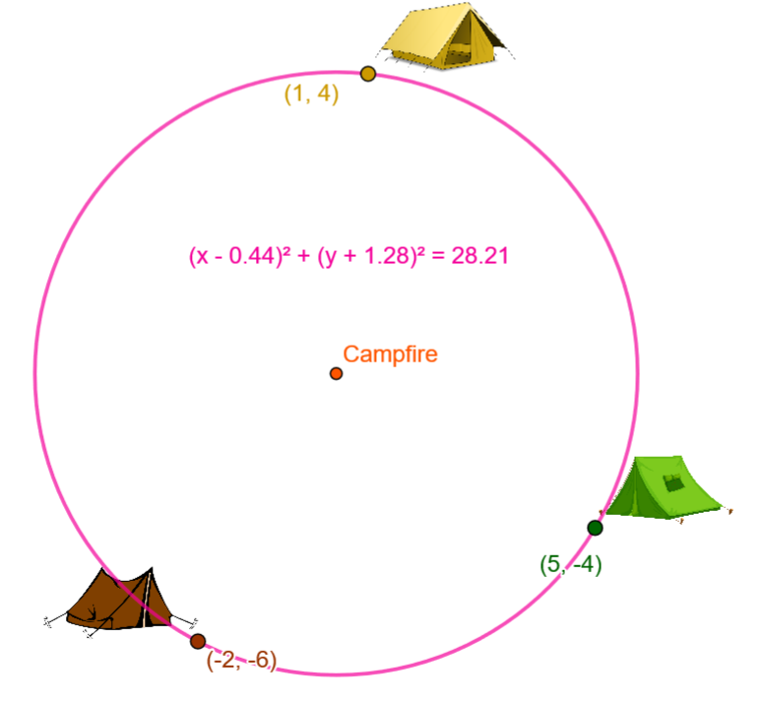
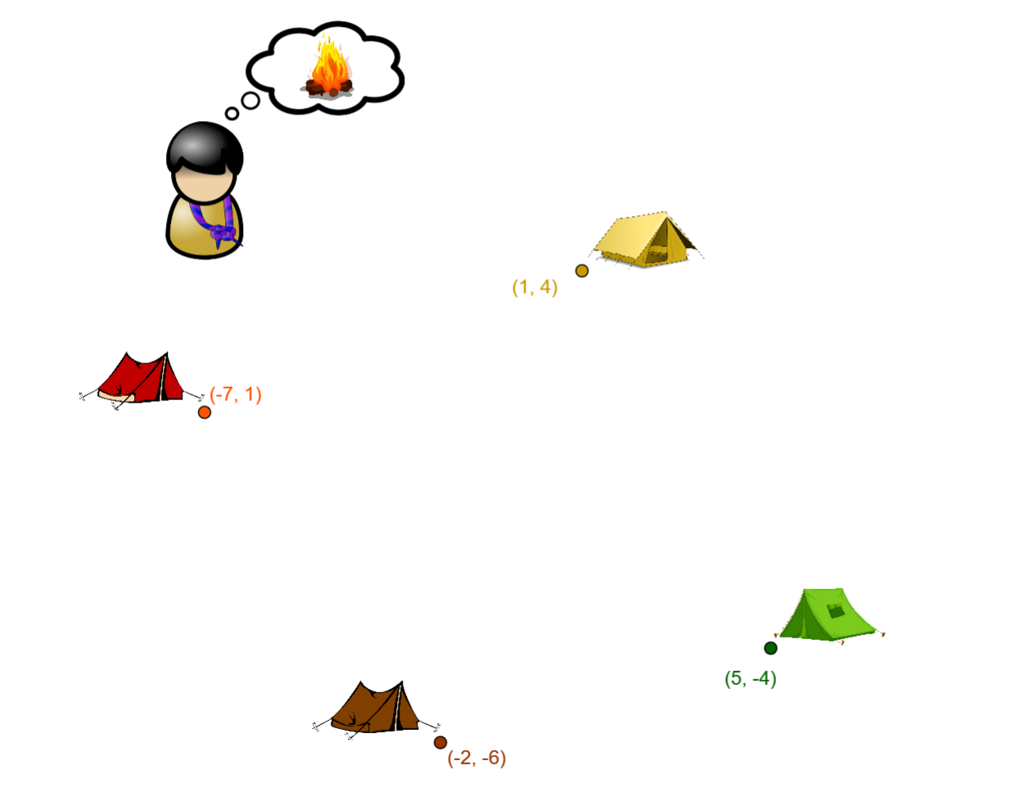
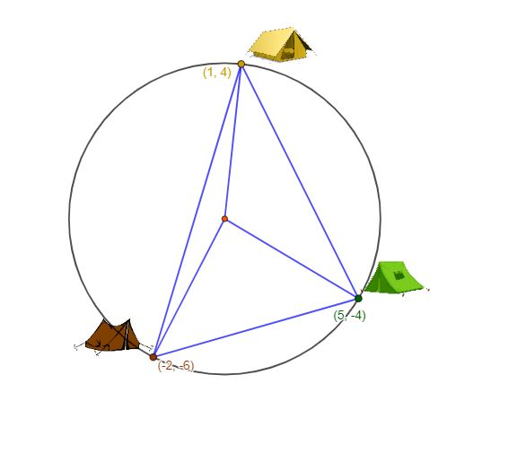
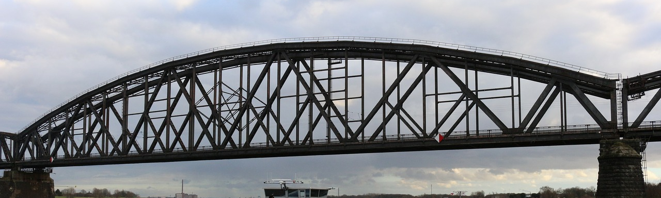
Making Connections and Real-Life Applications.
Notes:
Key Message: Effective learning experiences can be connected to other areas of Geometry and strands and applied to real-life contexts to promote students' positive disposition towards maths.
Purpose: Briefly discuss how effective learning experiences can connect multiple learning outcomes and be applied to real-life contexts to promote a positive disposition for our students. (MAX 2 MINS)
Script:
How could we use GeoGebra to expand on the learning and investigate some of the connected concepts.
Consider the following questions:
The troop wants to set up an additional tent. Without moving the original tents or the fire where could we place the extra tent? (Introducing the circumcircle)
Would this solution work if there were more than 3 tents? **(Cyclic Quadrilaterals then cyclic polygons, challenging question)
What is the relationship between the coordinates of the center of the circumcircle and the coordinates of any point on the circle?
How could we use these learner experiences to promote real – life applications of these concepts – Structural Design, Engineering, Promotion of STEM.
Additional Information:
If we have three points, we can always find a circumcenter and we can always draw a circumcircle.
The troop wants to set up an additional tent. Without moving the original tents or the fire where could we place the extra tent?
Would this solution work if there were more than 3 tents?
Key learning: We can only draw a circle through the vertices of a quadrilateral if the bisectors of each side intersect at a point that is equidistant from each vertex.
Under what circumstances can you draw a circle around a polygon?
What is the relationship between the coordinates of the center of the circumcircle and the coordinates of any point on the circle?
Investigating the Circumcircle
We now know from our investigation that if we have three points, we can always find a circumcenter and we can always draw a circumcircle.
Let’s consider now what happens if I want to introduce another tent.
Investigation: Without moving the original tents or the fire where could we place an extra tent?
We want our students to spend time investigating this and to come to the conclusion that they can put a tent anywhere that is the same distance from the center and if we examine this carefully we can see that we can locate the tent anywhere within a particular radius - thus leading to discovery of the circumcircle.
This moves our investigation on to the properties of the circumcircle –
Investigation: can we always draw a circle, under what conditions (given any three points).
Again the investigation and discussion are crucial to these investigations.
Students need more than just one example before we generalise. We don’t want to rush this conclusion, part of the social constructivist approach is that students create the new knowledge for themselves. We are then moving students towards a deeper understanding of the properties of triangles and considering where this new knowledge fits in their current understanding.
A natural next step then is to move beyond the triangle into other polygons and see whether our new knowledge holds true for more than three points. We might ask our students to consider for example
Investigation: “Would this solution work if there were more than 3 tents?”
This is not as straightforward as it may appear initially to students. The key learning may open up a conversation around the circumstances under which you can create a circle around a quadrilateral. We can only draw a circle through the vertices of a quadrilateral if the bisectors of each side intersect at a point that is equidistant from each vertex.
We could extend this then to ask some extension questions.
Under what circumstances can you draw a circle around a polygon?
What is the relationship between the coordinates of the center of the circumcircle and the coordinates of any point on the circle?
Possible real life application tasks:
Task 1: Structural Design and Stability (Centroid)
In structural engineering, the centroid is essential for stability. Using GeoGebra, create a triangular model of a bridge truss. Find the centroid and describe why this point is critical in ensuring the balance and stability of the structure.
Task 2: Optimization of Services (Circumcentre)
Imagine a situation where three cities form a triangular region, and a satellite or communications tower must be placed equidistant from all three cities. Use GeoGebra to determine the circumcentre of this triangle and discuss why the circumcentre is a practical solution for positioning the satellite or communication tower in this scenario.
Task 3: Urban Planning and Emergency Services (Incentre)
Model a triangular city in GeoGebra and locate the incentre. Analyse why this point is ideal for placing for emergency services. Although the incentre is not on the Euler Line, explain the incentre’s role in real-world applications.
Task 4: Euler Line in Engineering
Triangular frameworks (trusses) are commonly used in bridge design because triangles are geometrically stable structures. The structural property of triangles allows for efficient distribution of forces throughout the bridge, minimizing stress on any one point and increasing the stability of the structure. In any triangle, the centroid, orthocentre and the circumcentre lie on a line called the Euler Line. This line helps engineers visualize how the centroid, orthocentre and the circumcentre influence the stability and force distribution in a triangular structure. By analysing the Euler line, engineers can ensure that forces are balanced across the triangle and that the structure can handle both loads be it from heavy vehicles or from intense winds.
In GeoGebra create a Triangle representing a part of the truss,
-Find the centroid (this acts as the centre of mass for the triangular section).
-Find the orthocentre(this helps engineers analyse how the vertical load from above due to heavy vehicles is transferred throughout the different members of the triangular framework of the bridge).
-Find the Euler Line (A well-balanced triangular structure with a well-positioned Euler line will distribute forces efficiently, leading to greater stability and integrity.

Slide 16
Conclusion
Notes:
Purpose: Placeholder Slide

Slide 17


Reflection
What was the key learning from this workshop?
How will you bring this learning to the classroom?
What would I like to learn more about?
Page 10
Notes:
Key Message: Personal Reflection on today’s workshop.
Purpose: Individual Reflection on our own teaching practices and methodologies.
Script: Can you think of one way in your own teaching this week where you could incorporate GeoGebra as a digital manipulative?

Slide 18
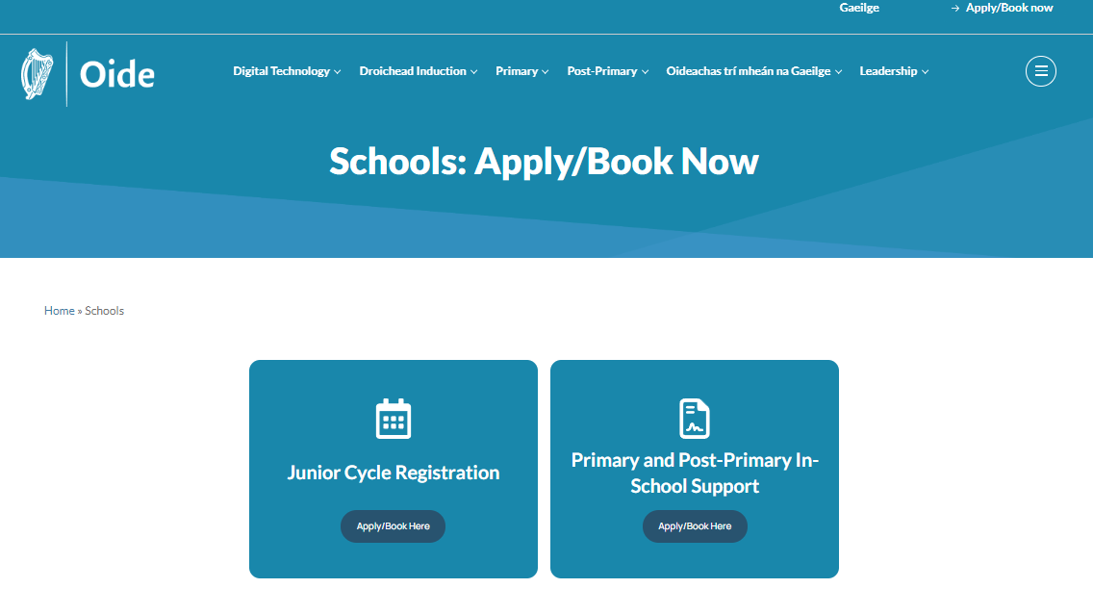
Applying for School Support
https://oide.ie/schools/
Notes:
Key Message: School Support - continue see the benefits of GeoGebra – apply on the DMS system, select OTHER and apply for support on the effective use of GeoGebra as a dynamic digital technology.
If schools require support in this area, the Principal must apply for this support.
School support is available and school leaders (Principals) can apply at the link…https://oide.ie/schools/
They then click on Primary and Post Primary In-School Support.
If a school Principal doesn’t have login details, they can email postprimarysupport@oide.ie

Slide 19
References
DES. (2024). Literacy, Numeracy and Digital Literacy Strategy for schools 2024-2033
DES. (2022). Digital Strategy for Schools to 2027. Dublin
DES. (2020). Digital Learning 2020: Reporting on practice in Early Learning and Care, Primary and Post-Primary Contexts
DES. (2017). Digital Learning Framework for post-primary schools. Dublin
DES. (2015). Digital Strategy for Schools. Enhancing Teaching, Learning and Assessment. Dublin
EC. (2020) Blended learning in school education – guidelines for the start of the academic year 2020/21
NCCA. (2016) Junior Cycle Specification. Dublin.
NCCA. (2013) Junior Certificate Mathematics. Dublin.
NCCA. (2012) Leaving Certificate Mathematics. Dublin.

