Slide 1

Using Desmos to deepen understanding

Slide 2

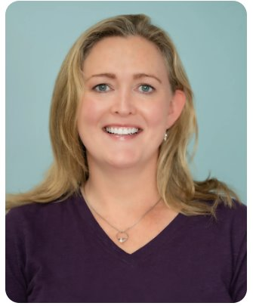
Welcome!
Meet the Team
emer.brady@oide.ie
samantha.mcmorrow@oide.ie
Notes:
Hello and welcome to this webinar Using Desmos to Deepen Student Learning ….
​

Slide 3



Mathematics & Computer Science
https://oide.ie/post-primary/home/mathematics/
Applied Mathematics @OideAppliedMath
Computer Science @Oide_CompSci
Mathematics @Oide_PPMaths
Numeracy

Slide 4
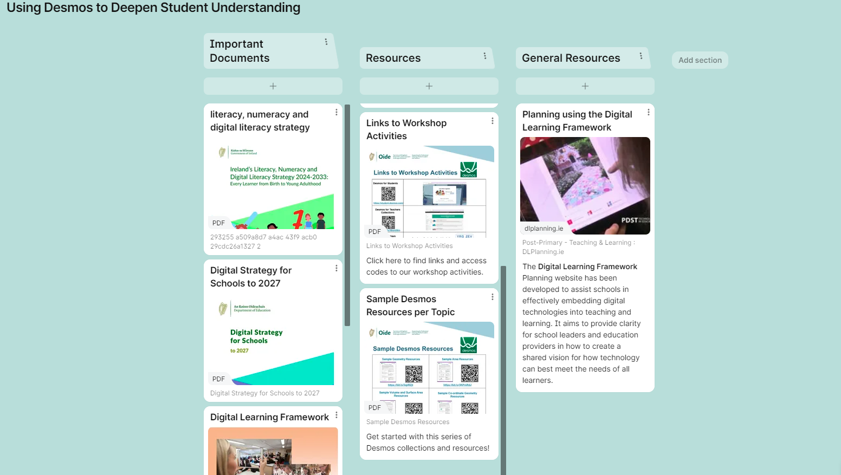

Supporting Resources

Slide 5

Key Message
Digital technologies offer deep learning opportunities for students when used with a constructivist approach

Slide 6
Learning Intention:
To consider how the effective use of Desmos in a Maths classroom deepens student’s conceptual understanding.
Success Criteria:
I have
been provided with an overview of the effective use of digital technologies with reference to key policy documents.
explored an overview of Desmos, its bank of existing resources and Desmos Classroom.
engaged with a student learning experience using Desmos Classroom to explore a range of concepts.
reflected on the key learning from this event.

Slide 7
Overview - Key Documents
7

Slide 8
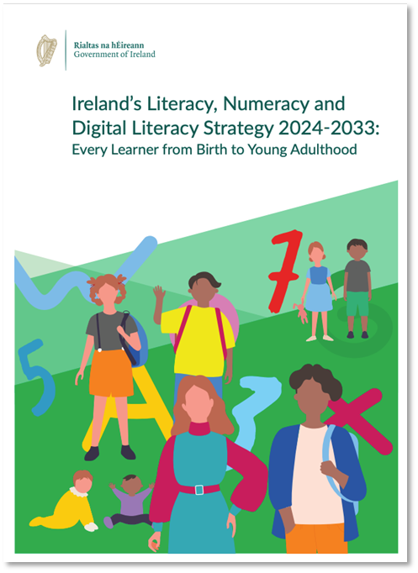
Literacy Numeracy & Digital Literacy Strategy 2024-2033
Numeracy Skills
Analyse patterns and relationships
Use skills of investigation, reasoning and problem solving
Hypothesis and make predictions through the examination of evidence
Analyse and make good arguments
Express ideas mathematically
Estimate, predict calculate
Adopt a positive disposition and attitude
towards numeracy
​
​
8
Notes:
The LNDL Strategy emphasises the importance of the following Numeracy, literacy and digital literacy skills, which can be explored through the use of digital tools such as Desmos in the Maths classroom.
Desmos can support student understanding as they ……….
(From slide)
8

Slide 9
Literacy Numeracy & Digital Literacy Strategy 2024-2033
Literacy
Subject specific literacy and language skills.
Digital Literacy
Using technology to facilitate expression
and creativity
​
​
9
Notes:
The LNDL Strategy emphasises the importance of the following Numeracy, literacy and digital literacy skills, which can be explored through the use of digital tools such as Desmos in the Maths classroom
It can also support the JC Key skills Being Numerate, Being Literate, Being Creative, Staying well, Managing Information Thinking for example
In a similar way SC key competencies, which will be encompassed in SC Maths redevelopment in tranche 3 can also be supported by tolls such as Desmos:
Key competencies are supported when
students’ literacies are well developed
students’ numeracy is well developed
students make good use of various tools, including technologies, to support their learning.
9

Slide 10
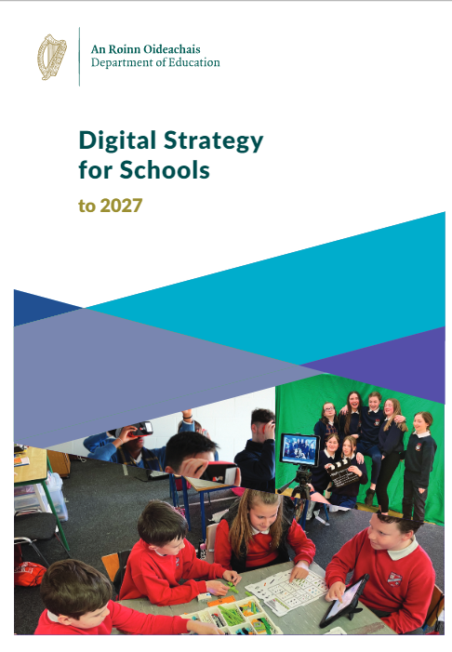
Digital Strategy for Schools to 2027
Using digital technologies actively and working with other learners promotes and encourages active learning, problem solving, critical thinking and communication skills, all of which are vital for the world we live in.
Digital Strategy for Schools to 2027 page 23
10
Notes:
10

Slide 11
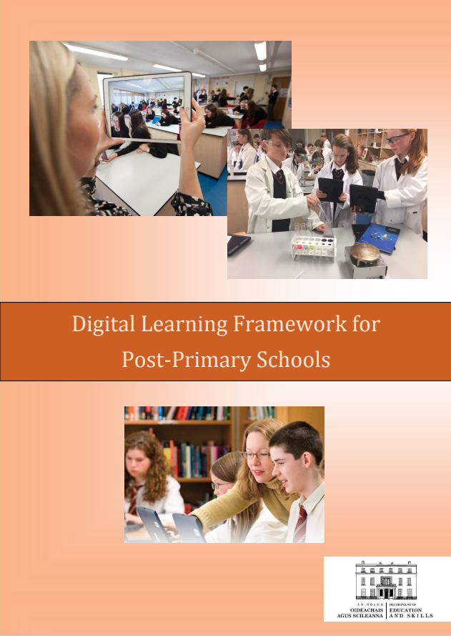
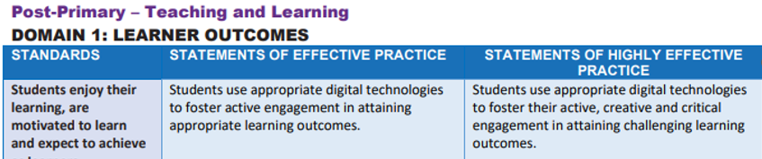
Digital Planning
11
Notes:
11

Slide 12
Exploring Desmos
12

Slide 13
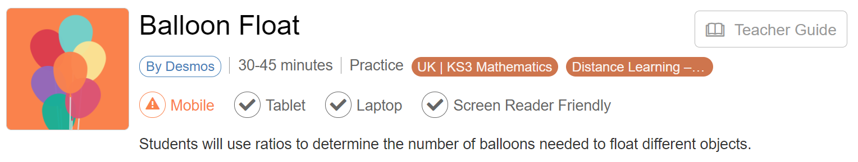
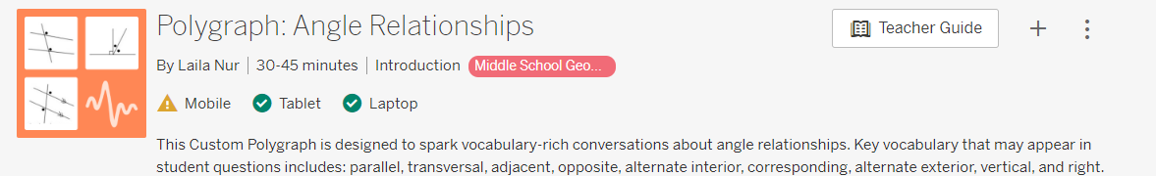
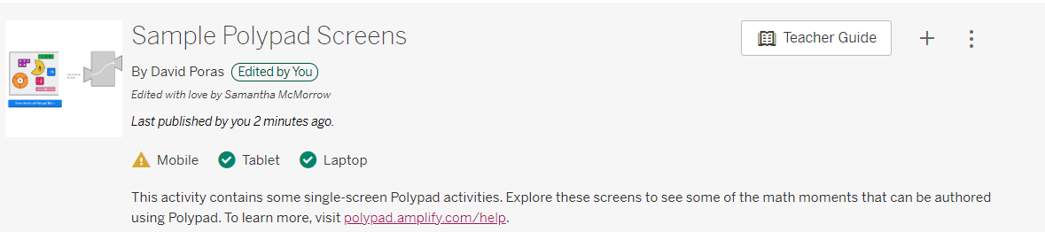



Exploring the Teacher View and
Student View
Watch listen and enjoy
OR
Watch copy and enjoy!

Slide 14

Reflection
What was the key learning for you from this session?
How can you bring the learning to your classroom?
14

Slide 15
Conclusion
15

Slide 16
Learning Intention:
To consider how the effective use of Desmos in a Maths classroom deepens student’s conceptual understanding.
Success Criteria:
I have
been provided with an overview of the effective use of digital technologies with reference to key policy documents.
explored an overview of Desmos, its bank of existing resources and Desmos Classroom.
engaged with a student learning experience using Desmos Classroom to explore a range of concepts.
reflected on the key learning from this event.

Slide 17
Key Message
Digital technologies offer deep learning opportunities for students when used with a constructivist approach

Slide 18


Slide 19
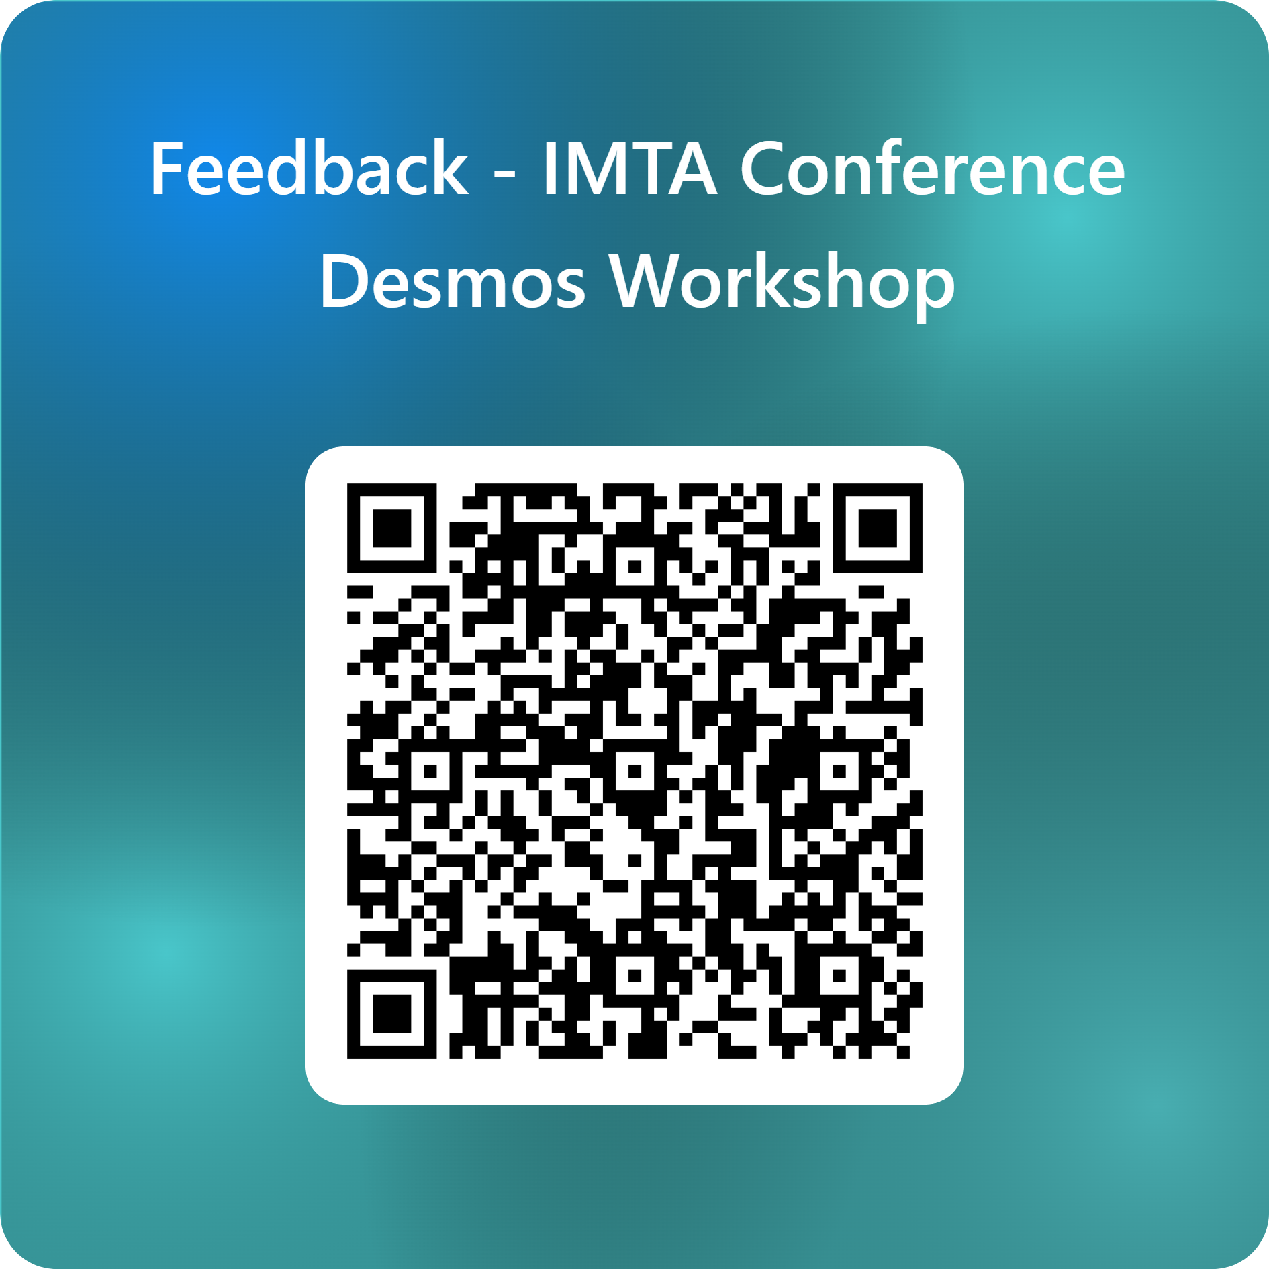

Feedback

Slide 20

Notes:
Thank you for joining us. We hope you have found the workshop useful and maybe you can see a way of integrating Desmos into your planning.

