Slide 1
Curriculum updates
October 2024
Rachel Linney
NCCA

Slide 3
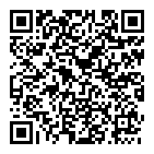
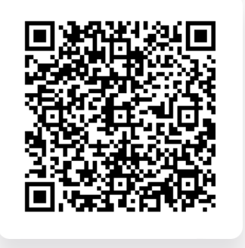
Junior Cycle Mathematics Updates
Curriculum Online –
Business Studies
Samples of work
Ongoing development of examples of student work.
  Would you like to involved?
  Please email - Info@ncca.ie
CBA calendar for 2024-2025
Examples of work
CBA Calendar 2024/25

Slide 5
Leaving Certificate Mathematics

Slide 6

LC Mathematics redevelopment: progress and milestones
School visits and public consultation
Background Paper
Approval and publication
Consultation on BP and Report
Board and Council
Feedback to DG and finalisation
Board and Council
Board and Council
Development Group
Consultation on Draft Specification
Specification Development
School visits
Public consultation
COMMUNICATION

Slide 7
Key Dates
Draft LC Mathematics Specification for consultation in Q1 2026 once approved by NCCA Council
Final specification to be published in Q2-Q3 2026 once approved by NCCA Council and signed off by Minister for Education
Support materials including Assessment Guidelines, sample assessment materials will be made available in line with other subjects
New specification introduced for all 5th year students in September 2027

Slide 8
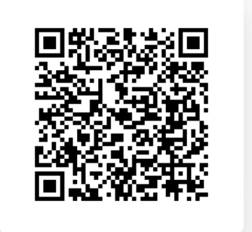
Follow the progress of Mathematics developments on ncca.ie

Slide 9
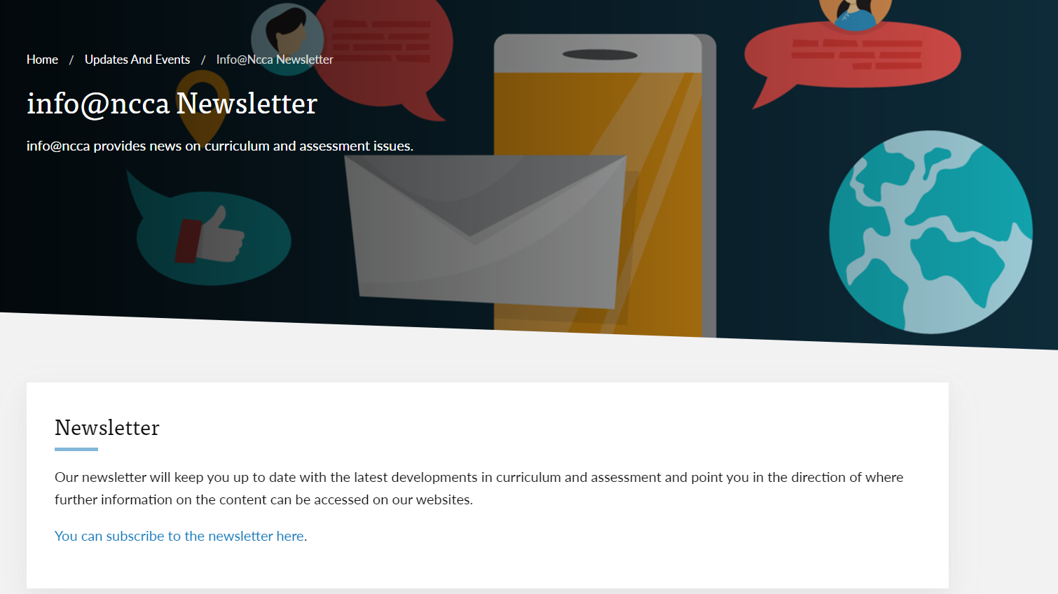
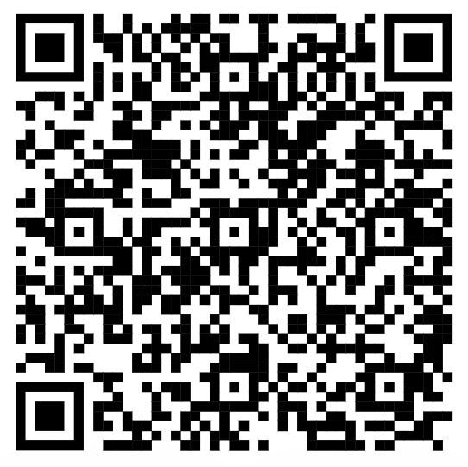
Stay in touch -sign up for the NCCA newsletter

Slide 10


