Slide 1
My Teaching Philosophy
&
Strategies for Success in the Mathematics Classroom
Meighan Duffy

Slide 2


A little background…
Graduate of University of Galway
Maths & Applied Maths teacher
Research Paper
1.1 Degree in Maths, Applied Maths & Education (2014)
Teaching in Athlone Community College since 2014
Assistant Principal 1 since 2020
Paper on Socratic Questioning published in JTAR (2019)

Slide 3

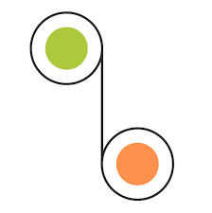

A little background…
Irish Applied Maths Teachers’ Association
Irish Mathemtical Trust Award
Female Student attainment
Chairperson
2019-2024
Victor Graham Award
2022
Presented with the 1st place award for Irish Teachers of Mathematics
2023
Society of Actuaries – Gender gap at highest attainment level in LCHL Maths
2023 - Present

Slide 4

My Teaching Philosophy
&
Strategies for Success in the Mathematics Classroom

Slide 5



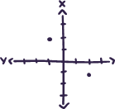
Getting to
know each student
Regular 1-1 meetings
Reciprocal Feedback
Noticing the small things
A focus on individual needs and building confidence

Slide 6

Creating a positive, team like atmosphere
Meaningful groupwork
Open discussions & sharing alternative approaches
Agreed deadlines and flexibility around workload
Taking responsibility of their learning

Slide 7
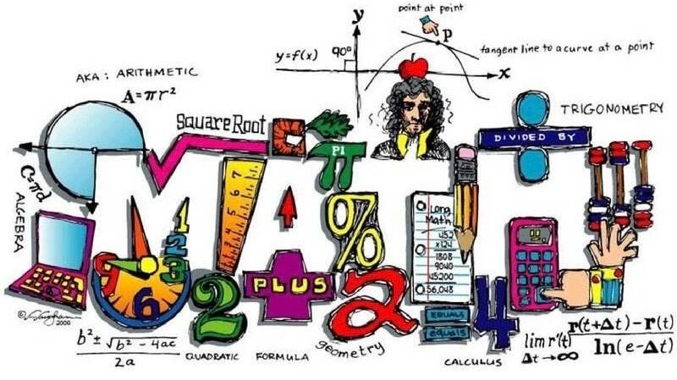

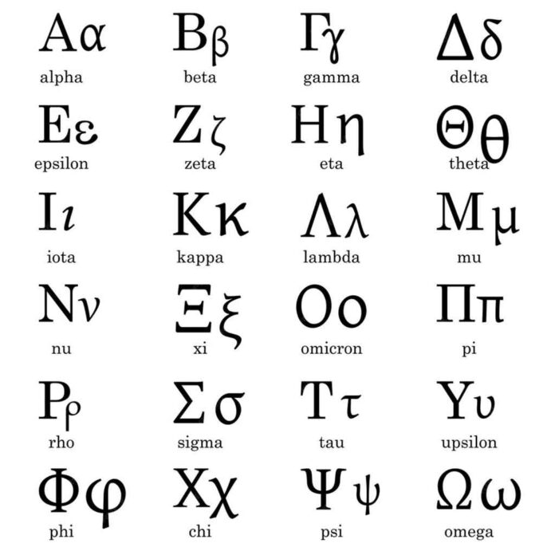
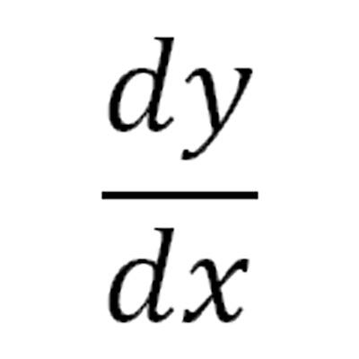
Use of Mathematical Language
Modelling normal practice
Algebraic Identities
Cancel & Cross Multiply
Reciprocal
A focus on Mathematical operations always
Pythagorean Triple
Variation in mathematical symbols used
Equation vs Expression

Slide 8




Maximising the effect of Questioning
Mistakes as learning opportunities
Knowing when to probe and step away & wait time
Critical thinking - justify & generalise
Opportunities for constructivism

Slide 9
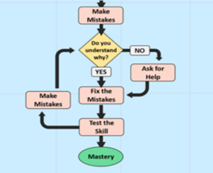
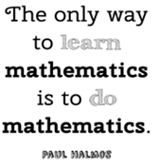
Encouraging
a Growth mindset
No such thing as a “maths brain”
Productive struggle – comfort in challenge
Sharing of correct & incorrect solutions
A focus on progression rather than grades

Slide 10
Applied Maths
Competitions
Discouraging Grinds
Significant benefits in Maths students studying Applied Maths too
Extra opportunities for problem solving and team work
Encouaraging students to take time to problem solve and struggle rather than rushing for (much of the time) unessecary assistance
No strict ‘Notes copy’
Perfecting basics & Variety of resources
Past student talks
Personalised class videos, visual representations (focus on understanding) extra assignments & mocks
Peer advice & Encouragment for students to consider Maths and Maths related courses in college
The non linear approach to concepts requires an alternative approach
3blue1brown.com

Slide 11
