Slide 1
Promoting Inclusive Mathematics for Mixed Ability Classes
Helen Keenan,
PhD Researcher, Ulster University

Slide 2
Agenda
Introduction to Inclusive Mathematics
Universal Design for Learning (UDL)
Practical Class Examples & Resources

Slide 3
What is Inclusive Mathematics Education?

Slide 4
Every child, without exception, is considered to have an innate, intuitive and instinctive sense of mathematics; is capable of using these tools and engaging with mathematical concepts and ideas from birth; and can deepen and develop her/his learning over time.
(NCCA, 2022)

Slide 5
An Irish Perspective
Estimated 1 in 4 students have a Special Education Need in the Irish education system.
Inclusion of all pupils is recognised as one of the Ten Key Principles of LAOS, 2022:
“It recognises the importance of high-quality learning and teaching that is inclusive, student-centred, informed and evidence-based, and that supports young people to participate in and make progress in all areas of their learning and development.”

Slide 6
What are the challenges?

Slide 7
Shevlin et al., (2013): Irish teachers’ barriers:
Time (i.e. lesson planning, correcting, administration)
Training
Support (i.e. professional, funding)
Staff resistance
Social, emotional & behavioural difficulties
Falling standards in numeracy & literacy

Slide 8
Universal Design for Learning
Developed by Centre for Applied Special Technology (CAST).
Established to promote inclusive learning environments, particularly within mainstream settings.
Emphasises three large brain networks that comprise the vast majority of the brain, playing a central role in learning.
Highly regarded internationally as a progressive and effective methodology to promote inclusion.
Recommended by NCCA.

Slide 9
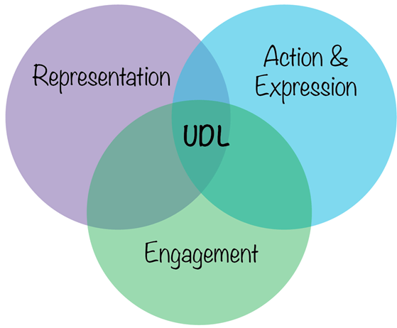
The UDL Framework
1.Provide multiple means of representation
2.Provide multiple means of engagement
3.Provide multiple means of action & expression

Slide 10
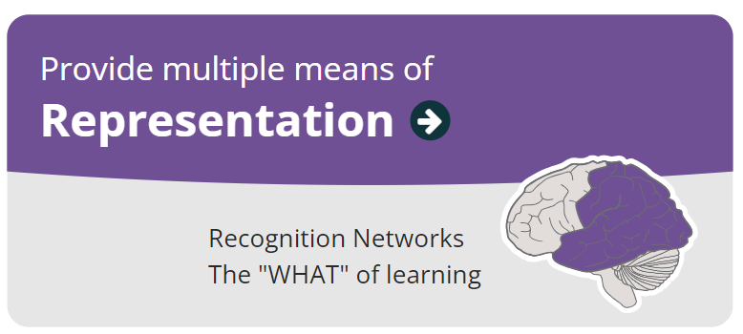

Slide 11
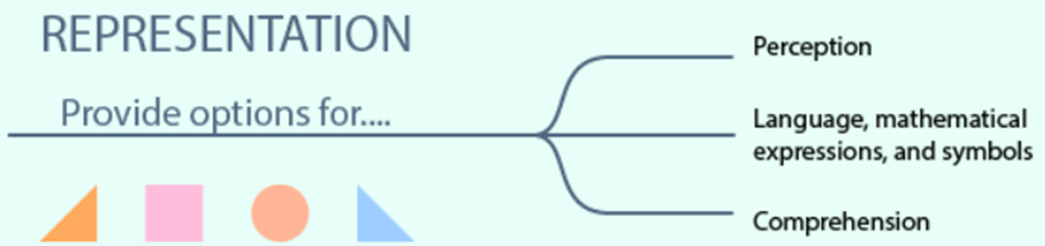
❖Perception: Offer varying ways of the display and presentation of information (font and highlighting of text, volume/rate of speech).
❖Language, mathematical expressions & symbols: Clarify vocab & symbols, syntax & structure, promote understanding across languages.
❖Comprehension: Activate or supply background knowledge, bridge connections, form cross-curricular links.

Slide 12
Representation
Classroom Examples:
Mathematics Simulations
Diagrams/physical objects
Mini whiteboards/Traffic lights
Mathematics Dictionaries/Literacy Walls
Subtitles on videos
Questions of inquiry activating previous knowledge
Cross-curricular questions
Mathematics journals

Slide 13
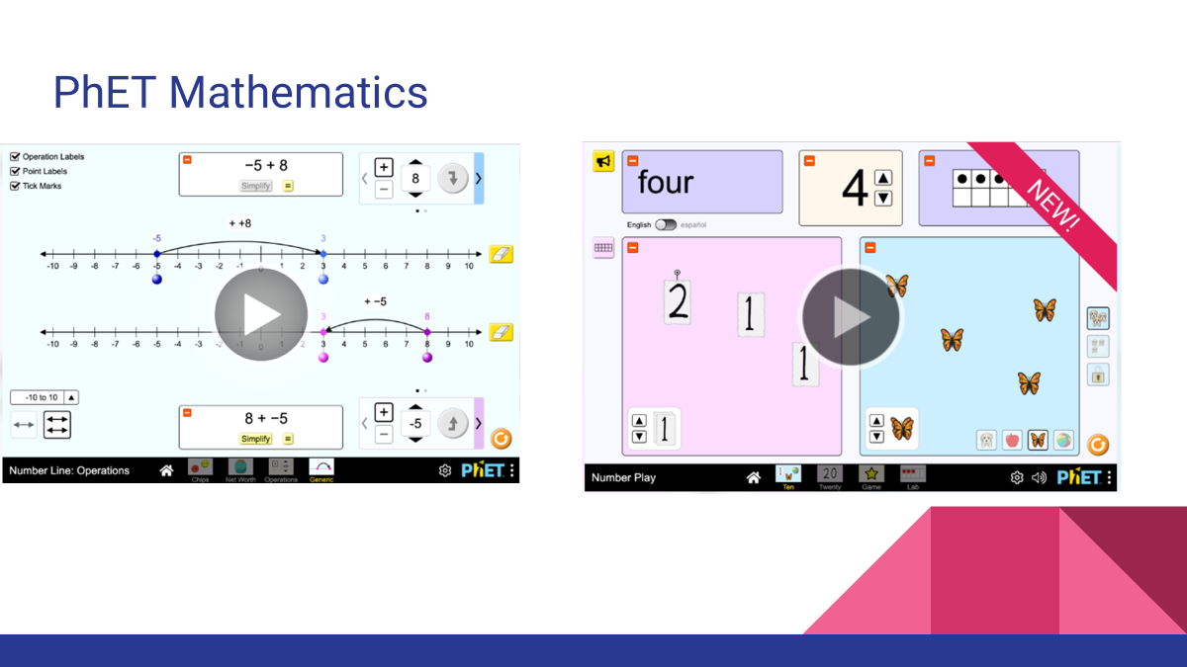

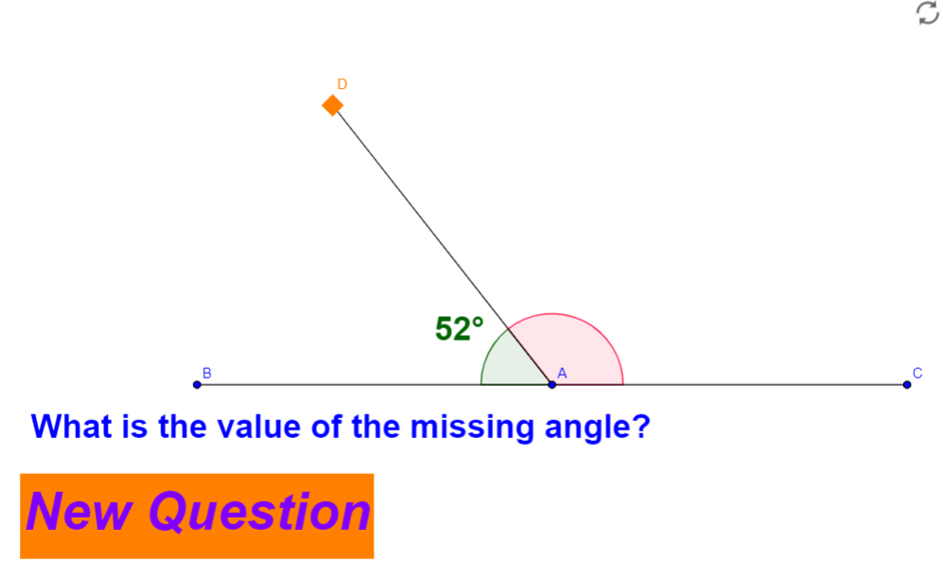
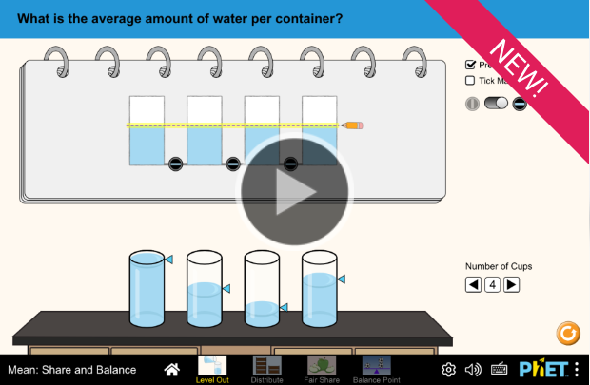

Slide 14


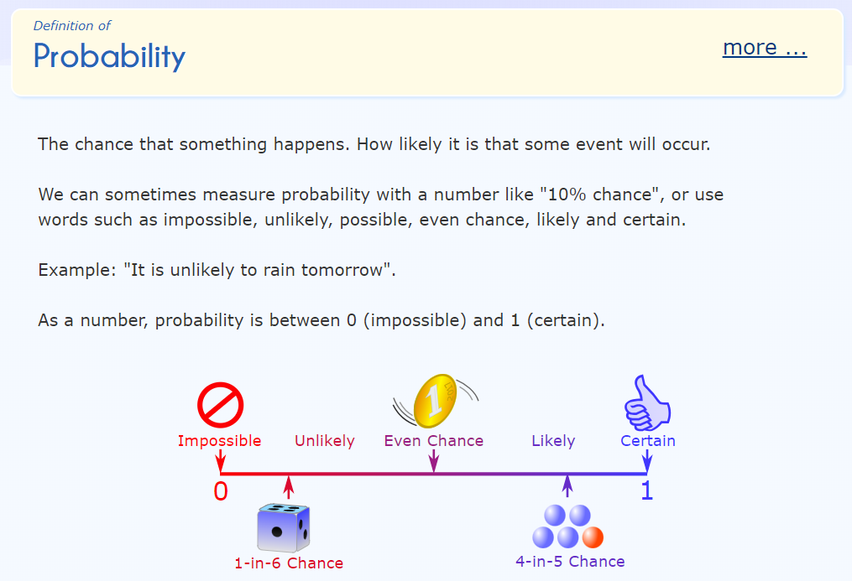
Online Mathematics Dictionary

Slide 15
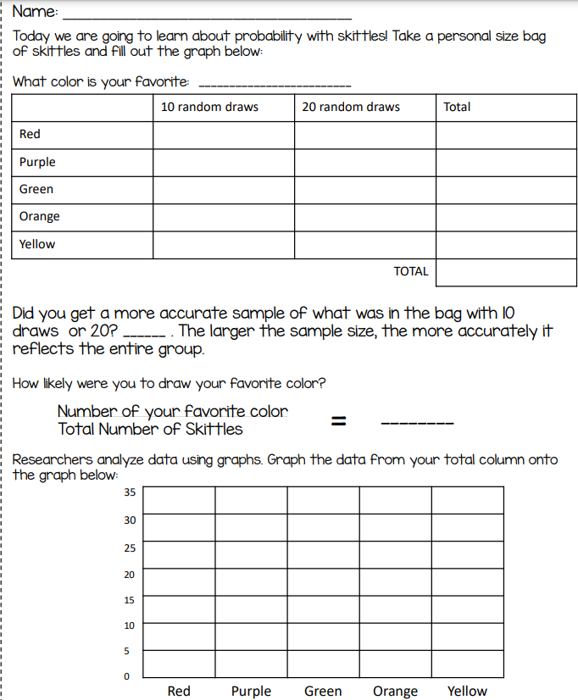
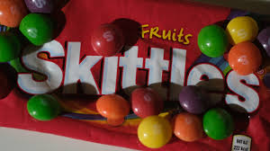

Physical object example
Calculating probability using Skittles

Slide 16
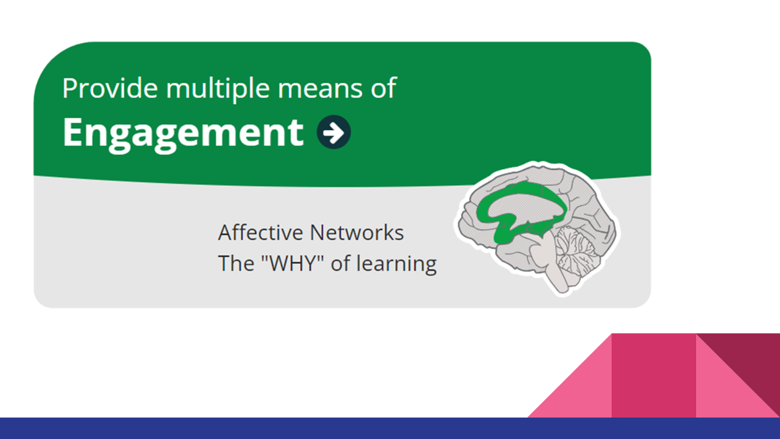

Slide 17
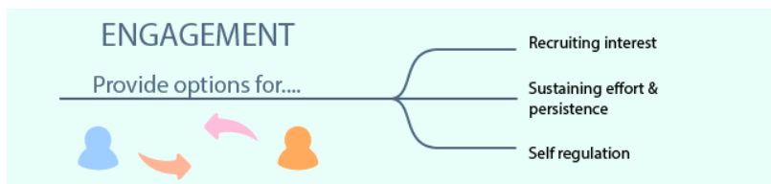
Recruiting interest: Providing choice, optimising relevance, incorporating activities to promote imagination to solve problems.
Sustaining effort and persistence: open ended questions, emphasising process, effort, and improvement.
Self-regulation: Promoting expectations and beliefs that support motivation and engagement, developing self-assessment and reflection.

Slide 18
Engagement:
Classroom Examples:
Ethic of Care
Activities tailored towards interest
Reflections/learning logs
Providing choice in classwork/homework
Maximising classroom participation
Offering rewards and valuing achievement
Open & effective questions

Slide 19
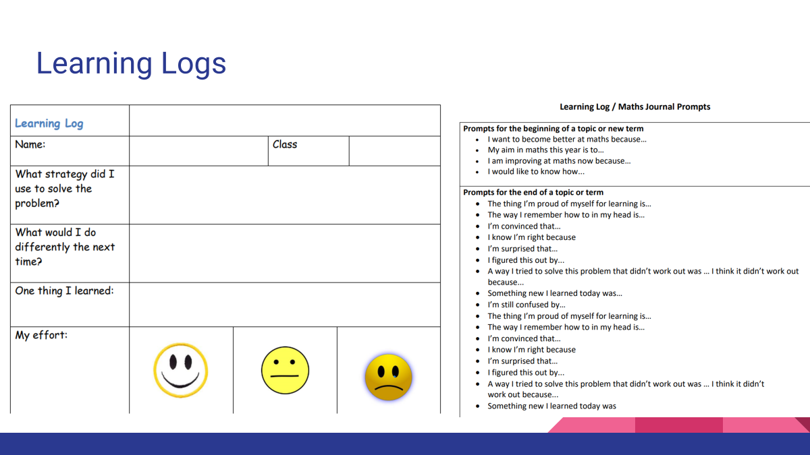
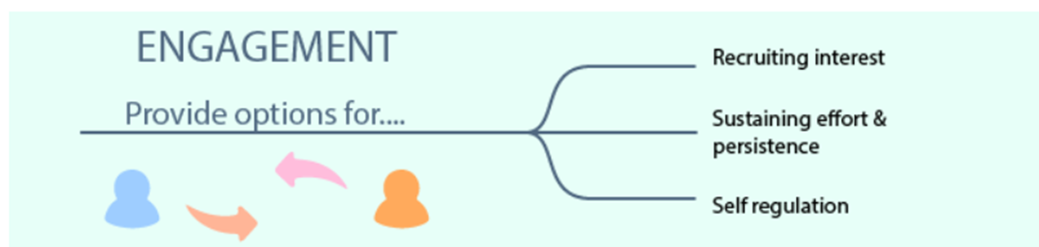
❖Recruiting interest: Providing choice, optimising relevance, incorporating activities to promote imagination to solve problems.
❖Sustaining effort and persistence: Differentiating core activities, emphasising process, effort, and improvement.
❖Self regulation: Promoting expectations and beliefs that support motivation and engagement, developing self assessment and reflection.

Slide 20
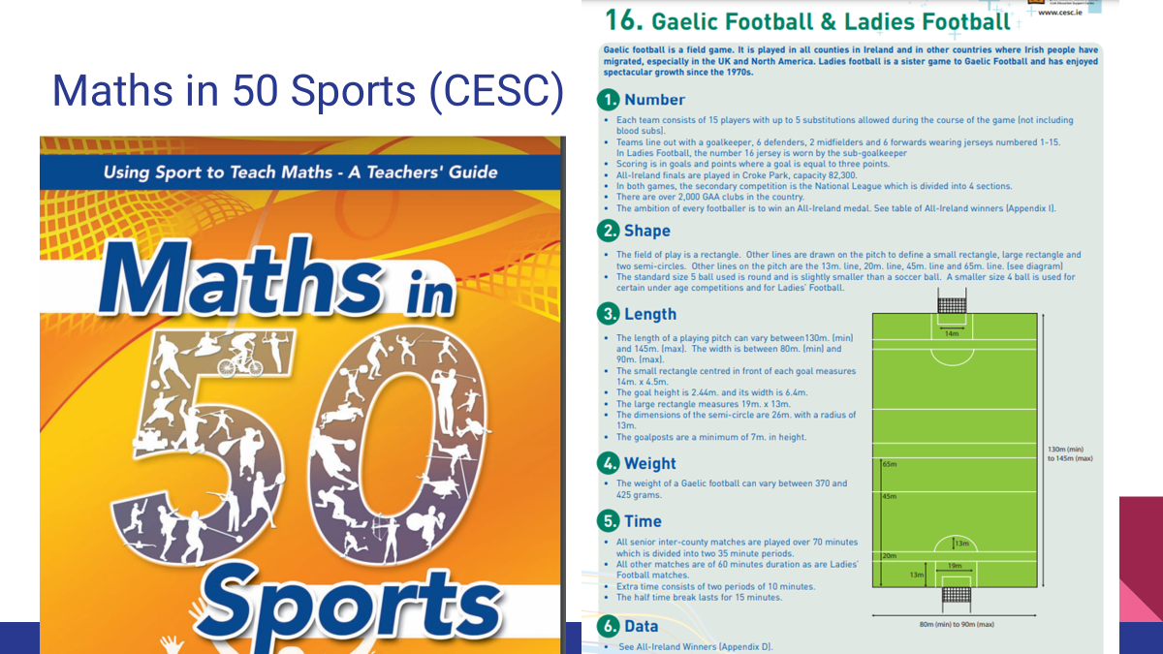

Slide 21
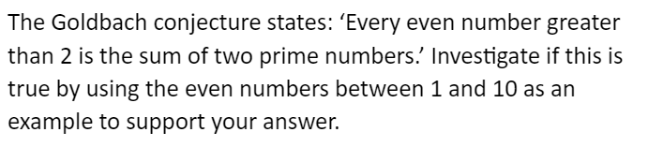
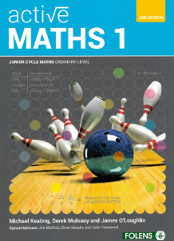

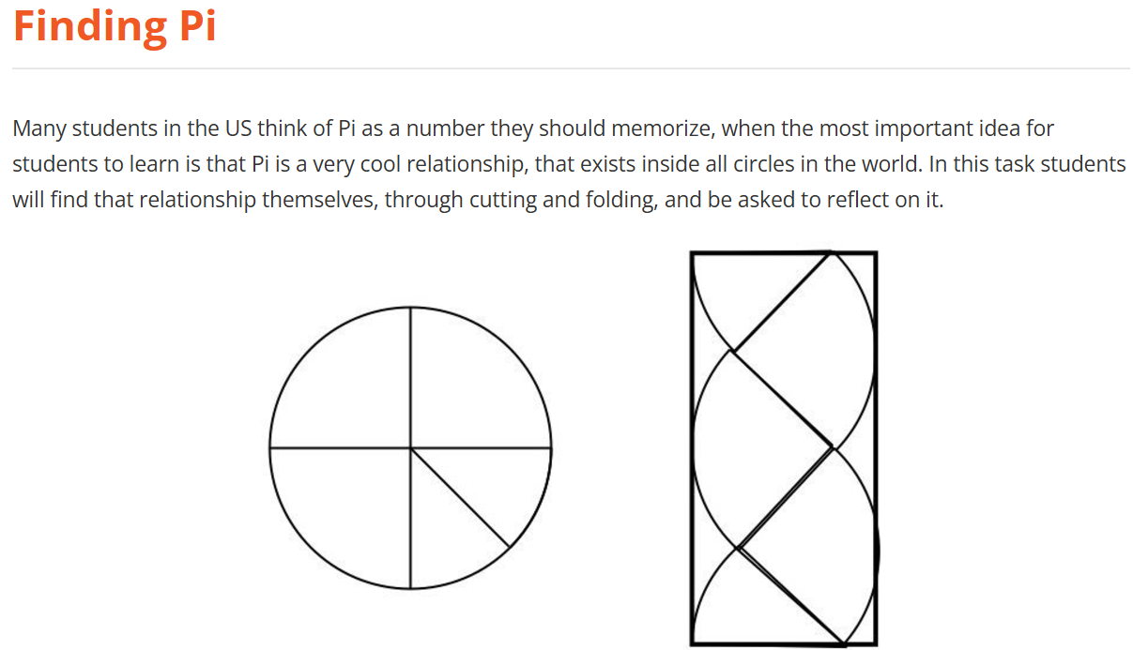
Open & effective questions
Examples:

Slide 22
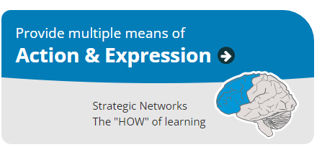

Slide 23
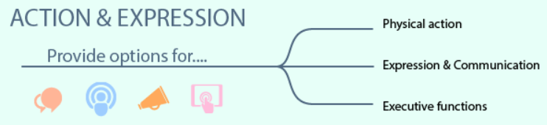
Physical action: Providing opportunities to utilise physical manipulatives, and technologies.
Expression & Communication: Providing multiple means for students to communicate and express ideas and conclusions.
Executive functions: Help students to develop their ability to set goals, plan and manage information.

Slide 24
Action & Expression
Classroom Examples:
Providing clear goals
Classroom debates
Promoting multiple solutions
Mini whiteboards/Traffic lights
Opportunities to express understanding using pictures/diagrams/physical objects
Station teaching (promoting peer assessment, self assessment)

Slide 25
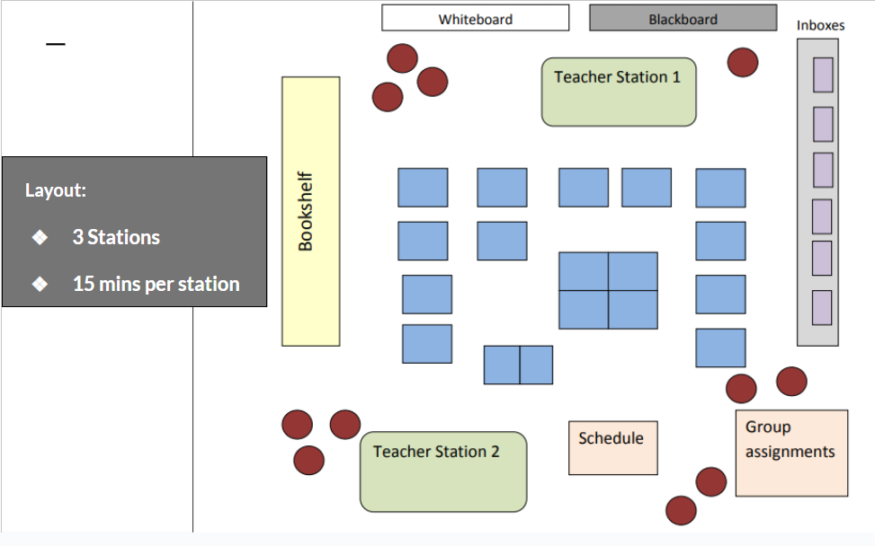
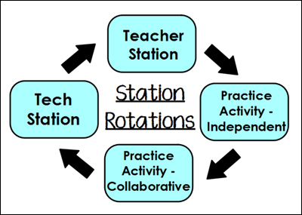
Station teaching

Slide 26
Multiple solutions
Asking students to…
Find two or three solutions to the same question
Represent the question using a diagram
Rewrite the question in their own words
Explain the question and the solution to their partner in their own words
Describe the solution in their own words (written or oral)

Slide 27
In summary:
Inclusive Mathematics Education: Refers to including all students, regardless of background or ability.
Universal Design for Learning: Effective framework for promoting IME through multiple means of Representation, Engagement, and Action & Expression.
Classroom practices: Can include providing mathematical simulations, mathematical journaling, and station teaching.

Slide 28

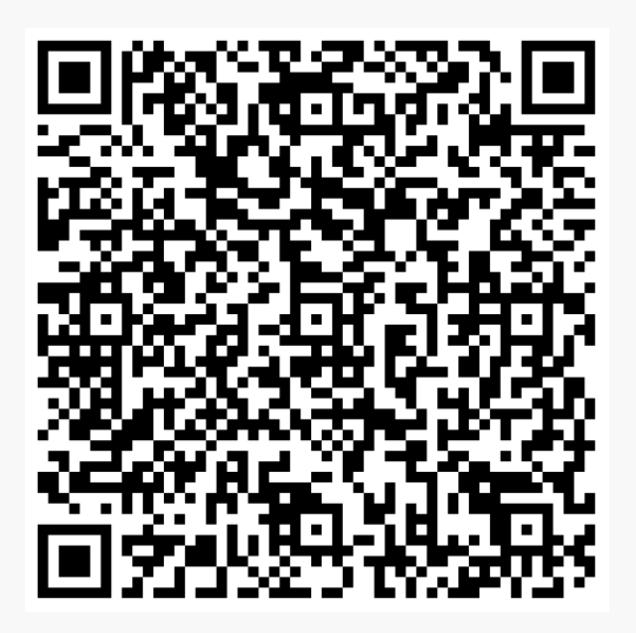

Slide 29
Resources (representation):
PhET Mathematics: https://phet.colorado.edu/en/simulations/filter?subjects=math&type=html
Mathematics online illustrated dictionary: https://www.mathsisfun.com/definitions/
Skittles probability worksheet: https://www.123homeschool4me.com/4-hands-on-probability-games-with-printable-worksheets/

Slide 30
Resources (engagement):
Learning logs/Maths Journal https://pdst.ie/sites/default/files/Sample%20Learning%20Log%20and%20Prompts.pdf
Maths in 50 Sports: https://drive.google.com/file/d/1-KGTcnfvren5JzRMAgoEQ2fFWIUIRNe2/view?usp=sharing
Effective questioning: www.youcubed.org

Slide 31
Resources (action & expression)
Station teaching explained (PDST, p.7): https://pdst.ie/sites/default/files/Session%202%20-%20Differentiation%20Resource%20_0_0.pdf
Guides for note taking: https://www.projectmaths.ie/

Slide 32
Other resources:
UDL Guidelines (CAST): https://udlguidelines.cast.org/
L2LP Guidelines and specification: https://www.curriculumonline.ie/junior-cycle/level-2-learning-programmes/

