Slide 1







Marie Skłodowska-Curie
grant agreement nº 956124
Developing Spatial Thinking in TY
IMTA Conference Nov 23, 2024
Gavin Duffy, TU Dublin
Sheryl Sorby, University of Cincinnati
Jeff Buckley, TUS
Liam Maquet, TUS
Ganjina Khujanazarova, TU Dubline

Slide 2
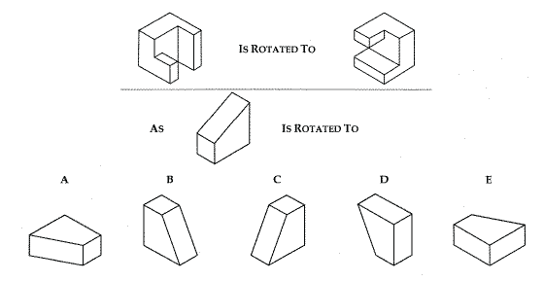
What is the right answer?

Slide 3
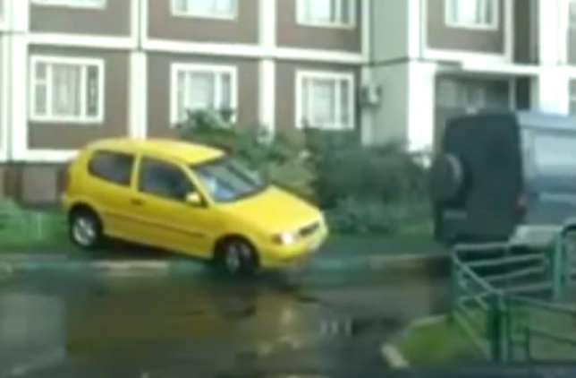
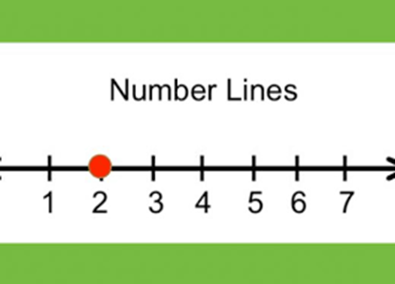

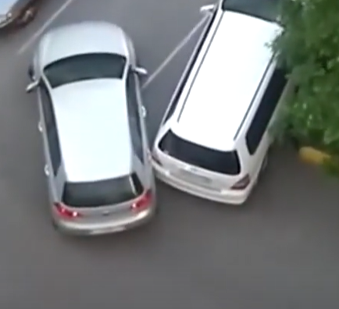
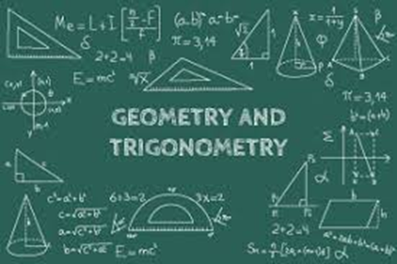
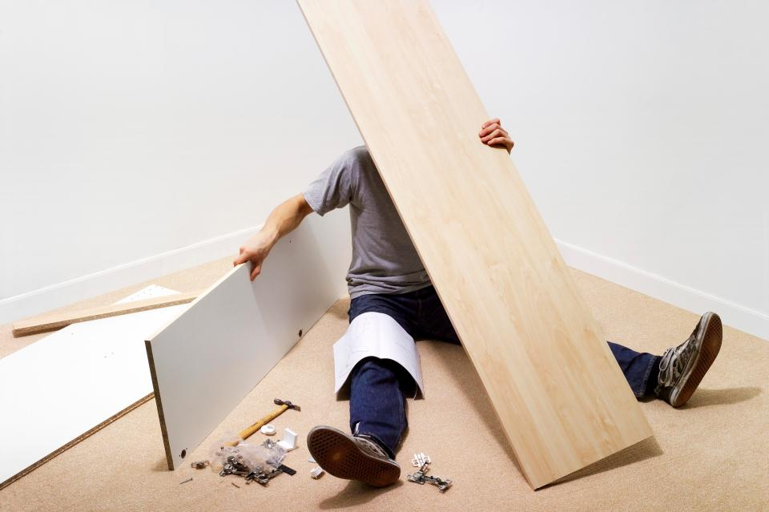


When is spatial ability needed?

Slide 4
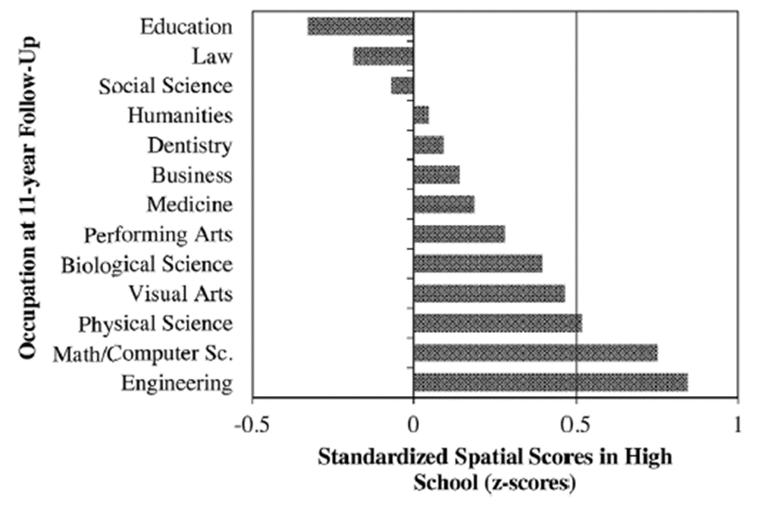
Spatial ability and STEM
Longitudinal study, ‘Project Talent’
Sample size = 400,000
50k boys and girls in grades 9 through 12
STEM careers filled by those with highest spatial ability
Same disciplines have largest gender imbalance

Slide 5
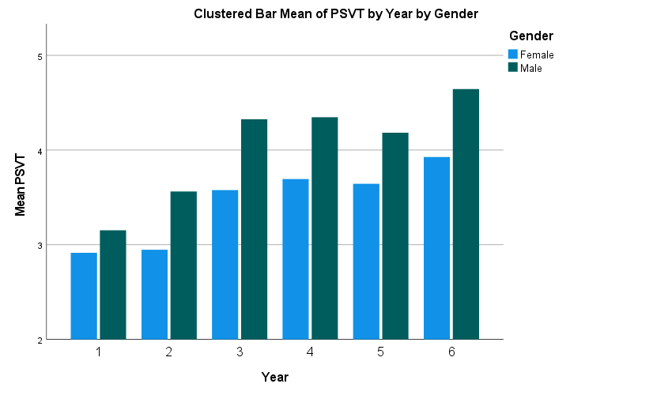
Data from Ireland
PISA Math sub scale | Ranking of Ireland | Mean score of Ireland
Change and relationships subscale | 20 | 501
Space and shape subscale | 34 | 478
Quality subscale | 19 | 505
Uncertainty and data subscale | 17 | 509
Gender and SES differences in spatial ability limit success in STEM for many children

Slide 6
Why promote spatial ability development
Spatial ability is important for STEM learning, including mathematics
Ireland performs well on PISA mathematics but not on the Space and Shape subscale
There is a gender difference in favour of males in some factors of spatial ability
There is an SES difference in spatial ability in favour of students from high SES backgrounds
There is a shortage of STEM graduates AND a gender gap in representation in (41.3 male STEM graduates per 1,000 persons aged 20-29, compared with 16.6 for females¹
6. Spatial ability can be developed
1. STEM Education 2020: Reporting on Practice in Early Learning and Care, Primary and Post-Primary Contexts
Notes:
Finish with How to promote spatial ability development. Integrated or separated, through formal or informal learning. Answer is all of the above. But in this study we looked at separate and formal.

Slide 7
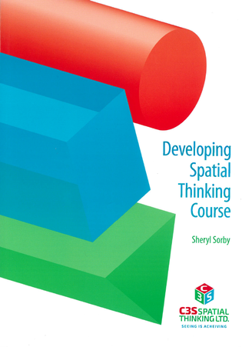
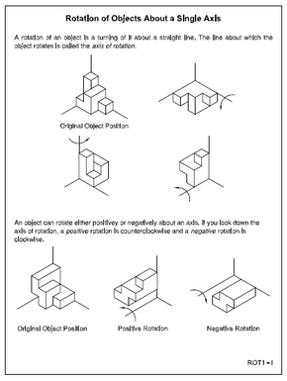
Developing Spatial Thinking Course
10 modules/chapters
Range of spatial tasks
  nets
  isometrics
  combining object
  rotating around 1, 2, or 3 axes
  mental cutting, orthographics
  symmetry
Sketching tasks and software
Notes:
An established course, running since the 1990s
Has been shown to lead to gains in spatial ability
And increased success in STEM learning in higher ed
Some work done in secondary level shows promising results

Slide 8
Pilot Study
Train mathematics teachers to deliver an existing course on Developing Spatial Thinking to TY students
Measure impact on students and teachers:
  Does the course lead to gains in spatial ability for the students?
  What, if any, impact does the course have on maths ability?
  How do gains vary by gender and SES?
  How well designed is the PD programme for teachers?
  How did the teachers experience delivering the course and what impact did it have on their spatial ability and approach to teaching maths?

Slide 9
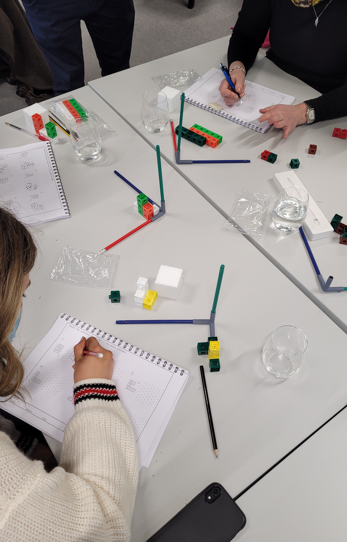
Overview of the study
Deliver the course to TY students
In cooperation with Oide
  A trial run was conducted with a few schools
  Maths teachers nationwide were invited to participate
  A PD programme was developed
A research design was developed, data collection involved
  For students
    Pre and post spatial ability
    Pre and post mathematical performance
  For teachers
    Pre and post spatial ability
    Interviews and focus groups on their experience of
      the PD programme
      delivering the course

Slide 10
Scope of the intervention study
Who was involved?
  48 maths teachers
  25 schools, 20 Coed, 4 all girls, 1 all boys, 8 of which are DEIS,
  1,199 TY students, 488 boys, 711 girls
  13 counties, all 4 provinces
  786 experimental, 413 control
Professional Development
  3 full day workshops
  Spatial testing
  6 different modules covered
  Use of manipulatives and supporting software
It has been run twice
  2022-23 – results presented are from this year
    6 modules delivered from Sep to Dec
    Control group took normal maths classes
    Exp used maths classes to do the modules
  2023-24 (incl. teachers running it a 2nd time)

Slide 11
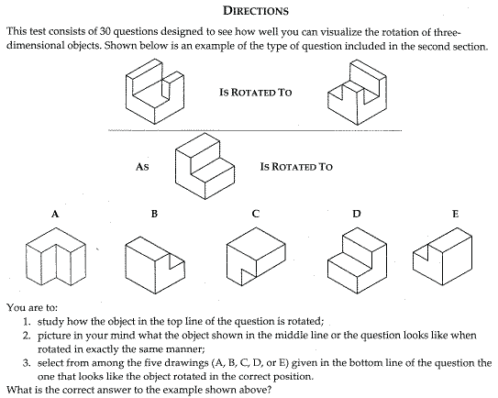
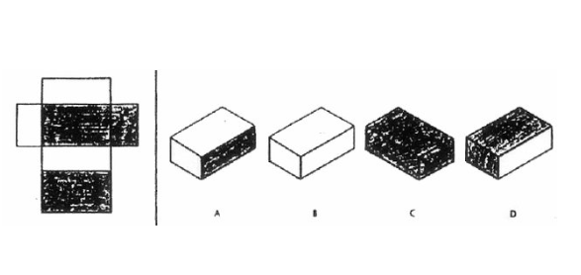
Spatial tests
Mental rotation (PSVT:R, 10 items)
Spatial Visualization (DAT: SR, 10 items)

Slide 12
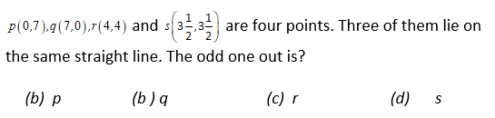
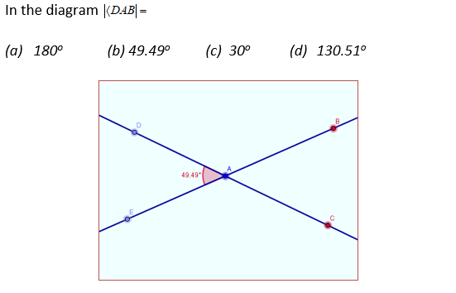
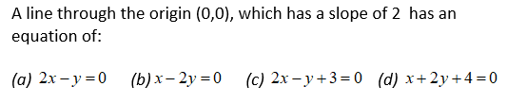
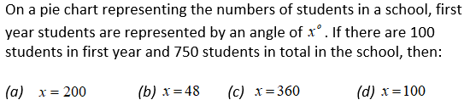
Mathematics test – PDST test Ordinary LC

Slide 13
Spatial ability, pre/post, Control & Exp
Significant
* Statistically significant difference

Slide 14
Spatial ability, pre/post by gender, Exp only
Significant
* Statistically significant difference

Slide 15
Spatial ability, pre/post by SES, Exp only

Slide 16
Maths ability, pre/post, Control & Exp
Significant
* Statistically significant difference

Slide 17
Maths ability, pre/post by gender, Exp only
Significant
** Statistically significant difference at 0.1

Slide 18
Maths ability, pre/post by SES, Exp only
Significant
** Statistically significant difference at 0.1

Slide 19
Feedback from teachers
Initial Apprehensions and Overcoming Challenges
“In the beginning, I was up and not alone and I was thinking, I dunno where to go with it.”
“Once I got into it, I was like, God, I really love this. I wish I did tech graph when I was in school.”
PD programme
“I felt like a student for the three days doing it.”
“I did like the discussions... how one teacher looks at it and how another person looks at it.”
Resources
“The amount of resources, you know, from videos to software, and the PowerPoints... there was a lot of support.”
“The props really kind of confirmed in my head that I was right.”
Surprising findings
Students from South Korea “were phenomenal at it, this is something they work on from primary school”
“math test at the start turned a good few of my weaker students off”
“.. a weak group and it was a lovely way of bringing it [maths] more hands-on, more practically for them”

Slide 20
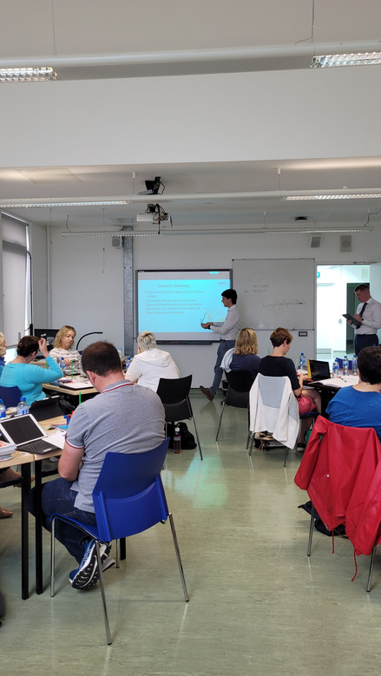
Feedback from teachers
Effective PD – workshops prepared teachers well
Initial apprehension was replaced with confidence
TY routine is variable – this is a challenge
Students benefited, it exposed them to a different challenge; some weak students were excellent
Many lessons learned about organising the delivery of each chapter, using manipulatives, software, managing the range in pace of learning
Teacher spatial ability level was not found to be related to student gains in spatial ability, i.e. teachers should not worry about their own spatial ability

Slide 21

Next steps
Offer teacher PD from Dec 2024 to Feb 2025
  A mix of synchronous and asynchronous online sessions and a 3 hour in person workshop
Deliver to students from Feb to May 2025
Offer teacher PD again Aug/Sep 2025
More work needed to examine transfer to math ability
  Collect pre and post spatial and math data
Examine impact on other STEM tasks, e.g. problem representation, graphing
Longitudinal study of impact on STEM education and career choice

Slide 22
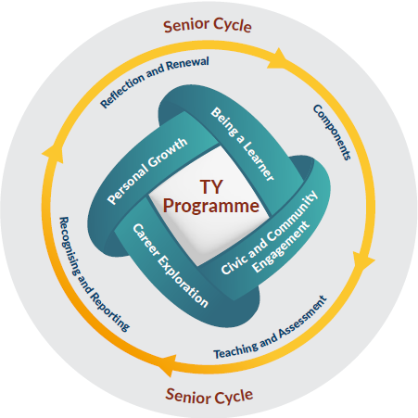
Alignment with TY programme statement
Complement maths learning without adding more hours of direct maths instruction
Career exploration – workbook activity on careers,
Key competencies – should include spatial ability, in addition to numeracy and literacy,
Develop key competencies irrespective of past – many teachers report emancipating effect of course on some students
Enjoyable learning - course is active, practical, enjoyable and has a range of learning activities
Sampling new subjects

Slide 23



Conclusions
Gender differences in spatial skills were eliminated.
SES differences in spatial skills were eliminated
Maths scores in the Experimental Group increased
Despite receiving more direct maths instruction, maths scores for students in the Control Group decreased slightly
Teachers were enthusiastic about teaching the spatial modules
Teacher confidence improved with practice
Students improved regardless of teacher spatial ability level
Can support goals of TY Programme Statement

Slide 24

Acknowledgements
Oide staff
TY teachers
TY students
PhD students
Research colleagues
Funded by
  European Union H2020 Marie Skłodowska-Curie grant agreement No 956124, SellSTEM
  TUS postgraduate research scholarship scheme
  Oide

Slide 25


Flat patterns – page 90
Video
https://tinyurl.com/3cvbba4t
Software
http://www.higheredservices.org/HES01/Module_6

Slide 26
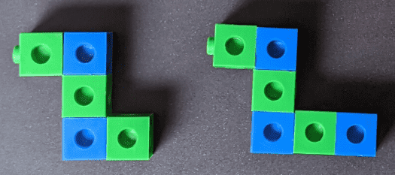


Delivering a module
Introduction
  Presentation
  Video
  Software
Move to workbook
  Work through the exercises
  Pencil
  Think, pair, share
  Homework
Teacher guide has answers to all questions in workbook
This Photo by Unknown Author is licensed under CC BY-NC-ND

Slide 27
Learning Intentions
Today, we are learning about flat patterns.
By the end of this module, I will be able to:
  Record, define and explain the keywords for this module.
  Identify a 3D object, given a flat pattern.
  Identify a flat pattern from a given orthographic projection.
  Identify a flat pattern from an isometric sketch.
  Visualise related 2D and 3D images and objects.

Slide 28
Success Criteria
I have:
Completed all the activities in my workbook.
Used the software to investigate flat patterns.
Created a 3D object using a flat pattern.
Verified the solution for all the workbook activities by:
  Checking my answers with my partner.
  Checking my answers with my teacher.
I can:
Explain the words: Flat pattern, Orthographic, Fold lines, Adjacent surfaces, Orientation, Net, Development.
Identify the correct orientation of a flat pattern.
Identify a 3D object from a flat pattern.
Identify a flat pattern from a 3D object.

Slide 29
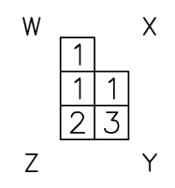
Isometric drawings and coded plans – p49
Using the Code grid can you:
Build it?
Draw if from viewpoint X?
Extension:
Can you draw the shape from viewpoints W, Z and Y?

Slide 30


Isometric drawings and coded plans
Video
https://tinyurl.com/y5xc99um
Software
http://www.higheredservices.org/HES01/Module_3

Slide 31
Supplementary material

Slide 32
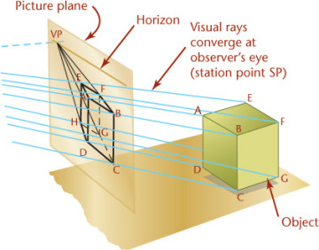
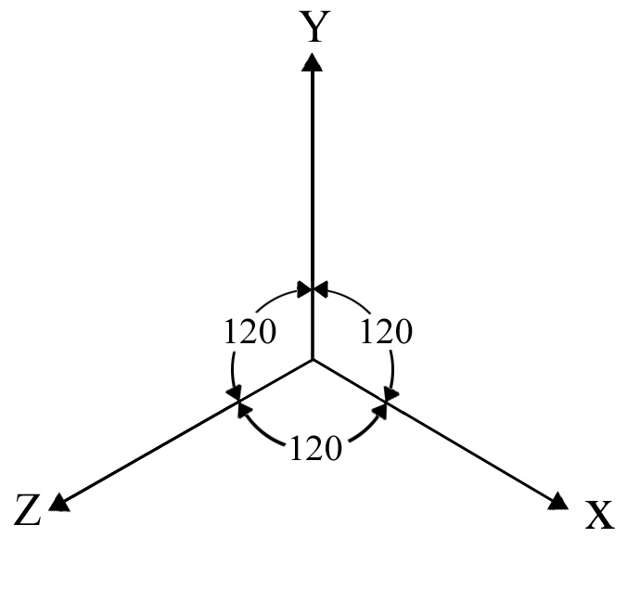
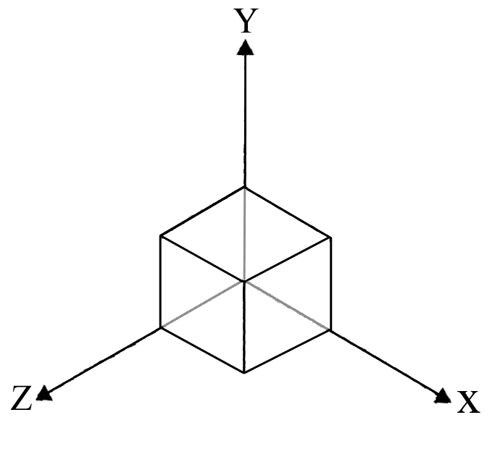
Isometric Axes and Sketch of cube

Slide 33
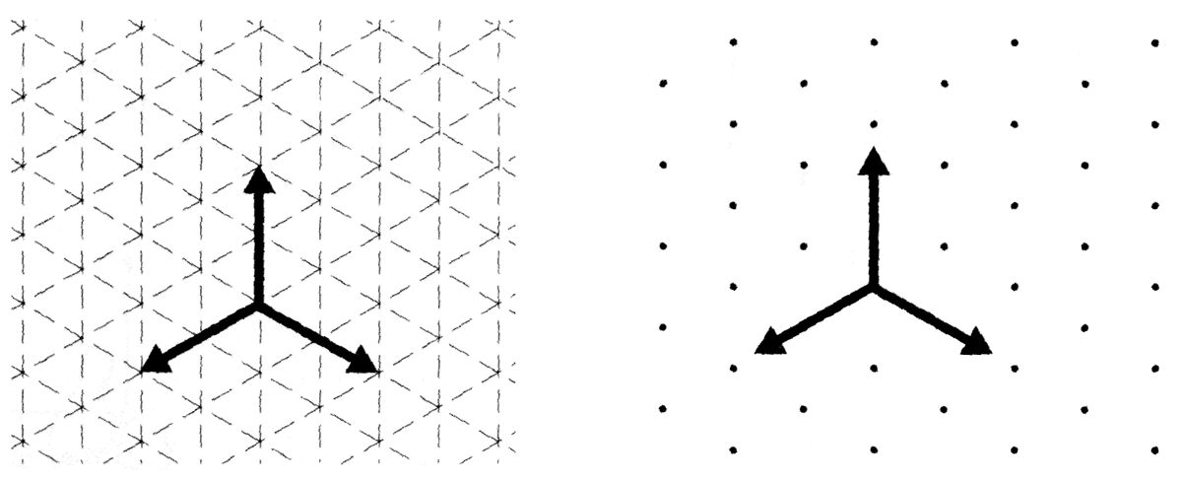
Isometric Axes
Isometric grid paper or dot paper is a useful tool for constructing isometric drawings.

Slide 34
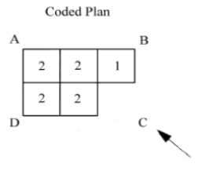
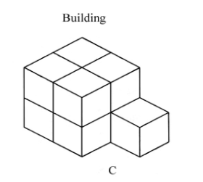
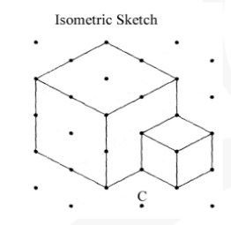
Coded Plans
Pictorial sketches can be made from coded plans.
Coded plans define the shape of a building made of blocks.
We can isometric sketch from any viewpoint, in this case C

Slide 35
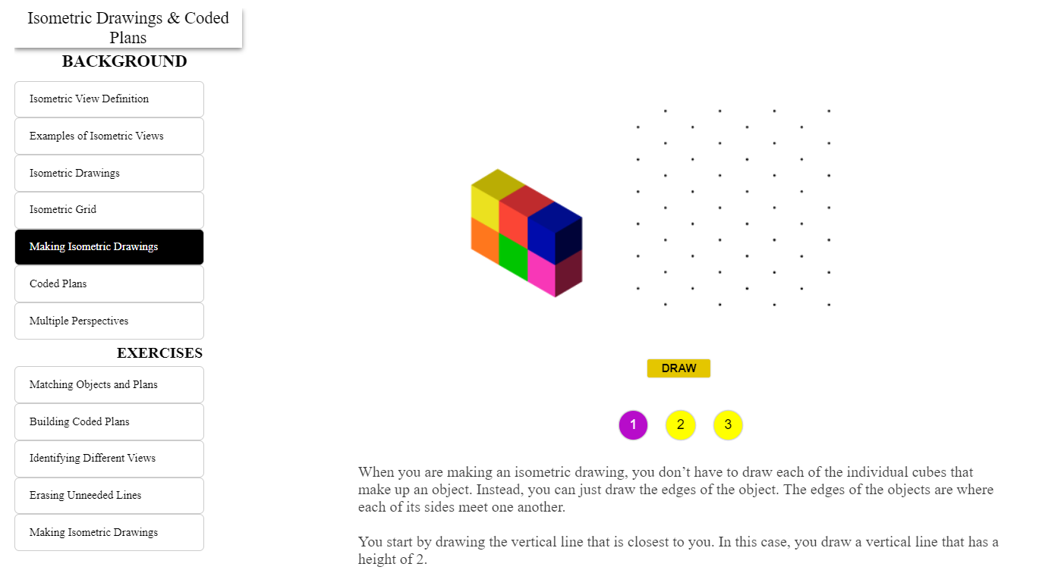
Links - Making Isometric Drawings

Slide 36
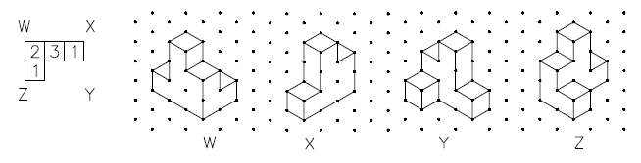
Different Viewpoints
The object will appear differently depending on the corner you are viewing it from

Slide 37
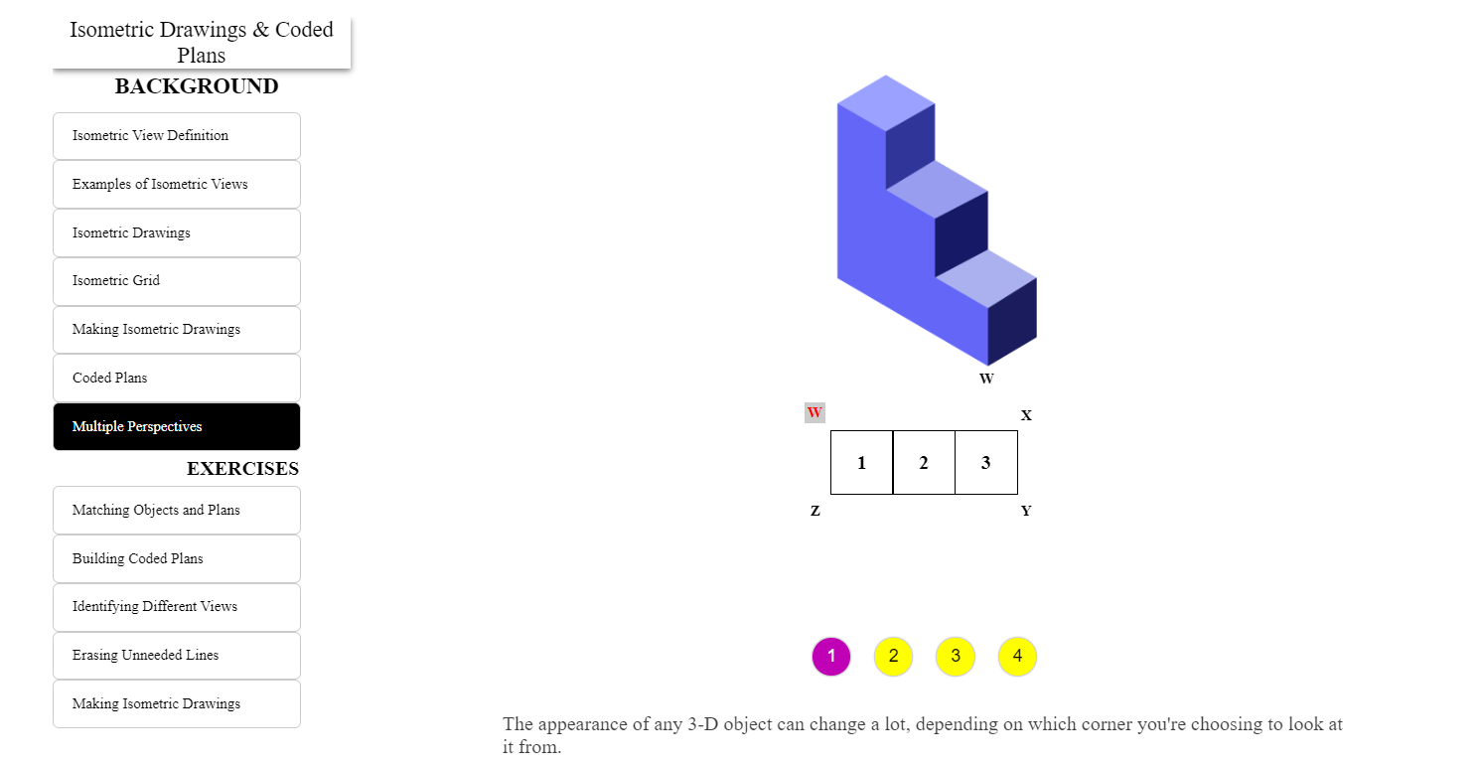
Multiple perspectives

Slide 38
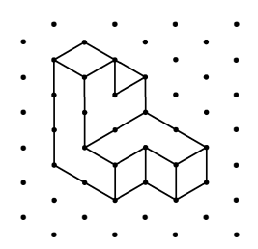
Viewpoint from X
Further Extension:
Build a 3D shape with the cubes and give it to someone else to create the isometric drawing.

Slide 39
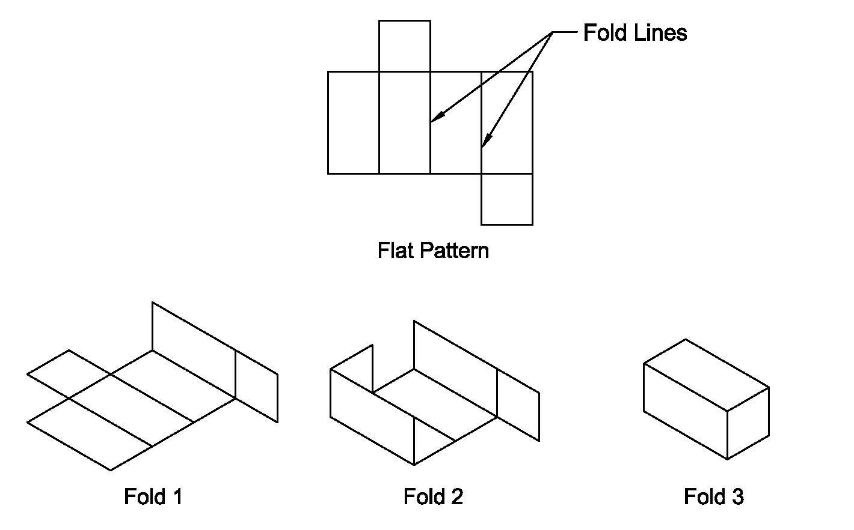
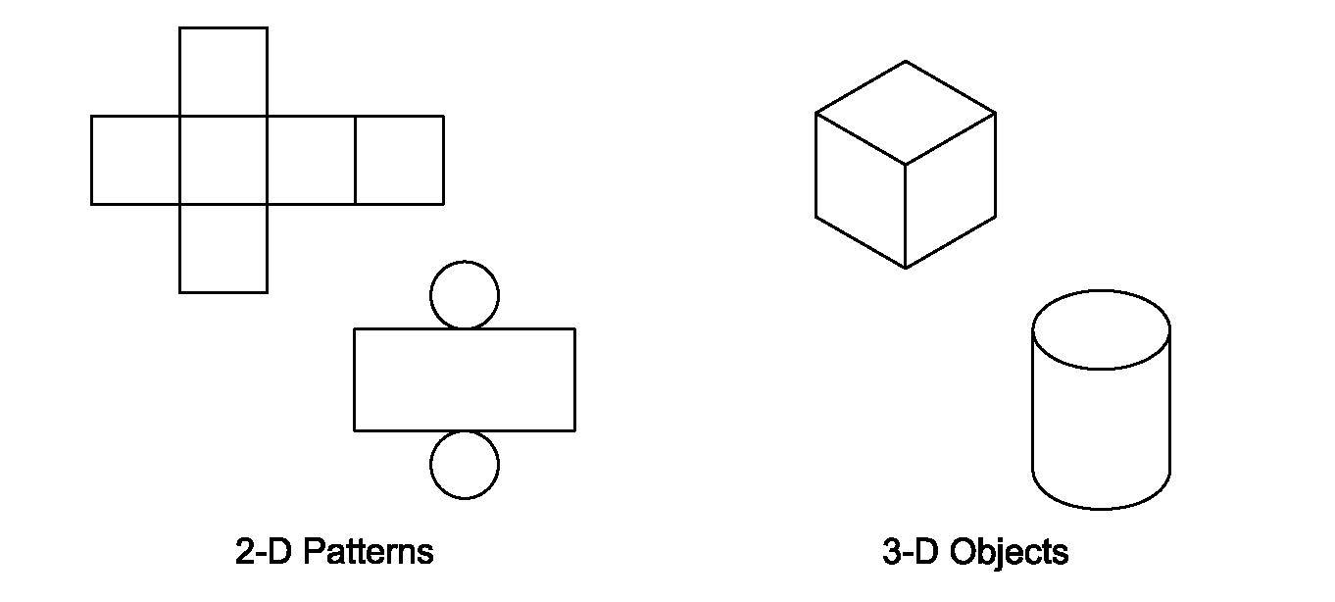
Flat Patterns Introduction
2D flat patterns can be folded to make a 3D object.
The solid lines on a flat pattern are fold lines.

Slide 40
Learning Intentions
Today, we are learning about isometric sketching.
By the end of the lesson, I will be able to:
Record, define and explain the keywords for this module.
Recognise isometric drawings
Visualise the isometric drawing of an object
Understand that objects can look different from different perspectives
Create an isometric sketch

Slide 41
Success Criteria
I have
Completed all the activities in my workbook
Used the software to identify isometric sketches and coded plans.
Used the snap cubes to identify isometric sketches.
Verified the solution for the activity by
  Checking my answers with my partner
  Checking my answers with my teacher.
I can
Explain the words: Isometric, Coded plan, Flat surface, Viewpoint
Identify examples of isometric drawings and coded plans.
Count the number of blocks in an isometric drawing.
Visualise an isometric sketch from a drawing.
Draw an isometric sketch.

