Slide 1



Engaging in a collaborative, critical dialogue with GenAI to develop units of learning
Eleanor Byrne
November 23rd

Slide 2

Aims of the session
We are learning to:
Develop an understanding of benefits & limitations of GenAI
Use GenAI as an “object to think with” in a collaborative dialogue
Use GenAI to plan in line with JC specification
Use GenAI to create and adapt resources to meet the needs of different classes and students

Slide 3



Maths teacher for 10+ years
Trinity Access Programmes
Doctoral Student

Slide 4


What skills are unique to humans?
ⓘ Start presenting to display the poll results on this slide.

Slide 5

3 Key Principals
Keeping Doors Open
Providing encouragement and opportunities for students to stay in higher level
Building confidence and resilience
Creating welcoming spaces, giving choice of assessment.
More digital technologies
Making it Attractive, Engaging & Fun
More tasks, investigation, discussion and reflection
Less ‘typical’ assessment focus

Slide 6
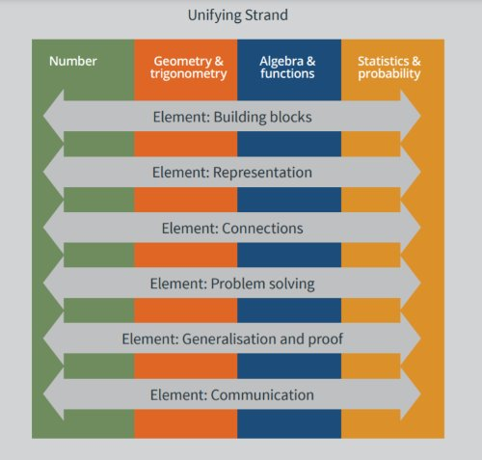
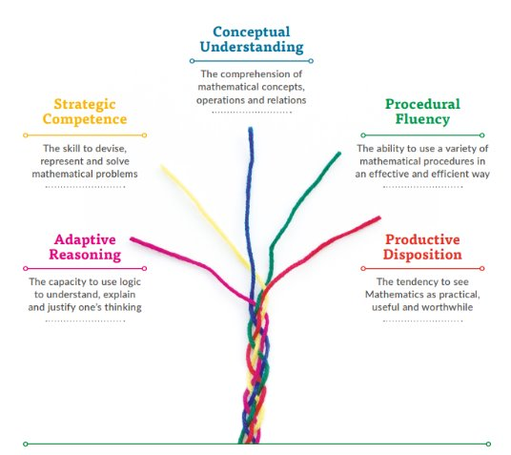
The Specification
The specification is underpinned by the conception of mathematics as an interconnected body of ideas and reasoning processes
Mathematics is composed of multiple but interrelated and interdependent concepts and structures which students can apply beyond the mathematics classroom
(NCCA, 2017)
Notes:
Fix slide

Slide 7
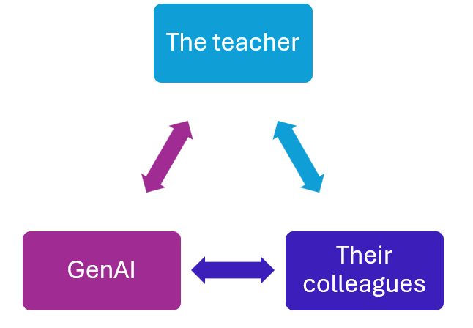
Collaborative Dialogue
“Object to think with”
(Jonassen et al., 1998)
Notes:
Jonassen, D. H., Carr, C., & Hsiu-Ping, Y. (1998). Computers as mindtools for engaging learners in critical thinking. TECH TRENDS-WASHINGTON DC-, 43, 24-32.

Slide 8

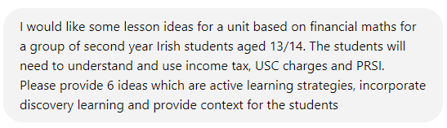
Prompt 1
Lesson ideas
Notes:
Cross-curricular opportunities highlighted
Project aims in the classroom

Slide 9
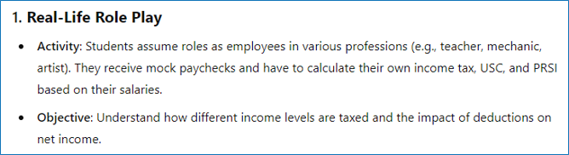
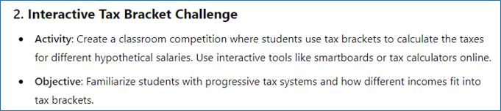
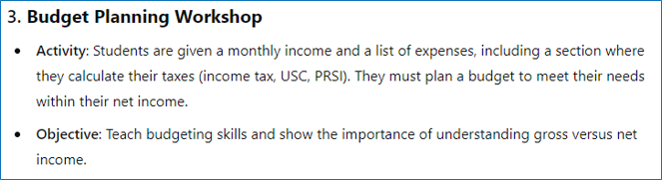
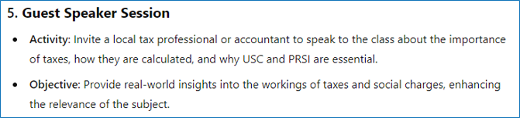
A
A big idea or context for the unit:
What careers will allow me to live the lifestyle that I want?

Slide 10
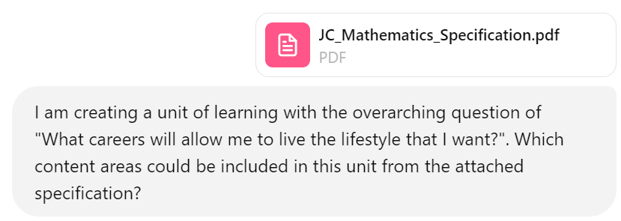
Prompt 2
Making links to the curriculum

Slide 11
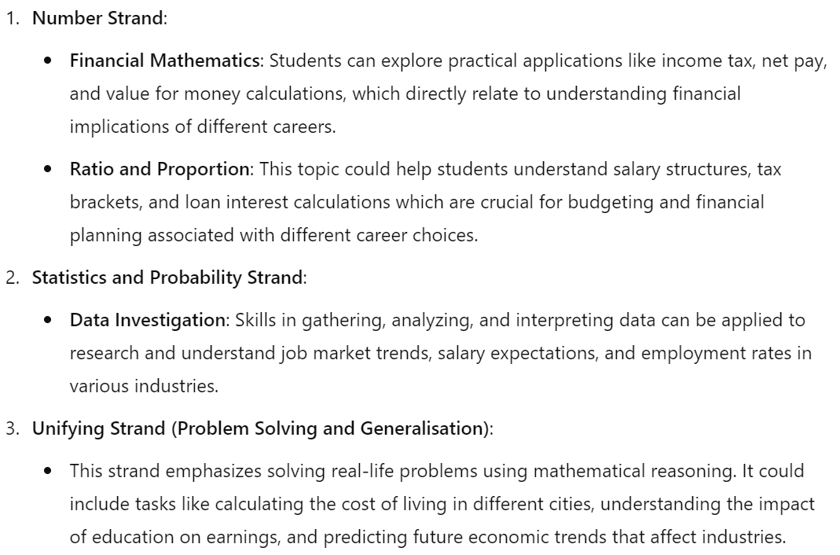
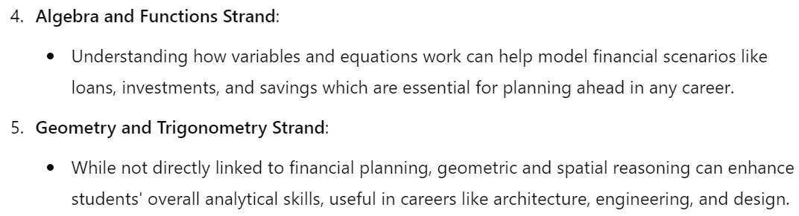

Slide 12

Some tips…
Tell the GenAI who you are, and who you are creating the resource for (e.g., I am a maths teacher working with a class aged 11-12 years old).
Be specific as to what you want, a worksheet, an idea, a table.
  Be clear on the topics you want included in the questions (area & perimeter, ratio, etc.)
  Insert the type of question which you would like to get similar questions back.
Critique the questions and engage in a dialogue to improve questions and ideas.

Slide 13
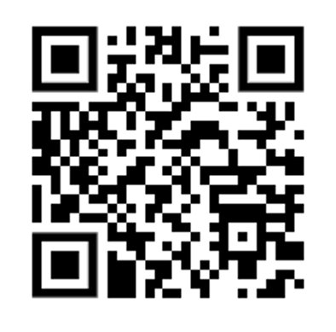


Working groups
Organise yourselves in groups of 2 or 3 max
Use one device per group
Least experienced GenAI user in control of the device
One of the others is the speaker/notetaker
https://chat.openai.com/auth/login

Slide 14
Let’s have a go..
“for the things we have to learn before we can do them, we learn by doing them”
Aristotle

Slide 15


Task 1
Unit of learning: Promoting connections
In your groups use ChatGPT along with the specification and your students' needs as the starting point consider a unit you might like to teach
Generate some possible topics which could be linked
Generate a “big picture” which could be used to frame the unit
Discuss the outputs and critique their effectiveness
  Which outputs worked? Why?
  Which outputs wouldn’t work with your group and why?
  Did it generate anything which you didn’t think of?
  Be prepared to feedback to the group

Slide 16


Slide 17


Task 2
Make the learning explicit
In collaboration with both ChatGPT and your group, discuss and/or generate the following:
The learning intentions for this unit
The prior knowledge and future learning for students
Discuss the outputs and critique their effectiveness
  Which outputs worked? Why?
  Which outputs wouldn’t work with your group and why?
  Did it generate anything which you didn’t think of?
  Be prepared to feedback to the group

Slide 19


Task 3
How do we engage our students?
In collaboration with both ChatGPT and your group, discuss and/or generate the following:
An engaging lesson plan or idea
Resources which would interest your students
Some questions or ideas about how to assess the learning taking place
Discuss the outputs and critique their effectiveness
  Which outputs worked? Why?
  Which outputs wouldn’t work with your group and why?
  Did it generate anything which you didn’t think of?
Be prepared to feedback to the group

Slide 21

Final thoughts
Outputs need to be critiqued
Colleague collaboration is key
Students are already using it
GenAI here to stay, teachers need to upskill

Slide 22
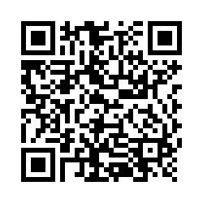

Any questions?
Contact information:
@byrneeleanor8, @AccessMathsTCD
Email: e.byrne@tcd.ie
Webpage: https://www.tcd.ie/trinityaccess/schools/accessmaths/
If you wouldn't mind participating in my research, please complete this short survey
Showcase for the project in March 2025

Slide 23
Thank you!

