Slide 1




EPI•STEM NATIONAL CENTRE FOR STEM EDUCATION
EPI•STEM Academy of STEM Teachers
David Godley (PhD Student in EPI•STEM)
Keith Kennedy (Maths Teacher and Research Assistant in EPI•STEM)
Notes:
v

Slide 2

The Purpose of this Workshop
Introduction to EPI•STEM
EPI•STEM Academy of STEM Teachers
Financial Mathematics in the Curriculum
Financial Mathematics in the Real World
The Career Mathways Project
CPD Resources for Teaching Financial Mathematics

Slide 3


Research and Teaching
Research Projects
International Research Profile
Publications
Lectures and Events
PDMT
Professional Diploma in Mathematics Teaching
Located at:
EPI•STEM Academy of STEM Teachers
Opportunities
Postgraduate Enrolments
Doctoral Enrolments
More information can be found at epistem.ie

Slide 4
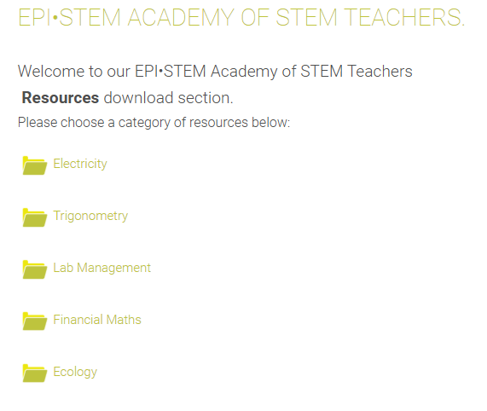
EPI•STEM Academy of STEM Teachers
A growing repository of CPD Resources
Aligns with national policy and curriculum
Research-led resources
We work with Oide and other national policy makers to ensure our CPD resources scaffold teachers’ continued learning
Resources are designed for teachers to adjust and adapt to their own classes
Resources follow the ‘Teaching Maths for Understanding’ framework
Emphasises the importance of conceptual understanding from Usiskin’s Framework.

Slide 5


Signing up for the EPI•STEM Academy of STEM Teachers
Scan the QR Code
Scroll down to ‘Register for access to our HEA Resources’
Insert your details and click ‘SUBMIT’
https://epistem.ie/hea-resources/

Slide 6
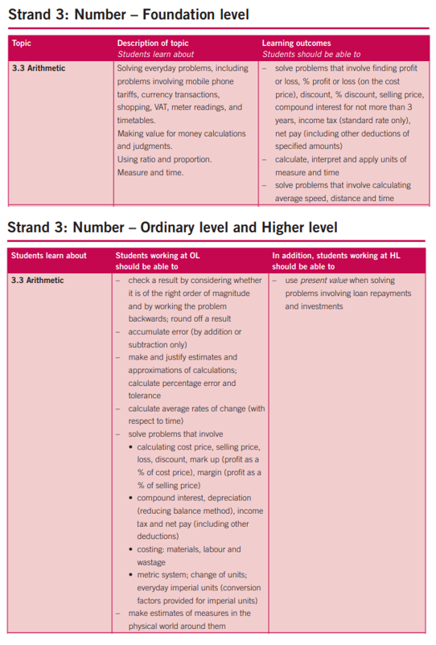

Financial Mathematics in the Curriculum
Junior Cycle
Leaving Certificate
NCCA Review (NCCA, 2024)
Student centred learning
Learning for understanding
Conceptual understanding
Procedural fluency
Real-world applications

Slide 7
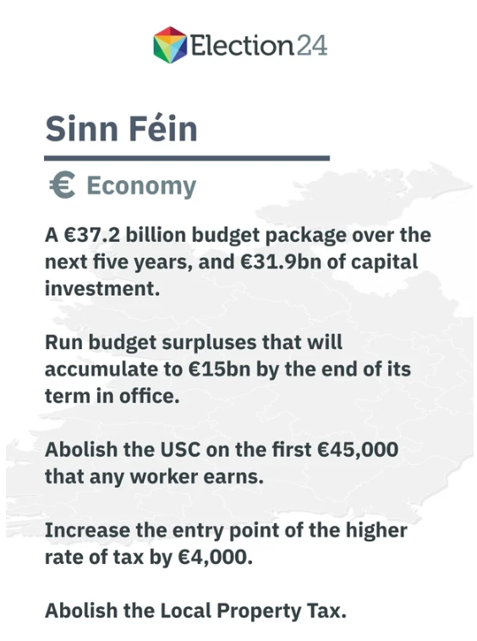
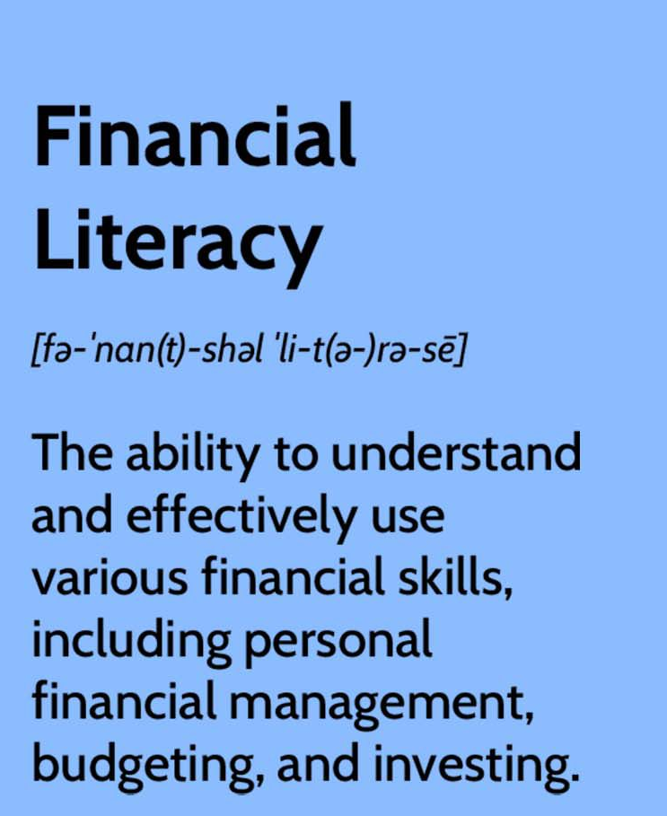
Financial Mathematics in the Real World
Where do we see financial mathematics…
Banks
Businesses
Investments
Stocks and Bonds
Interest rates (repayments of loans)
Insurance (calculating premiums)
General Election 2024!

Slide 8

The Career Mathways Project
Science Foundation Ireland (SFI) funded project designed for Transition Year students.
Aims to highlight the mathematics underpinning a variety of careers.
Aims to enhance student engagement across all STEM subjects.
The Career Mathways website will be launched in early 2025 and will include Teaching & Learning Plans, worksheets and more!

Slide 9
Introducing Myself and the Project
My name is Keith Kennedy and I have been a practicing maths teacher seven years. I have taught in Irish secondary schools for five years and in a US high school for the past two years.
When I began work on the resources presented in this booklet I wanted to create something that I would like to use in my own classroom and to keep my skills up to date.

Slide 10
Introducing Myself and the Project
The structure of the lessons follows that used by the Professional Diploma in Mathematics Teaching in their lessons.
The examples chosen to describe the mathematical content are rooted in real-world applications and Usiskin’s “Use Application”. Having delivered lessons for the PDMT in previous years, I have found this format has been enjoyable for both students and teacher!

Slide 11
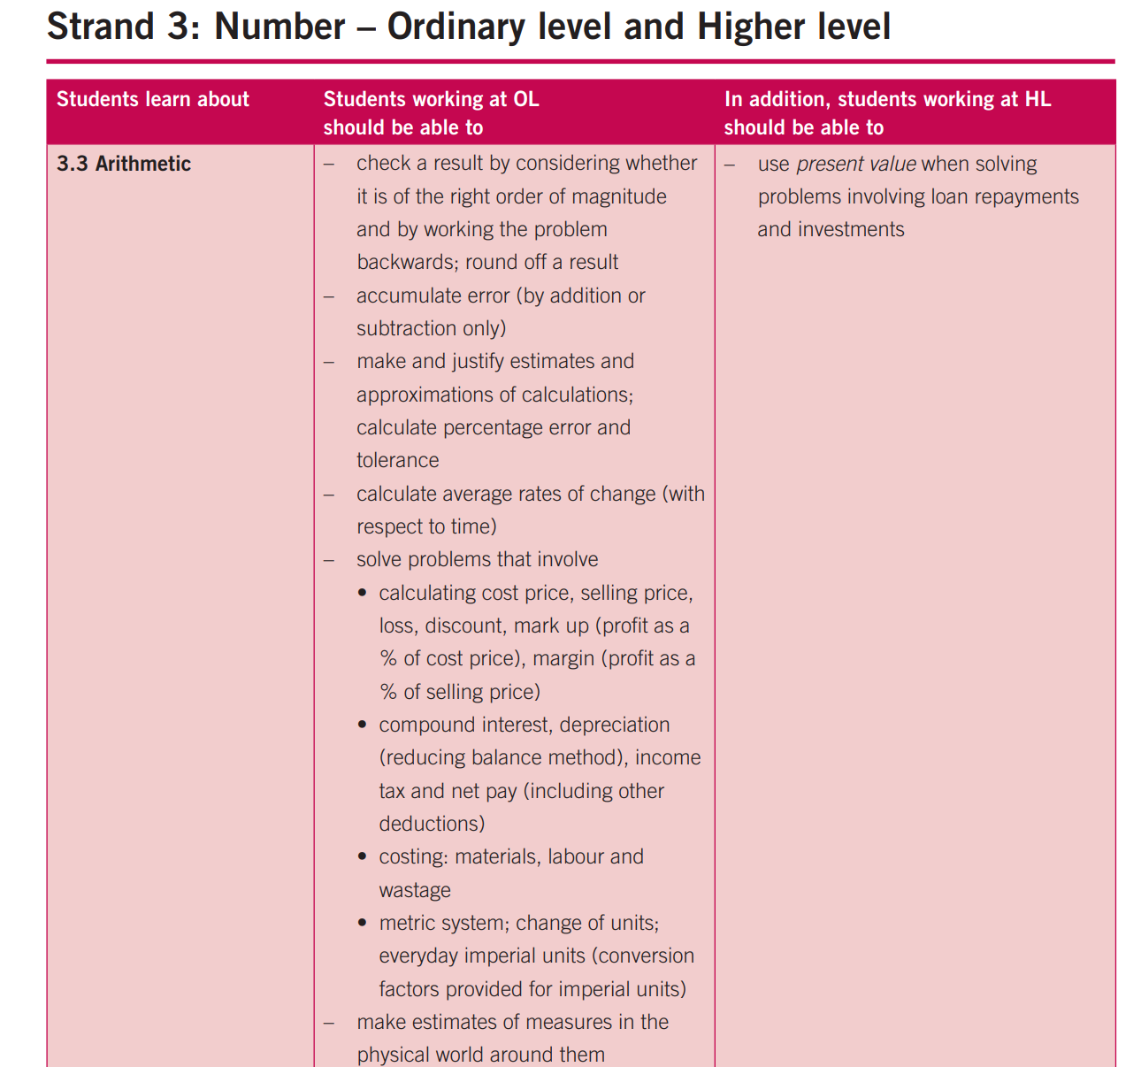
Financial Maths Specification

Slide 12
Financial Maths
Financial maths has been highlighted in surveys by EPISTEM as an area that teachers want further CPD in.
Financial maths opens doors for students and allows them to become financially literate; but do teachers and students have the conceptual understanding and adaptive reasoning in this relatively new topic?

Slide 13
Financial Maths
In general, financial mathematics is the application of mathematical methods to financial problems.
It draws on tools from other mathematical strands including arithmetic, sequences and series, probability and statistics.
In the early days financial mathematics primarily consisted of the study of compound interest and Albert Einstein has been accredited with saying “Compound interest is the eighth wonder of the world. He who understands it, earns it; he who doesn't, pays it.” Compound interest has also been referred to as “the most powerful force in the universe”.

Slide 14
Formulae
When teaching financial mathematics there are many important formulae which we will undoubtedly introduce.
However, it is important that we and our students understand where these formulae came from and why they work in particular circumstances.

Slide 15
Formulae
Some examples of formulae that are derived and explained when using the resources include:
  Compound interest/Depreciation formula
  Sum of geometric sequence
  Amortisation formula
  Reducing balance method of depreciation
  Present value of money

Slide 16
For Today
Today I would like to highlight two sections that are included in the financial maths package.
Compound Interest and Present Value

Slide 17
Continuous Compound Interest and e Activity
What happens if we vary the number of compounding periods for an investment? Let’s say you invest €1 for one year at an interest rate of 100% to be compounded n times that year.
What is the value of your investment if the interest is added:
1 year
Every 6 months
Every 3 months
Every month
Every week

Slide 18
Continuous Compound Interest and e Activity
Every day
Every hour
Every minute
Every second

Slide 19
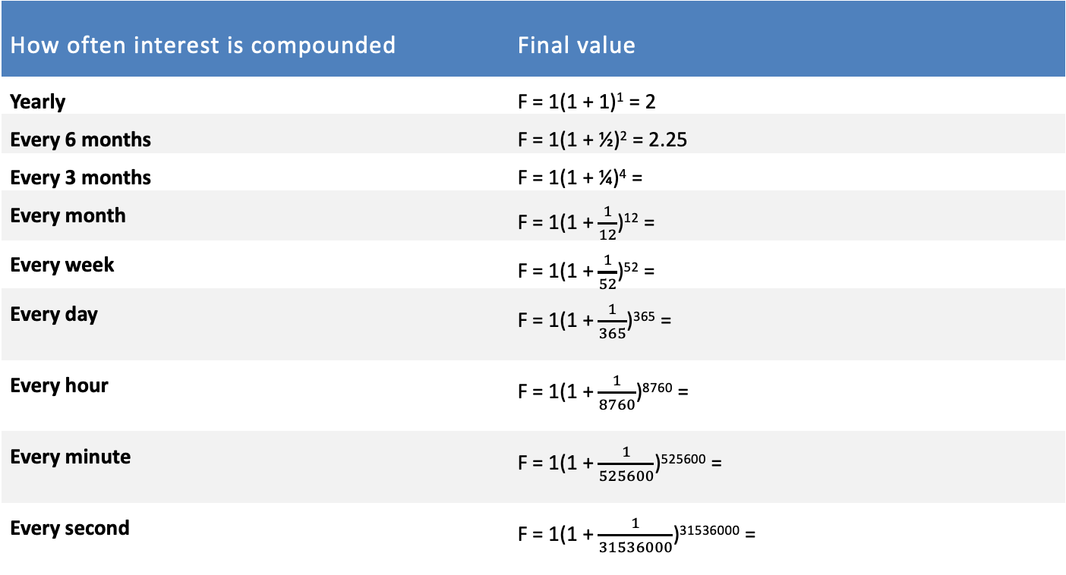
Continuous Compound Interest and e Activity
How often interest is compounded | Final value
Yearly | F = 1(1 + 1)¹ = 2
Every 6 months | F = 1(1 + ½)² = 2.25
Every 3 months | F = 1(1 + ¼)⁴ =
Every month | F = 1(1 + $\frac{1}{12}$)¹² =
Every week | F = 1(1 + $\frac{1}{52}$)⁵² =
Every day | F = 1(1 + $\frac{1}{365}$)³⁶⁵ =
Every hour | F = 1(1 + $\frac{1}{8760}$)⁸⁷⁶⁰ =
Every minute | F = 1(1 + $\frac{1}{525600}$)⁵²⁵⁶⁰⁰ =
Every second | F = 1(1 + $\frac{1}{31536000}$)³¹⁵³⁶⁰⁰⁰ =

Slide 20
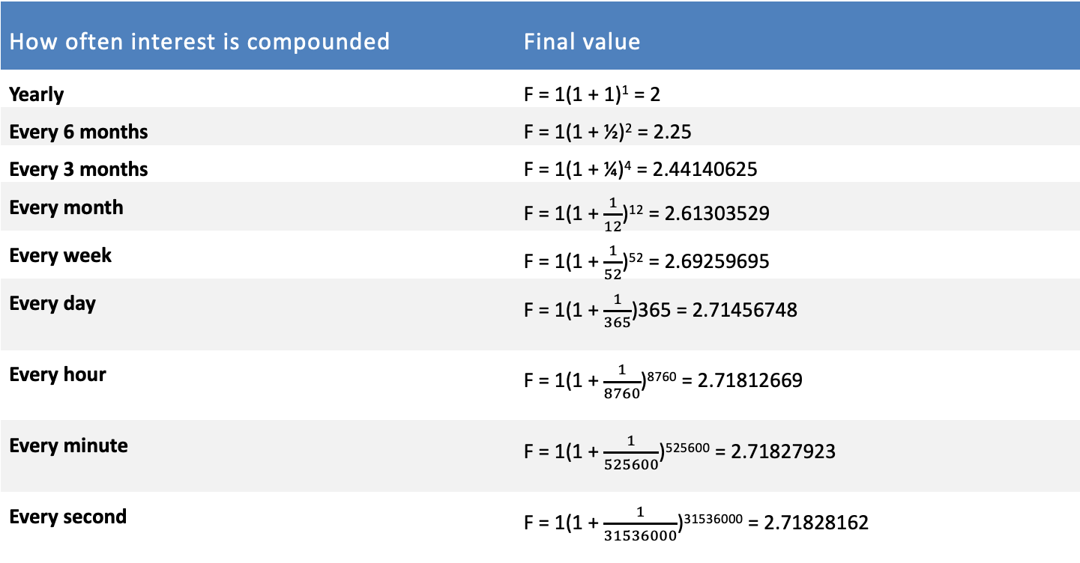
Continuous Compound Interest and e Activity
How often interest is compounded | Final value
Yearly | F = 1(1 + 1)¹ = 2
Every 6 months | F = 1(1 + ½)² = 2.25
Every 3 months | F = 1(1 + ¼)⁴ = 2.44140625
Every month | F = 1(1 + $\frac{1}{12}$)¹² = 2.61303529
Every week | F = 1(1 + $\frac{1}{52}$)⁵² = 2.69259695
Every day | F = 1(1 + $\frac{1}{365}$)365 = 2.71456748
Every hour | F = 1(1 + $\frac{1}{8760}$)⁸⁷⁶⁰ = 2.71812669
Every minute | F = 1(1 + $\frac{1}{525600}$)⁵²⁵⁶⁰⁰ = 2.71827923
Every second | F = 1(1 + $\frac{1}{31536000}$)³¹⁵³⁶⁰⁰⁰ = 2.71828162

Slide 21
Continuous Compound Interest and e Activity
Conclusion: As we compound the interest more frequently the rate of growth of our investment appears to slow down.
We can see that a limit exists at a value close to 2.7182. We can state with certainty that the value of the investment will never exceed 2.72. No matter how many times we compound the interest we cannot exceed this value.
As n, the number of compounding periods gets larger and larger, the “unrounded” amount is getting closer and closer to the number e.

Slide 22
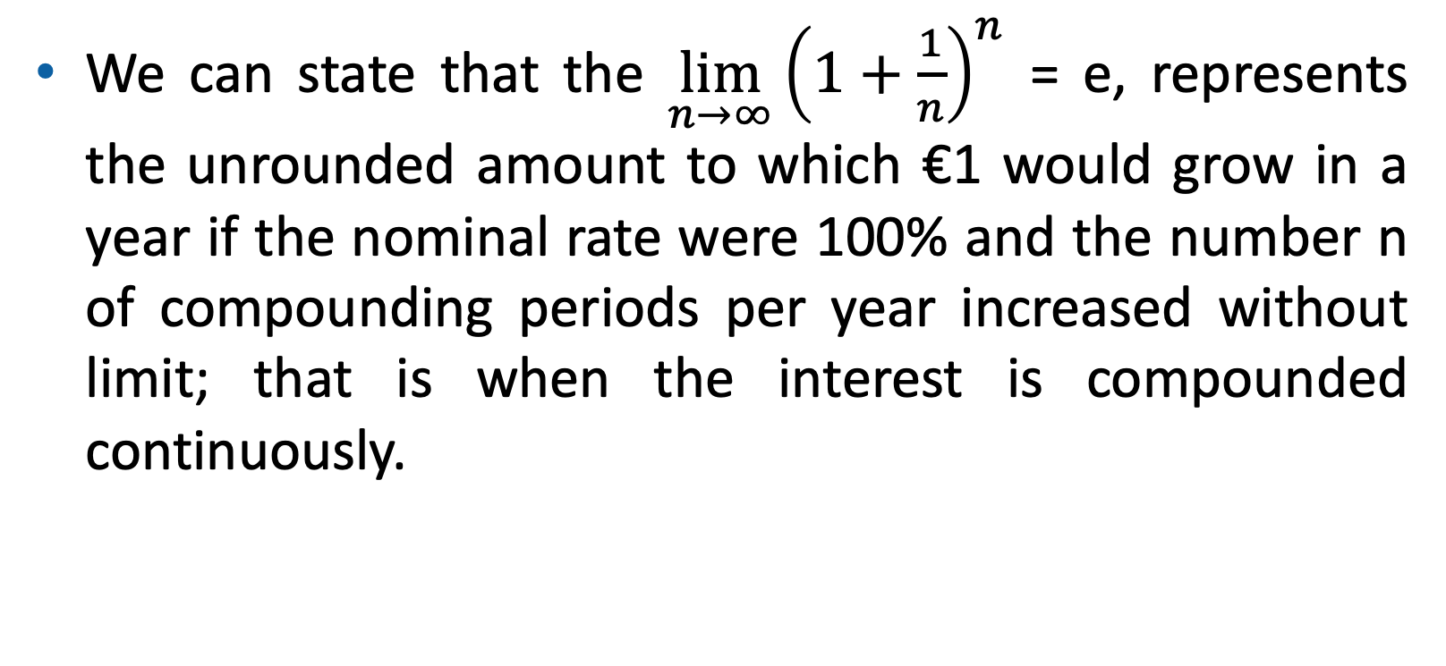
Continuous Compound Interest and e Activity
We can state that the $\lim_{n→∞}{{\left(1+\frac{1}{n}\right)}^{n}}$ = e, represents the unrounded amount to which €1 would grow in a year if the nominal rate were 100% and the number n of compounding periods per year increased without limit; that is when the interest is compounded continuously.

Slide 23

House Prices
Property prices in Ireland have increased nationally by 12.4% in the year to September 2023.
The owners of a house might say that they will sell it to you now for €360,000 today or for €440,000 at the end of two years.
What is the interest rate applied? Are we getting a good deal?

Slide 24
House Prices
In this example we are not given the interest rate as is normally the case.
We can however label the variables we do have and change the subject of the present value formula to make i the subject.
F = 440,000
P = 360,000
t = 2

Slide 25

House Prices
$$\frac{F}{\left(1 + i\right)t }=P$$
Multiply by (1+i)^{t}
$F=P$ $\left(1 + i\right)t$
Divide by P
$$\frac{F}{P}=\left(1 + i\right)t$$

Slide 26
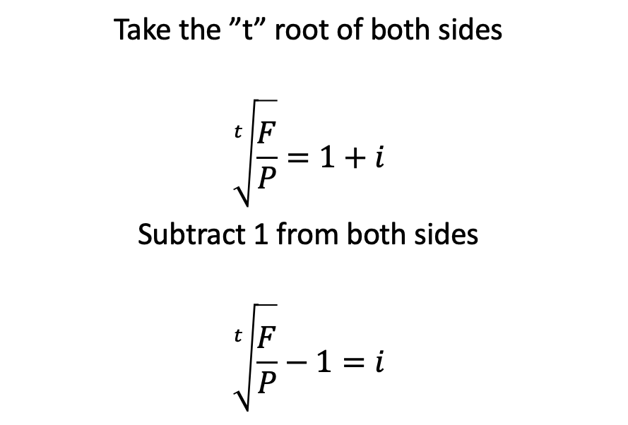
House Prices
Take the ”t” root of both sides
$$\sqrt[t]{\frac{F}{P}}=1+i$$
Subtract 1 from both sides
$$\sqrt[t]{\frac{F}{P}}−1=i$$

Slide 27
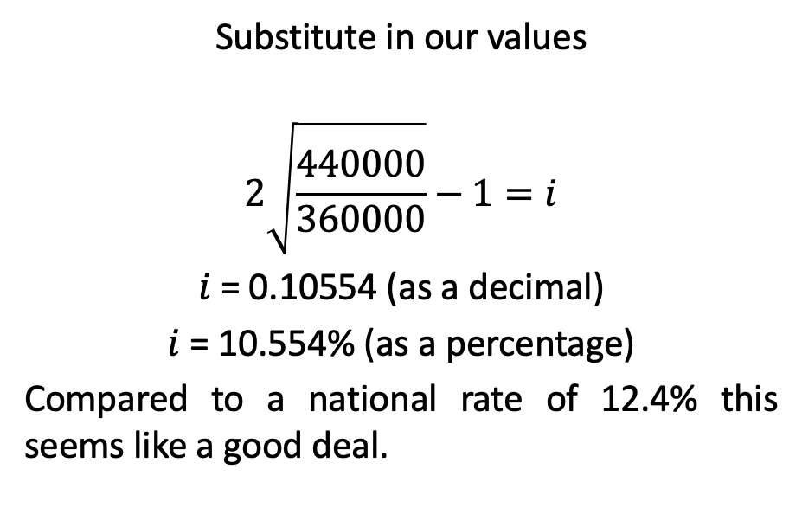
House Prices
Substitute in our values
$$2\sqrt{\frac{440000}{360000}}−1=i$$
$i$ = 0.10554 (as a decimal)
$i$ = 10.554% (as a percentage)
Compared to a national rate of 12.4% this seems like a good deal.

Slide 28
Reflective Practice
How did I teach this topic before?
How will I teach it now?
Will I change something here?
Will I stay the same in some areas?

Slide 29
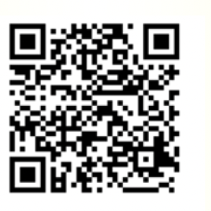
Junior Cycle Mathematics Specification Evaluation
A team of researchers from UL and UCC are looking to ascertain mathematics teachers’ perspectives on the Junior Cycle Mathematics Specification.
Teachers’ perspectives on the following aspects of the Junior Cycle Mathematics Specification are being sought as part of this study:
  The key changes that came about with the introduction of the Junior Cycle Mathematics Specification;
  The impact of the Junior Cycle Mathematics Specification on teaching and learning;
  The approaches to assessment;
  The enablers and barriers to this reform.
We are hoping to give teachers a platform to share their insights prior to any changes being considered or implemented at Senior Cycle.
Survey can be found here!

Slide 30
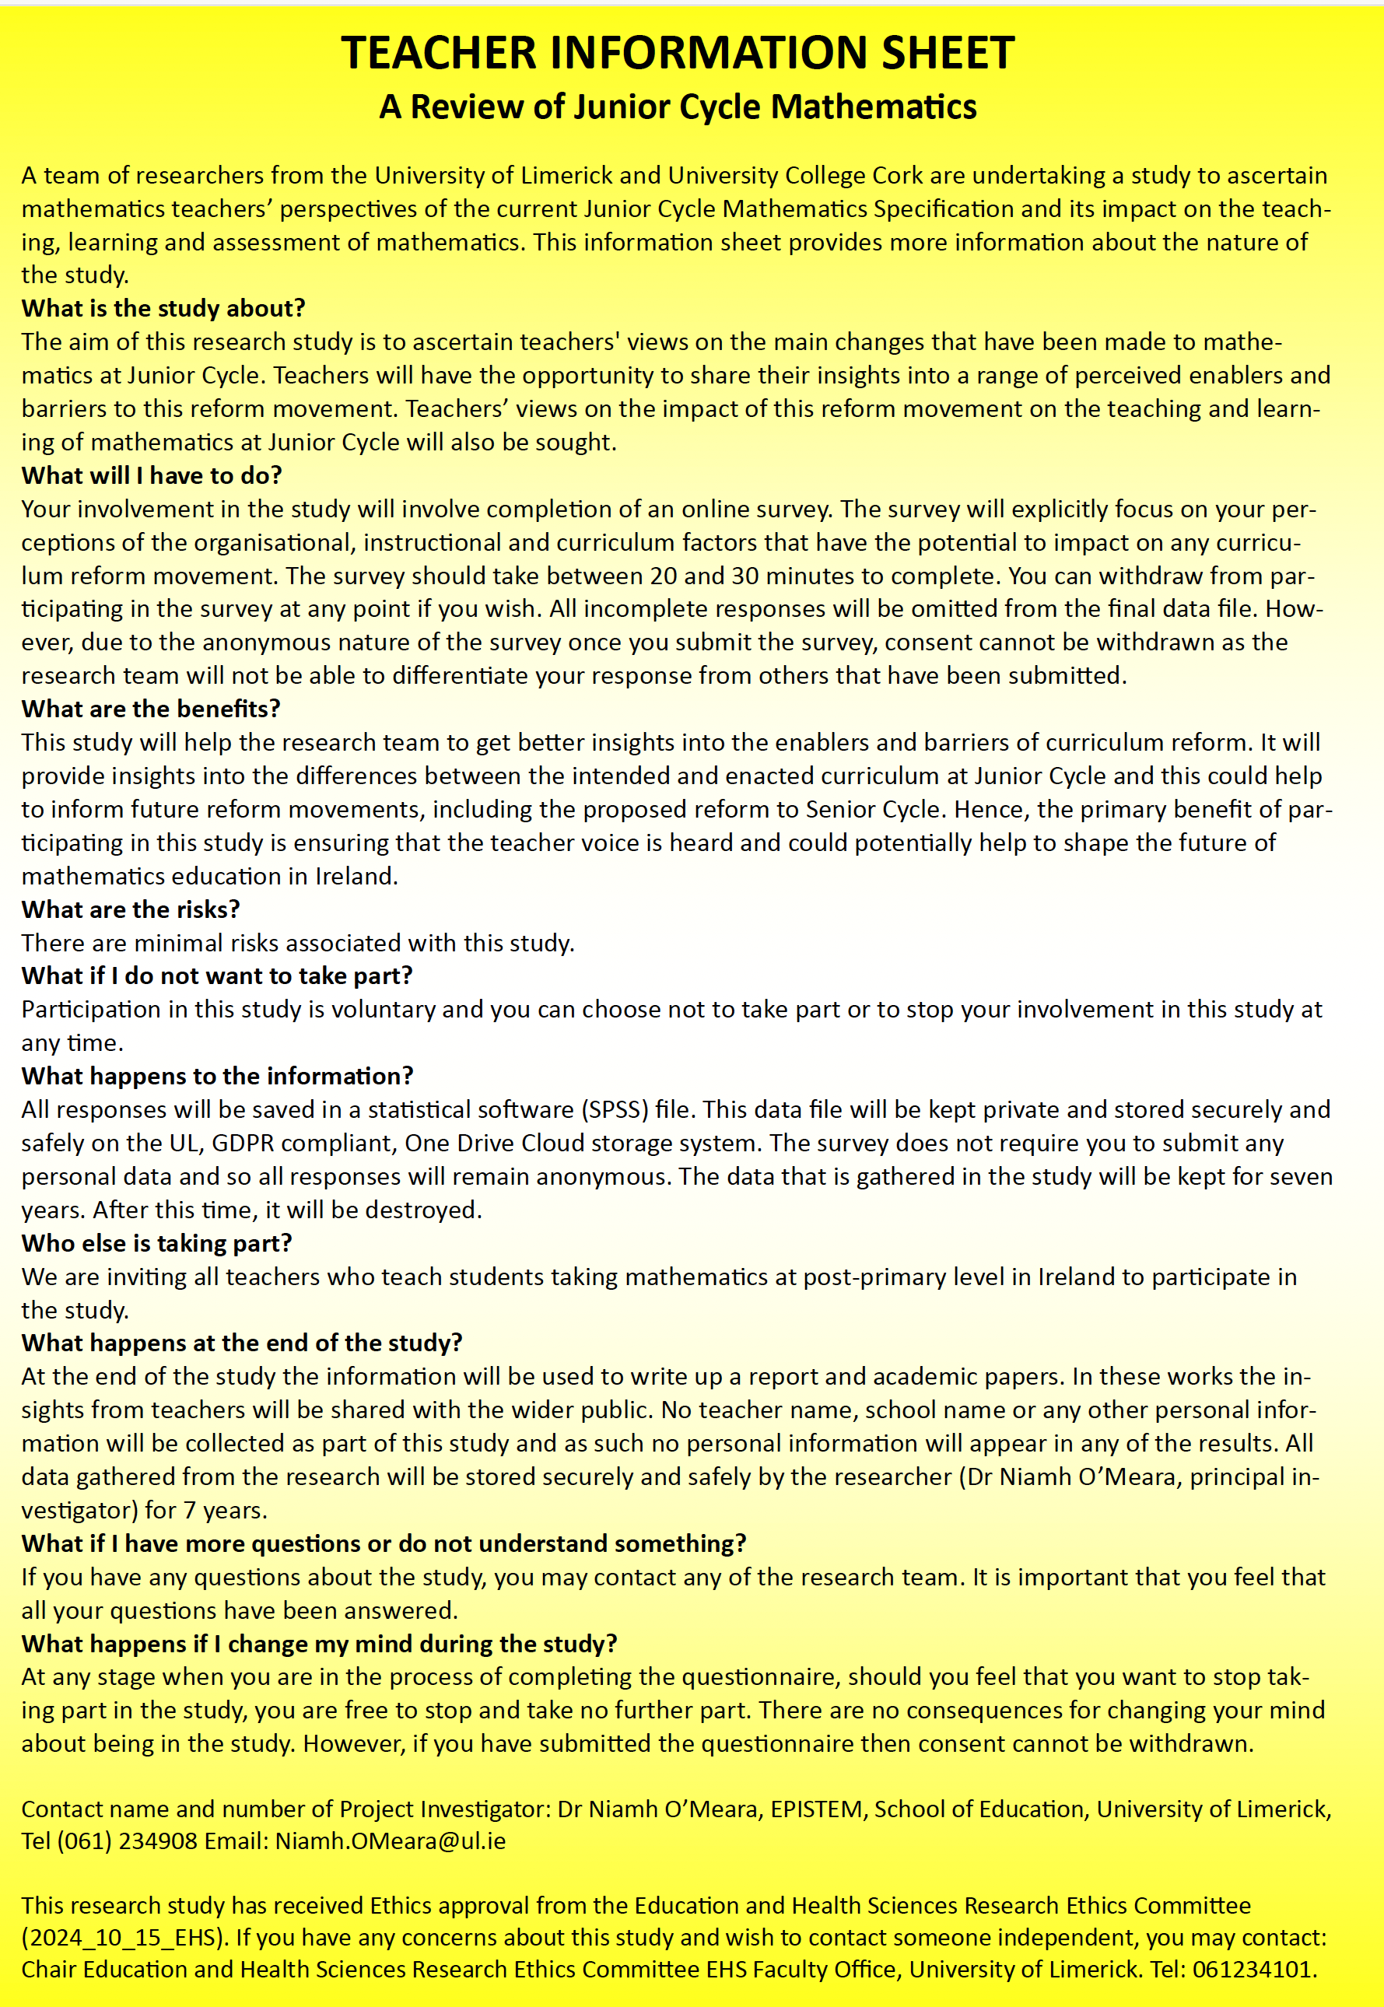
What can you do?
Do you have 20/25 minutes to spare today? If so, that is all it will take for you to complete the survey.
The survey, which can be accessed via the QR code below, can be completed on a phone or tablet.
The leaflet, containing the teacher information sheet as well as the QR code can be collected from the EPISTEM desk. We would encourage you to take a leaflet and share with colleagues teaching mathematics at Junior Cycle who are not in attendance today.

Slide 31

HOW TO GET ACCESS TO THIS EPI•STEM TEACHER RESOURCE:
Clink the link: https://epistem.ie/hea-resources/
OR
EMAIL SENIOR EXECUTIVE ADMINISTRATOR: HELEN.FITZGERALD@UL.IE

