Slide 1
Exploring Mathigon's Polypad
A Digital Learning Technology for Visual Representations and Manipulatives in Mathematics
Notes:
Have jct.ie/maths open
Google…mathigon

Slide 2
Introduction
2

Slide 3
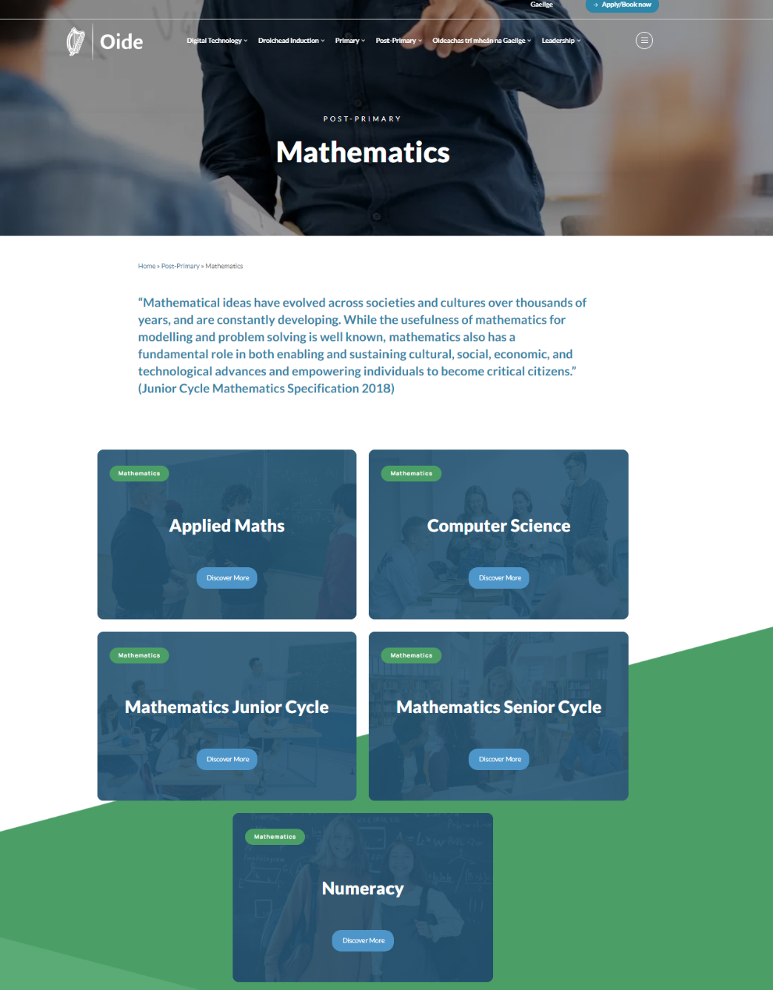

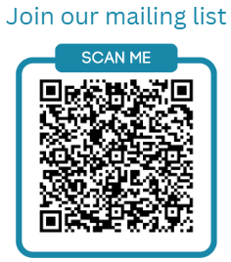
Mathematics & Computer Science
https://oide.ie/post-primary/home/mathematics/
Applied Mathematics @OideAppliedMath
Computer Science @Oide_CompSci
Mathematics @Oide_PPMaths
Numeracy

Slide 4

Key Message
Digital technologies offer deep learning opportunities for students when used with a constructivist approach

Slide 5
Learning Intention:
To create digital learning experiences for students that can develop their conceptual understanding in Mathematics
Success Criteria:
I have
been provided with an overview of the effective use of digital technologies with reference to key policy documents
engaged with a student learning experience using Mathigon to explore a range of concepts
designed a learner experience using Mathigon
reflected on the key learning from this event

Slide 6


Welcome to the workshop:
P.L.L.
Danny.Redmond@oide.ie

Slide 7
Supporting learning using representations and visual manipulatives
7

Slide 8

"Proficient problem solvers frequently use representations to solve problems and communicate results…Professionals in mathematical jobs such as engineering or nursing frequently represent their ideas as part of their work.”
The Elephant in the Classroom - Jo Boaler
Notes:
Visual representations help us solve problems and communicate our understanding to others.
The potential is here for students to engage in open-ended tasks and to create and explain their own maths using digital tools such as mathigon.
Today we are trying to supplement some of the excellent pedagogy in our classrooms.

Slide 9
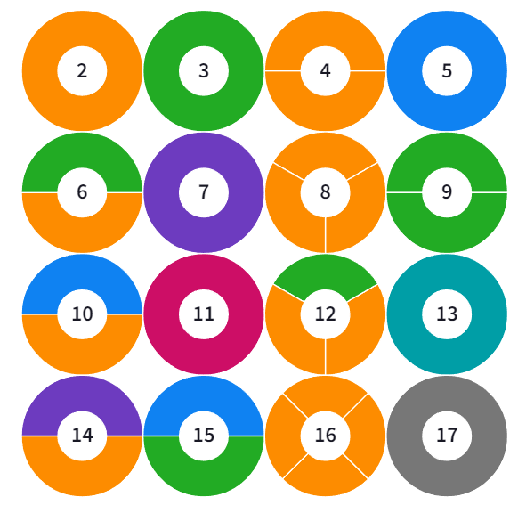
* Originally created by Dan Finkel

Slide 10

Literacy Numeracy & Digital Literacy Strategy 2024-2033
Numeracy Skills
Analyse patterns and relationships
Use skills of investigation, reasoning and problem solving
Hypothesis and make predictions through the examination of evidence
Analyse and make good arguments
Express ideas mathematically
Estimate, predict calculate
Adopt a positive disposition and attitude
towards numeracy
​
​
10
Notes:
The LNDL Strategy emphasises the importance of the following Numeracy, literacy and digital literacy skills, which can be explored through the use of digital tools such as Desmos in the Maths classroom.
Desmos can support student understanding as they ……….
(From slide)
10

Slide 11
Literacy Numeracy & Digital Literacy Strategy 2024-2033
Literacy
Subject specific literacy and language skills.
Digital Literacy
Using technology to facilitate expression
and creativity
​
​
11
Notes:
The LNDL Strategy emphasises the importance of the following Numeracy, literacy and digital literacy skills, which can be explored through the use of digital tools such as Desmos in the Maths classroom
It can also support the JC Key skills Being Numerate, Being Literate, Being Creative, Staying well, Managing Information Thinking for example
In a similar way SC key competencies, which will be encompassed in SC Maths redevelopment in tranche 3 can also be supported by tolls such as Desmos:
Key competencies are supported when
students’ literacies are well developed
students’ numeracy is well developed
students make good use of various tools, including technologies, to support their learning.
11

Slide 12
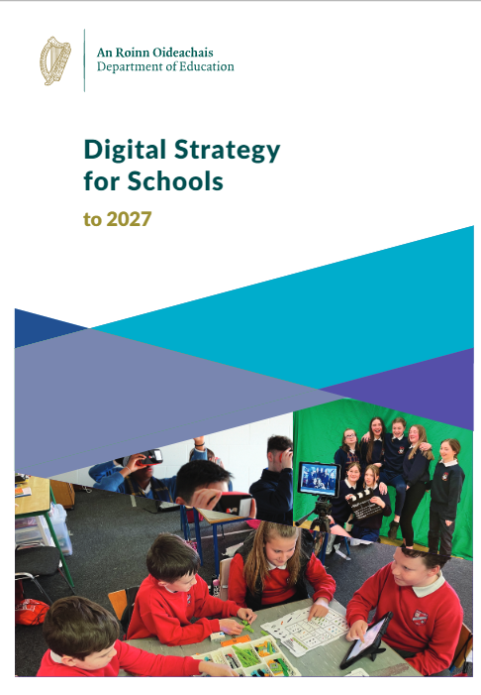
Digital Strategy for Schools to 2027
Using digital technologies actively and working with other learners promotes and encourages active learning, problem solving, critical thinking and communication skills, all of which are vital for the world we live in.
Digital Strategy for Schools to 2027 page 23
12
Notes:
12

Slide 13
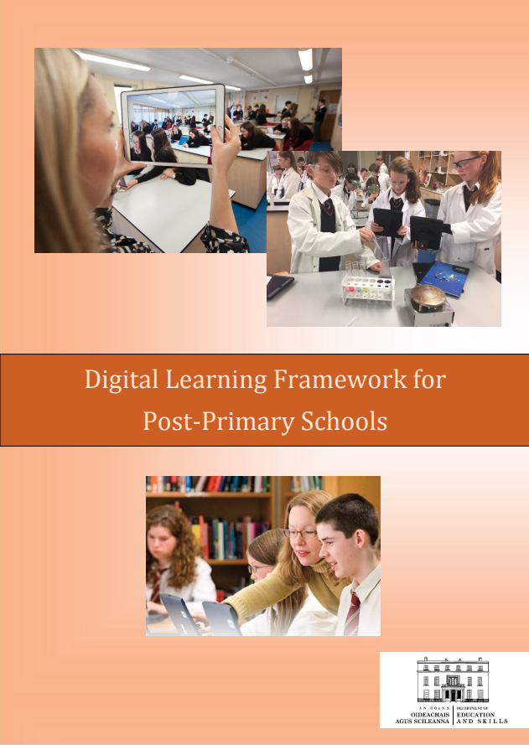
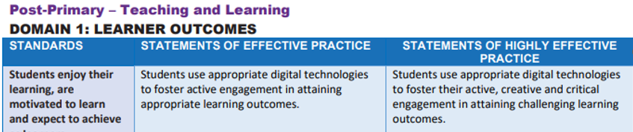
Digital Planning
13
Notes:
13

Slide 14

Learning Outcome U.4:
“Students should be able to represent a mathematical situation in a variety of different ways, including numerically, algebraically, graphically, physically, in words; and to interpret, analyse, and compare such representations.”
Mathematics Specification 2015
Notes:
We will give you a moment to read these quotes. [Pause]
All of the activities that we do today could be done without manipulatives.
However, they do offer the potential to build students conceptual understanding in new ways and in particular to make connections between the concepts they engage with.
The digital tools we are considering today will hopefully help our students understand the underlying structures of the mathematics they are engaging with.
We can do many of the same things using physical manipulatives but in can handy to use digital manipulatives as they are always readily available.

Slide 15
“Mathematical ideas have evolved across societies and cultures over thousands of years and are constantly developing. Digital technologies are facilitating this expansion of ideas and provide new tools for mathematical exploration and invention.”
Mathematics Specification 2015
Notes:
We will give you a moment to read these quotes. [Pause]
All of the activities that we do today could be done without manipulatives.
However, they do offer the potential to build students conceptual understanding in new ways and in particular to make connections between the concepts they engage with.
The digital tools we are considering today will hopefully help our students understand the underlying structures of the mathematics they are engaging with.
We can do many of the same things using physical manipulatives but in can handy to use digital manipulatives as they are always readily available.

Slide 16
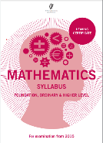
“Learners should engage with a dynamic geometry software package.”
“A high level of achievement in Mathematics is characterised by
…can move confidently between different forms of representation.”
Leaving Cert Mathematics Syllabus from 2015
Notes:
We will give you a moment to read these quotes. [Pause]
All of the activities that we do today could be done without manipulatives.
However, they do offer the potential to build students conceptual understanding in new ways and in particular to make connections between the concepts they engage with.
The digital tools we are considering today will hopefully help our students understand the underlying structures of the mathematics they are engaging with.
We can do many of the same things using physical manipulatives but in can handy to use digital manipulatives as they are always readily available.

Slide 17
Exploring Conceptual Learning Experiences with Mathigon
17

Slide 18

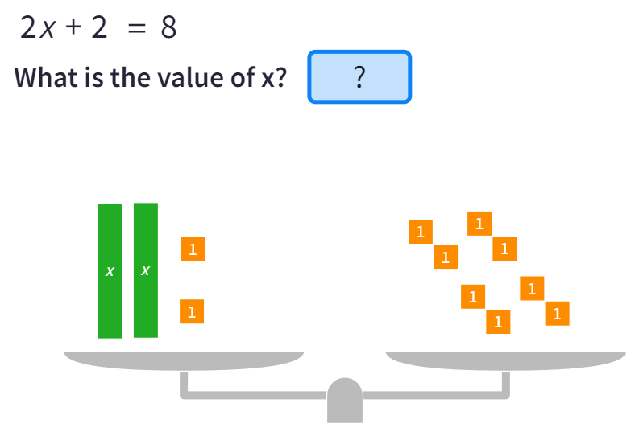
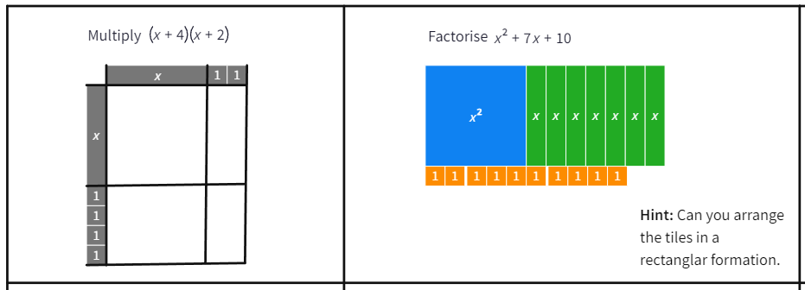
Mathigon’s Polypad is free to use software to support the use of multiple representations and visual manipulatives in the maths classroom.
Notes:
Mathigon is free to use.
You don’t require a login to use it.
You can use a login if you want to save different tasks.
Any of the links we provide you today don’t require a login.
Students don’t need an account they can just follow any links as well.

Slide 19
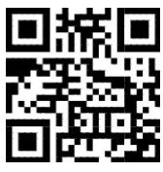
Link to Workshop Polypads
https://tinyurl.com/2ujmncwd

Slide 20
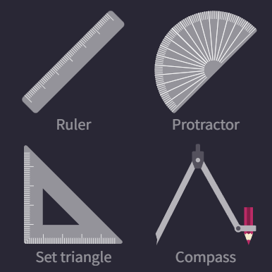
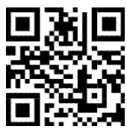
Constructions Polypad
https://tinyurl.com/yt86sfnr

Slide 21
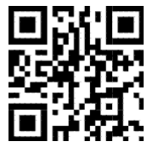
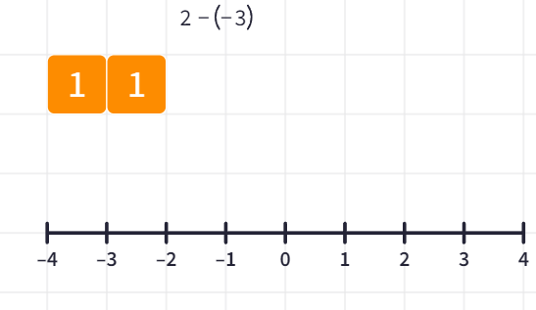
Addition and Subtraction of Integers Polypad
https://tinyurl.com/vt28u24e

Slide 22
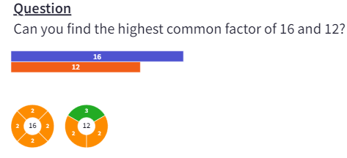
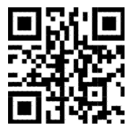
Prime Numbers Polypad
https://tinyurl.com/4mhs777s

Slide 23
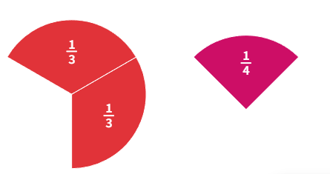
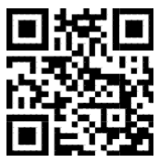
Fractions Polypad
https://tinyurl.com/yc4cvdxs

Slide 24
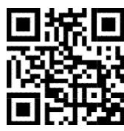
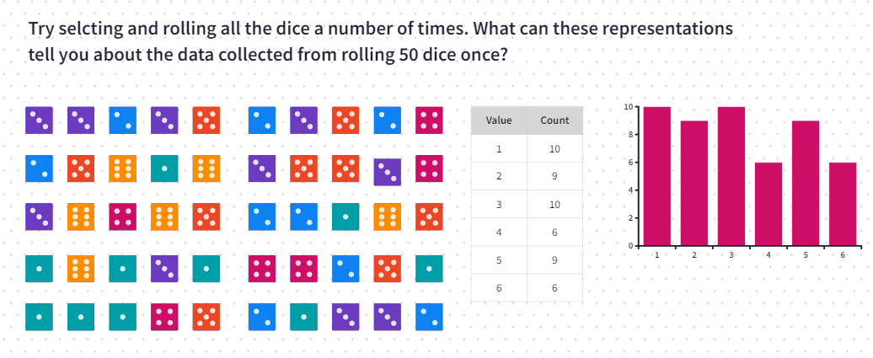
Dice Polypad
https://tinyurl.com/muuybsfb

Slide 25
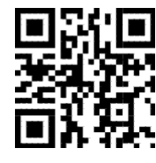
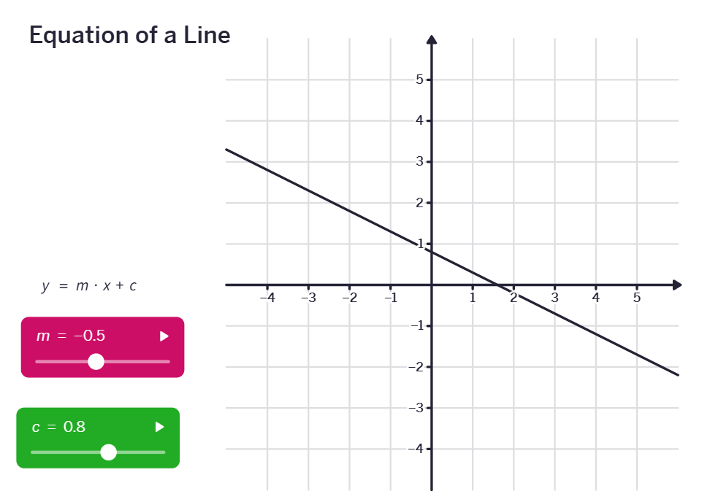
Equation of a Line Polypad
https://tinyurl.com/mrvw95s4

Slide 26
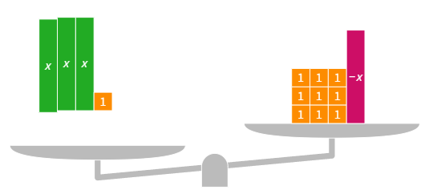
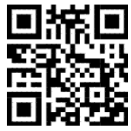
Algebra Polypad
https://tinyurl.com/237bc9pp

Slide 27
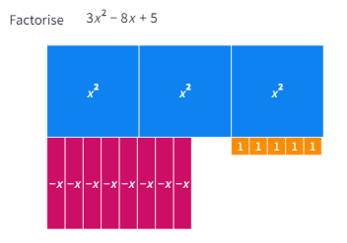
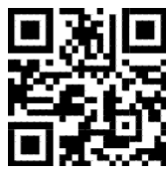
Multiplication and Factorising Polypad
https://tinyurl.com/yn3ej6w8

Slide 28
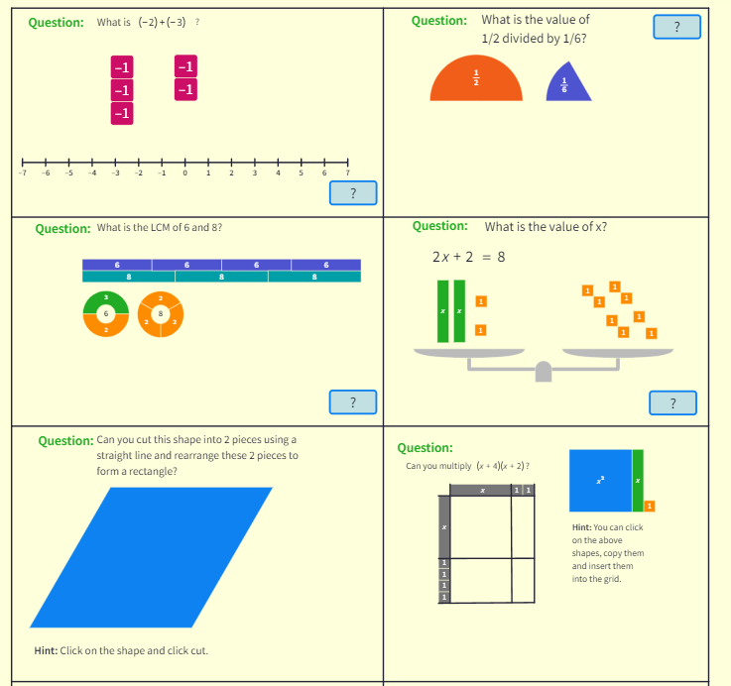
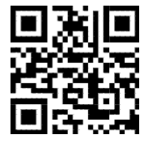
Additional Activity
https://tinyurl.com/5n6jpff9

Slide 29
Creating a Polypad

Slide 30
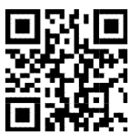
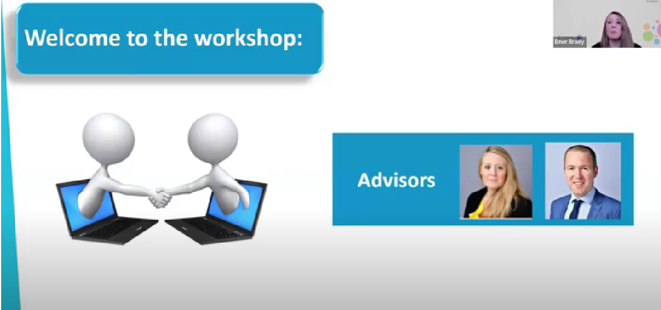
Webinar
https://tinyurl.com/4sy3d29p

Slide 31


Reflection
Which of Mathigon’s visual manipulatives can help my students develop conceptual understanding?
Are there physical manipulatives that would complement the visual manipulatives discussed today?
63
Notes:
need time to absorb the learning
reflect useful exit ticket to check if students understood the key concept
Take time to reflect on session.
Standard from Domain 2 (Learner Experiences) of LAOS 2022:
‘Students reflect on their progress and develop a sense of ownership and responsibility for their learning.

Slide 32
Conclusion
64

Slide 33
Learning Intention:
To create digital learning experiences for students that can develop their conceptual understanding in Mathematics.
Success Criteria:
I have
been provided with an overview of the effective use of digital technologies with reference to key policy documents.
engaged with a student learning experience using Mathigon to explore a range of concepts.
designed a learner experience using Mathigon
reflected on the key learning from this event.

Slide 34
Key Message
Digital technologies offer deep learning opportunities for students when used with a constructivist approach

Slide 35
Thank you
P.L.L.
Danny.Redmond@oide.ie

