Slide 1
Preparations for and Reflections on a Maths Inspection
Ciara Delaney and Caoimhe McDonnell
Ardgillan College

Slide 2
Overview of our DES Subject Inspection
7 days notice
2-day Subject Inspection
Met with Principal, Maths Co-ordinator and SENCO
Reviewed subject documents
Observed six teachers and gives individual feedback
Conducted focus groups with student
Evaluated learning and teaching in Mathematics
Notes:
Ciara

Slide 3
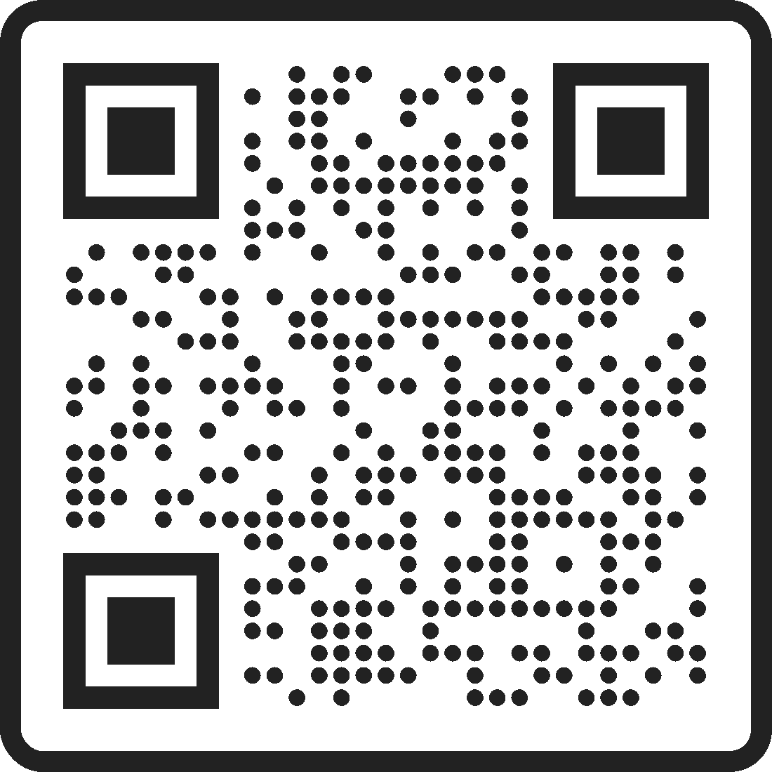
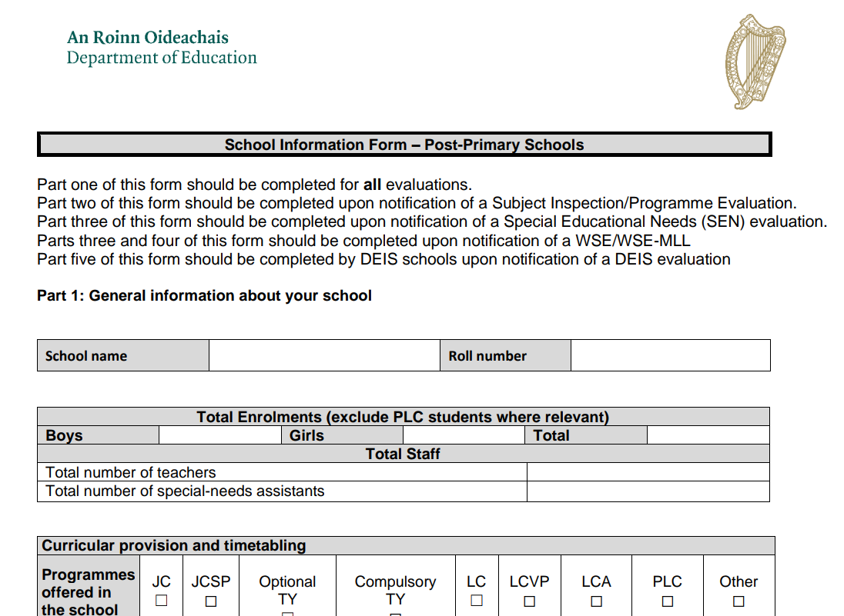
Prior to Inspection
Complete School Information Form
- Provision and Timetabling
Coordinator Role
Teacher Roles, Classes Taught and CPD
AEN Provisions
SSE and Assessment Practice
Resources and Facilities

Slide 4
What are they looking for?
Basics done well
In line with Junior Cycle Guidelines
Documentation
Cross Topic Links
SSE
Collaboration

Slide 5
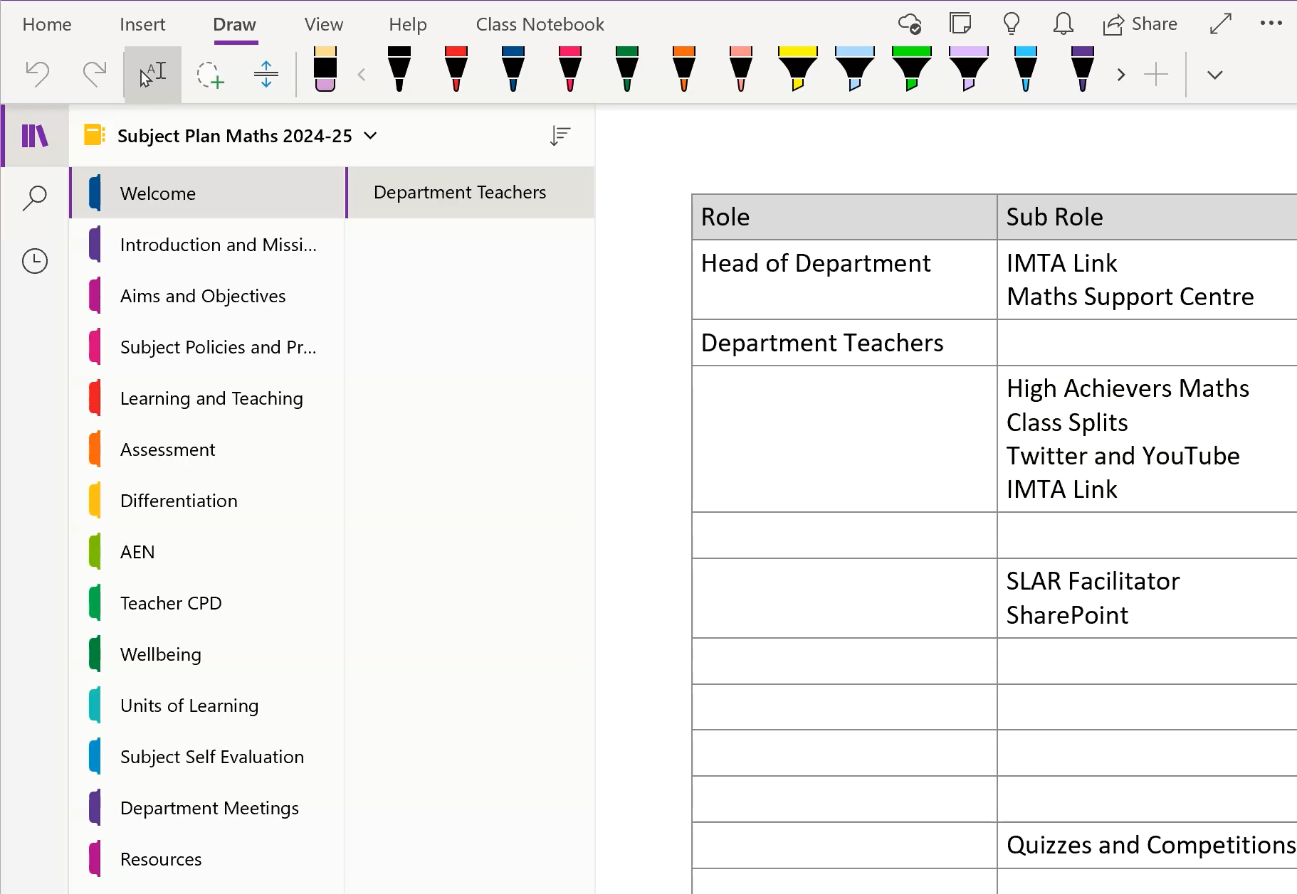
Subject Plan
Department Notebook
Accessible
Links to SharePoint

Slide 6
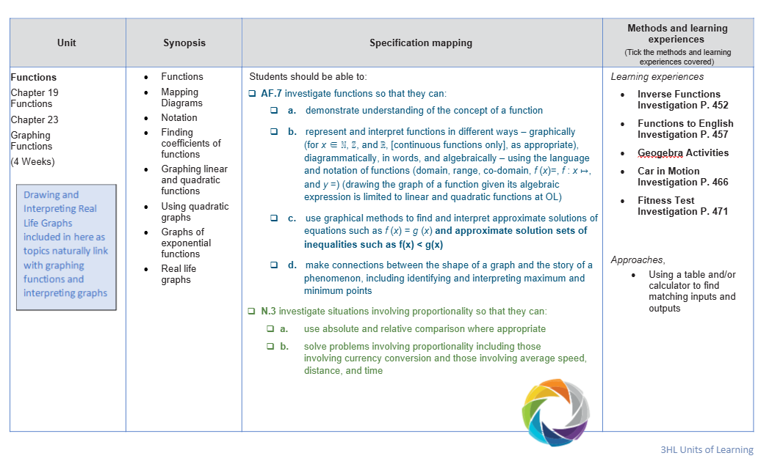
Units of Learning
In line with new Junior Cycle
Cross Topic Links
Live Document

Slide 7
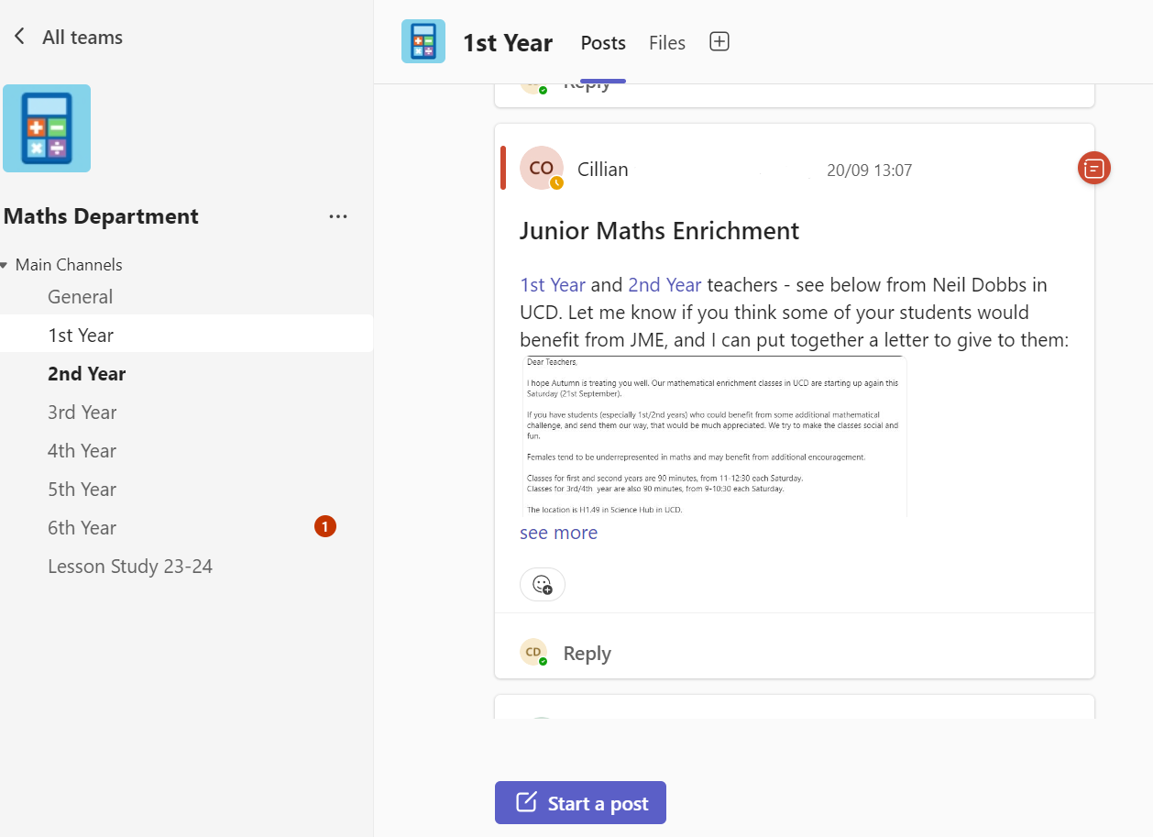
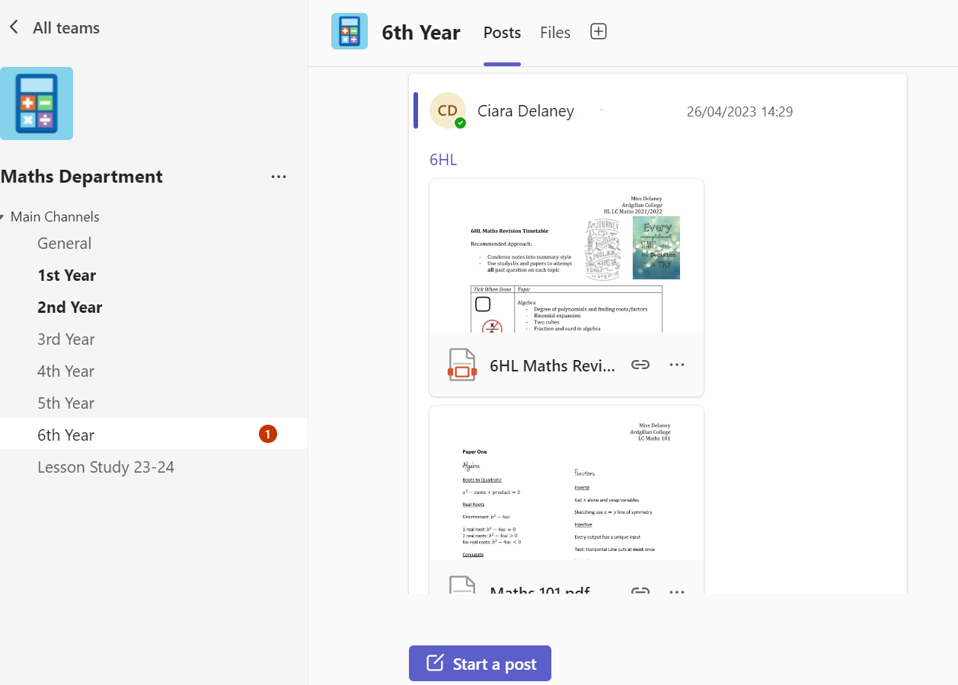
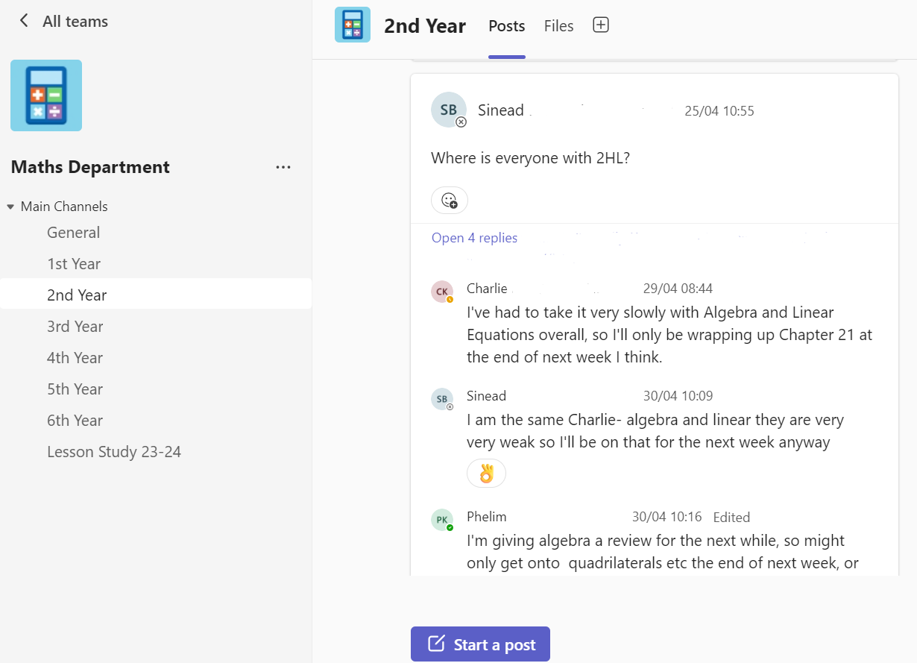
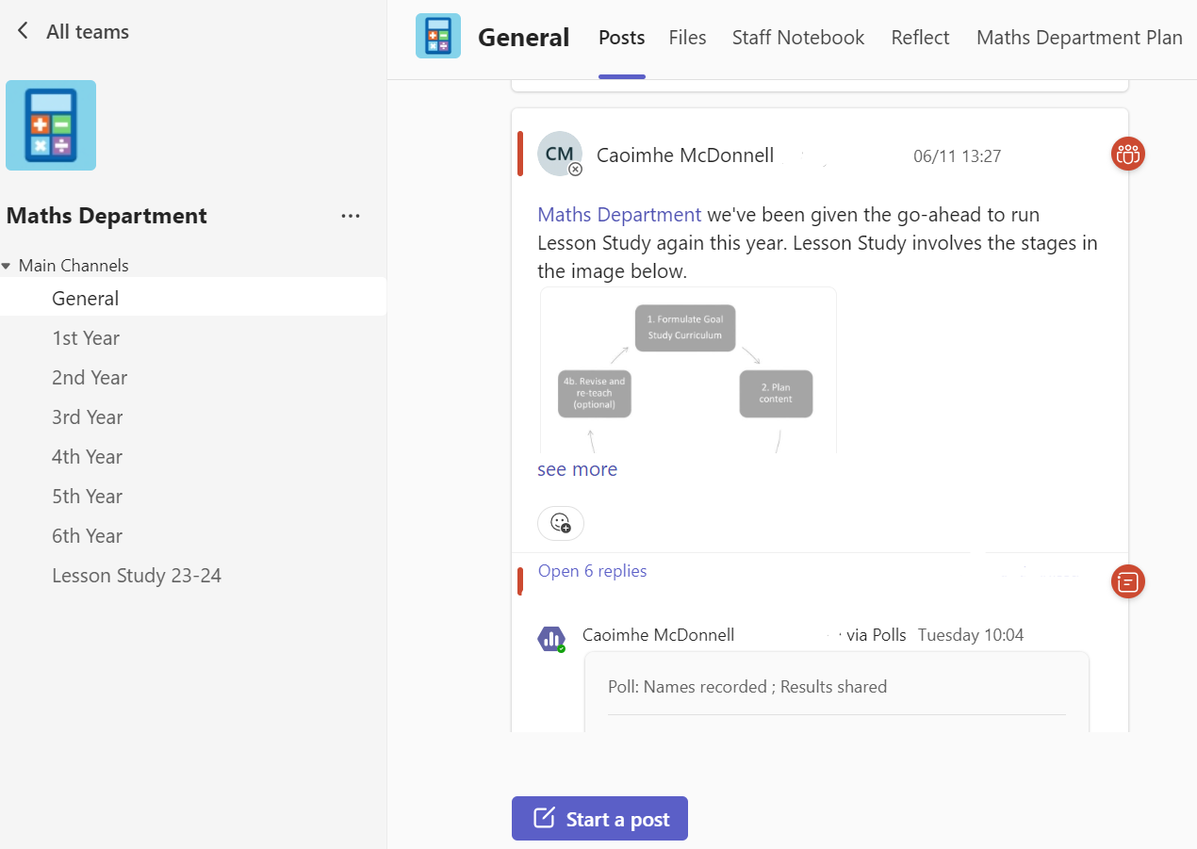
Collaboration
Teams
Channels
Tags

Slide 8
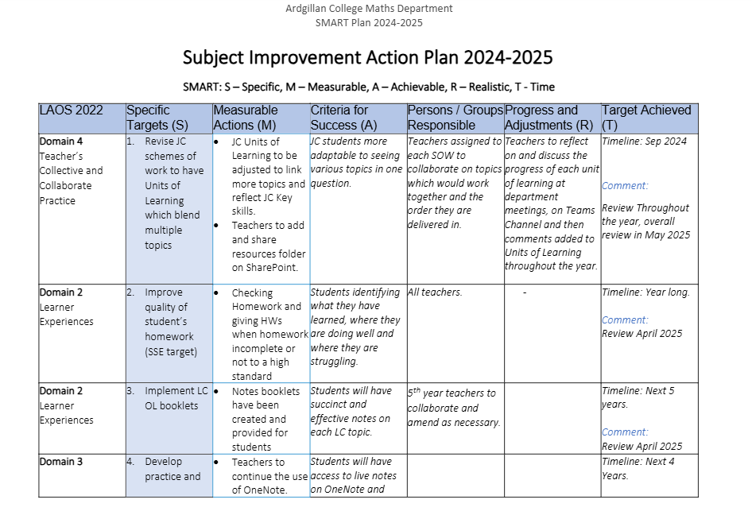
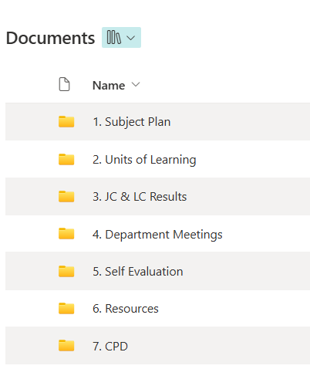
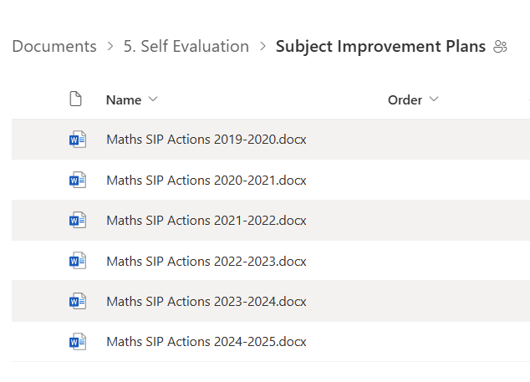
SSE

Slide 9
The Inspection
Day One
Inspector arrives and meets Principal
Reviews documentation
Visted 4 classes and gave feedback
Inspector meets Coordinator
Day Two
Inspector meets SENCO
Inspector meets students
Visted 2 classes and gave feedback
Inspector prepares feedback
Feedback given to Principal and Department

Slide 10
Meeting with Coordinator
How are you using your Junior Cycle planning time?
How does the department feel about CBAs?
How do you handle level requests from students and parents?
How does the department collaborate?
Who makes and updates the units of learning?

Slide 11
Evaluated Learning and Teaching in Mathematics
  Teaching, learning and assessment
  Subject provision and whole-school support
  Planning and preparation
Notes:
Caoimhe

Slide 12
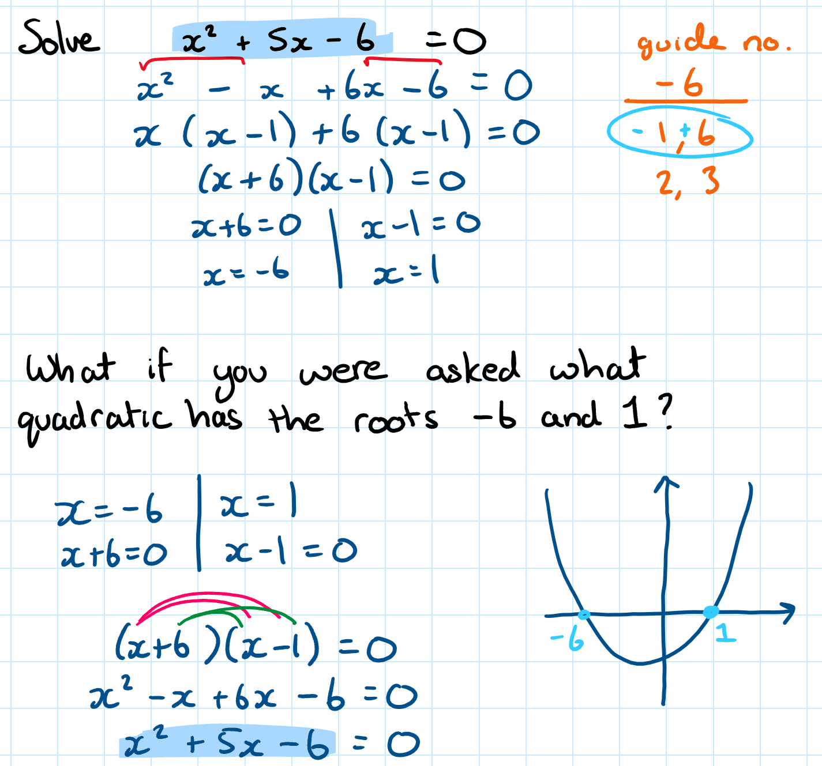
Teaching, learning and assessment
The Positives
High quality teacher instruction, pair and group work, and discovery approaches. Explanations and instructions were clear.
Consider the ‘why’ as well as the ‘what’
  Factorised quadratics, solved to find roots, and multiplied the factors to get back to the original.

Slide 13
Reflecting on teaching the 'Why?'
Algebraic Fractions
Pythagoras Theorem
Differentiation by First Principles
Surface Area
The Discriminant

Slide 14
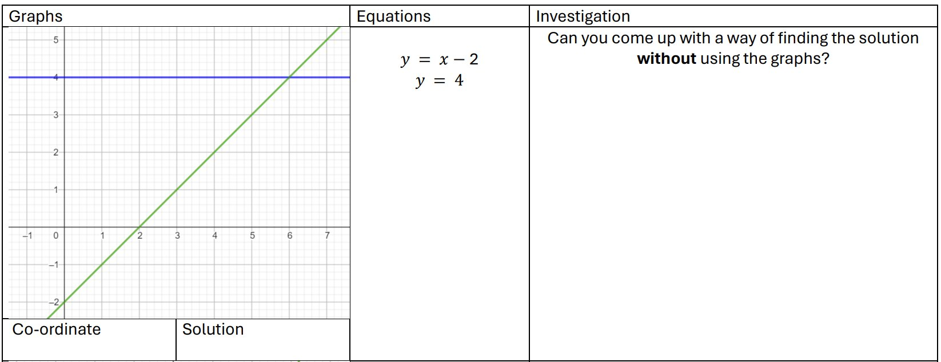
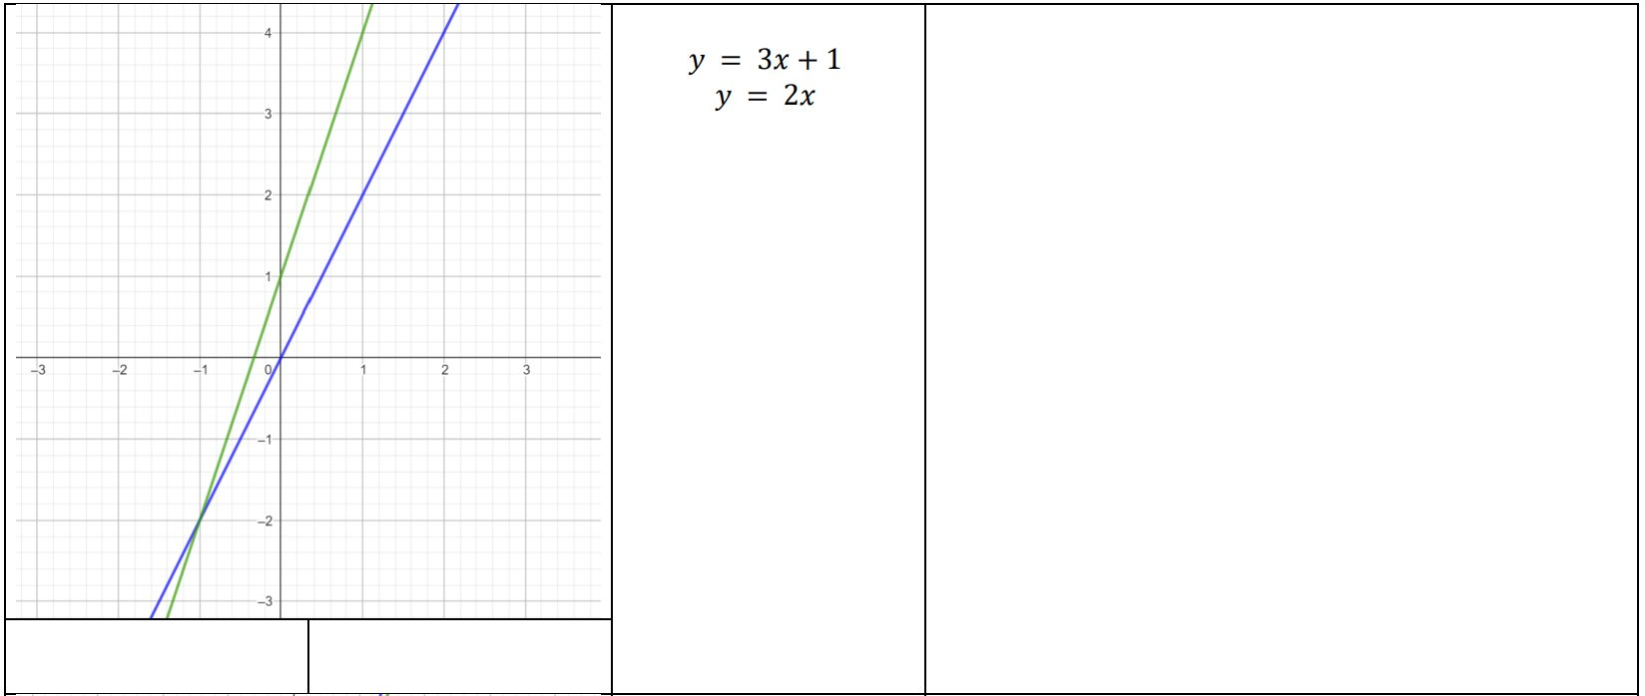
1. Teaching, learning and assessment
The Positives
Cross-topic linkages which facilitated the teaching of concepts in their appropriate contexts.
  E.g. Simultaneous equations were taught alongside graphing lines.

Slide 15
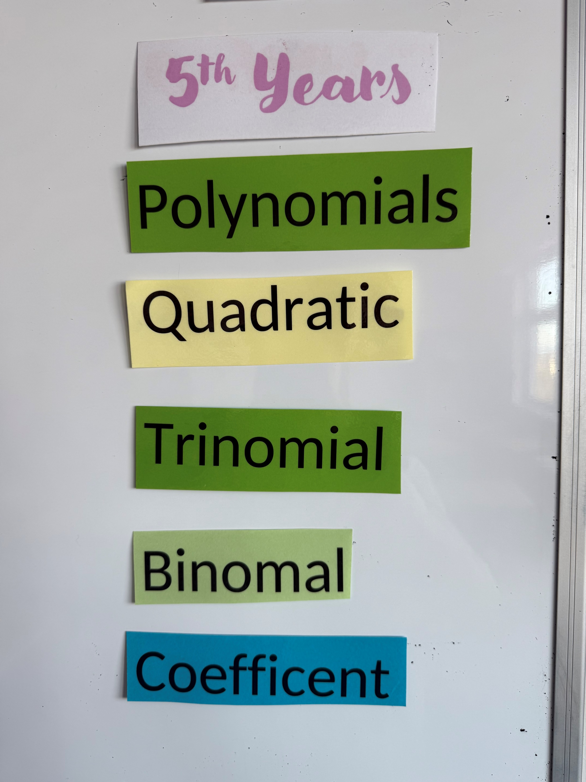
1. Teaching, learning and assessment
The Positives
Very high engagement noted when working in pairs, comparing answers, debating discrepancies, and when shown new material before it was explained.
Very good quality of assessment; questioning and mini-whiteboards.
Students who struggled were identified by teachers and supported.
Practices for giving and checking homework in most lessons were good.
Good attention to mathematical language and key words.

Slide 16
1. Teaching, learning and assessment
The Recommendations
Need for clearer focus on specific learning intentions and not moving on until sure that students fully understand each topic.
OneNote can slow the lesson dynamic and reduce teacher’s mobility around the room.
In minority of lessons, tasks were not linked sufficiently which contributed to a lack of student understanding.
Avoid global questioning.
In a significant minority of lessons, the correction of homework took up too much class time.
Additional challenge for the more-able students needed. E.g. Prove 1+1 = 2

Slide 17
1. Teaching, learning and assessment
The Students’ Feedback
Appreciated maths resources being available online, such as on OneNote
Valued teachers providing differentiated homework in a discreet manner
Favoured group work. Especially when the groups got different answers, and they had to work out why.
Mnemonics to help them remember important formulae were helpful
Valued when teachers provided them with learning intentions and success criteria
Preferred note-making as opposed to note-taking
View CBAs as a distraction to their day-to-day learning, teachers seemed stressed about them

Slide 18
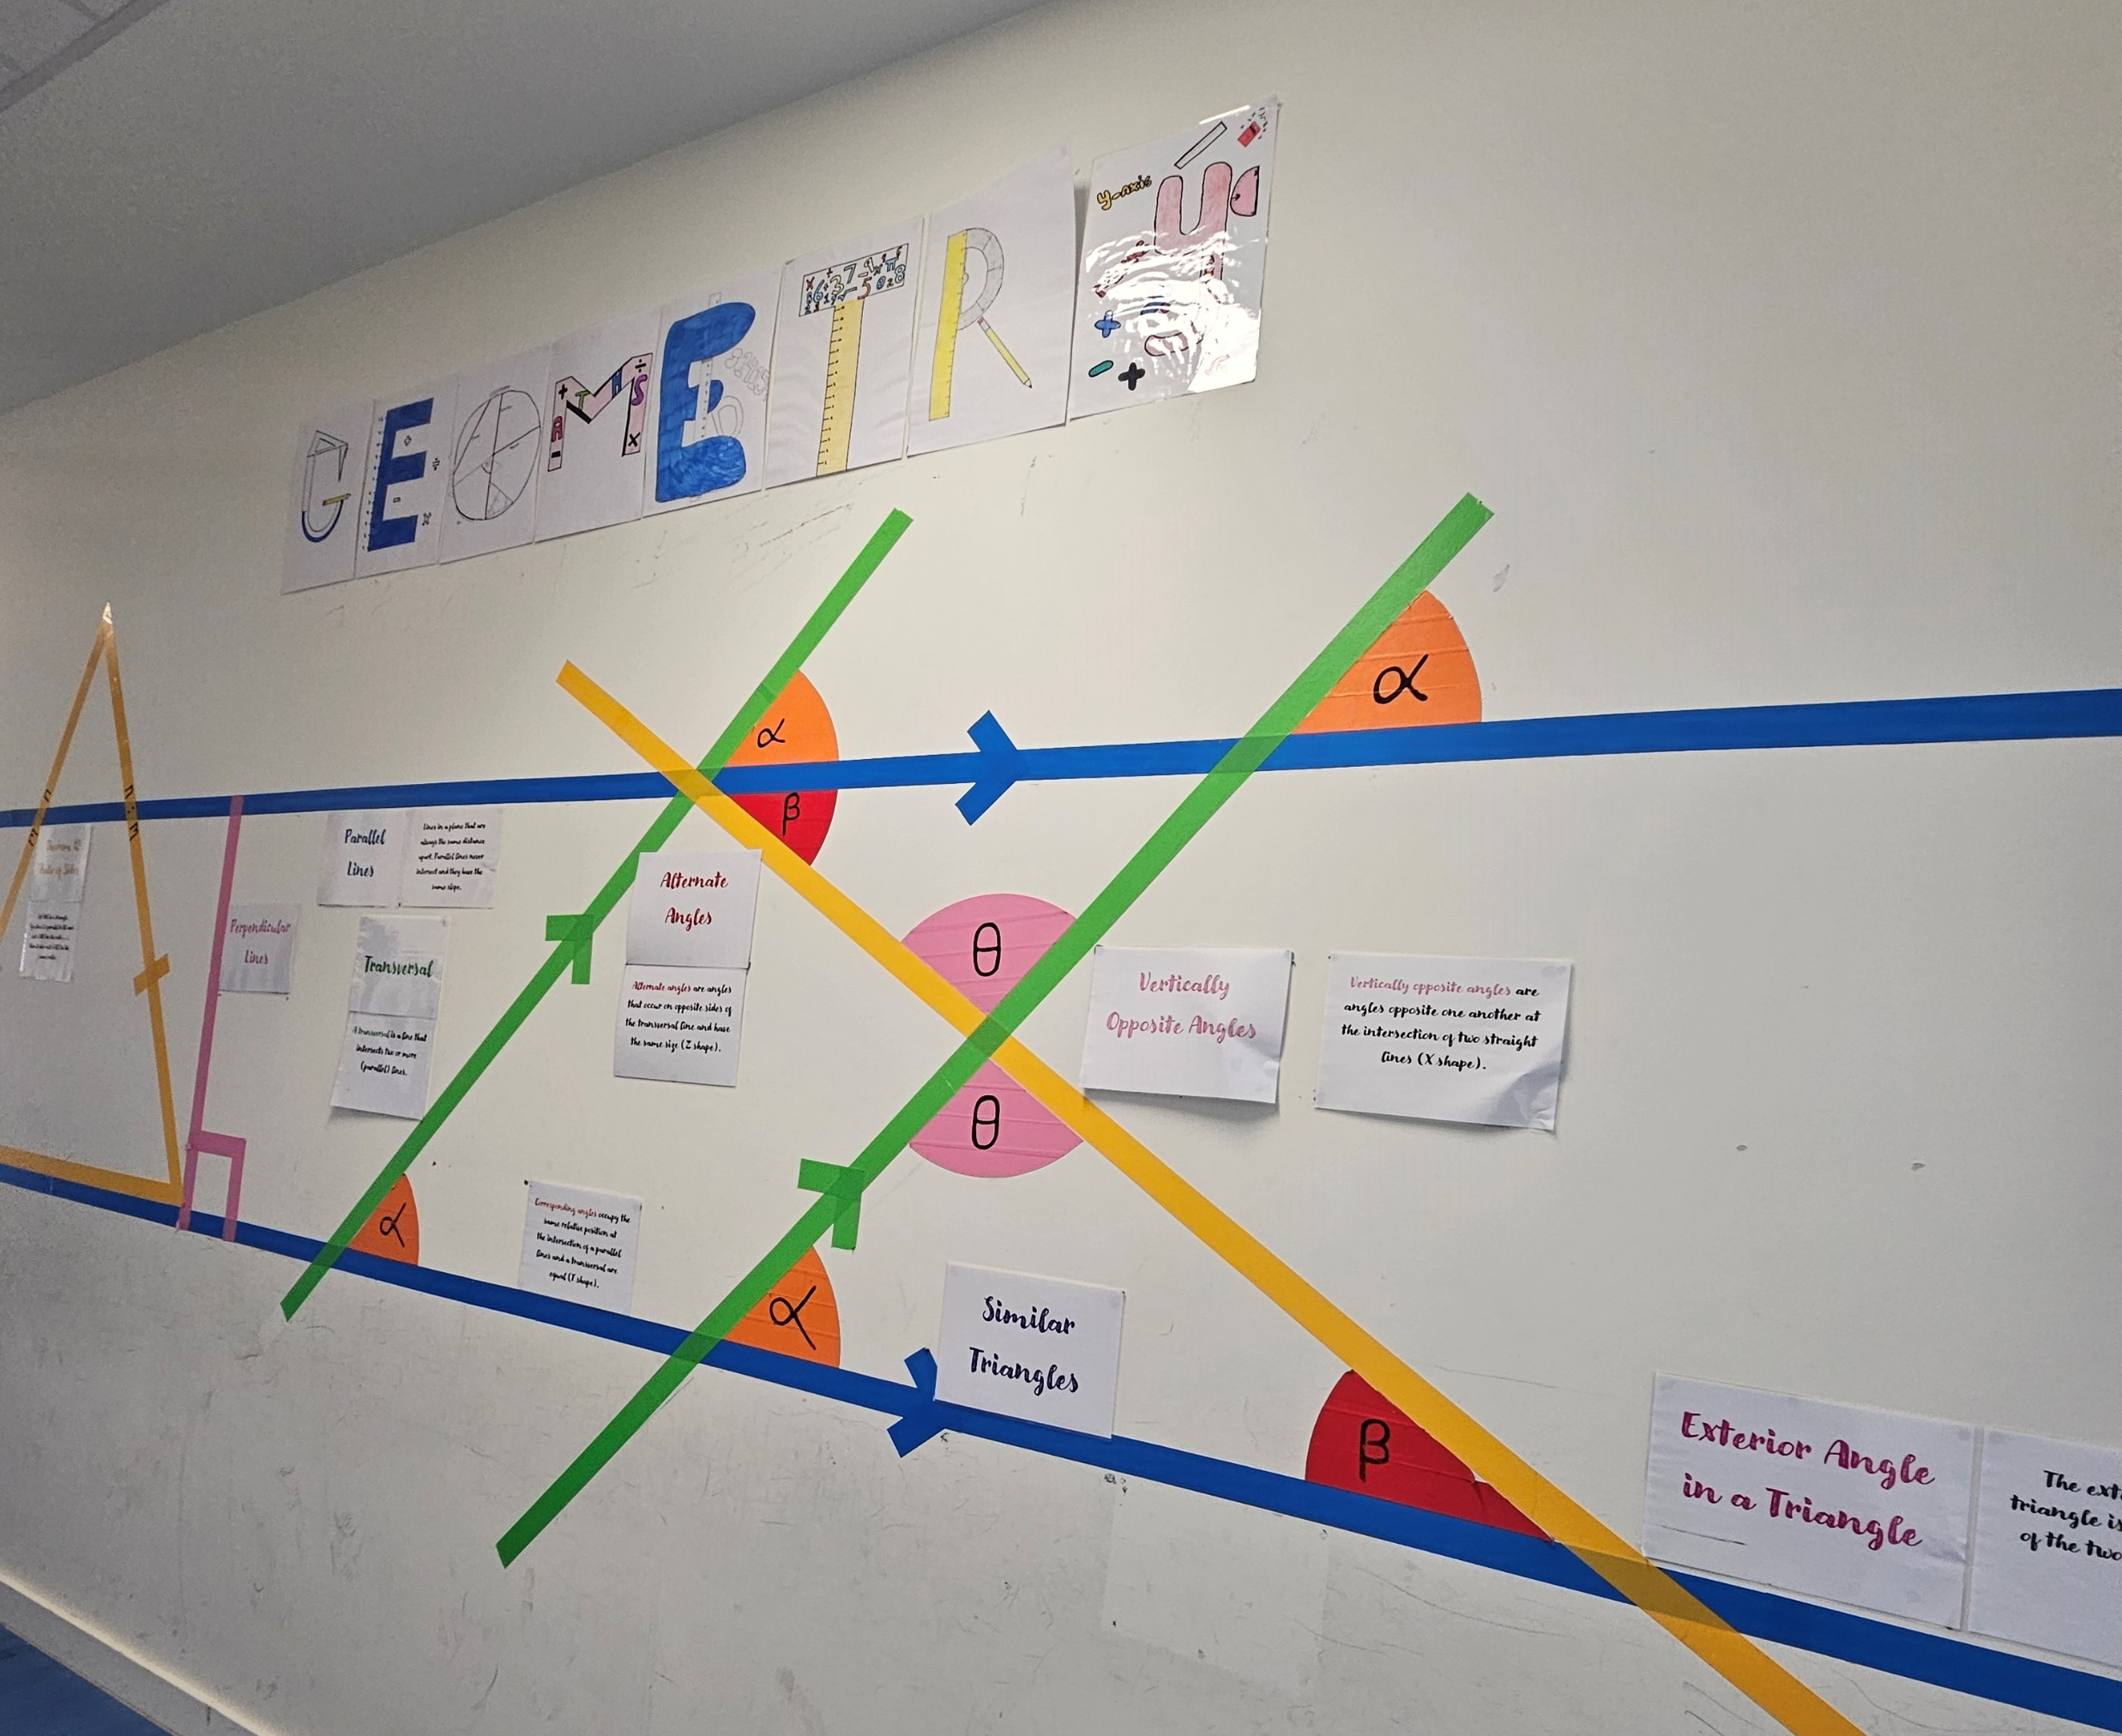
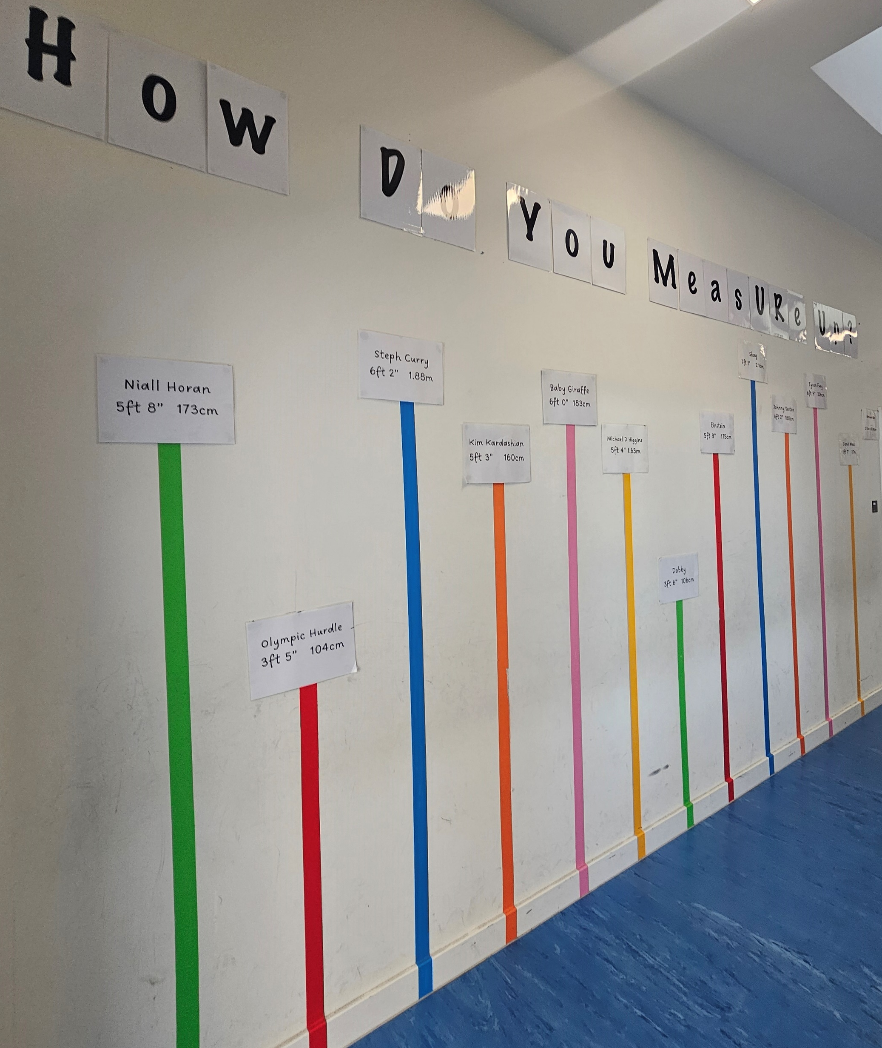
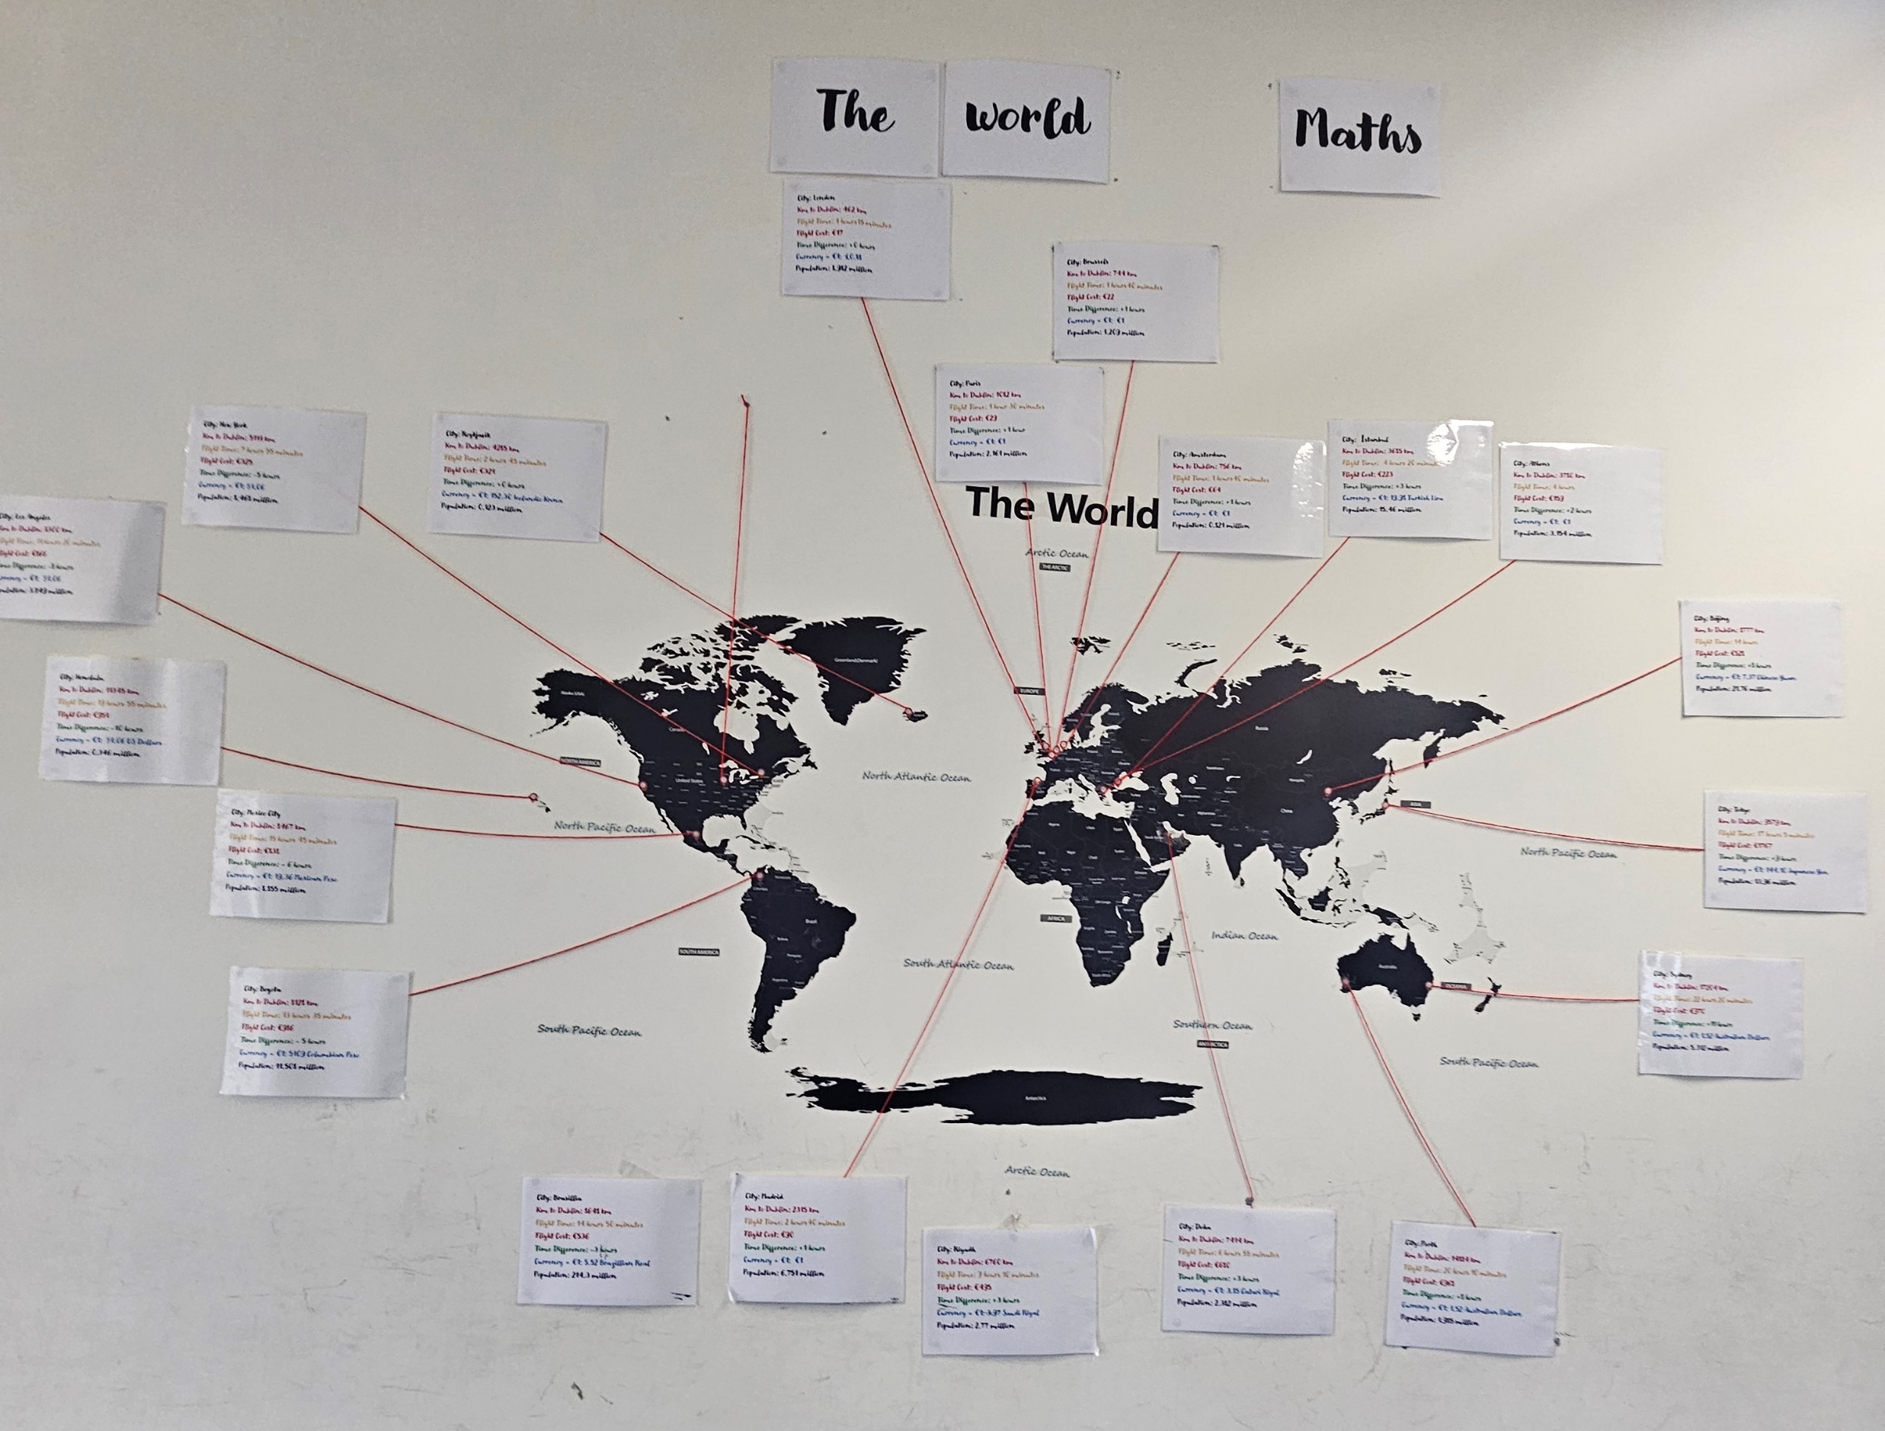
2. Subject provision and whole-school support
Subject provision and whole-school support for junior cycle Mathematics was very good. Timetable allocation to Mathematics was in line with the Junior Cycle Guidelines.
Mixed-ability groups for Mathematics is good practice.
Very good access to digital technology and general classroom resources.
The mathematics classrooms were along one corridor, which was designed as a very stimulating mathematics environment.
Notes:
Ciara

Slide 19
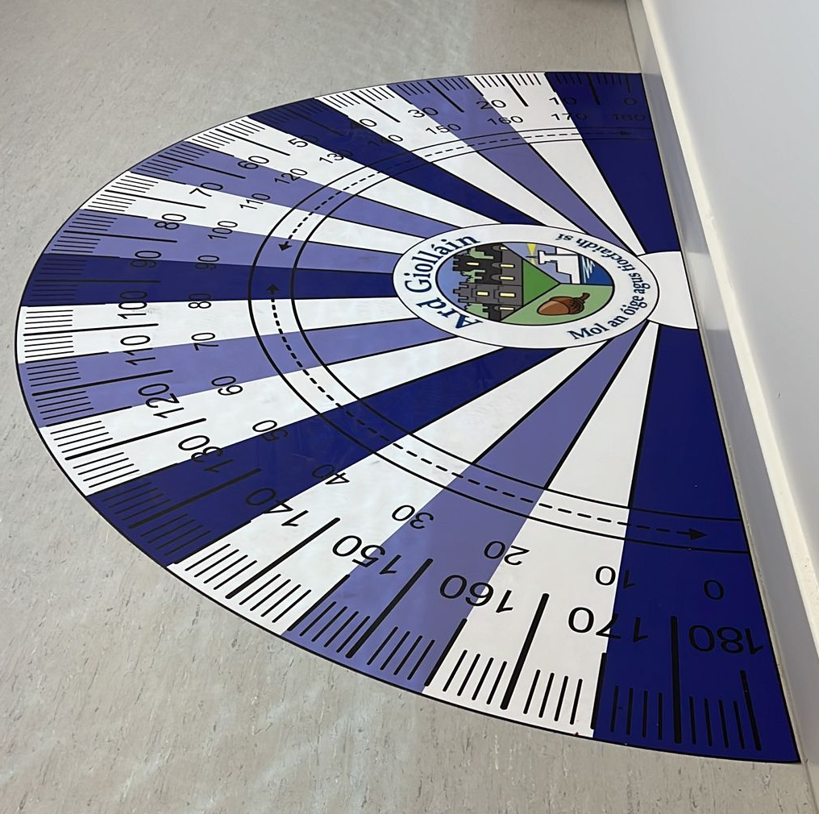
2. Subject provision and whole-school support
Provision for students experiencing difficulty with Mathematics was very good.
There was a very high level of collaboration and communication between the mathematics and special educational needs (SEN) departments.
Provision for students of the special classes was very good.

Slide 20
3. Planning and Preparation
The quality of planning and preparation for Mathematics was very good.
The members of the Mathematics department worked very well as a team and collaborated on planning for the subject.
The mathematics plan was designed around units of learning that took a cross-topic approach to learning and this is good practice.
The subject plan also included a section on school self-evaluation for Mathematics, which is good practice.
There were many opportunities provided by teachers to encourage students to experience Mathematics for fun.

Slide 21
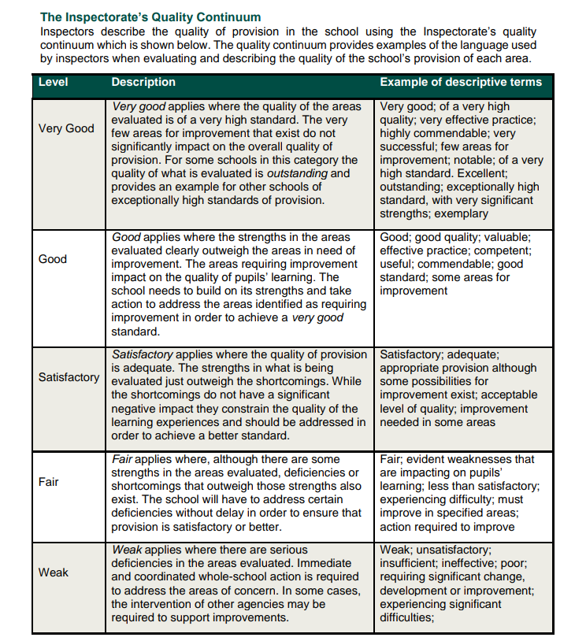
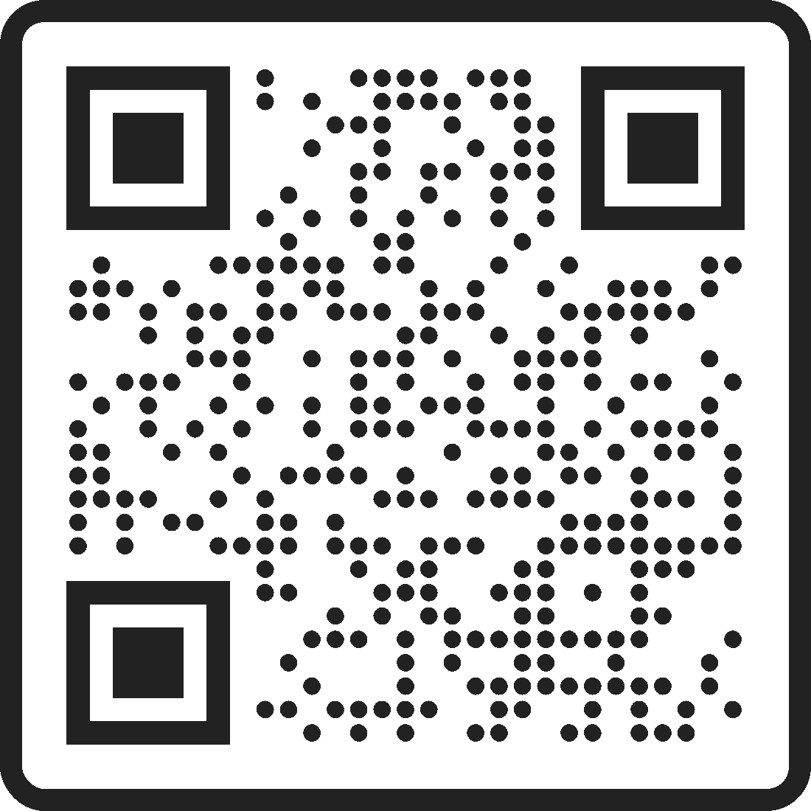
Quality Continuum
Notes:
Ciara

Slide 22
Recommendations
Teaching approaches which facilitate thorough exploration of the Mathematics taught should be further used in lessons
“The Maths Classroom as a Workshop”
Example: Roots to Quadratics

Slide 23
Recommendations
Ensure that the connections between the activities are clear,
and
that students understand each concept before moving on to the next element of the lesson.
Notes:
Caoimhe

Slide 24

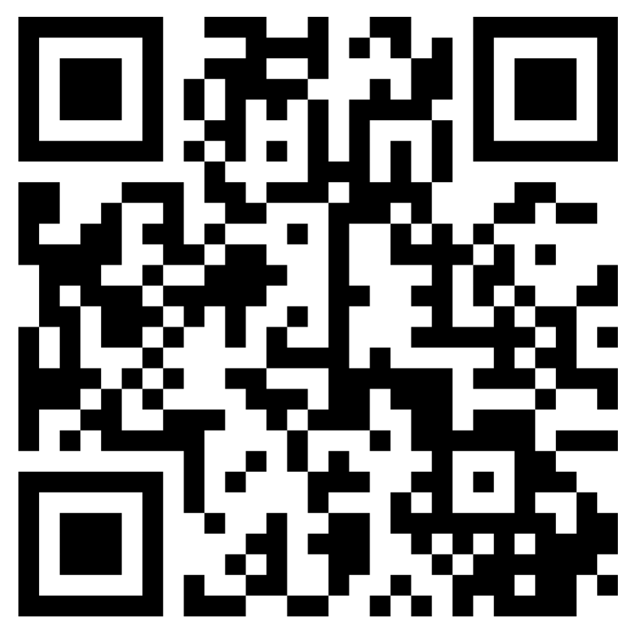
Recommendations
Most teachers used a wide range of effective assessment approaches to ensure that students understood the concepts taught. These valuable strategies should be further used throughout the mathematics department.
Teachers used questioning very well to assess and involve students.

Slide 25

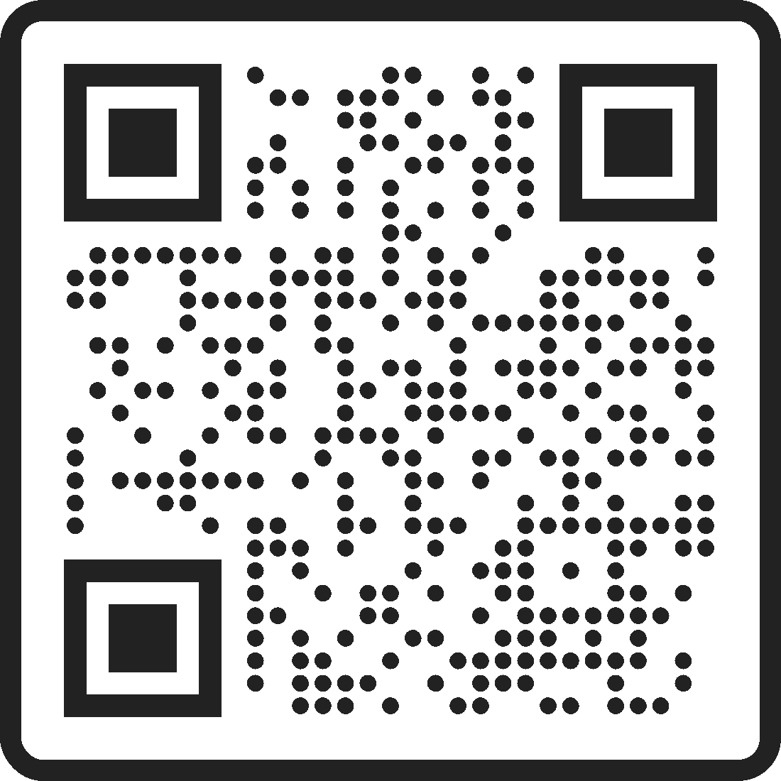
Guide to Inspections

Slide 26
Any Questions?

