Slide 1

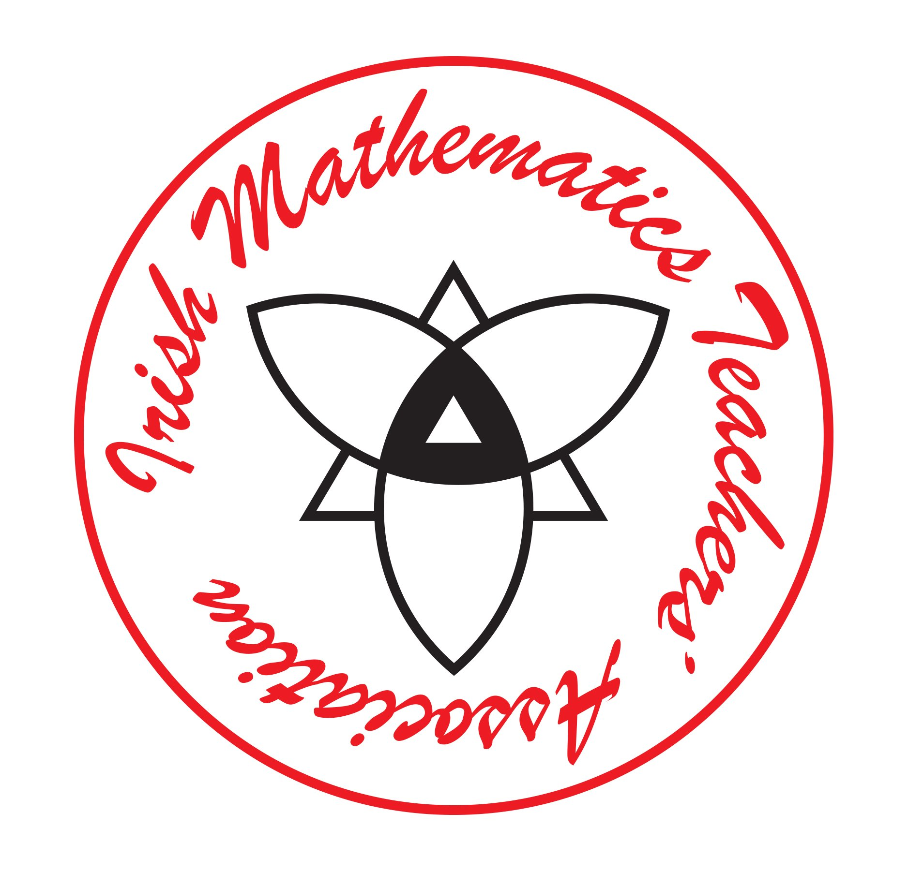


Open Tasks in Mathematics: Fostering Thinking and Problem- Solving Skills.
Aidan Roche

Slide 2

Defining Open Questions in Maths
Questions with multiple approaches or answers
Examples:
What numbers add to 10?
How can you represent 1/2 in different ways?
Comparison: Closed questions vs. open questions

Slide 3
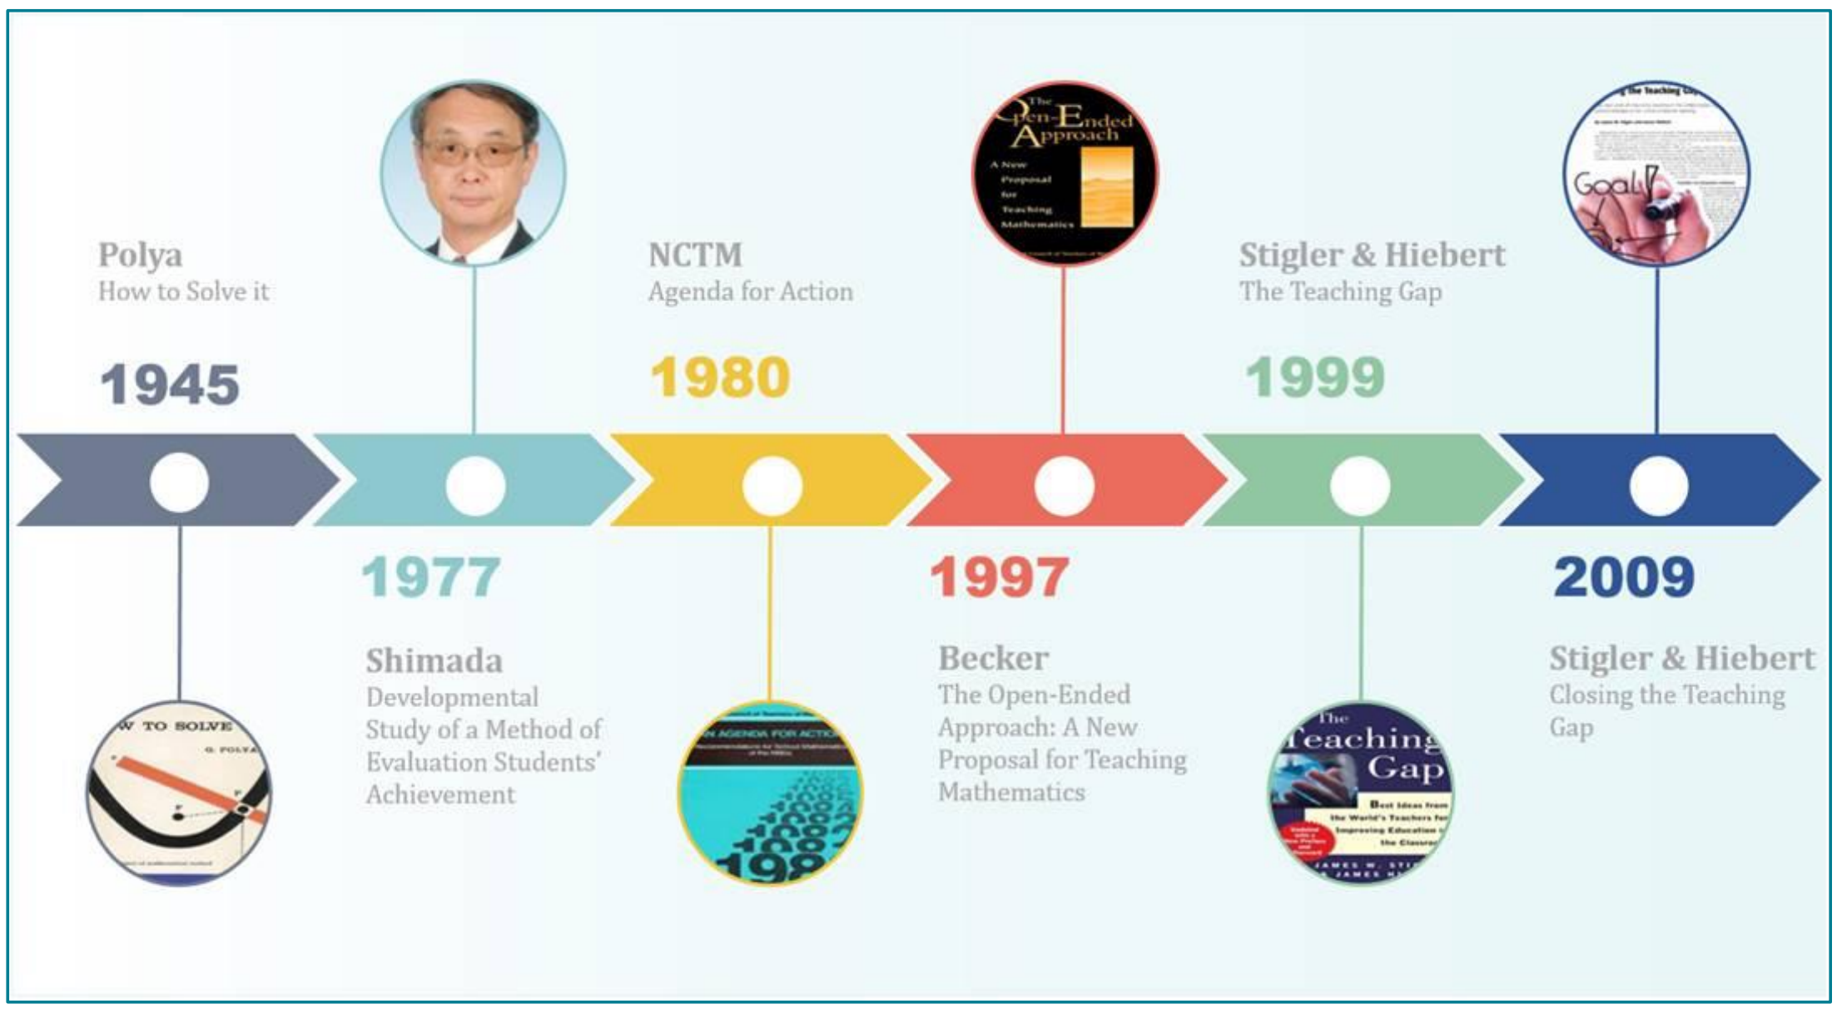
Open tasks play a crucial role in supporting problem-solving skills in mathematics by fostering creativity, deep thinking, and a more profound understanding of mathematical concepts. In Japanese maths classrooms open ended tasks are extensively used (Becker & Shimada, 1997; Stigler & Hiebert, 1999, 2009).
Notes:
Incorporating open tasks into math instruction can significantly enhance students' problem-solving skills, encouraging them to think critically, explore different approaches, and develop a deeper understanding of mathematical concepts.

Slide 4
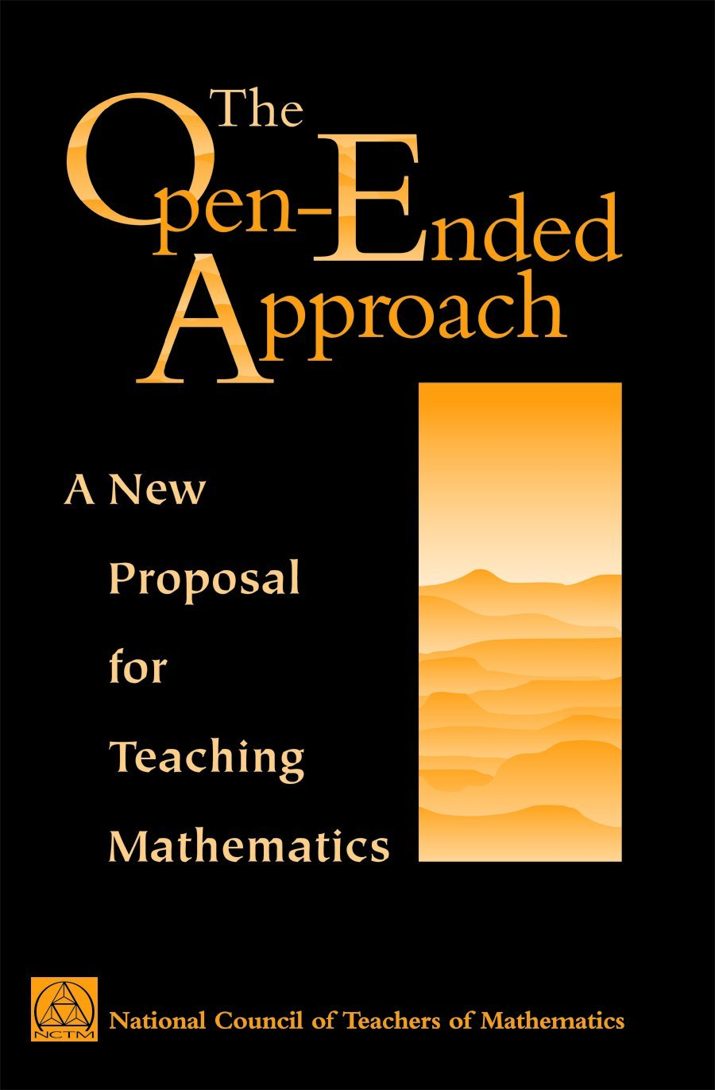
"The Open-Ended Approach: A New Proposal for Teaching Mathematics" is a seminal work edited by Jerry P. Becker and Shigeru Shimada, published in 1997 by the National Council of Teachers of Mathematics (NCTM). This book introduces the open-ended approach to mathematics education, a method that encourages students to explore multiple solutions to problems, thereby fostering higher-order thinking and problem-solving skills.
Notes:
Outline of the Book:
The Significance of an Open-Ended Approach: This chapter discusses the importance of incorporating open-ended problems in mathematics education to enhance students' analytical and creative abilities.
An Example of Lesson Plan Development: Provides a detailed example of how to develop a lesson plan using the open-ended approach, illustrating the practical application of the method.
Developing Lesson Plans: Offers guidance on creating lesson plans that integrate open-ended problems, emphasizing flexibility and adaptability in teaching strategies.
Examples of Teaching in Elementary Schools: Presents case studies and examples of implementing the open-ended approach in elementary school settings, highlighting its effectiveness in early education.
Examples of Teaching in the Lower Secondary Schools: Explores the application of open-ended problems in lower secondary education, demonstrating how this approach can be adapted for older students.
Examples of Teaching in the Upper Secondary Schools: Discusses the use of the open-ended approach in upper secondary schools, providing examples of complex problem-solving scenarios suitable for advanced students.
Round-Table Discussions to Review the Project: Concludes with discussions and reflections on the implementation of the open-ended approach, offering insights and recommendations for educators.

Slide 5
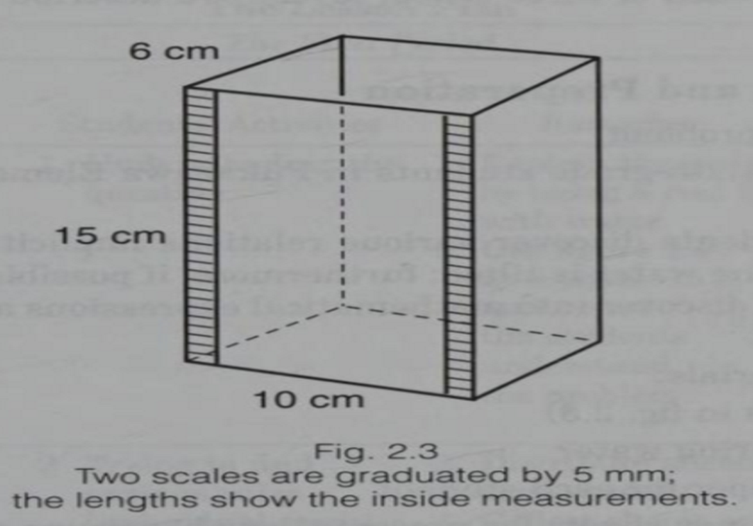
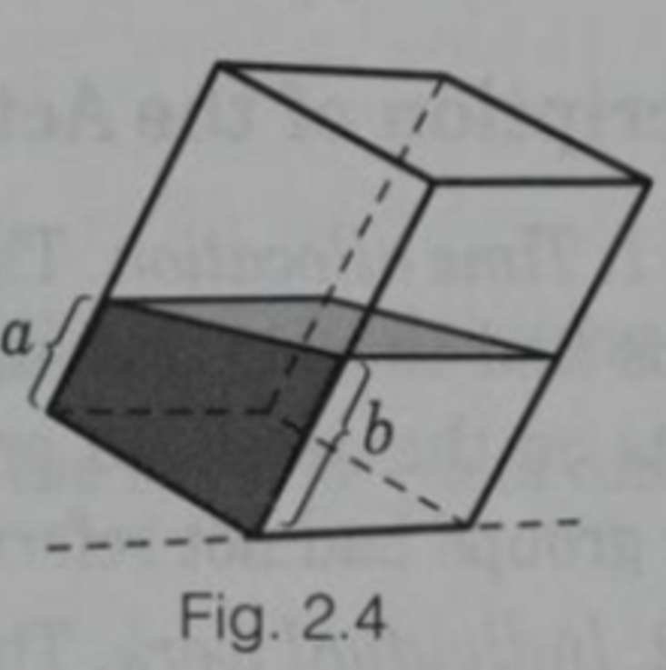
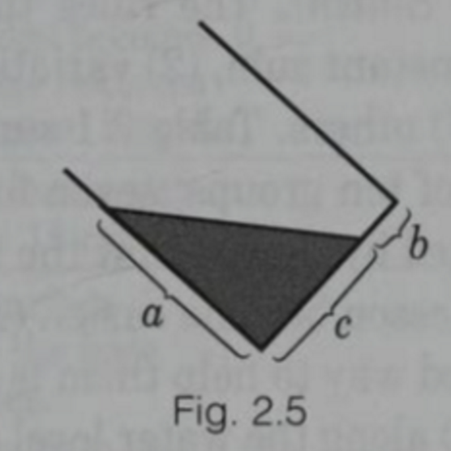

Slide 6
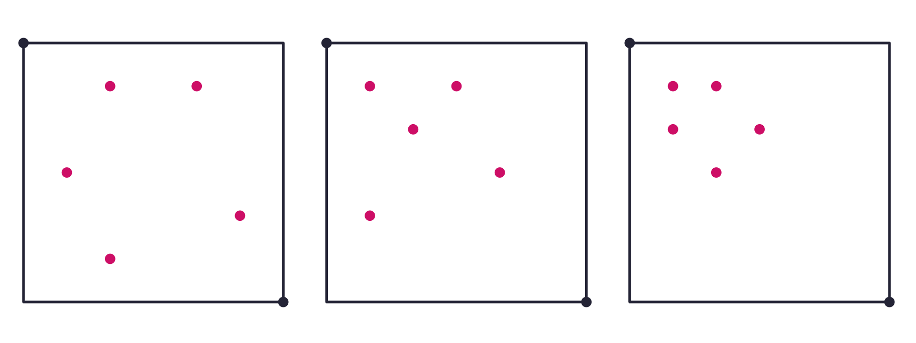
https://polypad.amplify.com/p/fv7zhEAsIFSOzA

Slide 7
Which is the odd one out: 2, 3, 6, 9?
"Teaching and Evaluating 'Open-Ended' Problems" by Klavir and Hershkovitz (2008)

Slide 8
Why Use Open Questions?
Encourage critical thinking and problem-solving
Promote discussion and collaborative learning
Cater to diverse skill levels and learning styles
Encourages exploration of mathematical concepts
Builds confidence in problem-solving
Enhances communication and reasoning skills
Engages all learners, from beginners to advanced
Notes:
Open tasks support student problem solving skills. Here are examples of how open tasks help students develop their problem-solving skills: Student Thinking: Open tasks typically have multiple entry points, allowing students to approach the problem from different angles. This encourages students to think creatively and consider several ways to tackle the problem, which is an essential aspect of effective problem solving. Open tasks require students to analyze the problem, identify patterns, connections, and relationships, and make informed decisions about which strategies to use. This process enhances their critical thinking and spatial thinking skills as they evaluate different options and consider the best approach. Open tasks promote higher-order thinking skills, such as analysis, synthesis, and evaluation. Students need to synthesize information, make connections between different concepts, and evaluate the validity of their solutions. Flexibility and Adaptability: Since open tasks do not have a single prescribed solution path, students need to be flexible and adaptable in their problem-solving strategies. They may need to adjust their approach based on the information they uncover as they work through the problem. Collaboration and Communication: Open tasks frequently encourage students to collaborate and share their approaches, strategies, and findings. Collaborative problem solving improves communication skills and exposes students to new perspectives and solutions. Engagement and Motivation: In comparison to routine exercises, open tasks are more engaging and motivating for students. The tasks' open-ended nature piques students' curiosity and encourages them to put in more effort and time investigating potential solutions. Deeper Understanding: Students gain a deeper understanding of the underlying mathematical concepts and principles as they work on open tasks. They gain insights into why certain strategies work and others do not, resulting in a more comprehensive understanding of the subject. Problem Definition: Students are frequently required to clarify the problem statement, define relevant variables, and consider the scope of the problem in open tasks. This problem-solving practice can help them approach several types of mathematical challenges more effectively. Real World Connection: Frequently open tasks are designed to simulate real-world problems, making mathematical concepts more relatable and applicable. This connection to real-life situations can motivate students to solve the problem and help them see the practical value of mathematics. Productive Disposition: Open tasks may be more difficult and require sustained effort to complete. This experience fosters qualities such as perseverance, resilience, and a willingness to work through difficulties—all of which are important in problem solving.

Slide 9
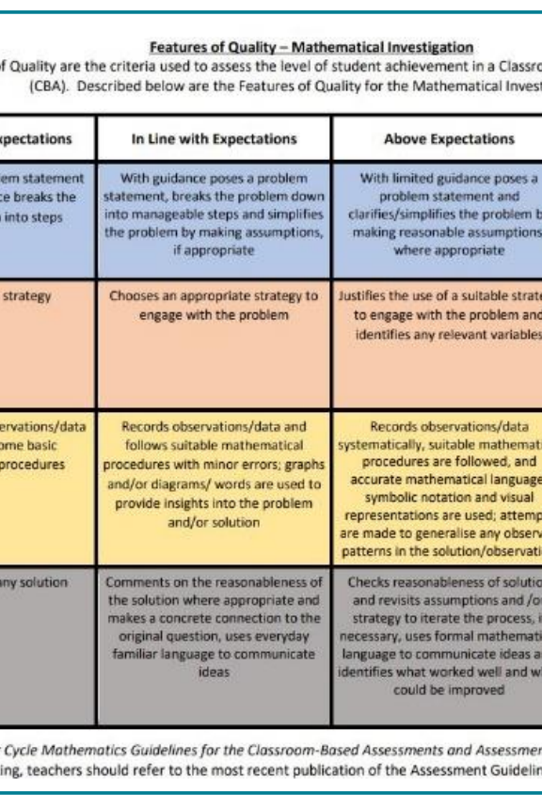
CBA 1
The NCCA recommends the use of rich task-based learning experiences in preparing students for Classroom Based Assessment (CBA) 1 - Mathematical Investigation. CBA 1 provides an opportunity for teachers to engage students in open-ended problem-solving tasks. The CBA 1 Features of Quality (below) make it explicit that students should use multiple representations and schematic representations in their Mathematical Investigations (JCT, 2019)

Slide 10
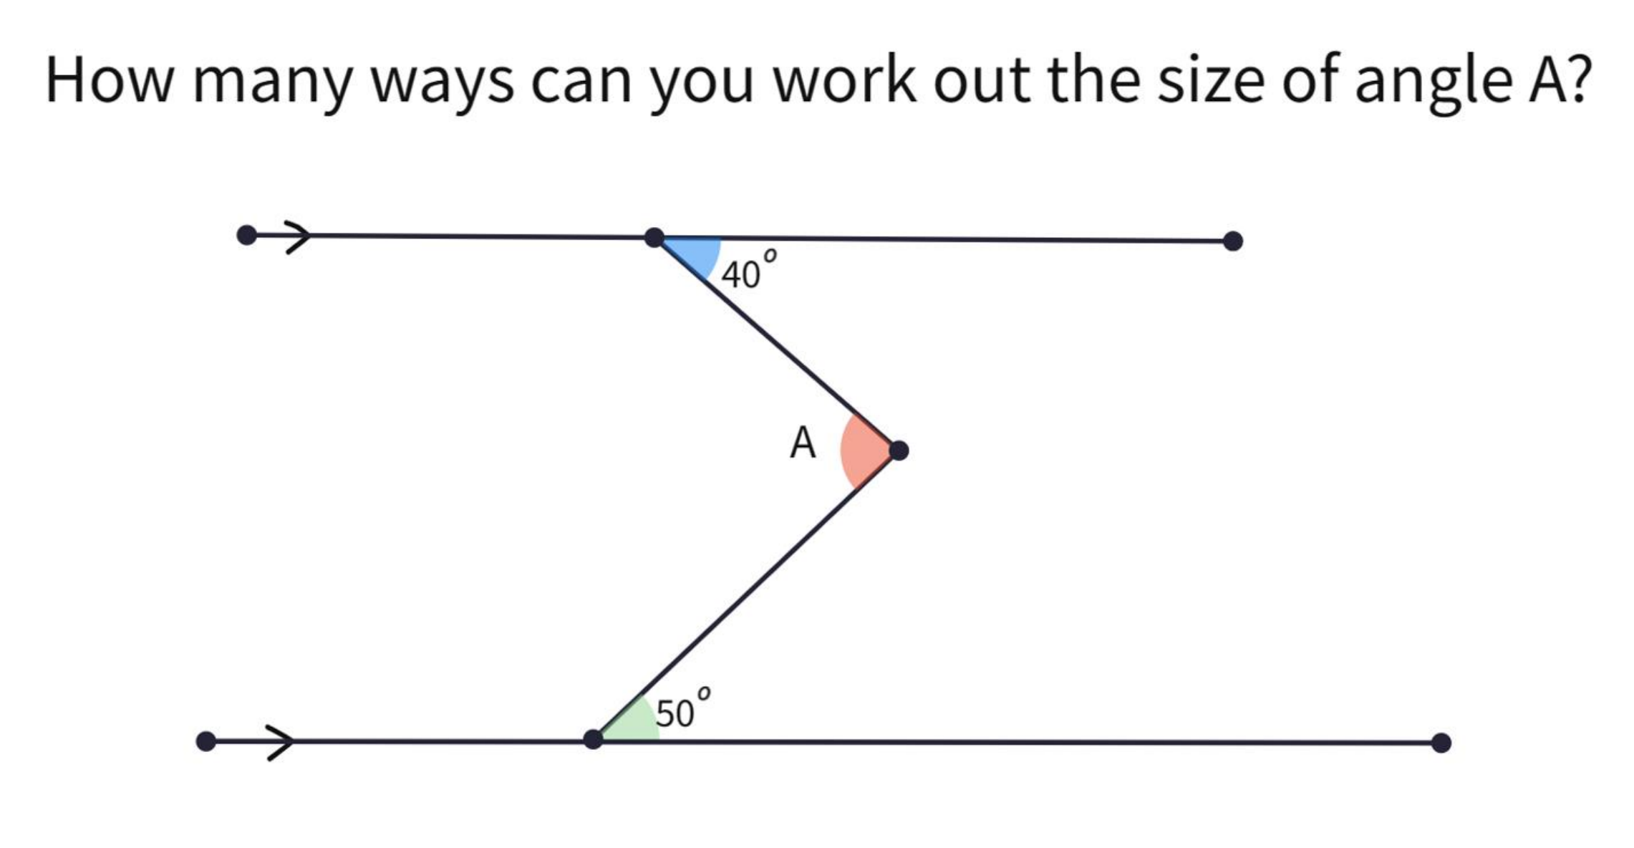

Slide 11
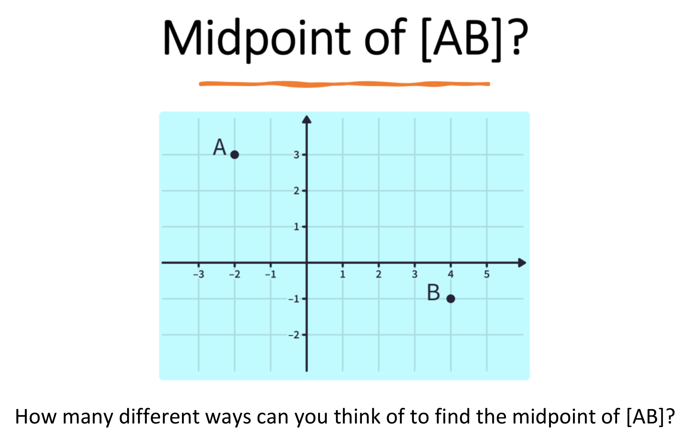

Slide 12
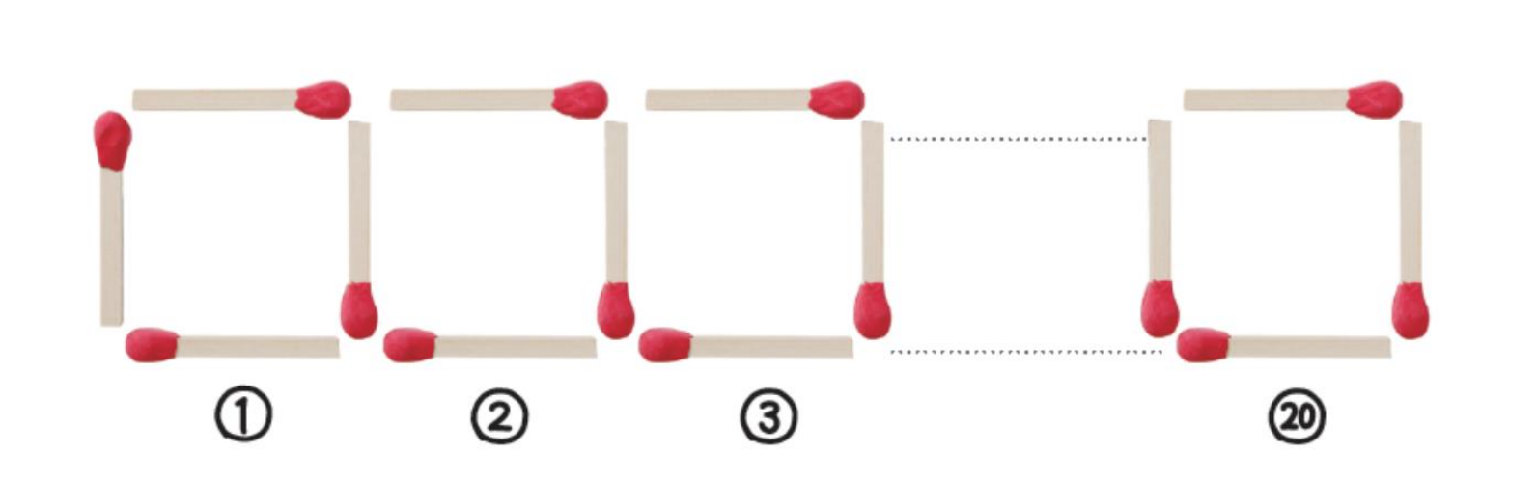

Slide 13
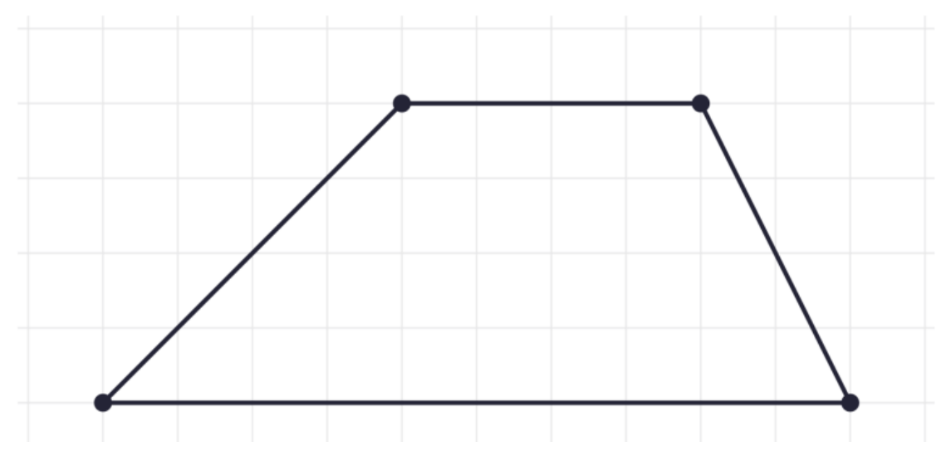

Slide 14
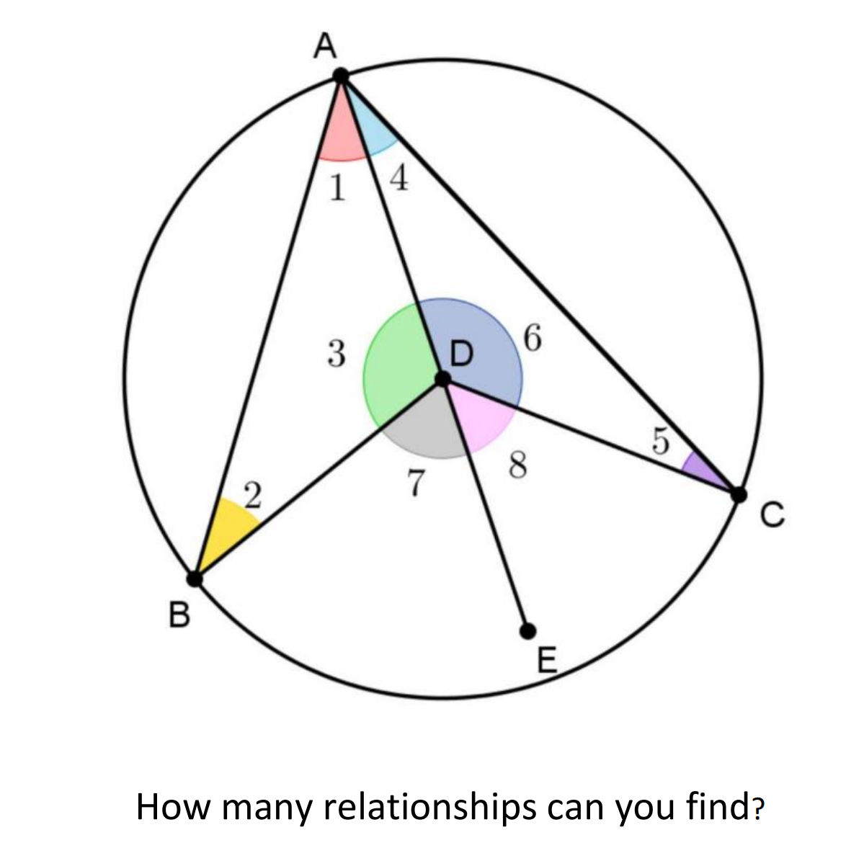

Slide 15
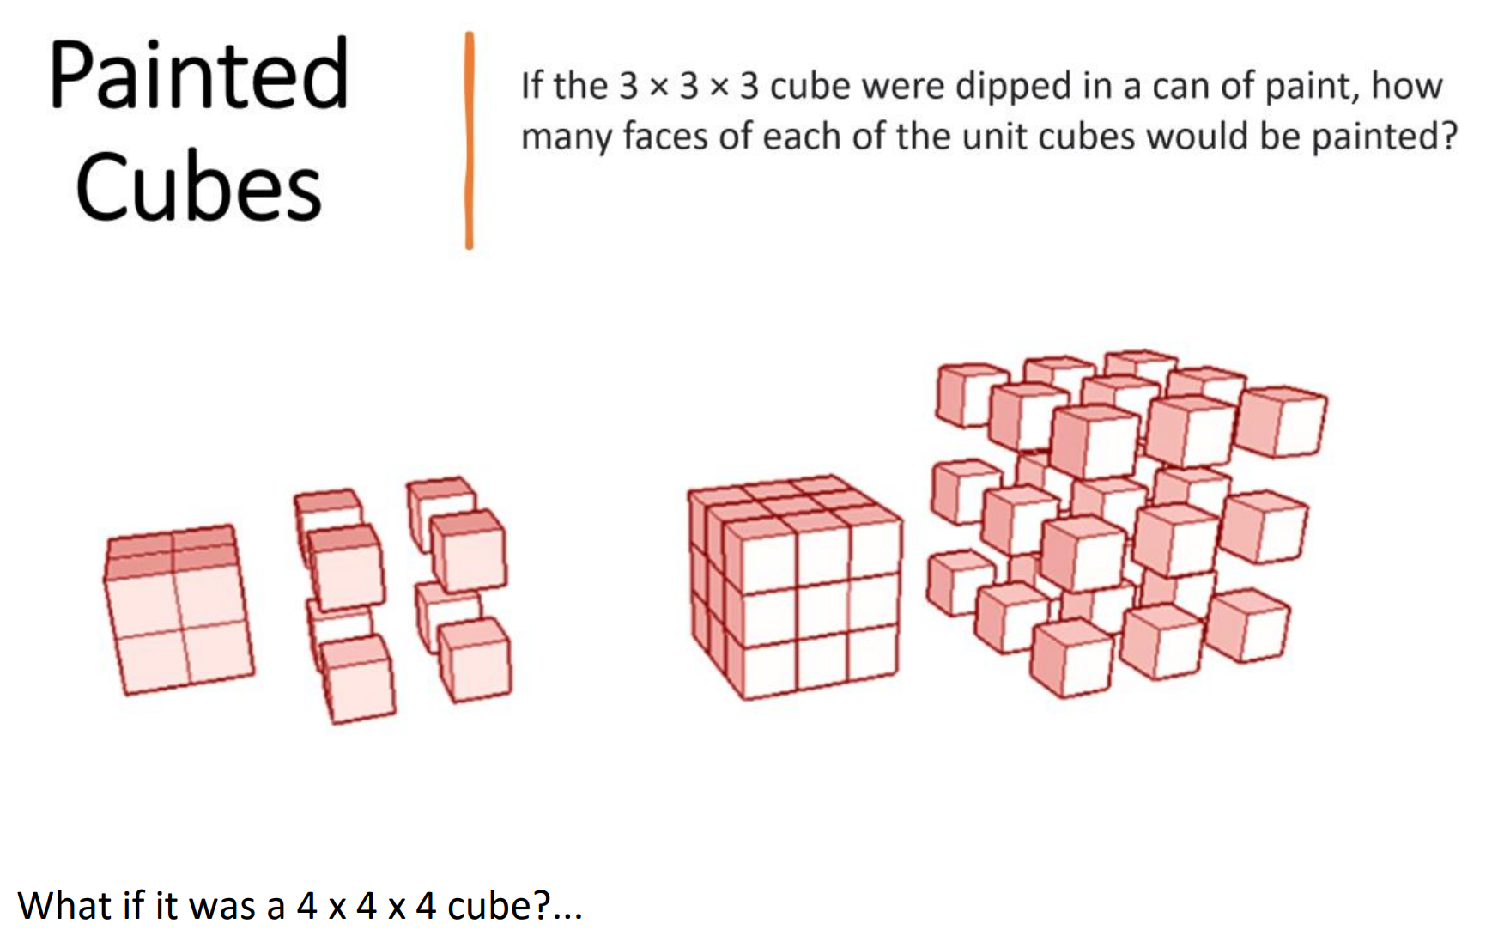

Slide 16
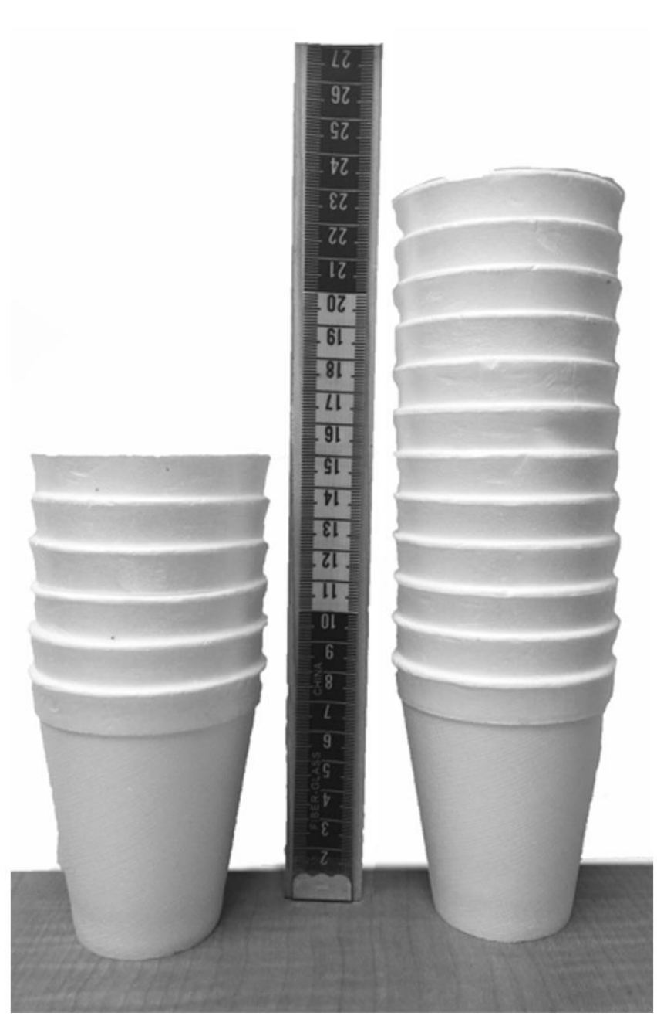

Slide 17
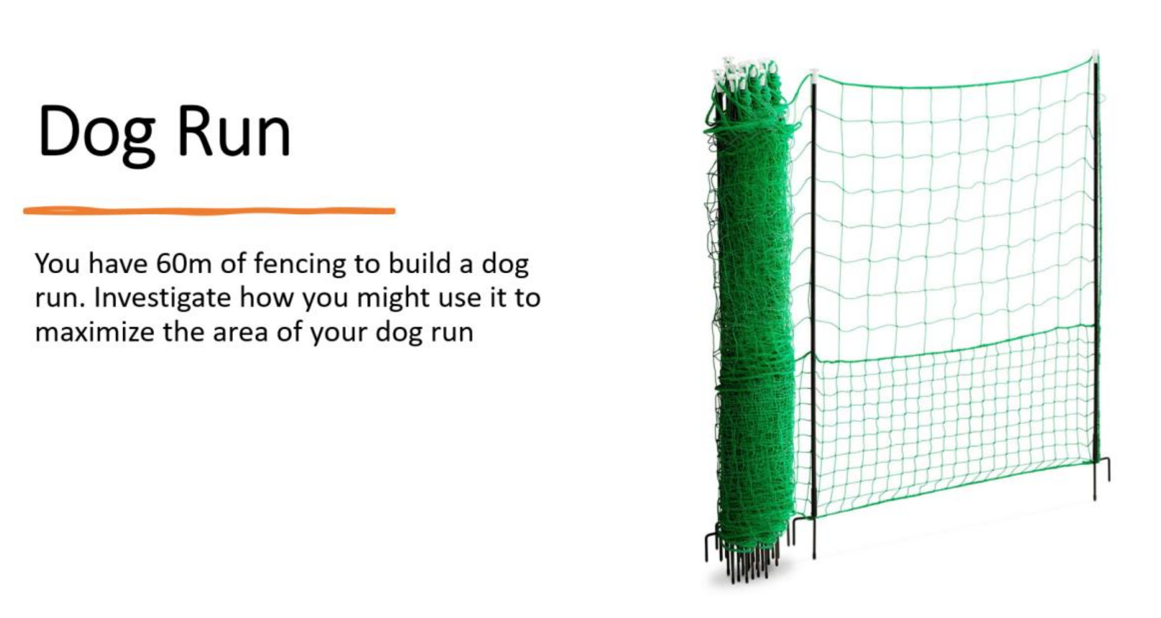

Slide 18
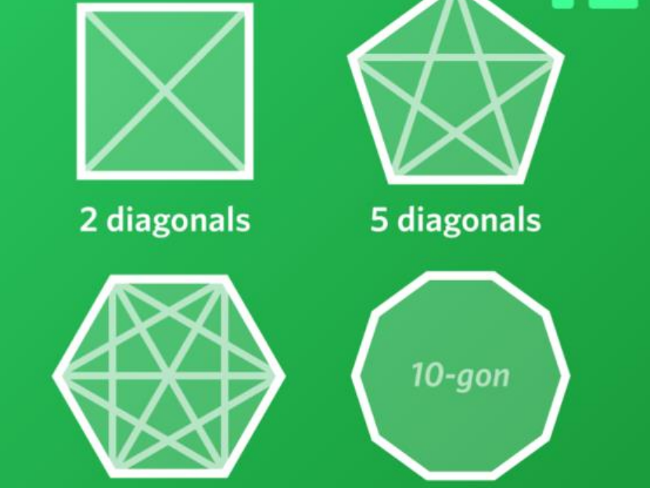

Slide 19
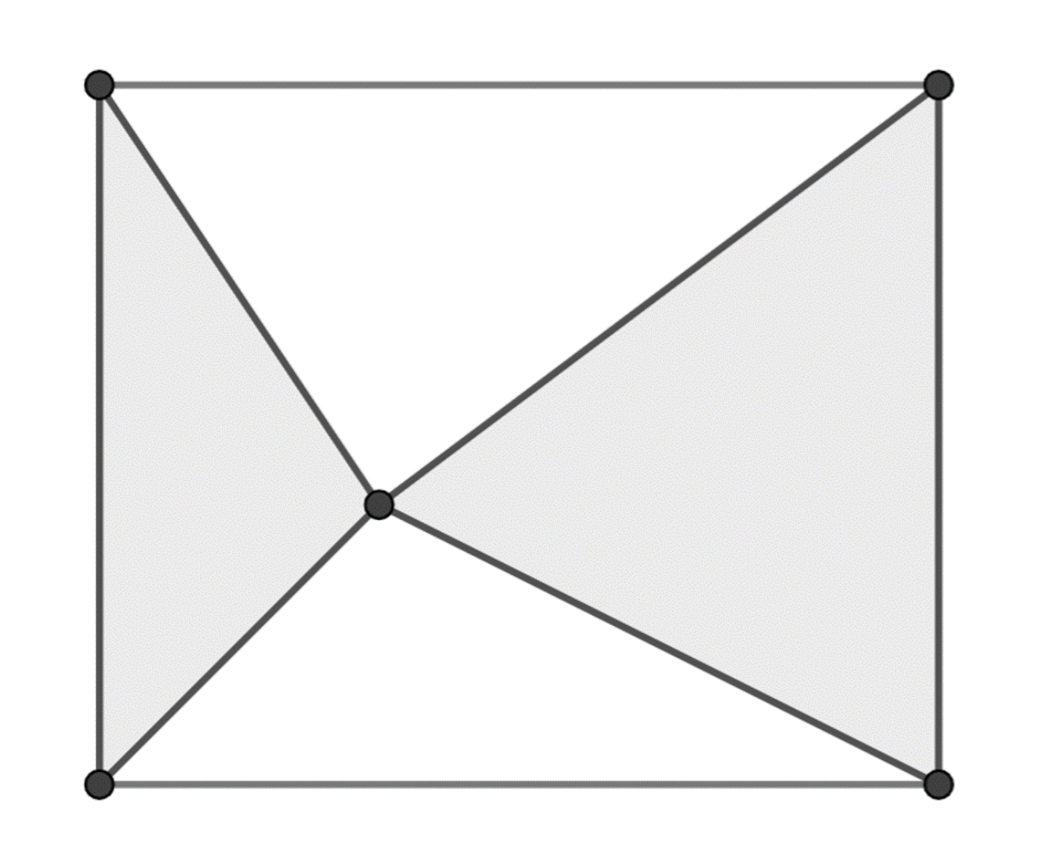

Slide 20
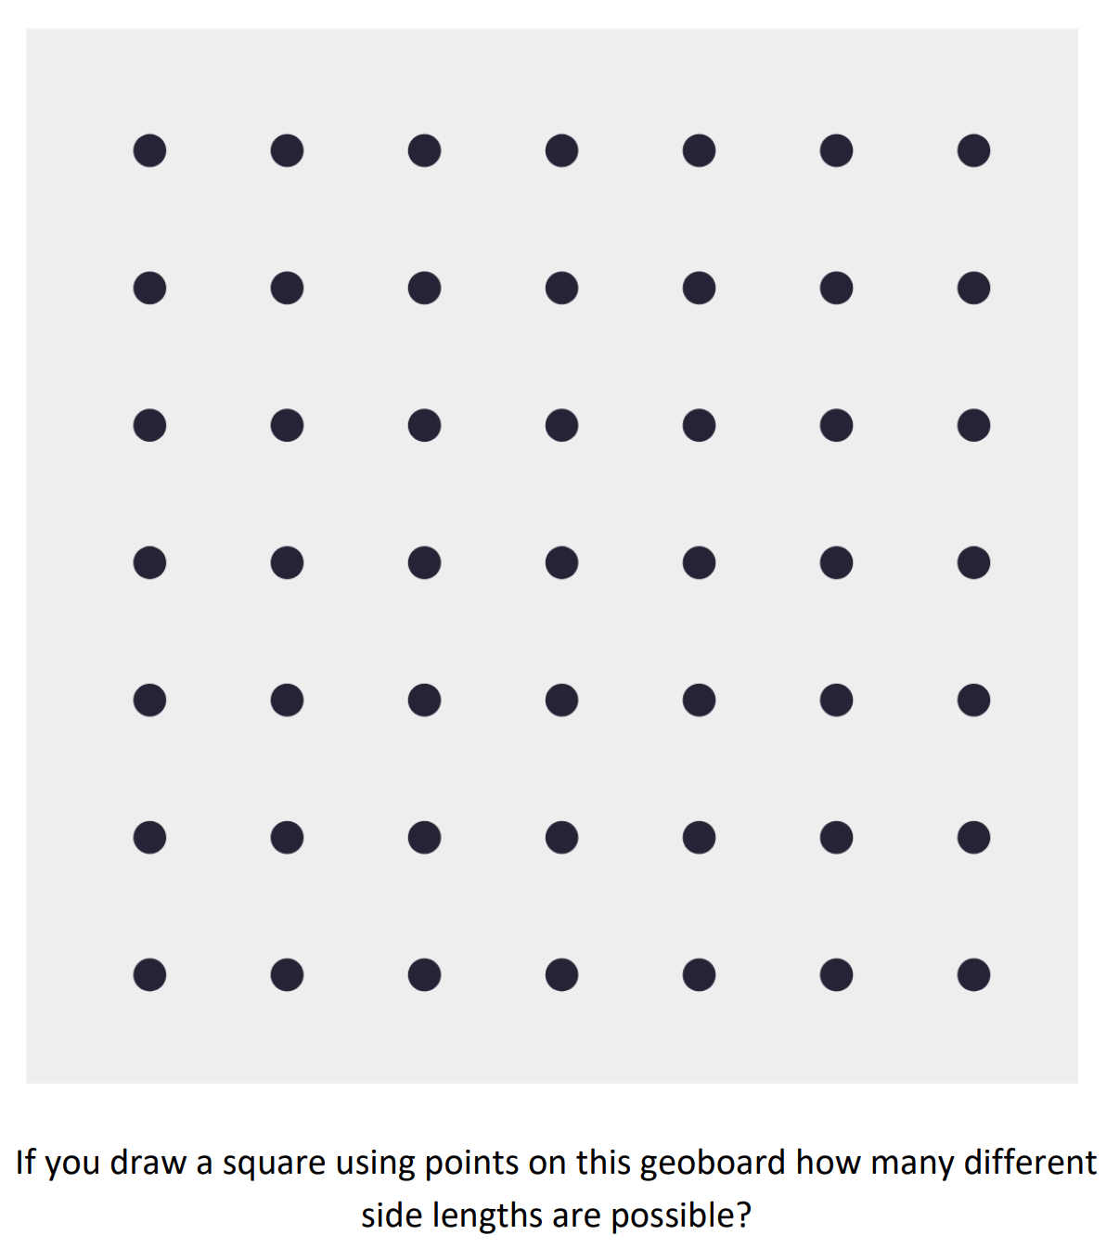

Slide 21
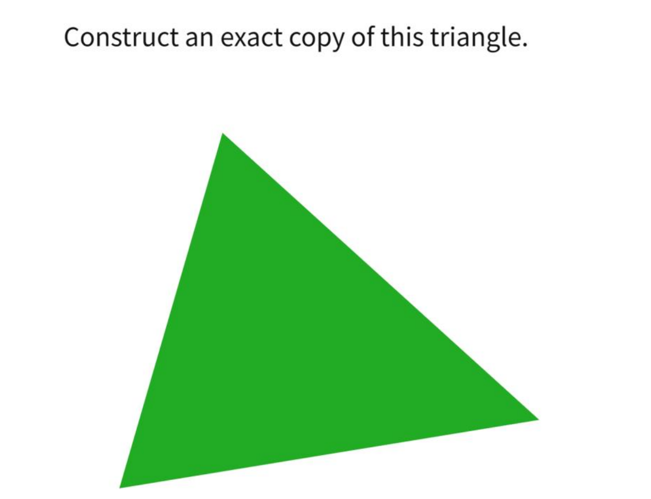

Slide 22
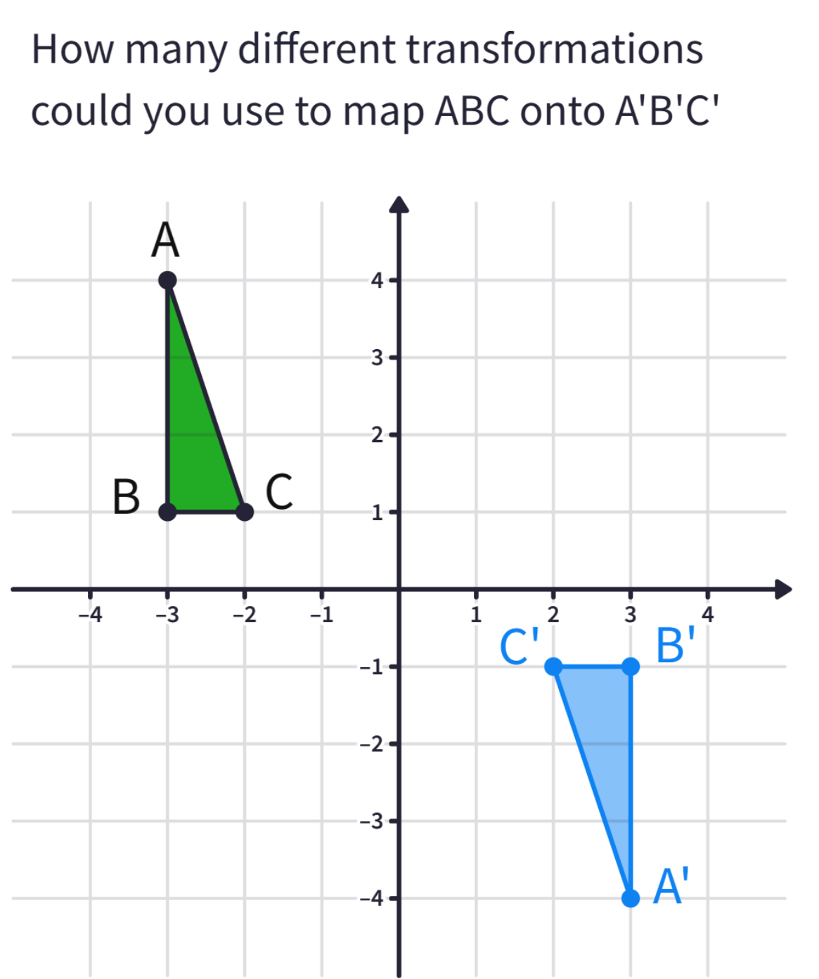
Transformations

Slide 23
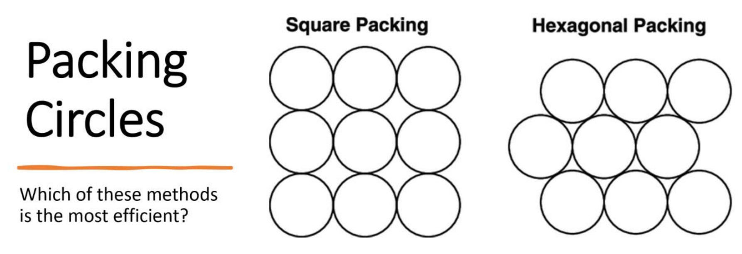

Slide 24
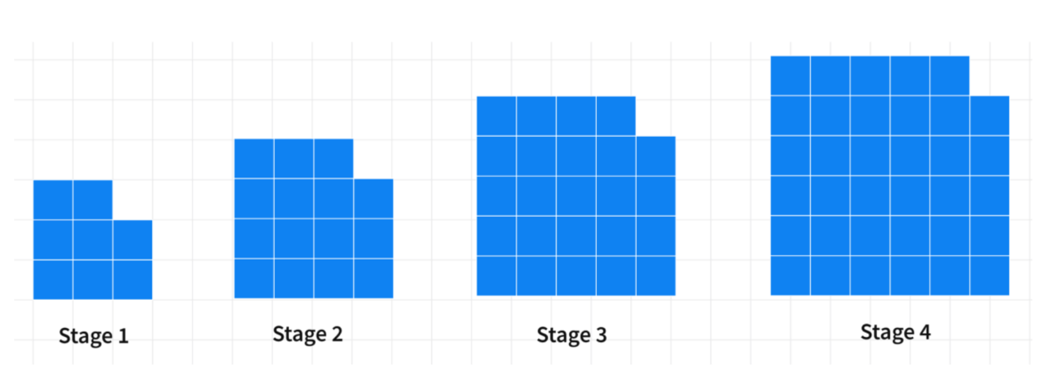
https://polypad.amplify.com/p/XVcULGKkkQj3A

Slide 25

Practical Ideas
In how many ways… Is there another way?
Group work: Solve an open-ended problem collaboratively
'What if' scenarios: Modify a problem and explore results
Real-world contexts: E.g., What shapes can you design for a park?

Slide 26

Overcoming Barriers
Challenge: Students are reluctant to engage. Solution: Start with simpler open-ended tasks
Challenge: Time management. Solution: Use strategically during lessons
Challenge: Assessing open-question responses. Solution: Focus on reasoning over correctness

Slide 27
Supporting Materials
Online resources with open-question banks
Tools for creating dynamic questions: GeoGebra, Desmos
Professional development workshops

Slide 28
Questions?

