Slide 1

Supporting teachers to engage with Structured Problem Solving in their Junior Cycle classrooms
Róisín Neururer
School of Mathematics & Statistics
^{University College Dublin}

Slide 2



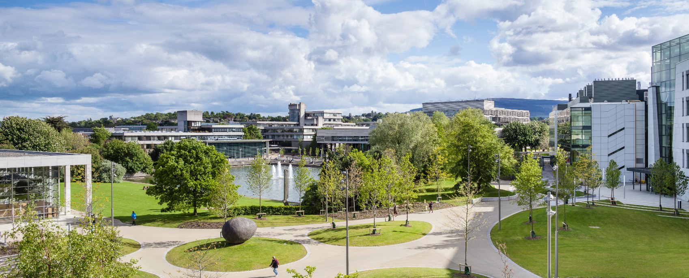
My Background
Studied Mathematics
Qualified and worked as a teacher in the UK
Completed my MA Education
Started my PhD in UCD

Slide 3
My Research
Supporting teachers to engage with problem-solving in their Junior Cycle Classrooms
Interviewing teachers about their experiences and concerns regarding problem-solving
Developing resources that support teachers with problem solving in their classrooms

Slide 4
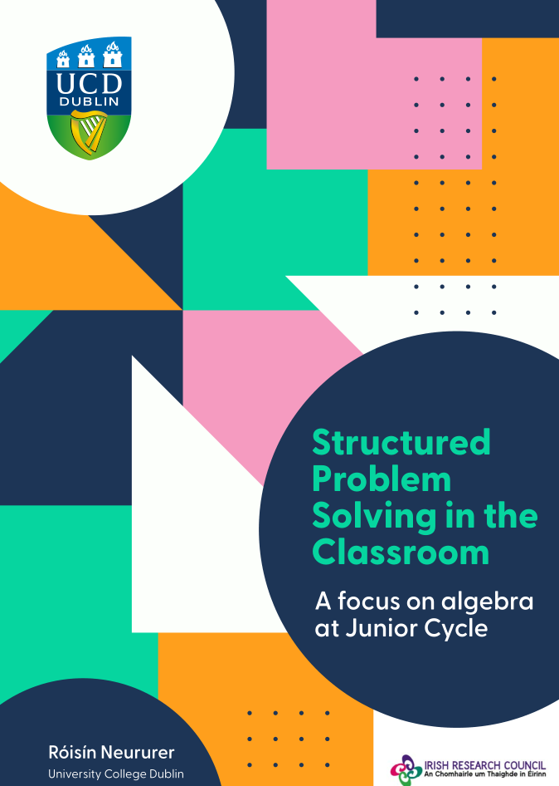
Curriculum materials to support teachers with problem-solving
A variety of well-designed resources.
Outlines Structured Problem Solving
Introduces “5 Practices” to support teachers with engaging with problem solving in the classroom

Slide 5
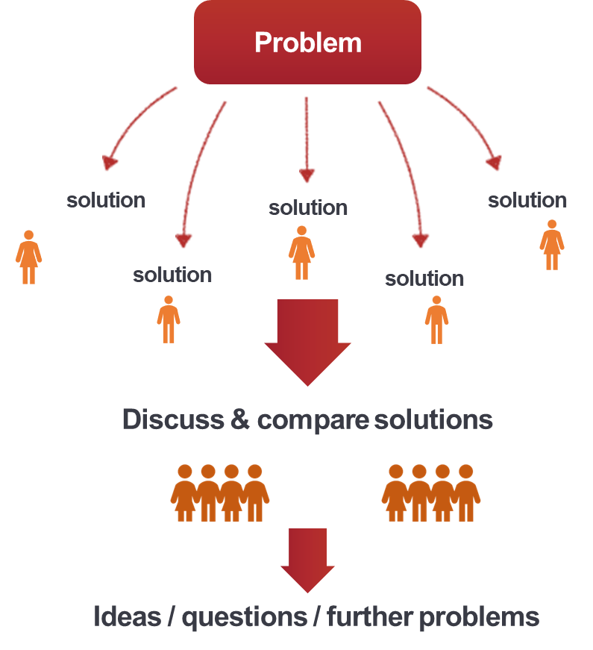
Structured Problem Solving
Not a “one-off” or “end-of-chapter” approach
The discussion is at the heart of SPS
More than “show and tell”
BUT challenging for teachers and demands a change in role
(Hino, 2007; Takahashi, Lewis & Perry, 2013)
Notes:
Structured problem solving is a model of teaching through problem solving. Students engaging with, learning about and developing all the skills and concepts WHILE engaging in problem solving. It is not a one off or end of chapter approach.
It generally involves posing a problem, students then work on the problem, and then the teacher orchestrates a whole class discussion in which the different approaches are compared, contrasted and explored before leading into a summary, reflection and consolidation of the core ideas or perhaps further questions or problems.
It’s the class discussion that is the heart of the lesson – this is where the real learning takes place. It is more than students reporting what they did… but this makes it challenging. Its’ a different role to what many of us might be used to.
The Problem Solving Approach is one which highlights the fact that there can be many ways to find a solution in mathematics and, indeed, sometimes many solutions. Students get time on their own to individually solve the problem but where the learning truly occurs is in the compare and contrast element of all of the solutions. Students learn to articulate and communicate their own mathematical thinking, but also learn important skills in listening and considering other solutions. The skill for the teacher is in the “neriage” element of the lesson where they lead the discussion for students to conclude their learning.

Slide 6

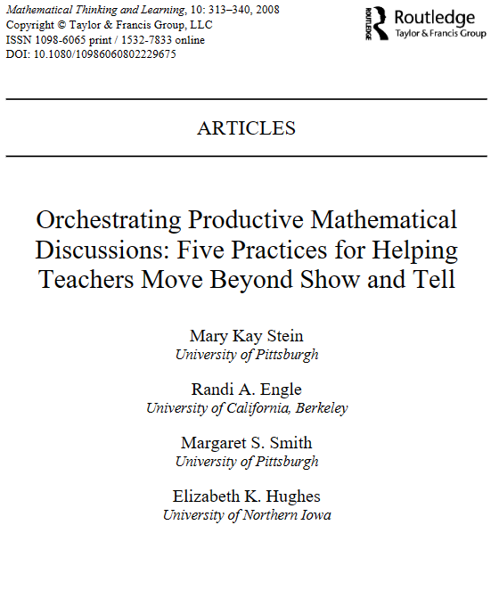
Five key practices
Anticipating students’ mathematical responses
Monitoring student responses
Selecting student response for public display
Sequencing student responses
Connecting student responses
(Stein et al., 2008)

Slide 7
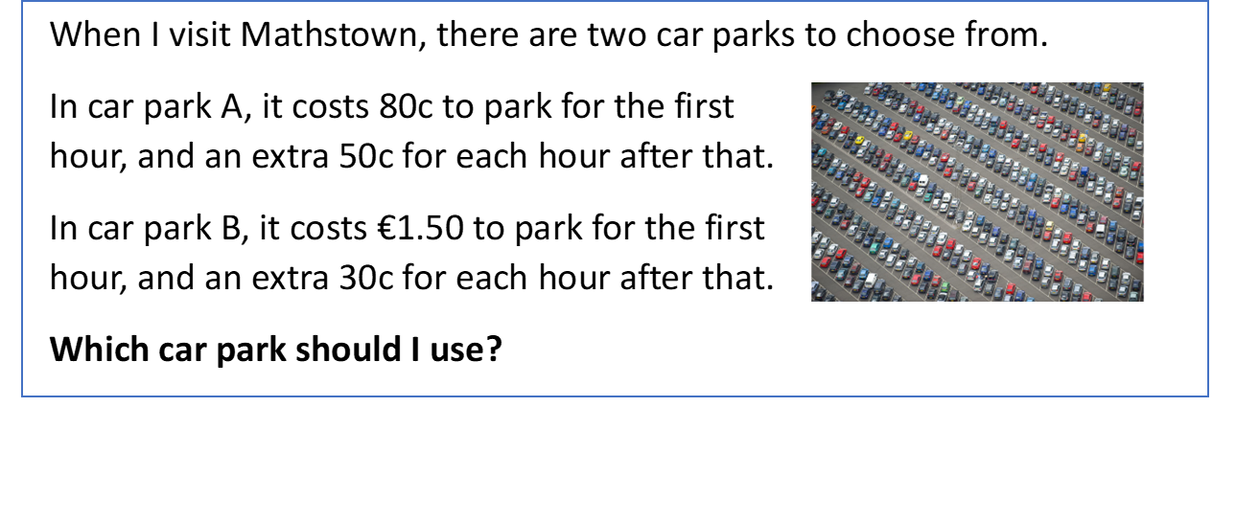
Problem

Slide 8
Notes:
Side by side comparison of forming and solving equations with a focus on defining the variable.
Do you agree?
How can they both be correct?
What is different?
What is the same?

Slide 9
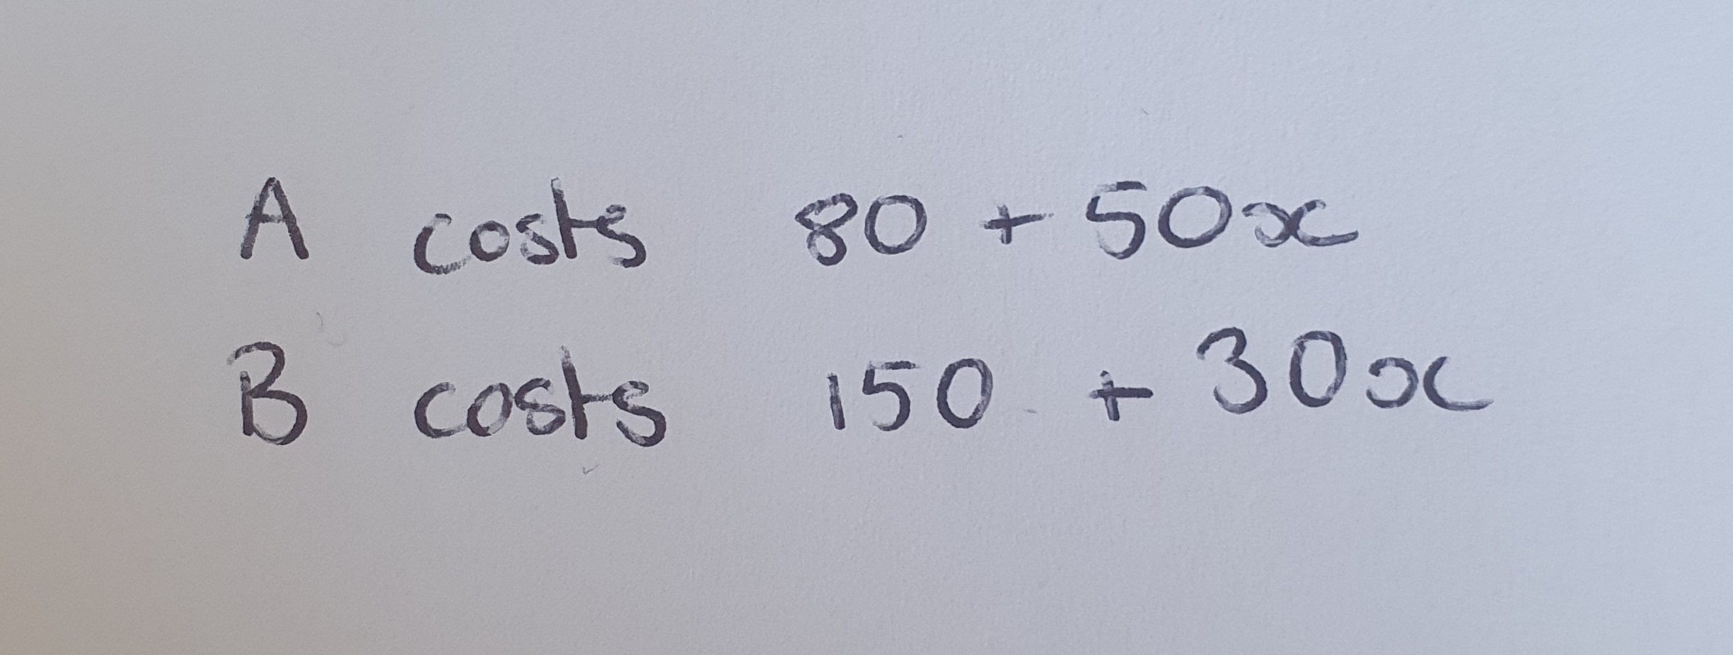
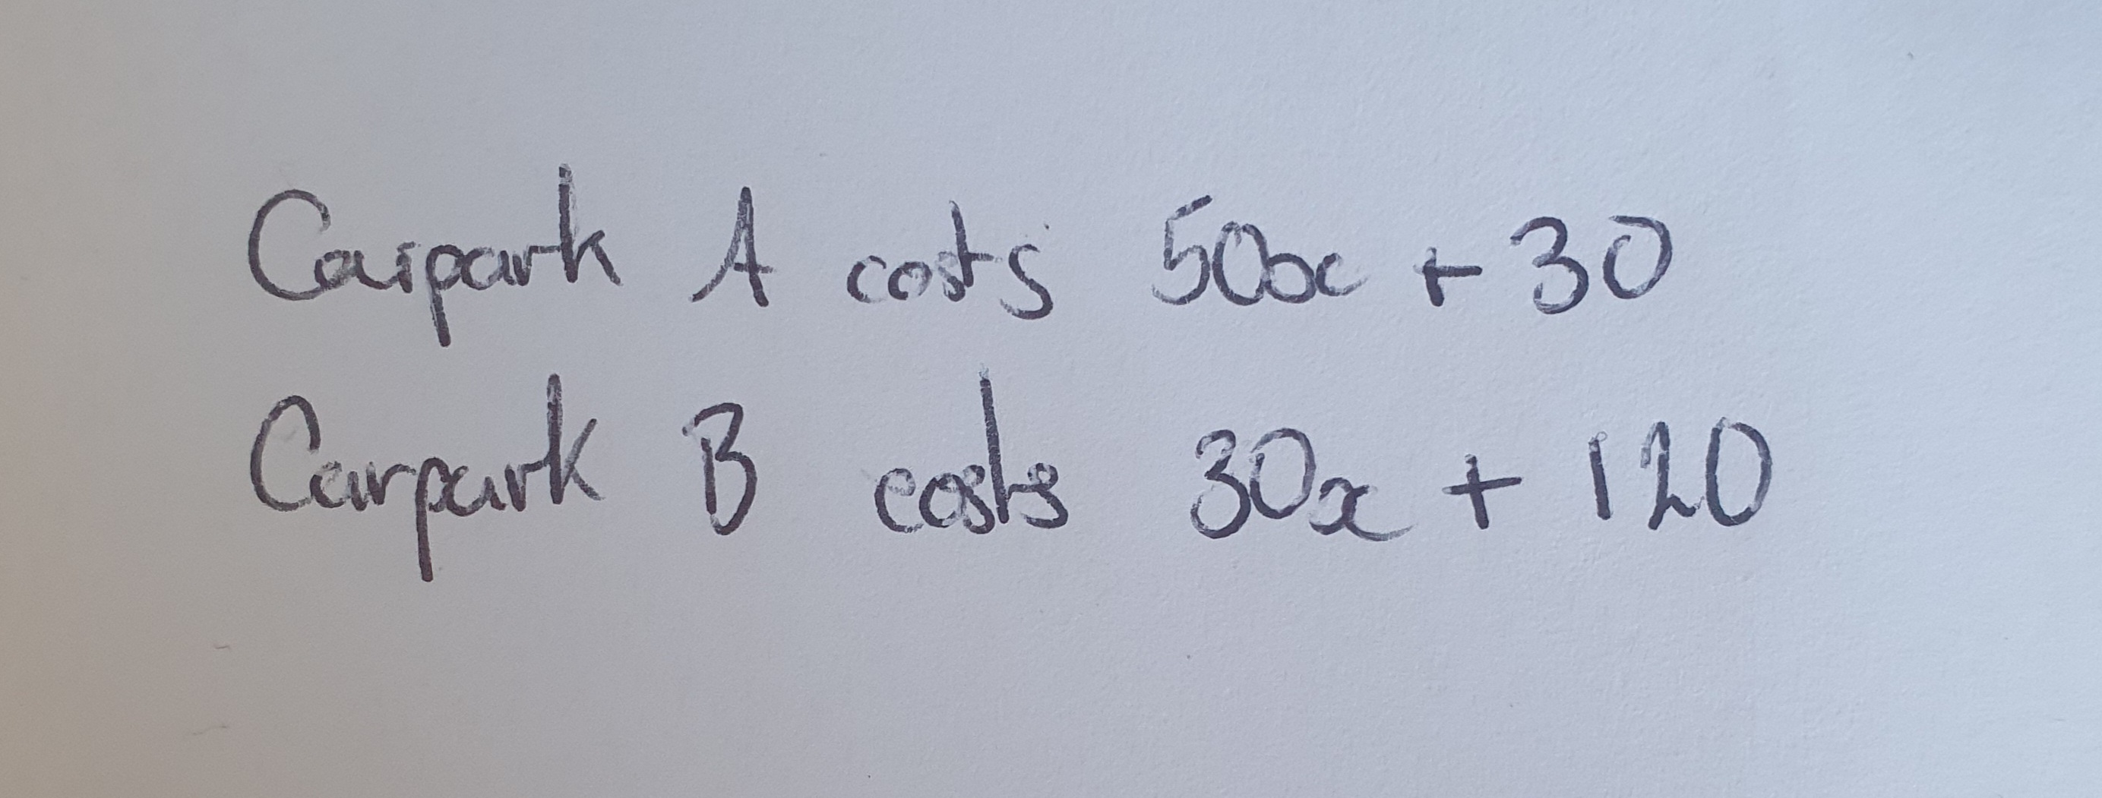
Notes:
Side by side comparison of forming and solving equations with a focus on defining the variable.
What is x?
Do you agree?
How can they both be correct?
What is different?
What is the same?

Slide 10
Problem

Slide 11
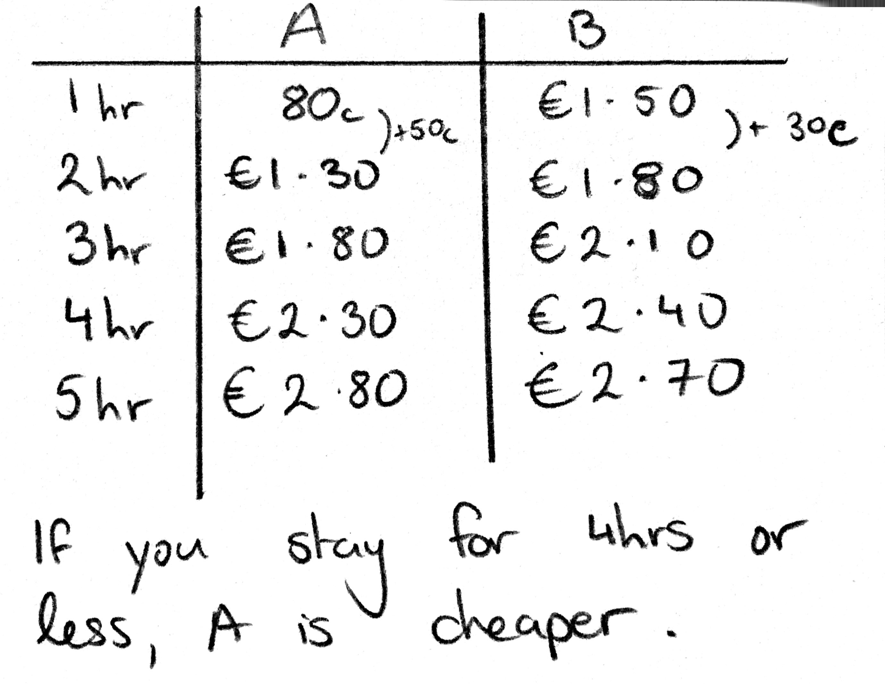
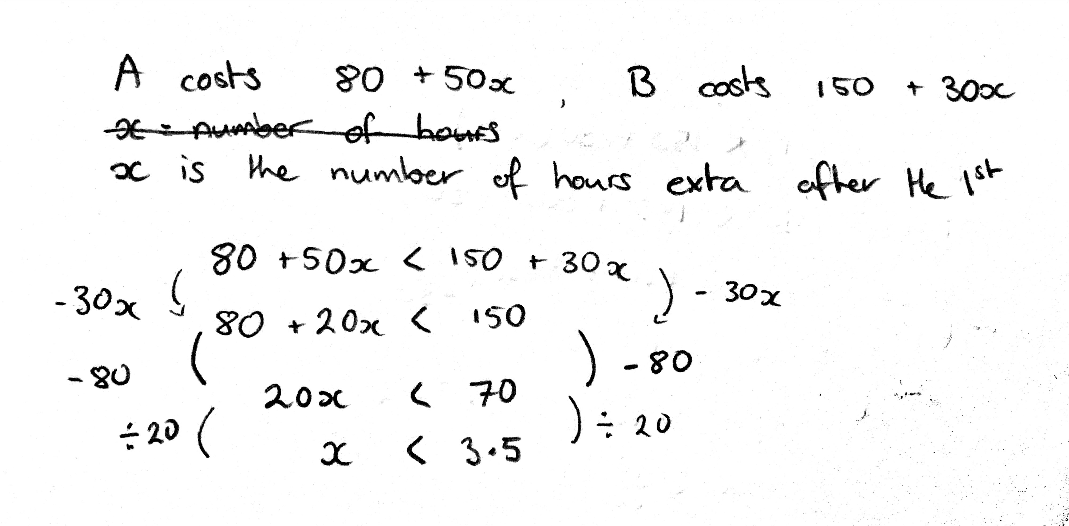
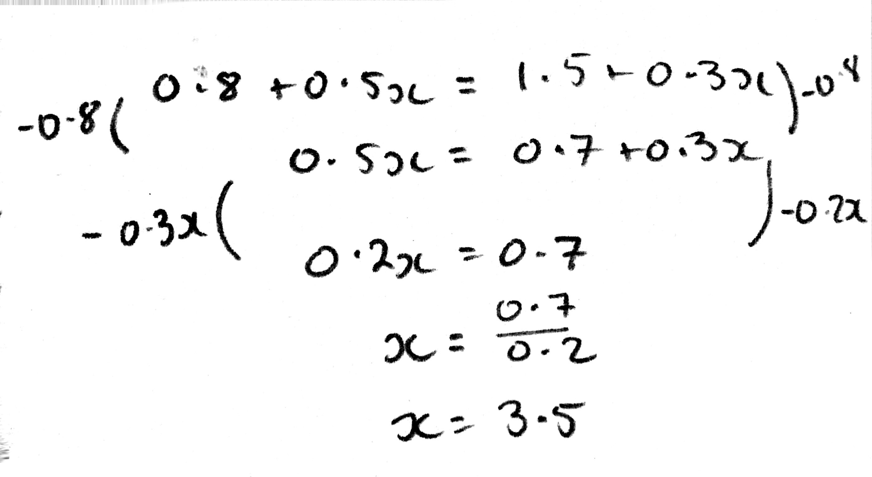
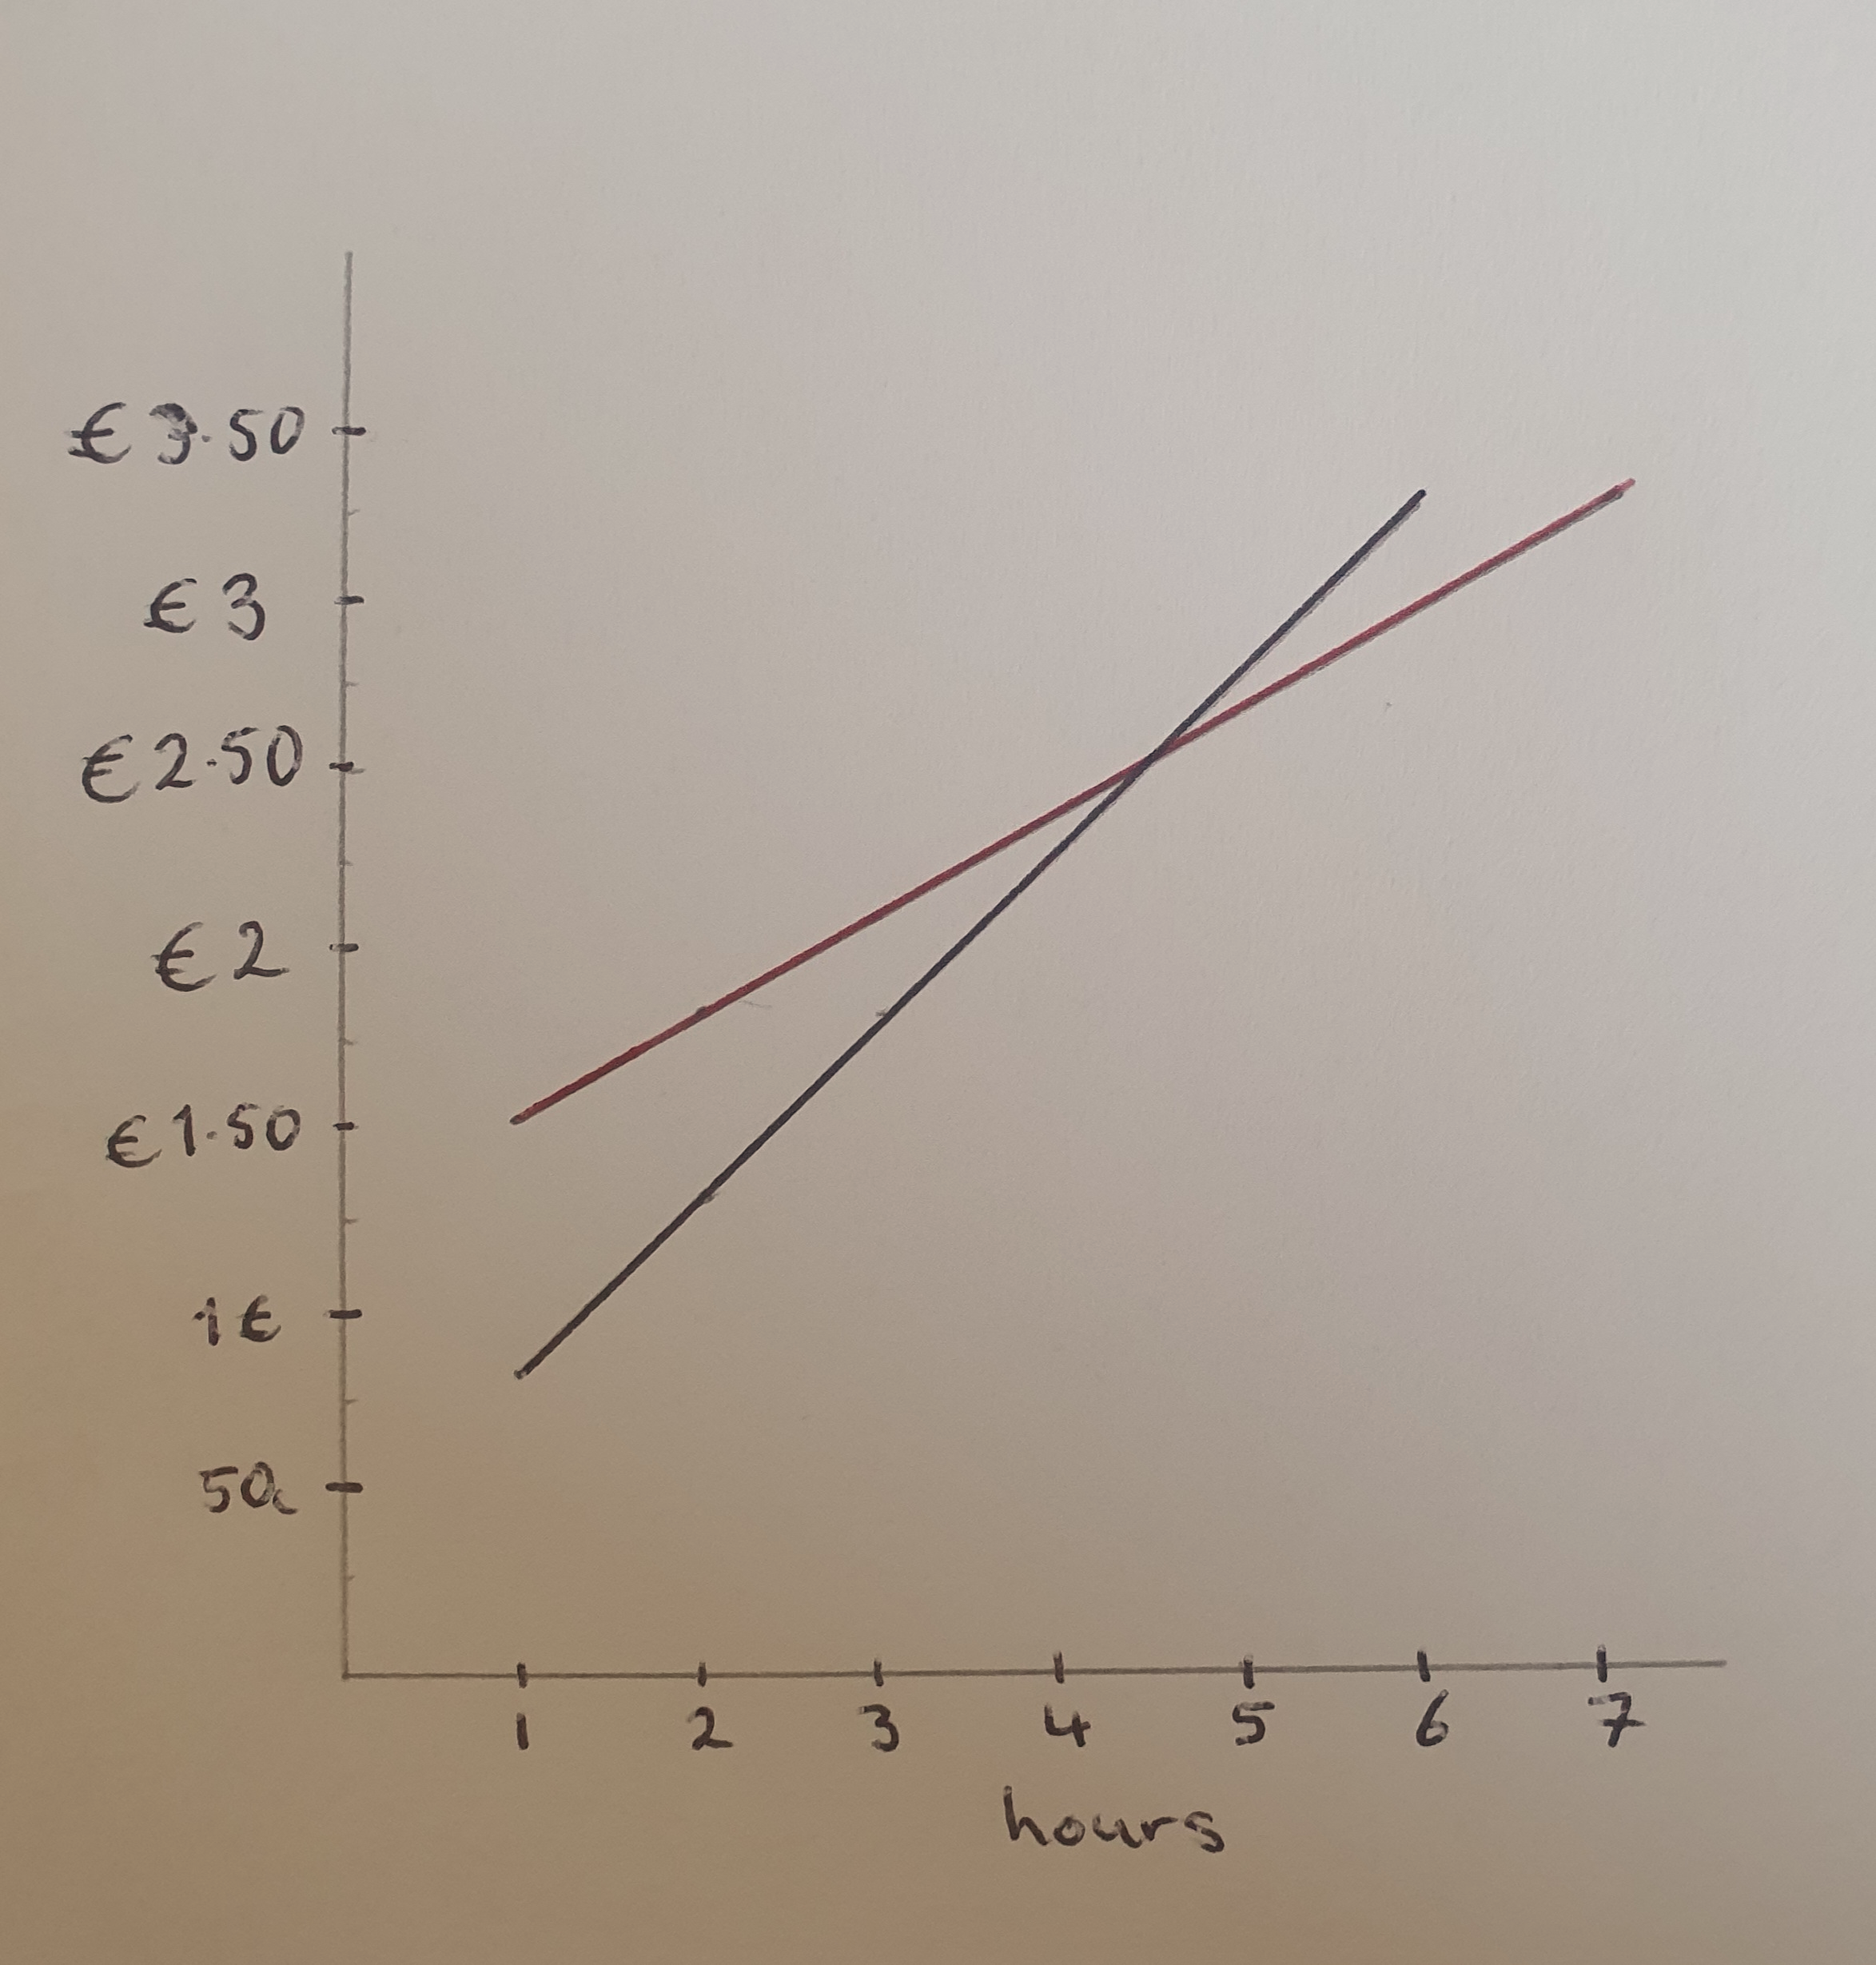
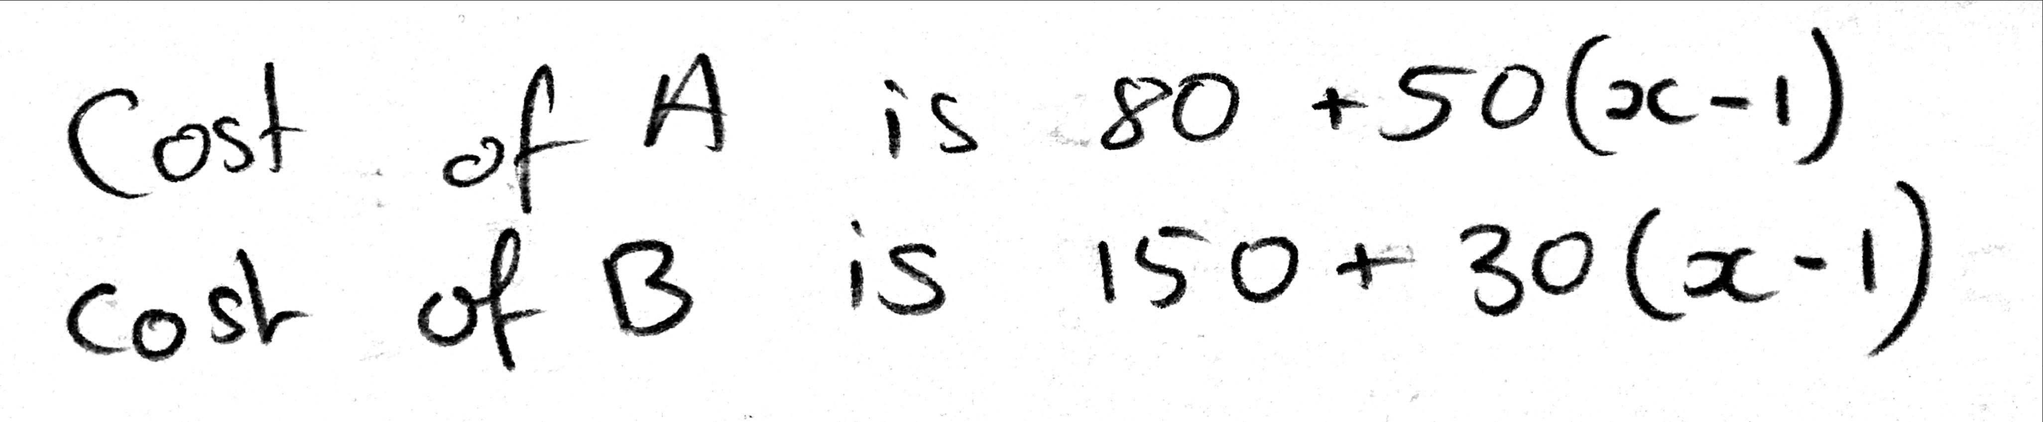
Anticipating
1. A table of values/ organised list
2. Algebraic inequality
4. Trial and improvement
5. Forming and solving an equation
3. Graphing the relationships
6. Forming an expression

Slide 12
Monitoring
1. A table of values/ organised list
2. Algebraic inequality
4. Trial and improvement
5. Forming and solving an equation
3. Graphing the relationships
6. Forming an expression

Slide 13
Selecting/Sequencing/Connecting
1. A table of values/ organised list
2. Algebraic inequality
4. Trial and improvement
5. Forming and solving an equation
3. Graphing the relationships
6. Forming an expression

Slide 14
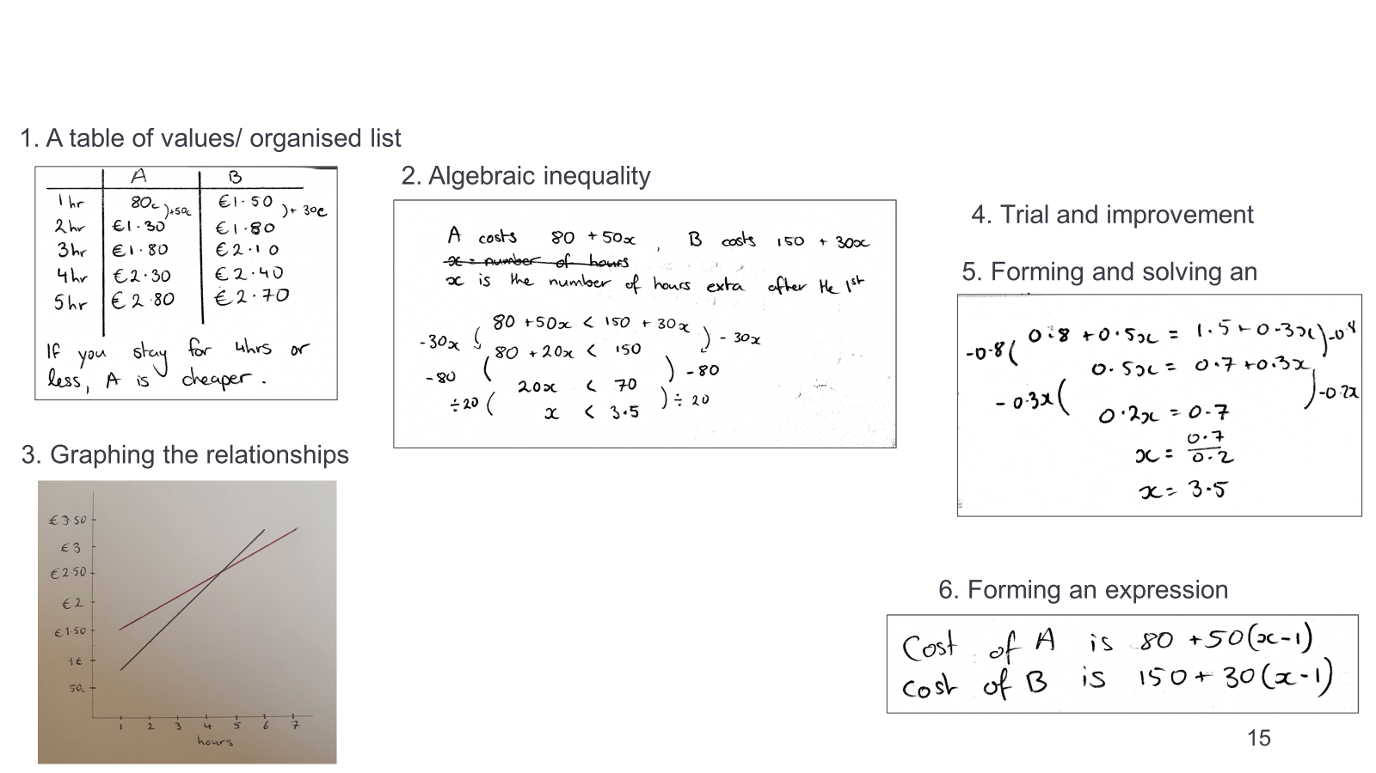
Selecting/Sequencing/Connecting
Depends on the goals of the lesson

Slide 15
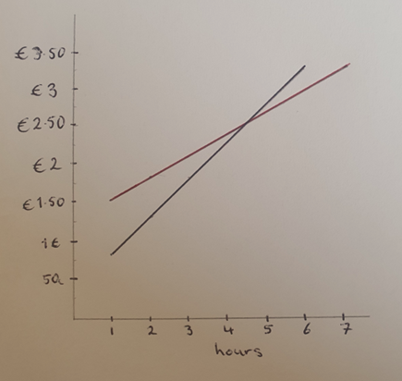
A possible sequence
Goal of the lesson is to develop/introduce linear graphs as a tool for solving linear inequalities
1. A table of values/ organised list
2. Algebraic inequality
How do you know car park B will always be cheaper after that point?
How can we see this from the table?
How can we see this from the graph?
3. Graphing the relationships
How does the graph relate to the table?
How does the graph relate to the algebraic expression/equation/inequality?
How does the graph show us which carpark is cheaper?
Notes:
What is the same? What is different?
Which do you prefer? Why?

Slide 16
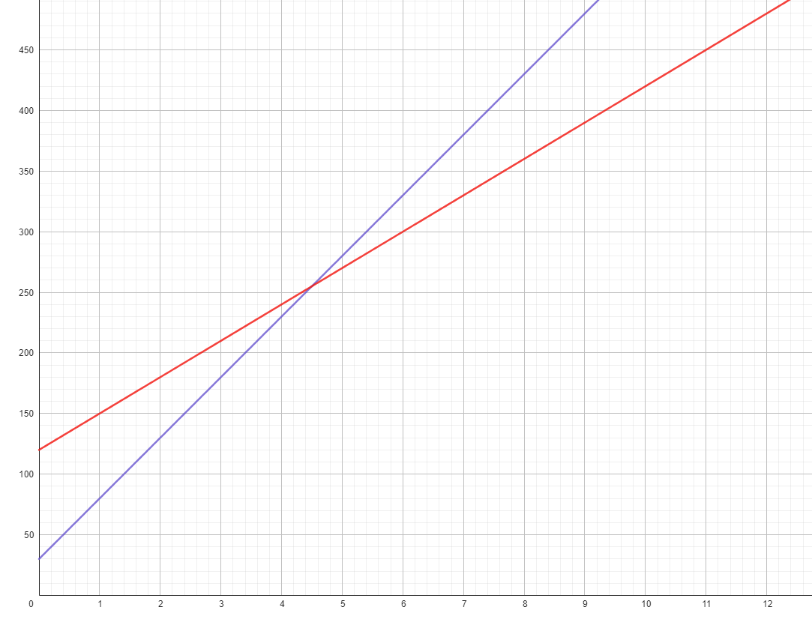
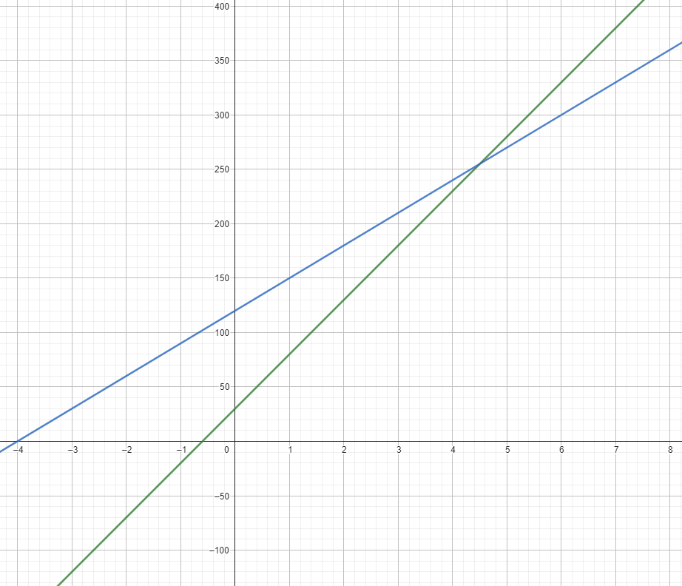
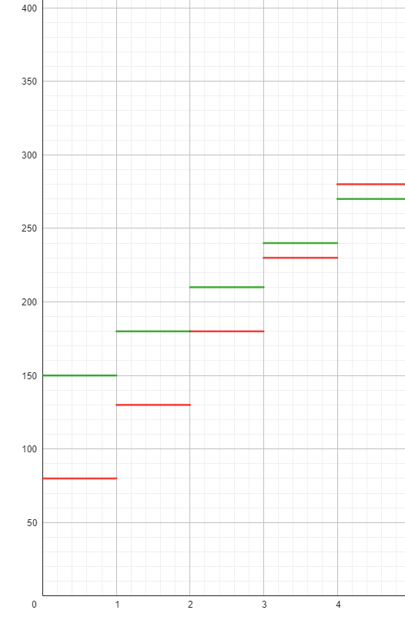
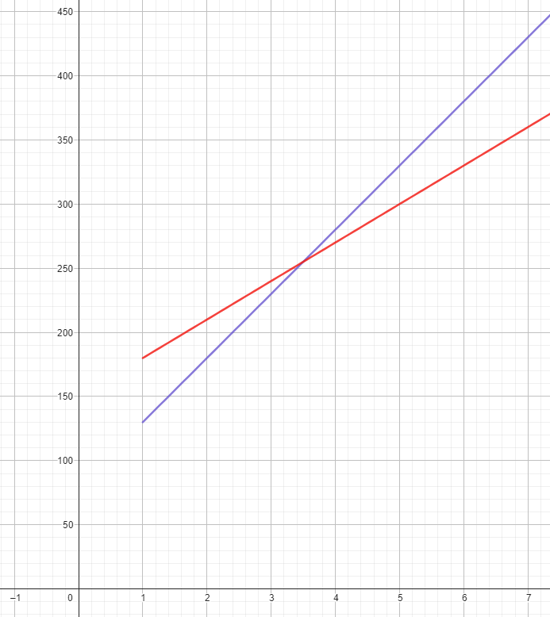
Notes:
The same problem could be used to explore linear graphs and deepen students' knowledge in this area. In this case, you might present the problem after a quick recap of linear graphs.

Slide 17
Next steps….
Goal of the lesson is to develop/introduce linear graphs as a tool for solving linear inequalities
There is a Park and Ride service where it costs 40c an hour to park, but I also have to pay €1 bus fare into town.
Alternatively, I could park for free at the train station and get the train to Mathstown. A return ticket costs €3.80.
Should I use one of the car parks, the Park and Ride, or the train?
Notes:
Students can then apply what they’ve learned.
In some cases, you might deliberately choose a next question that highlights how some methods are better in some situations.
Here, you can have all the information easily contained and visually accessible in a single graph so that it is easy to see which one is cheaper and when.
In other instances, you might introduce decimal values or continuous data to highlight the advantage of an algebraic approach over trial and improvement or a table of values.

Slide 18
Next steps….
There is a Park and Ride service where it costs 40c an hour to park, but I also have to pay €1 bus fare into town.
Alternatively, I could park for free at the train station and get the train to Mathstown. A return ticket costs €3.80.
Should I use one of the car parks, the Park and Ride, or the train?
Here are some challenges to try.
Can you work out what the charging structure might be in each case?
Two car parks A and B, where A is cheaper if I park for less than 5 hours and B is cheaper if I park for more than 5 hours.
Three carparks C, D and E, where car park C is always cheaper than D and E, regardless of how long I park.
Three car parks, F, G and H, where F is cheapest if I park for less than 2 hours, G is cheapest if I park for between 2 and 6 hours, and car park E is cheapest if I park for more than 6 hours.

Slide 19
Concluding comments/takeaways
Students need to experience regular and varied problem-solving.
Structured problem solving is one way of engaging students in problem solving while also introducing concepts, developing procedures and skills, applying knowledge to new situations…
High quality, mathematical discussion is key.
It is challenging – requires quality resources!
It’s not all or nothing.

Slide 20
Questions / Comments
roisin.neururer@ucdconnect.ie

