Slide 1
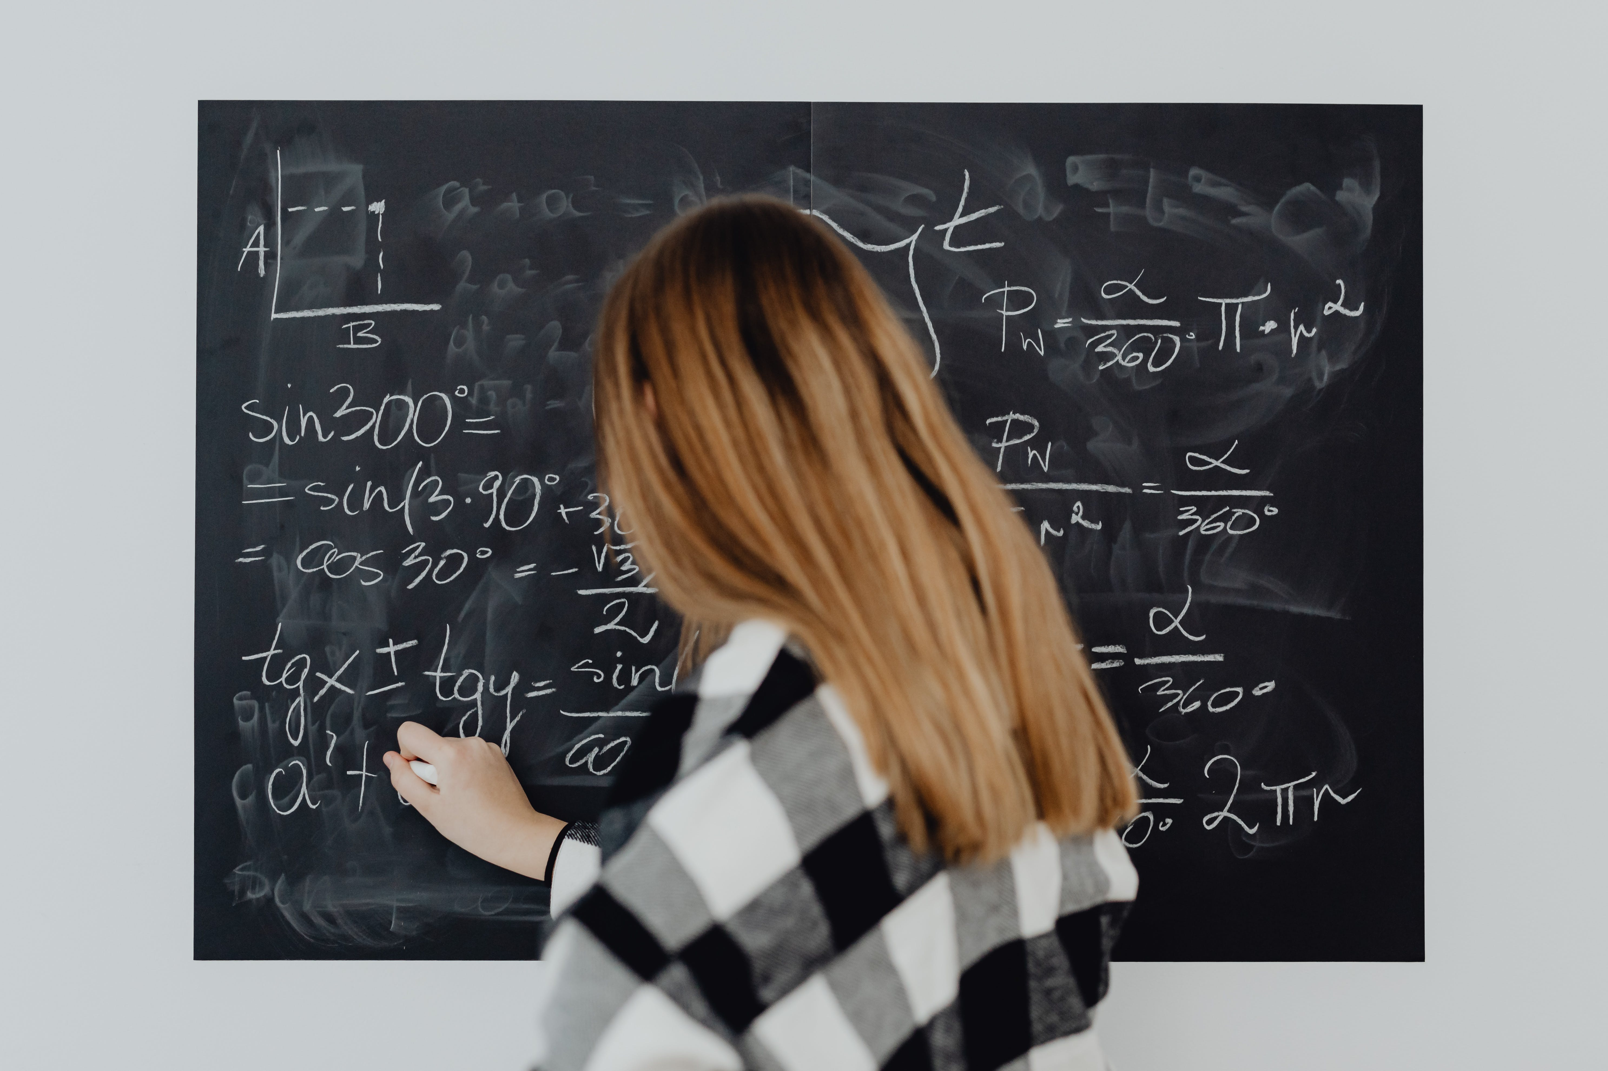
Increasing Rigor in Mathematics Lessons Beginning at the Primary Level

Slide 2
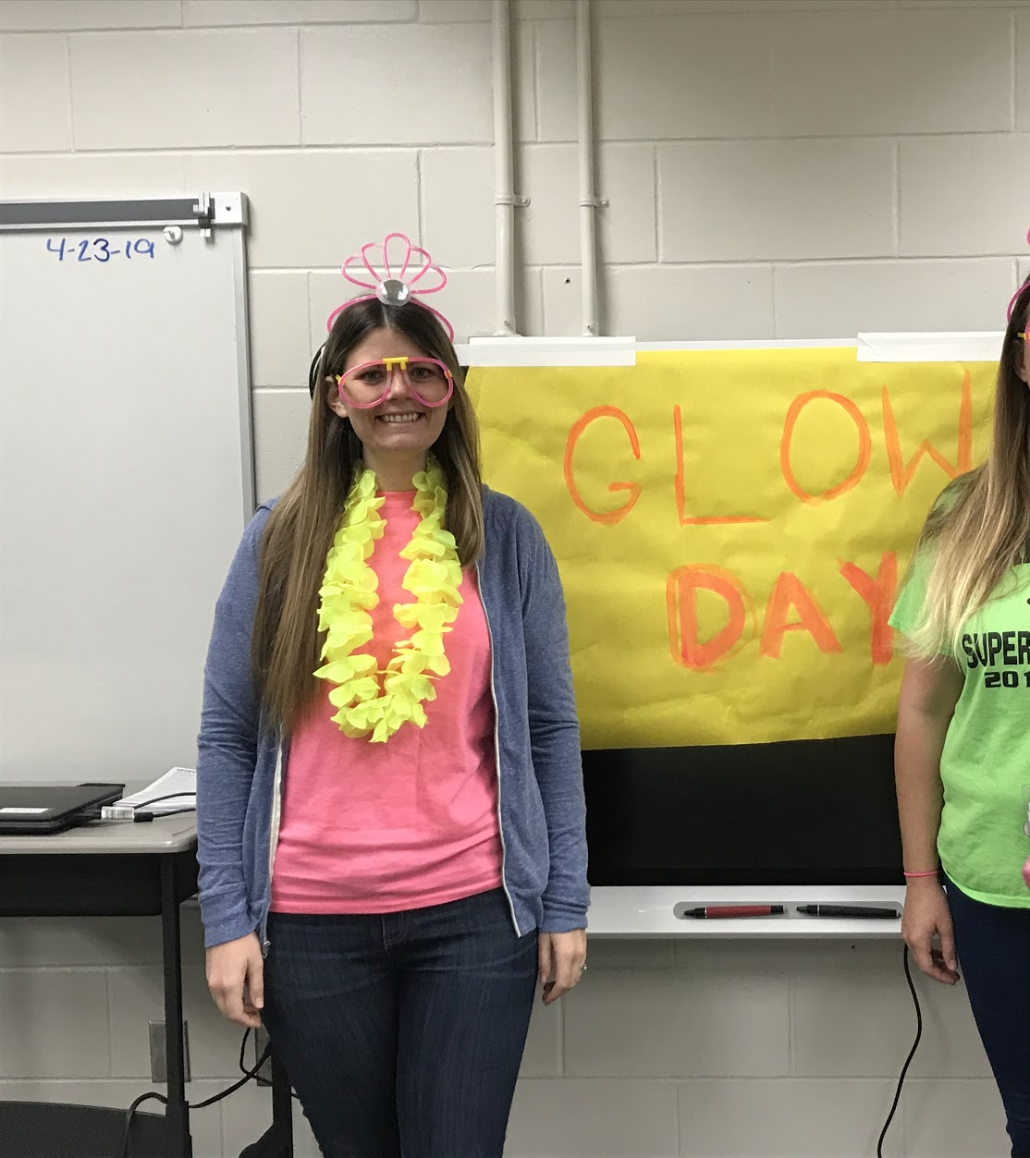
Sarah Porcenaluk
Primary Teacher in the U.S.
Instructional Mathematics Coach
MEd in Mathematics and Science Education
PhD Student and Lecturer at University of Galway

Slide 3
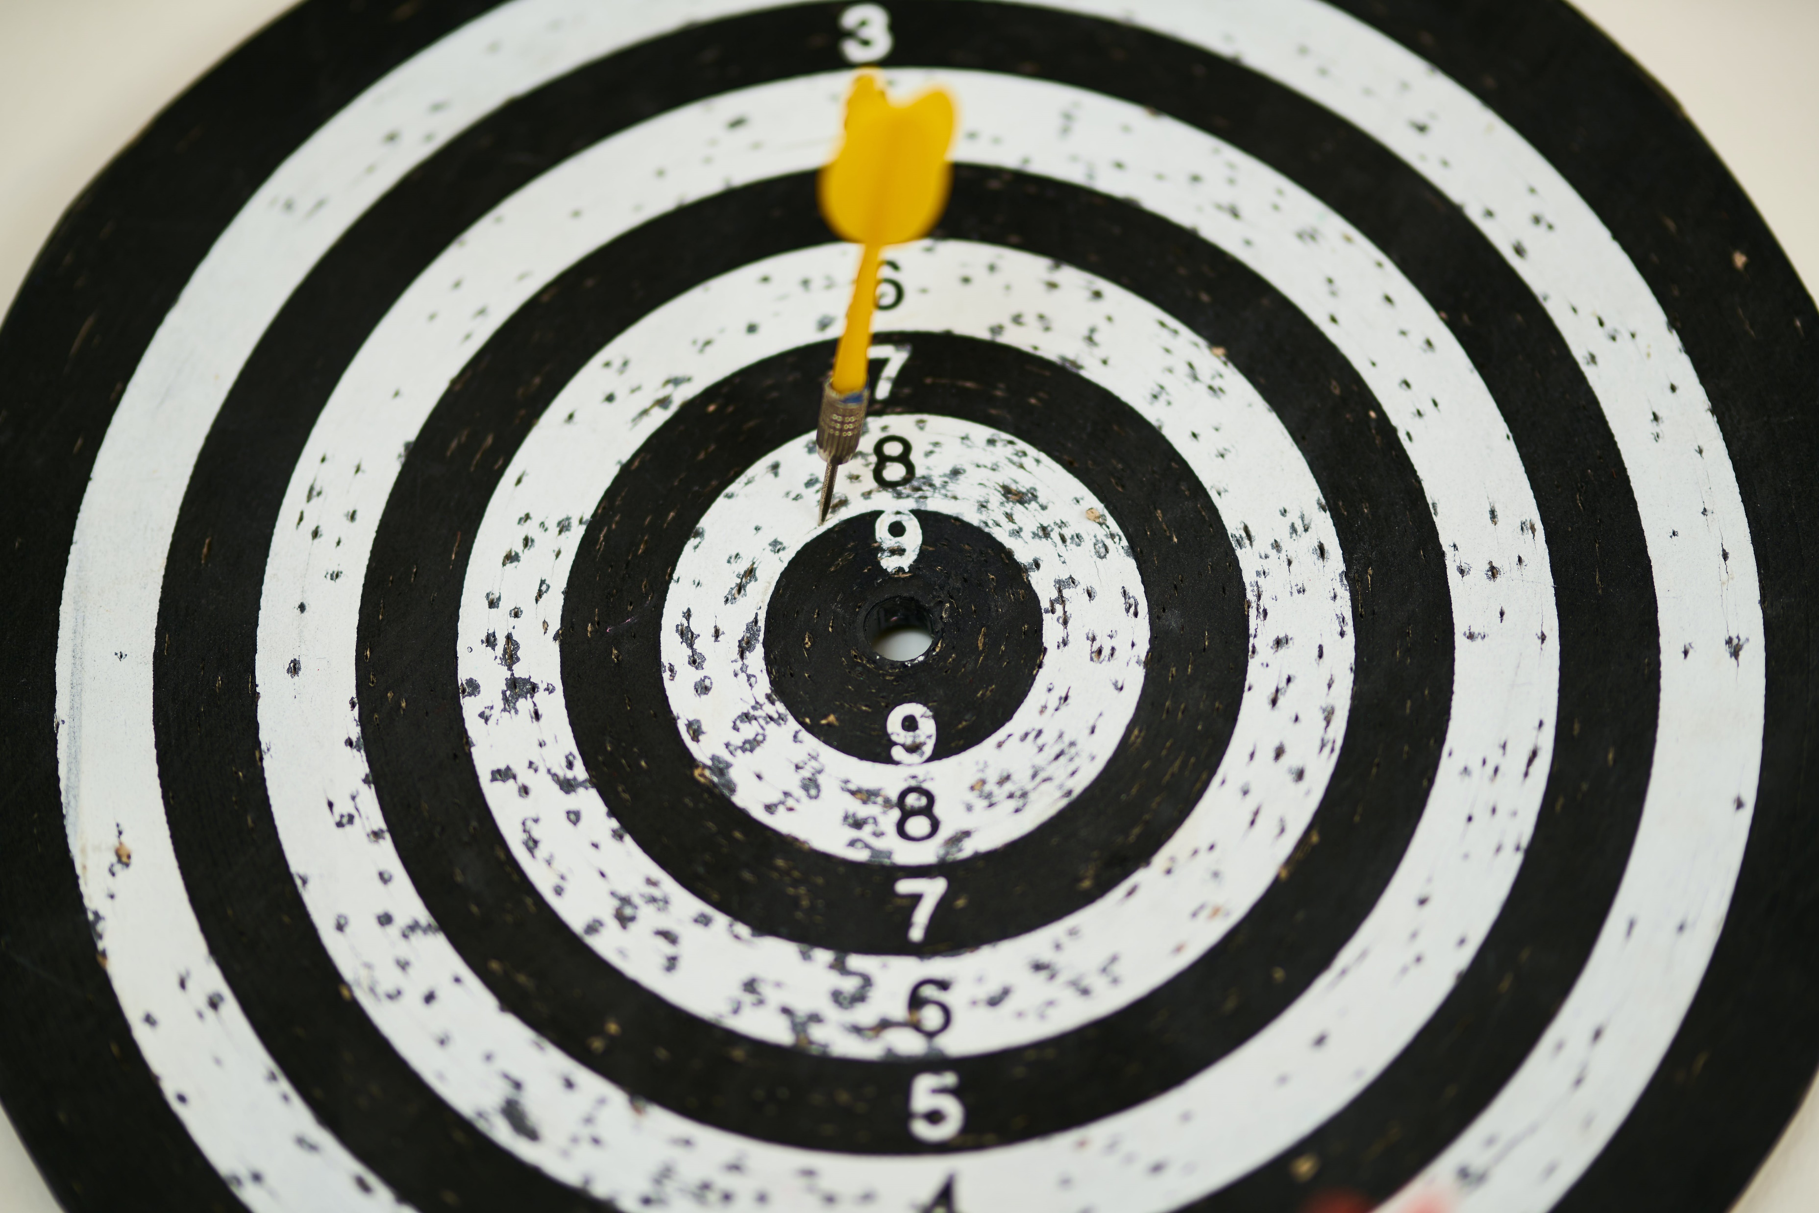
Increasing rigor for all students in mathematics

Slide 4
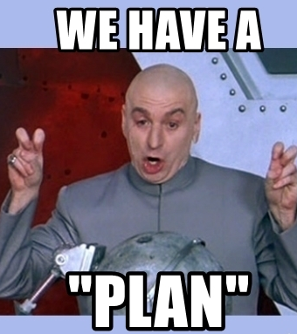
Primary Maths Curriculum
Equity and Access to High-level Mathematics
Less is More in Teaching
Fun with Fractions
Real-world examples
Take-aways

Slide 5
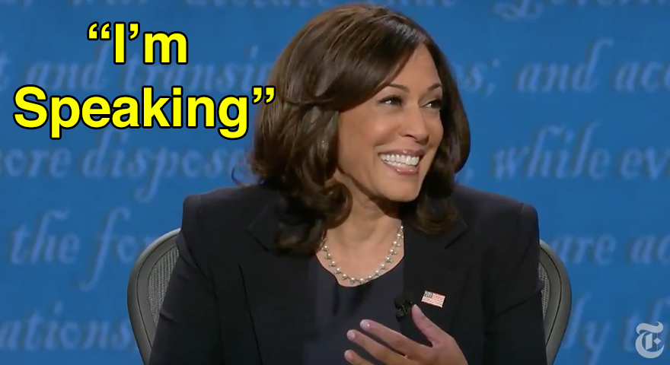
Please Interrupt Me

Slide 6
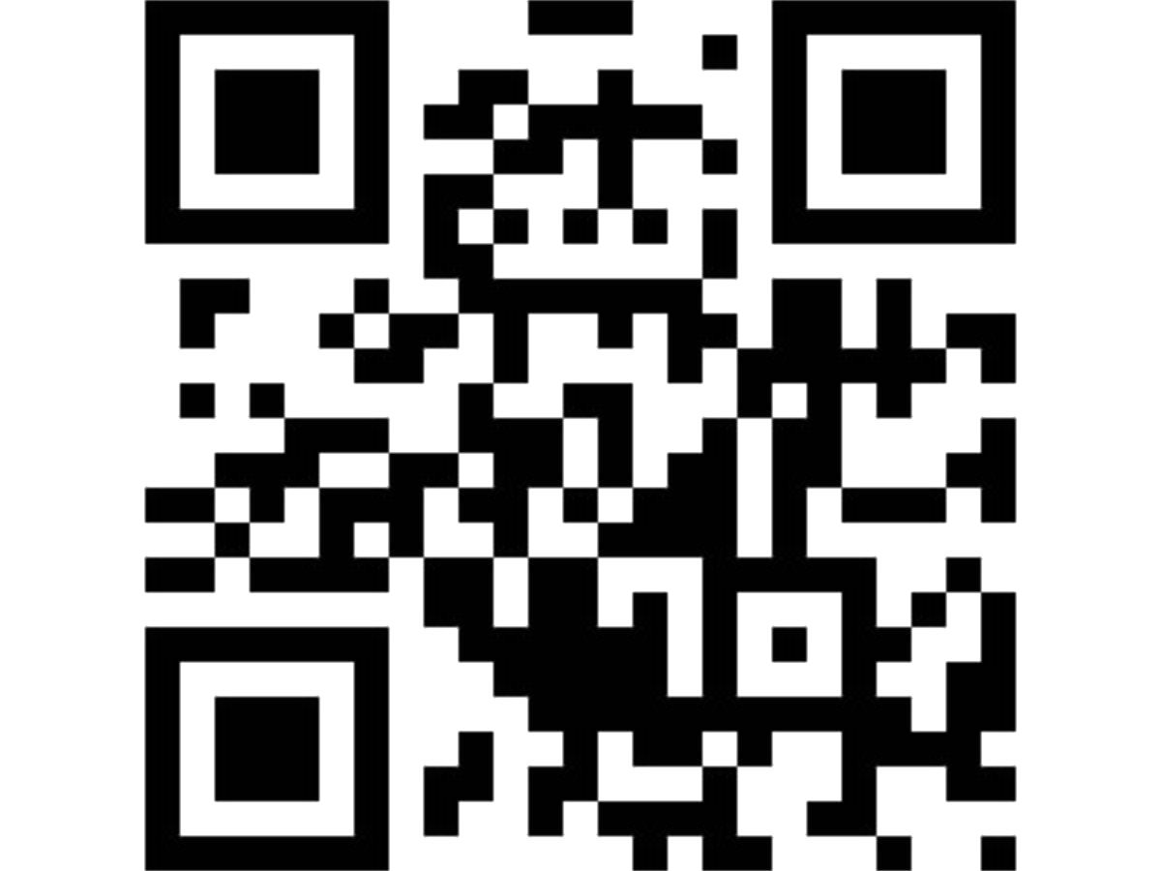
What do you hope to learn or take away from this session today?

Slide 7
Which one doesn’t belong? Why?
1375 | 4058
4379 | 8,492

Slide 8
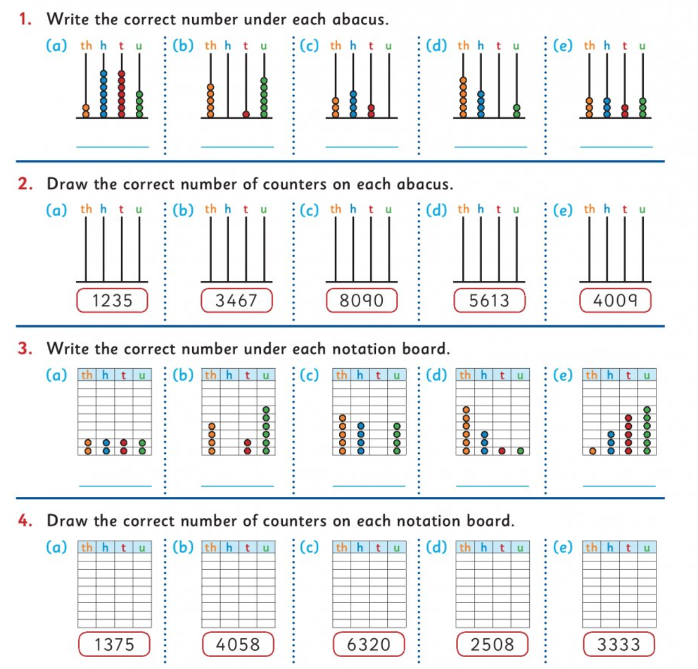

Slide 9

Productive Disposition
Equity and Access
Real-world mathematics
Growth Mindset
Develop higher-level thinking skills for
21st-century life

Slide 10
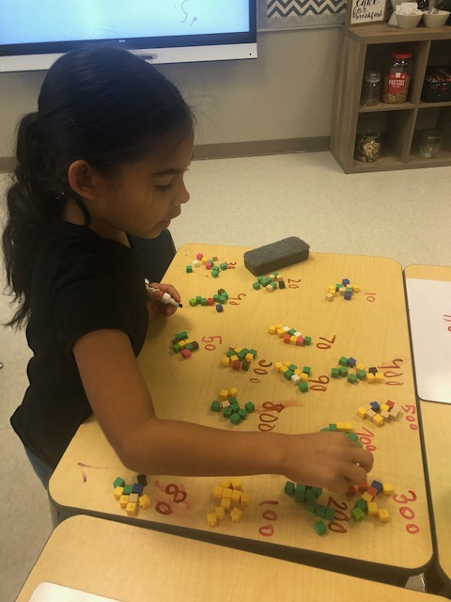
Focus on developing students as mathematicians with mathematical proficiency
Connect information
Communicate
Construct and justify arguments
Analyse solutions (theirs and others)

Slide 11
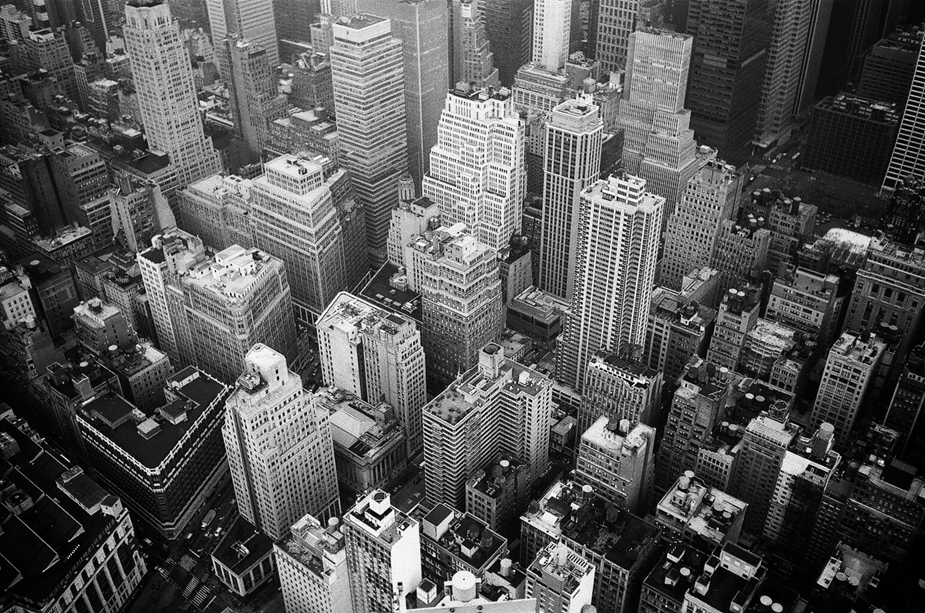
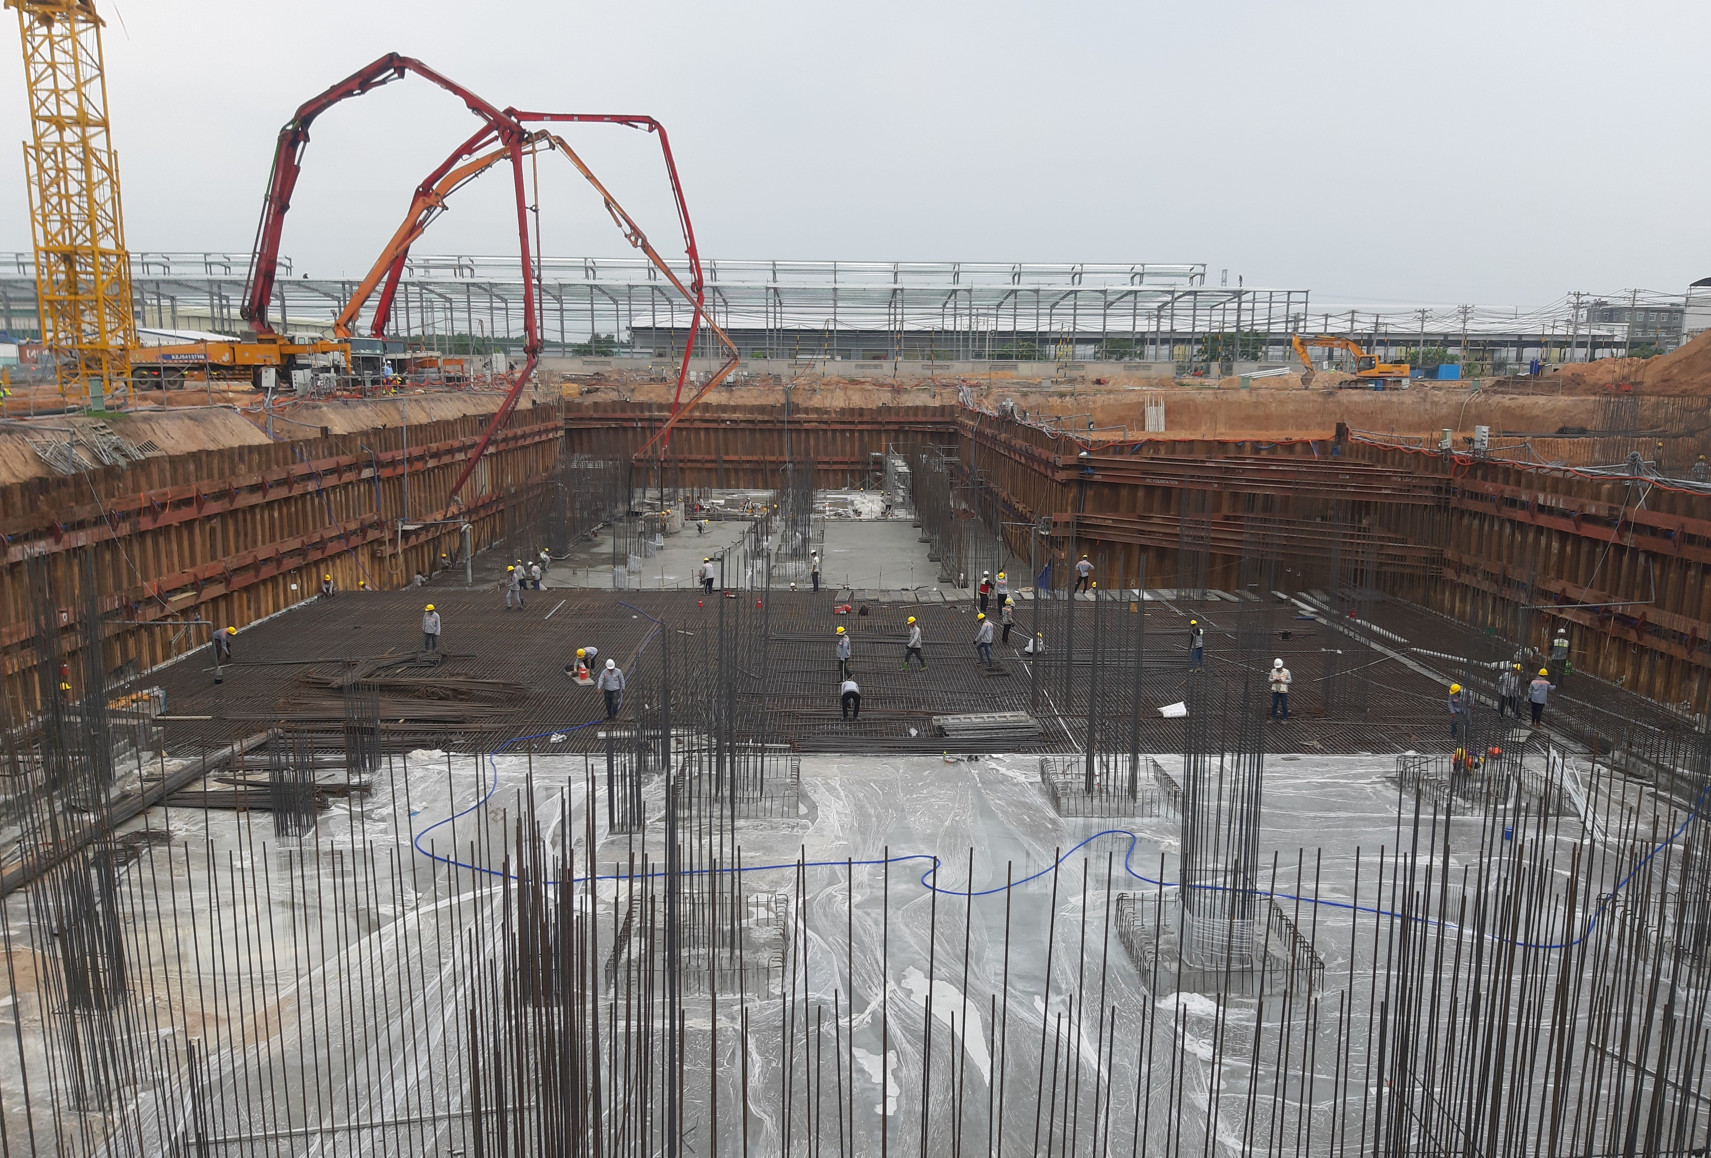

Slide 12

Draw a picture of what a classroom might look like (at any level) with:
Productive disposition
Equity and access
Real-world mathematics
Growth mindset
Development of 21st-century skills

Slide 13
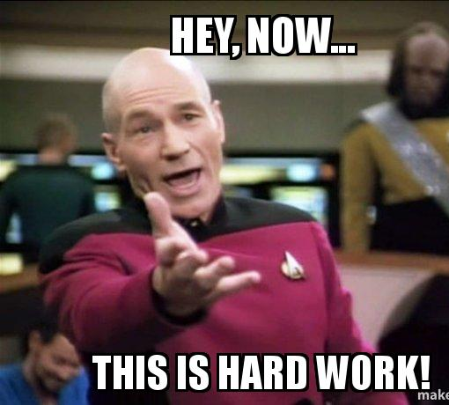
How can I find time to integrate this into my already busy schedule and classroom?

Slide 14

Less Can Be More in Teaching Mathematics

Slide 15
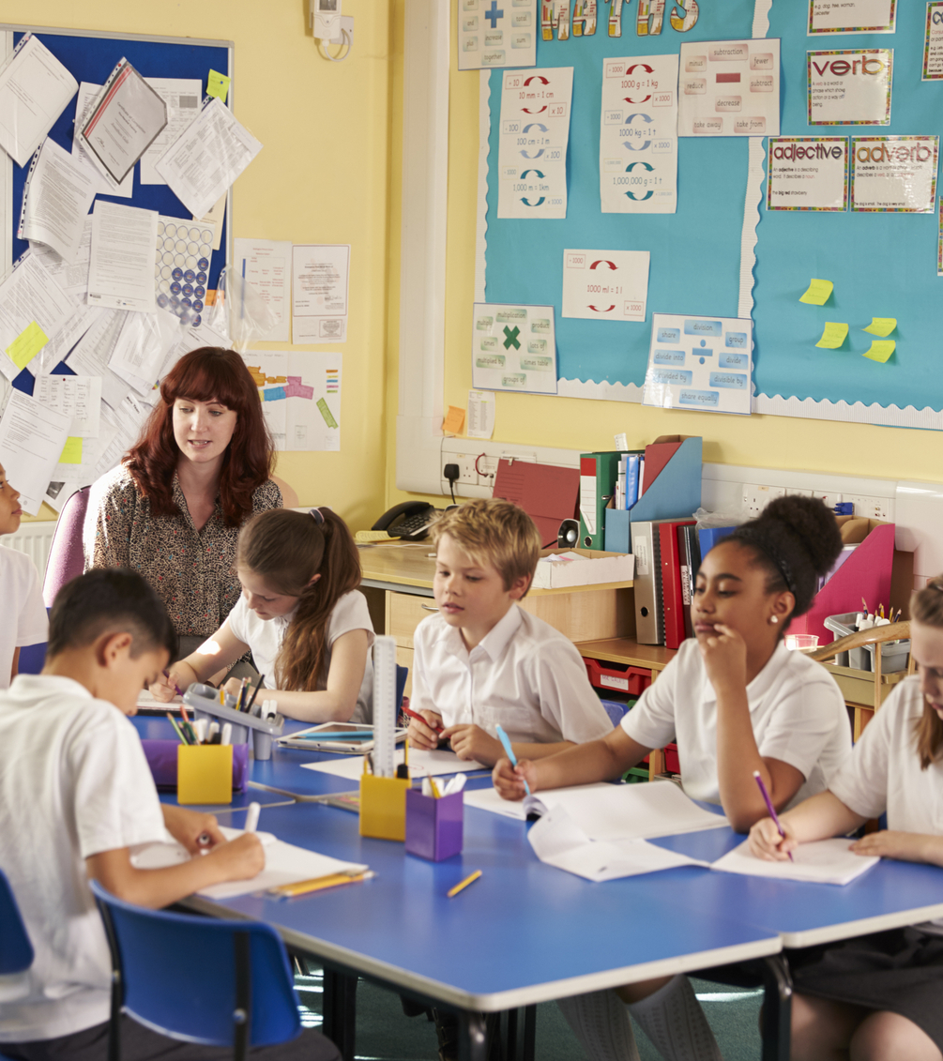
Less Is More
Foster productive struggle
Facilitate conversations
Avoid “lifesaver” mentality
Use “just-in-time” scaffolding
Use purposefully planned questions in lessons to help with all the above

Slide 16
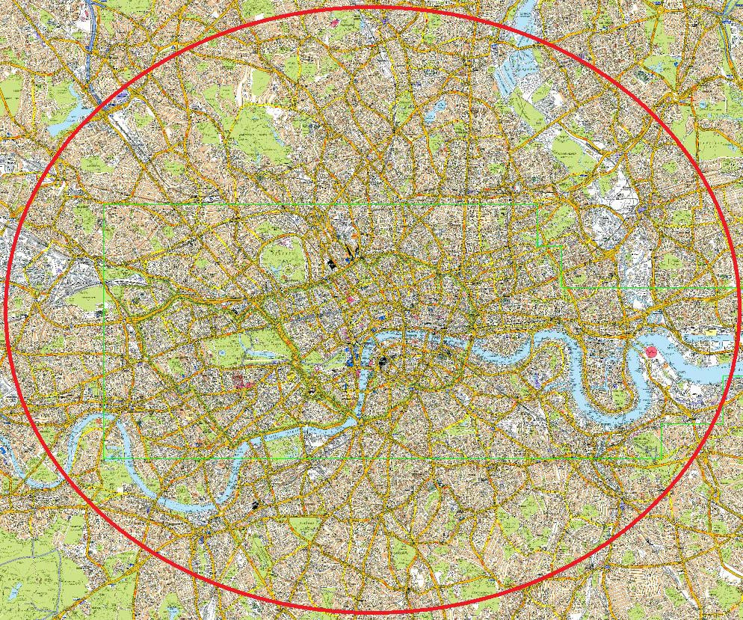
Productive Struggle
Helps us learn
Helps our brains grow
Supports a growth mindset mentality

Slide 17
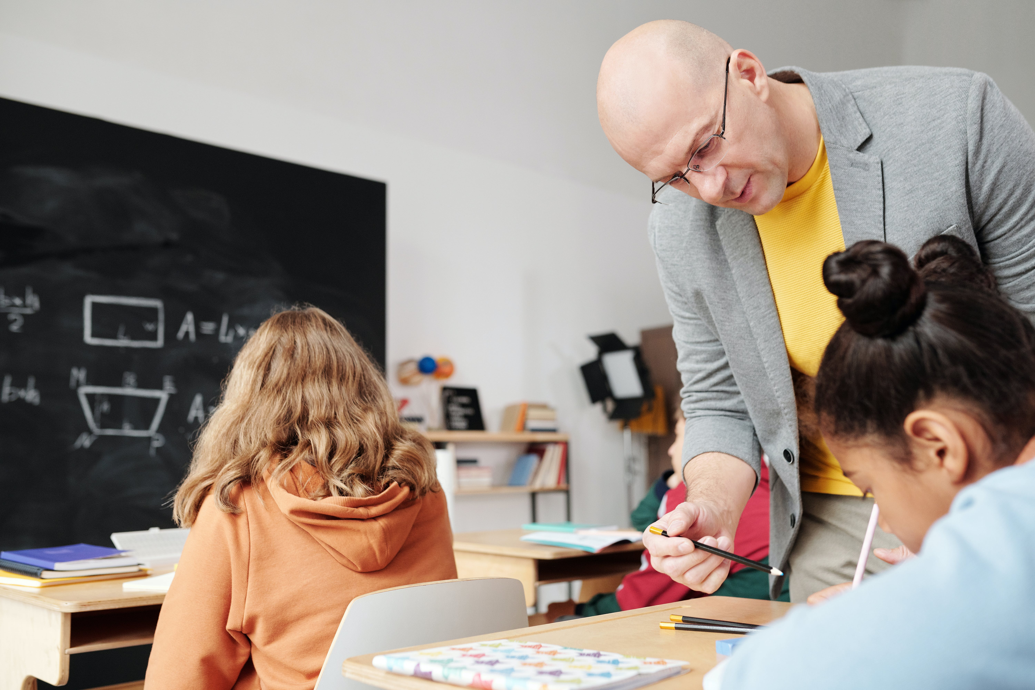
Facilitate Conversations
Help us to learn student understanding
Connect ideas
Help students process

Slide 18
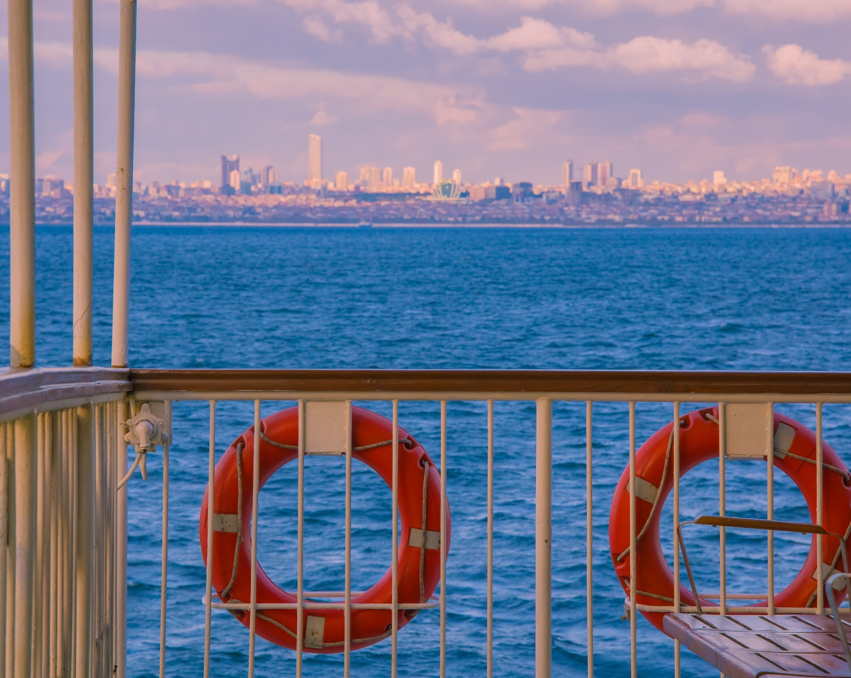
Avoid the “lifesaver” mentality
Allow students that “aha” moment
Allow them to experience the joy of learning

Slide 19

Just-in-Time Scaffolding
Scaffold when students need it, not before
Scaffold for individual students

Slide 20

Use Questions in Greater Amounts
Access to student thinking
Allows processing
Collaboration
Promote critical thinking skills

Slide 21
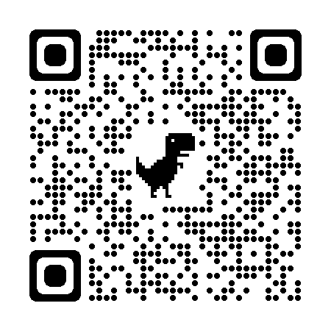
BRAIN BREAK
Scan the QR Code
Draw the images requested

Slide 22
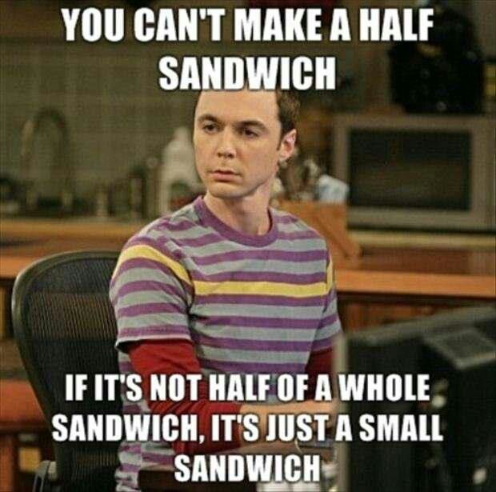
Solve the Fractions Problem
Where might students succeed?
Where might students struggle?

Slide 23
Douglas ordered 5 small pizzas during the great pizza sale. He ate 1/6 of one pizza and wants to freeze the remaining 4 5/6 pizzas.
Douglas freezes the remaining pizza in serving-size bags. A serving is 2/3 of a pizza. How many servings can he make if he uses up all the pizza?

Slide 24
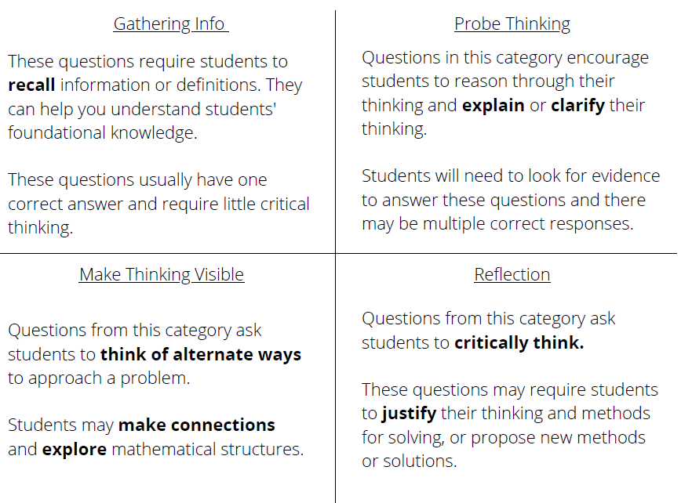
Question Types

Slide 25
Generate Questions for the Pizza Task

Slide 26
Generate Questions for the Pizza Task
Gathering Info | Probing Thinking
Making Thinking Visible | Reflection

Slide 27
Let’s see it in action!
What do you notice the teacher doing?
What do you notice the teacher doing?
What questions/answers are there?

Slide 28
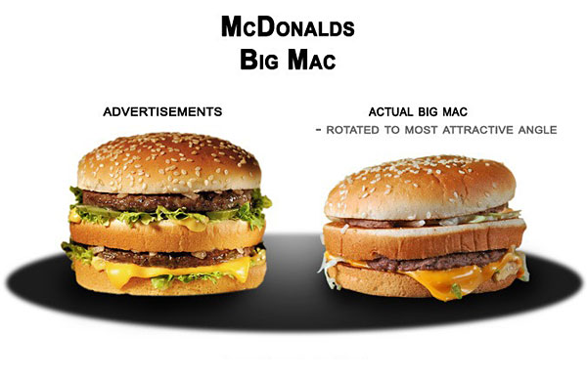

Slide 29
Change takes time
Change takes patience
Change is incremental
Change is complex
Change is messy

Slide 30
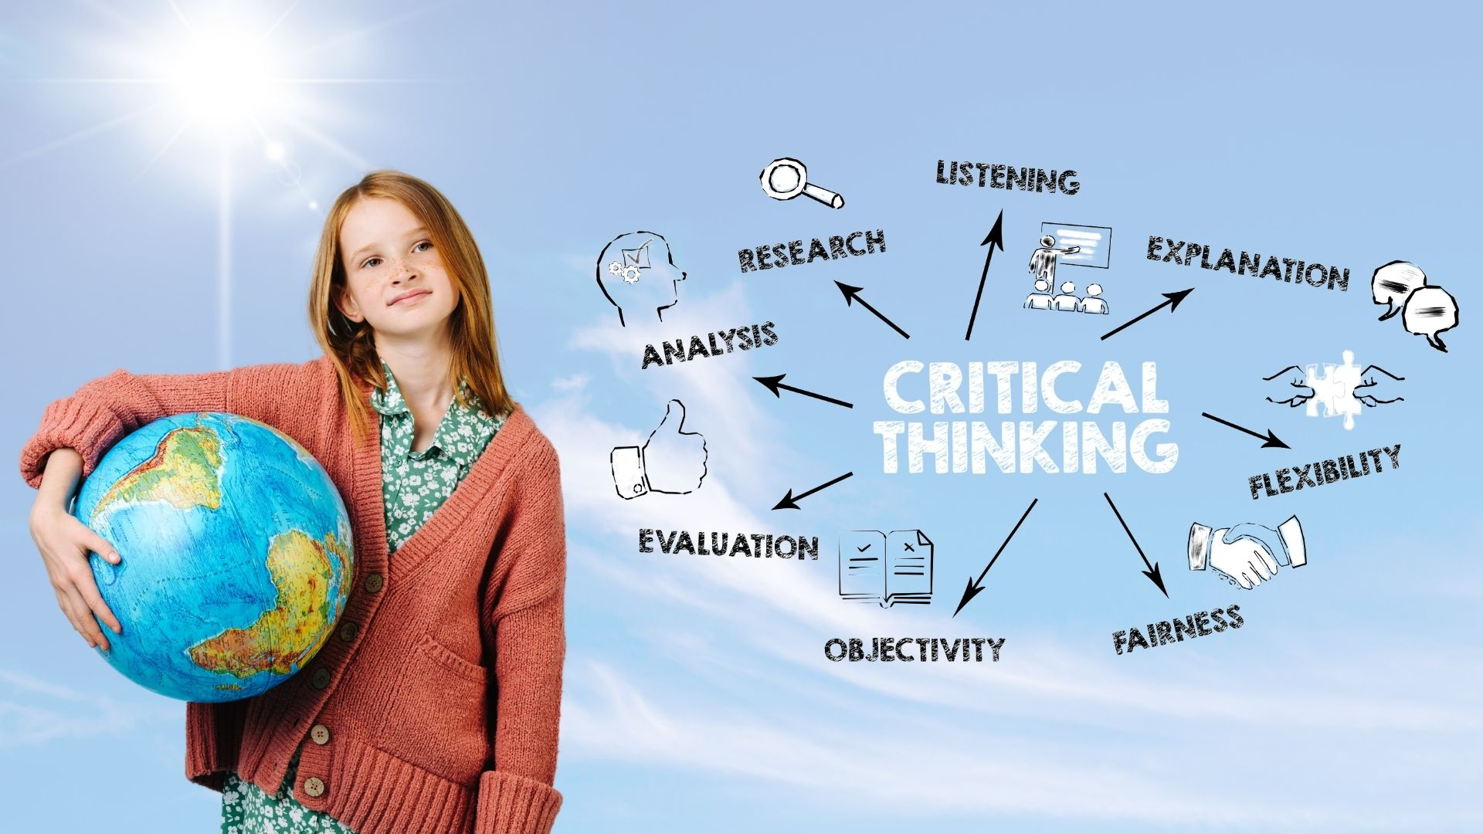
“The only way to learn mathematics is to do mathematics.”
- Paul Halmos

Slide 31

3, 2, 1 Reflection
3—What are three things you learned today?
2—What are two things you can implement, or try, in your classroom?
1—What is one area you want to learn more about?

Slide 32
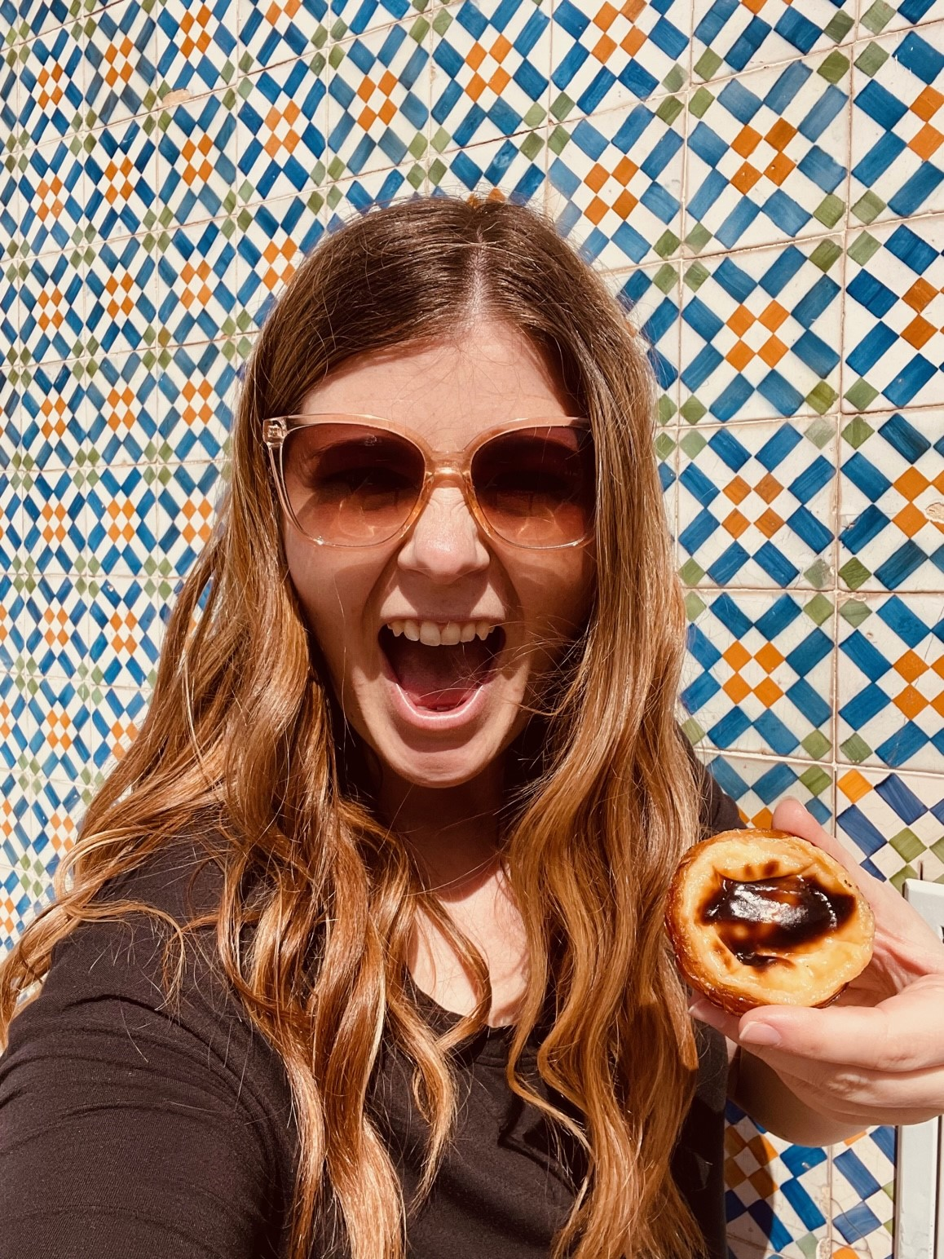
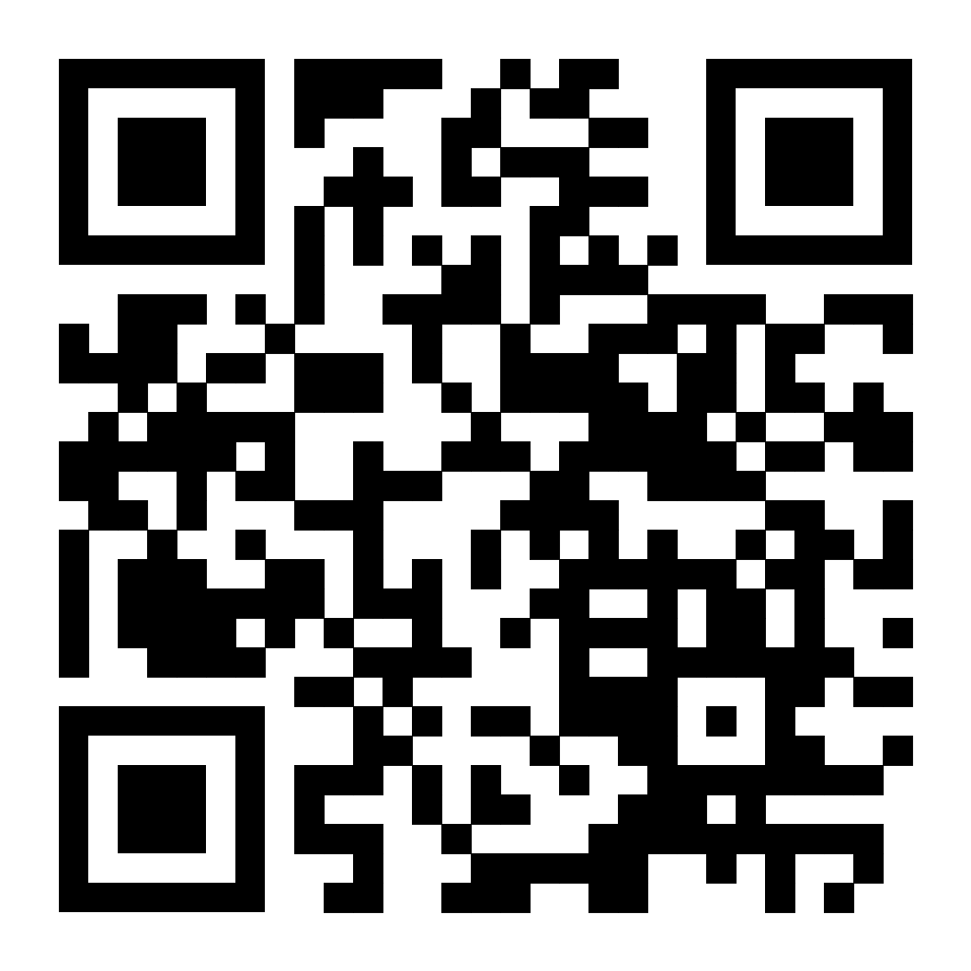
Sarah Porcenaluk
sporcenaluk@gmail.com
@sarahporcenaluk
Sarahporcenaluk.com
Please reach out with questions, concerns, stories, etc.!

