Slide 1



RETRIEVAL PRACTICE AND EFFECTIVE MATHS REVISION
Darren Russell

Slide 2

Aims
The aims of this workshop are to provide you with some knowledge on what retrieval practice is, the benefits for our students and some ideas for building it into your practice.
I also hope to give you some strategies to improve the quality of our students independent revision skills.

Slide 3

Retrieval practice – What is it?

Slide 4

What is successful teaching? Or even what is successful learning?
Students understand and absorb the information being taught.
Students can perform the skills they have learned.
But can they do this after a period of time? Can they recall the skills and information they have learned in previous days, weeks, months or years?
Successful teaching or learning is when students can recall knowledge and perform taught skills after a period of time.

Slide 5

The Sciencey bit
To understand how to improve students ability to learn information and recall it later we must consider how learning and recall happens for our students.

Slide 6
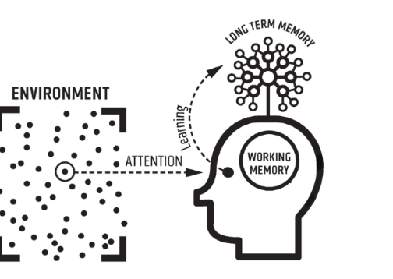
In broad terms information goes into working or short term memory first.The information is being taught, discussed, students are focusing on it, thinking hard about it.
“Learning happens when people have to think hard.”
– Rob Coe (2013)
Through classroom activities, repetition, practice and problem solving it is committed to long term memory.

Slide 7
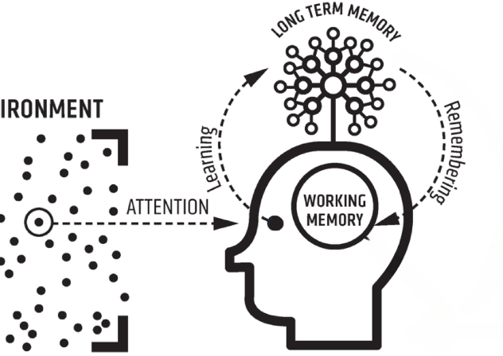
Once information is stored in long term memory we want our students to be able to recall it efficiently.
For students to use this information in the future they must recall, retrieve or remember it and bring it back into their working memory.

Slide 8

All of our memories have a storage strength and recall strength.
How well we learned and understood the information determines the storage strength.
How accessible the memory is determines the recall strength.
Each and every time a memory is recalled or retrieved the recall strength of that memory is increased.
In simple terms the more often students retrieve information the more easily they will retrieve this information in the future.

Slide 9
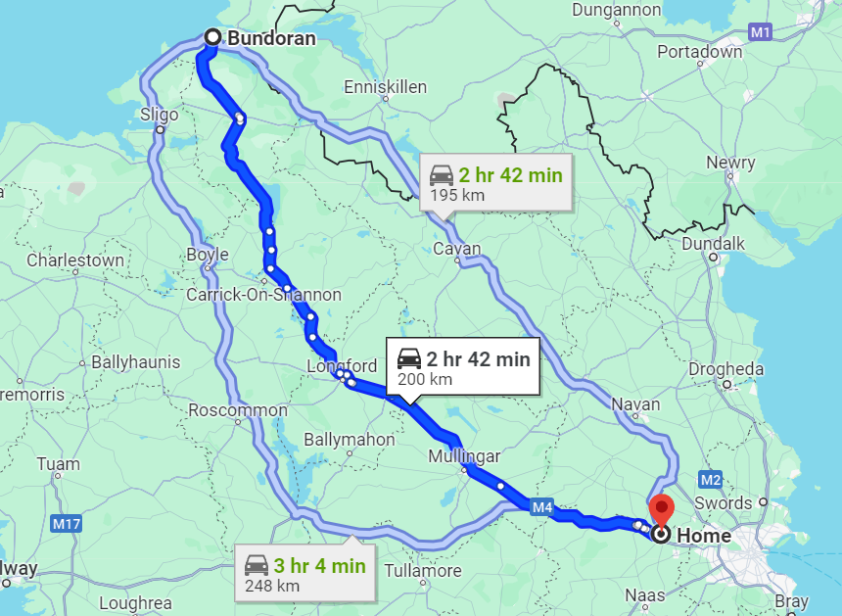
Think of it like getting directions from google maps…
Compare the first journey to the third journey, to the hundredth journey.

Slide 10

Retrieval practice – what is it?
Retrieval practice is a learning strategy where teachers provide students with the opportunity to recall previously learned information.
We want our students to practice pulling the information back out. The more often they do this the stronger their ability to recall that information becomes.

Slide 11

Ideas for Retrieval Practice Activites
There is no right or wrong answer here or one size fits all but here are some ideas…

Slide 12
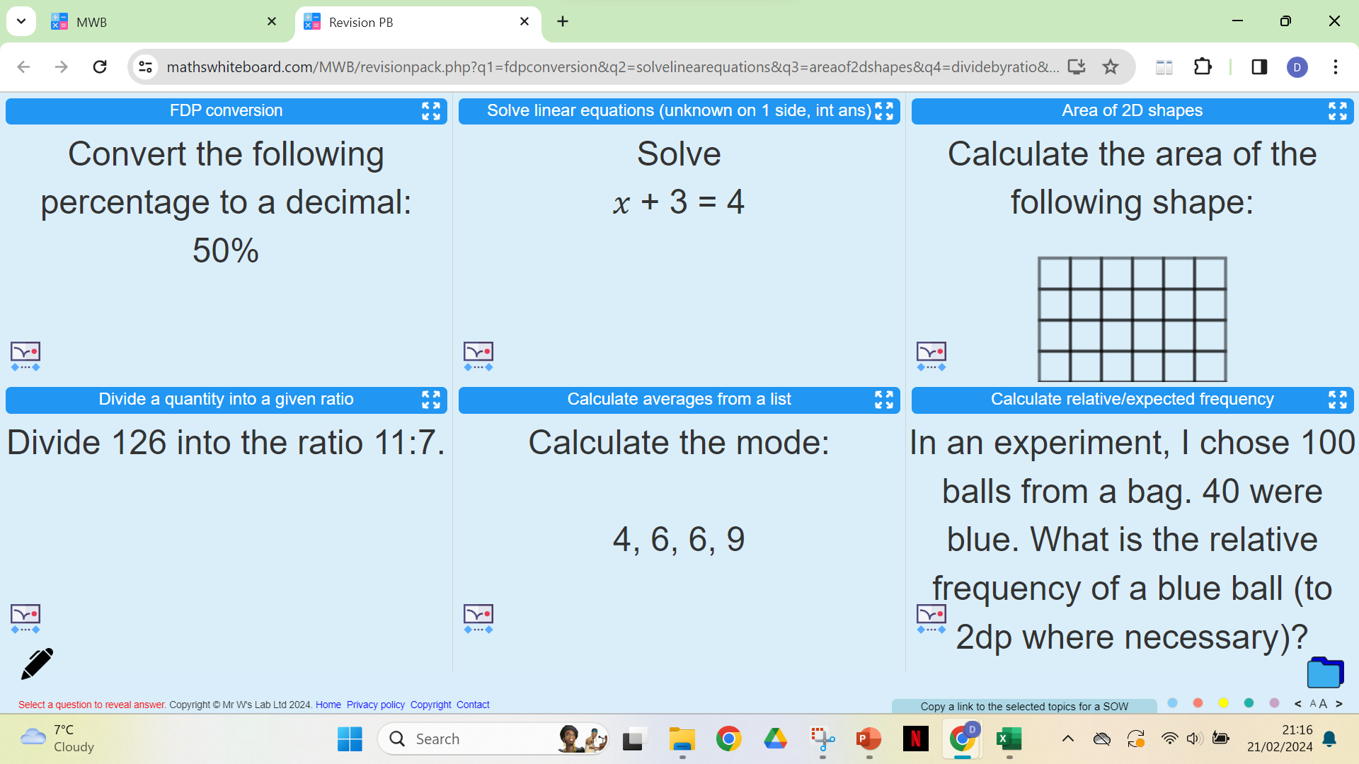
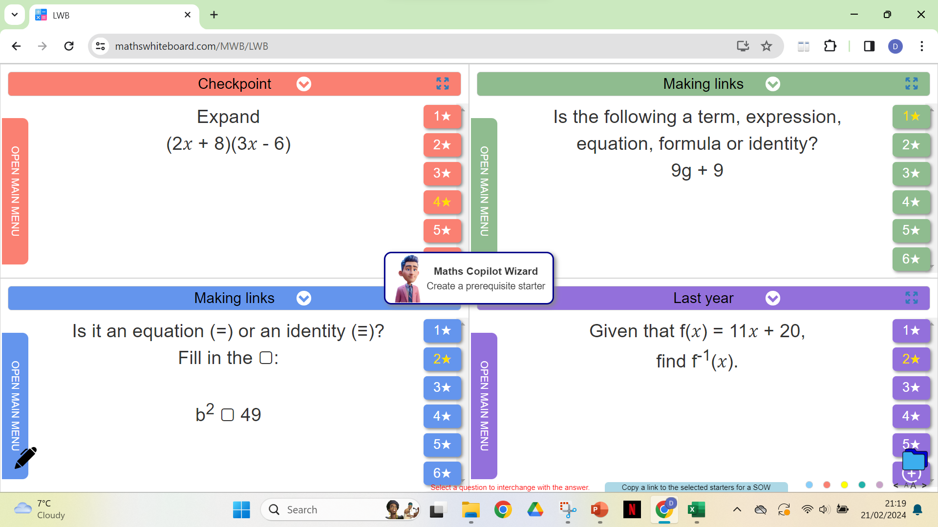
Mixed starters with LWB
https://mathswhiteboard.com/
Revision White Board
Last White Board

Slide 13


Slide 14
Mixed starters with LWB
https://mathswhiteboard.com/
Revision White Board
Last White Board

Slide 15


Slide 16
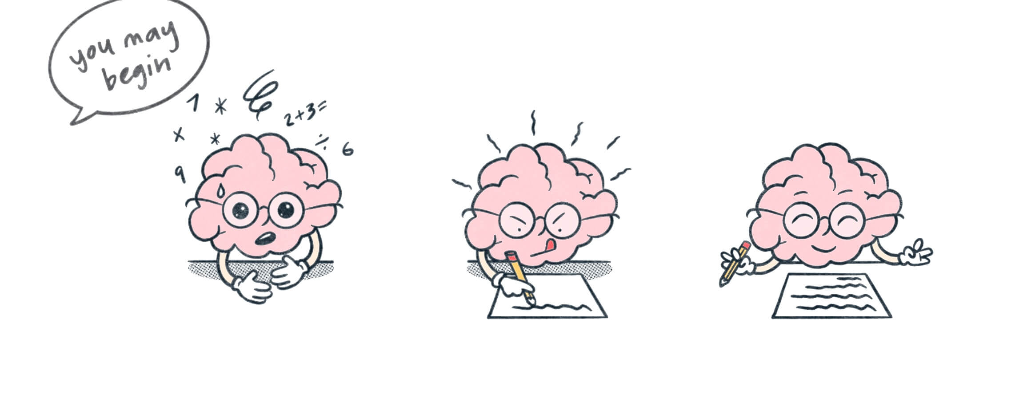
The Brain Dump
Students begin with a blank piece of paper and the task is to write down as much information as possible on the given topic in a certain period of time.

Slide 17
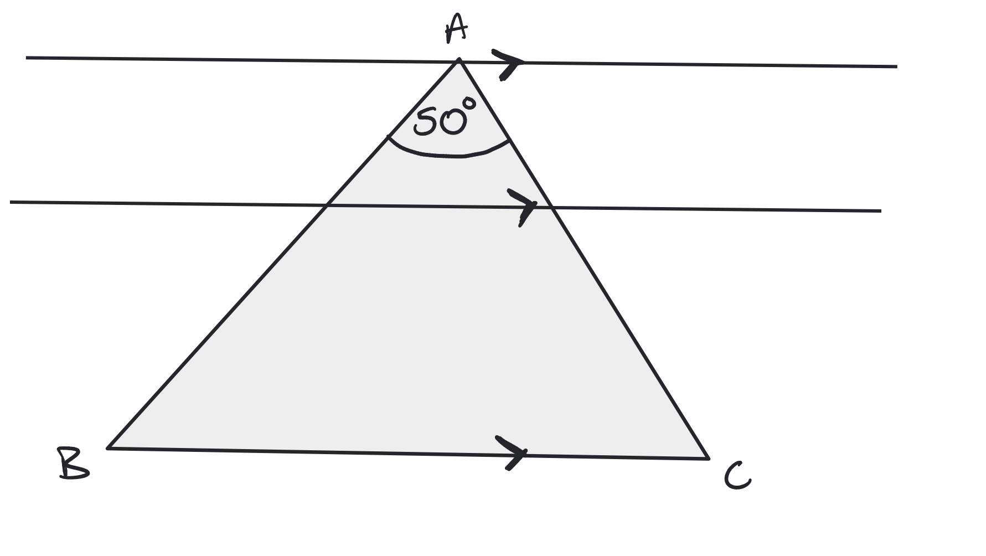

The Brain Dump Example
Copy the diagram and find the value of as many angles as possible, try to write down the reason/relationship for each angle value.

Slide 18

Low/No stakes Quizzing
Low stakes quizzing is about removing the pressure of achieving results and testing retrieval.
Kahoot, Socrative, 5 ‘check in’ questions in your copy, print outs, MCQ’s etc.
Students are testing their ability to recall information and skills. The emphasis is on the ability to recall not the overall results.
Remember:
Tests = Scary, Quizzes = Fun

Slide 19

Question Basket
Students create a question based on a given topic and write the answer on the back. Flashcards are great here, and the question creation can also be done as a homework activity.
The teacher collects the questions in a ‘basket’ and redistributes the questions for other students to answer.
For an excellent retrieval practice opportunity keep the questions for repeated use later.

Slide 20

Other Strategies for Retrieval Practice
Lots of the strategies we use for assessment are excellent examples of retrieval practice:
Summative exams
Mini whiteboards
Kahoots/Socratives
Plenaries
Often however we focus these tasks solely on our current topic, the same activities with past topics mixed in provides excellent opportunities for retrieval.
The possibilities are endless.

Slide 21

Key considerations when creating a retrieval activity

Slide 22


Struggle, Elaboration and Question Types
Desirable difficulty – We want our students thinking hard when retrieving but if we make it too difficult the students wont or cant engage and no retrieval takes place.
Aiming for an 80% average score is a great rule of thumb.
We can provide lots of challenge for our students by varying our question types.
If our retrieval activities are all about facts and procedures, then are students may only be recalling surface level knowledge and not being challenged to recall the skills and deep level understanding they need.
“Are students familiar or fluent?”

Slide 23

Hints and prompts
Students shouldn’t be provided with any hints or prompts initially, we want them to retrieve the information independently.
However including a hint or prompt after a certain amount of time provides an opportunity to scaffold the activity for all students.

Slide 24
Hints and prompts
Providing the answer without any workings can allow students to check whether they are correct or need to reconsider their solution
We have to be careful here – we don’t want to provide the students with any outside information to solve a problem.
For retrieval to occur the information must come from the student. Don’t provide any worked examples!!

Slide 25
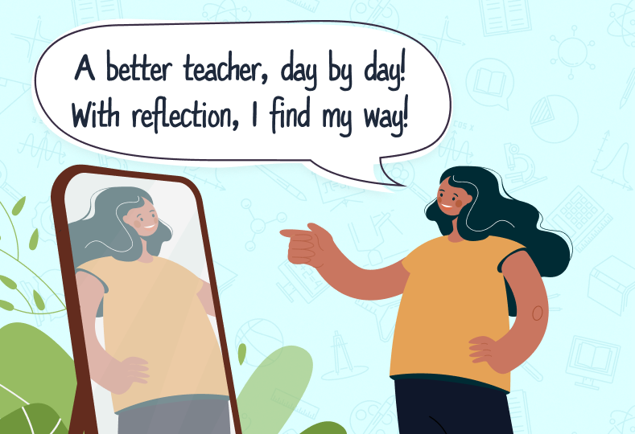
Reflection
We want our students to reflect on their retrieval performance. If they were unable to recall the information or skill this is an area they need to focus on when revising independently.
We also want to gauge the overall performance of the class – are there any areas all students struggled with? Do I need to revisit a certain topic briefly? This can inform the planning for the next retrieval activity.

Slide 26

Planning for Retrieval

Slide 27
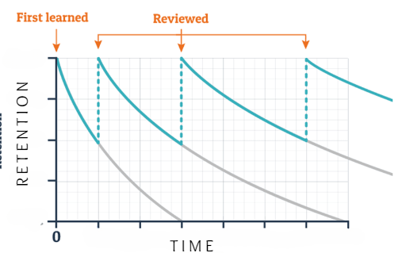
Spacing and the Power of forgetting
We want students to recall information from their long term memories so we need to allow them time to ‘forget’ it.
The Golden Question:
How long should I allow for forgetting before retrieving a given topic?

Slide 28
Spacing and the Power of forgetting
We want students to recall information from their long term memories so we need to allow them time to ‘forget’ it.
One key thing to consider is that while students hold information in their working memory then no retrieval takes place, as it is not necessary.
Generally any spacing is good. And we can continue to revisit topics over longer periods of time to ensure retrieval is occurring.

Slide 29
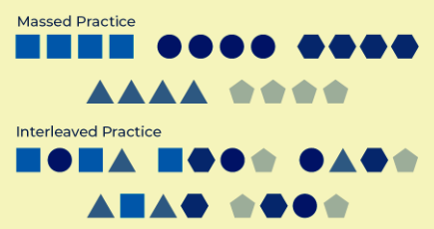
Interleaving
Retrieval practice does not need to be a stand alone activity. There are opportunities to retrieve everywhere.
Interleaving is the opposite of blocking, teaching all topics in a block as a stand alone. Interleaving is teaching multiple topics at once and switching over and back.

Slide 30
Interleaving or Interweaving
Interweaving is (I think) the best of both worlds. Including previous topics and skills as extensions on worksheets and assessments to force students to recall information while also focusing on what they are currently learning.

Slide 31

To Summarise
Retrieval practice is a learning strategy which improves the students ability to recall and apply previously learned topics and skills.
The more often students practice retrieval the stronger this ability becomes.

Slide 32

That’s what we can do what can our students do?

Slide 33

We want to provide our students with the skills and strategies to revise effectively.
A lot of our students want to revise but don’t know how, what works , how long to spend, what to prioritise… and become overwhelmed.
We began working with our students on Effective Revision and saw immediate benefits.

Slide 34
What is Effective Revision?

Slide 35
Effective revision is when our students spend more time in Active revision rather than Passive revision.
Effective revision is when our students consistently evaluate their knowledge and work to fill in gaps in that knowledge.
Effective revision is when our students practice recalling information.
What is Effective Revision?

Slide 36

Passive revision
Reading through information
Copying information
This can be a necessary part of revision but it leads to recognition of information not recall.

Slide 37

Active Revision
We want our students to:
Assess their knowledge
Review their knowledge
Identifying gaps in their knowledge
Address these gaps
Repeat

Slide 38
Strategies for Active Revision

Slide 39

In the classroom
By incorporating these strategies into our classroom practice we are giving our students an opportunity to try before you buy.
Students can decide which strategies suits them as individuals and which ones they can build into their own routines.
These strategies are also excellent examples of retrieval practice activities.

Slide 40
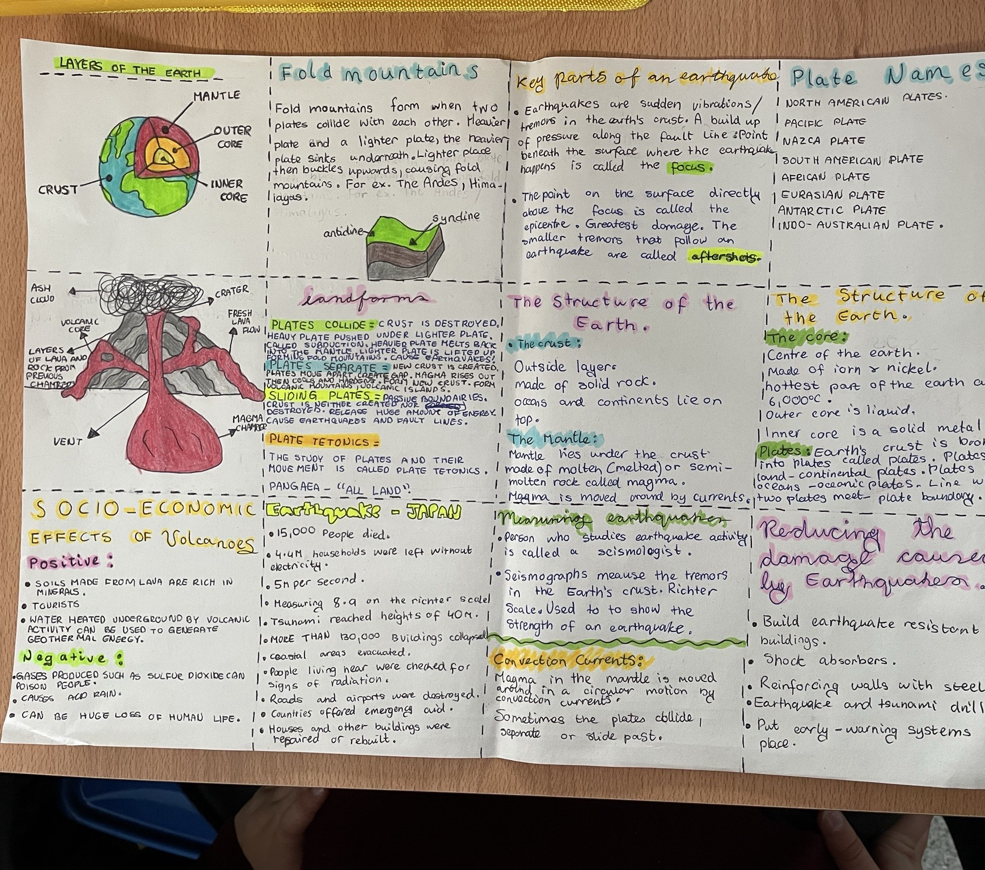
Knowledge Organisers
A Knowledge Organiser is a personalised sheet summarising the key information of a given topic in a students own words.
To properly create a Knowledge Organiser students will need to:
Review the content
Summarise the content
Explain in their own words
Highlight key words or definitions
Organise the information into one place.

Slide 41
In the classroom

Slide 42
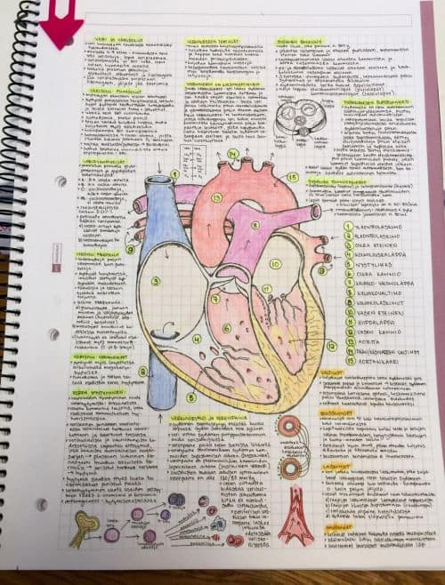
Knowledge Organiser
At the end of a topic/chapter/unit of learning we can ask our students to create a knowledge organiser to summarise.
This can be done on an A4 sheet and kept in a folder. At the end of the year students would then have a series of personalised revision sheets.
This could also be done in a notes copy to summarise the previous set of notes.
Allowing students to use their Knowledge Organiser as a ‘cheat sheet’ for a class test is a great incentive to get students to create high quality knowledge organisers.

Slide 43

Flashcards
Students can create flashcards to help them assess and review their knowledge.
Students can test themselves at the start of a study session to identify gaps in their knowledge. This will give provide a clear focus on what to revise.
Students can use flashcards to test a variety of material – short answer questions, labelling diagrams, keywords or verbs in a language subject.
Students can recite the answers out loud, write the answers and check them afterwards or even create a study group and test their friends.
Once created students can reuse flashcards throughout the year as quick check in to assess their knowledge.

Slide 44
In the classroom

Slide 45

Flashcards
Ask students to create three flashcards on a given topic in class or for homework – one easy question, one medium question and one challenging question. The students must provide the answer as well.
Students then use their flashcards to test each other.
Students will have to review the content to create and answer their own questions and then have the benefit of answering other students questions.
We can add a scoring sheet into this where students receive points for answering another students question.

Slide 46

Brain Dump
The brain dump is an activity where Students begin with a blank piece of paper.
Students must write down everything they know about their chosen topic in a short space of time, usually 5 to 10 minutes.
Students then take time to review what they wrote down and identify any mistakes and any key information they missed.
Students can perform this activity at the beginning of a study session to give them a focus.

Slide 47
In the classroom

Slide 48
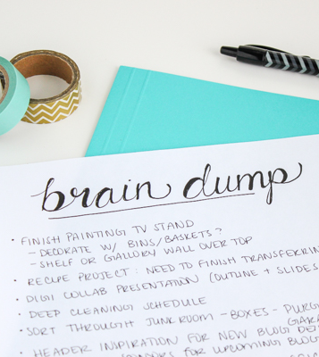
The Brain Dump
This is an excellent starter or plenary activity.
Provide students with a blank piece of paper and put a timer on the board.
“You have five minutes to write down everything you know about Coasts”
Students can then self or peer assess each other and include any information they missed.
Its important that the teacher highlights the information that the students should have.

Slide 49

Be the Teacher
This strategy is based on the idea that “If you want to understand something well, try to explain it simply.”
Students write the subject/concept they are studying at the top of a sheet of paper.
Students then try to explain the topic it in their own words as if they were teaching someone else. What are the key words and definitions? What are the key concepts? What tips and tricks would you give to help someone understand.
Students being able to explain in detail in their own words improves their understanding and ability to recall information.

Slide 50
In the classroom

Slide 51

Be the teacher
We can provide our students the opportunity to be a teacher in a group setting. Take a given topic and split it into 2 or 3 or 4 sections, one for each member of the group.
Students have a given time limit to become an ‘expert’ and then teach the information to the rest of the group. Repeat the process until all information has been taught.
Gauge the progress made by having a short quiz or test on the topic of the lesson.
Students can feedback to their classmates on what they taught well and what areas to improve.

Slide 52

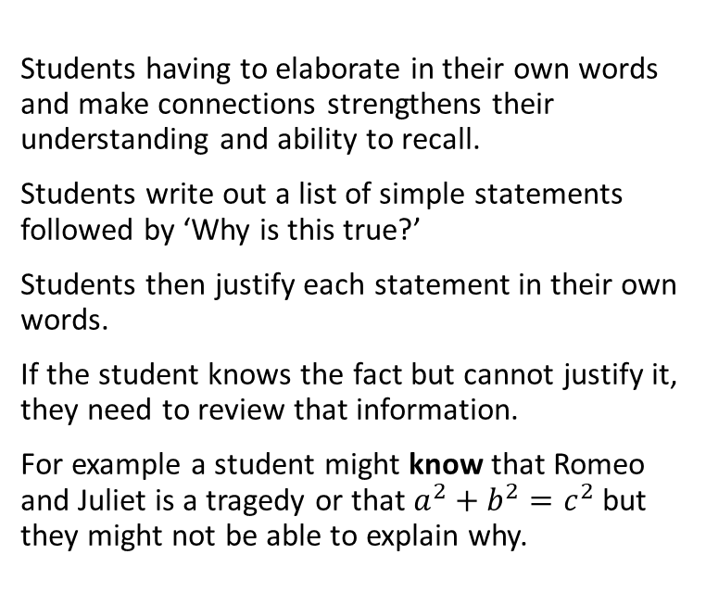
Elaborative interrogation
Students having to elaborate in their own words and make connections strengthens their understanding and ability to recall.
Students write out a list of simple statements followed by ‘Why is this true?’
Students then justify each statement in their own words.
If the student knows the fact but cannot justify it, they need to review that information.
For example a student might know that Romeo and Juliet is a tragedy or that $a^{2}+b^{2}=c^{2}$ but they might not be able to explain why.

Slide 53
In the classroom

Slide 54
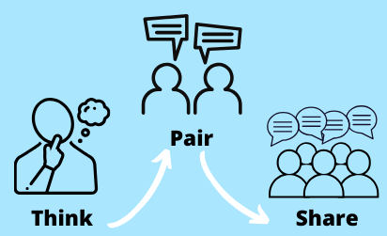
Elaborative Interrogation
Elaborative interrogation is all about having students provide justification for knowing facts. This lends itself perfectly to a Think Pair Share exercise.
The teacher can provide a list of ‘facts’ about a given topic and students can think of their own justifications.
They can then discuss their justification in their pair.
Finally the student pair can share and discuss their justification to the entire class group.

Slide 55

The key takeaway
We want our students to be Active not Passive when revising.

Slide 56

The key message
We want our students to:
Assess their knowledge
Review their knowledge
Identifying gaps in their knowledge
Address these gaps
Repeat

Slide 57
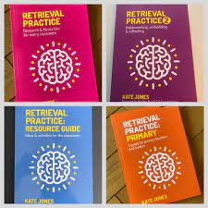

Further Reading
For Retrieval practice ideas
Retrieval practice website https://www.retrievalpractice.org/
Kate Jones
Retrieval Practice series of books:
For the ‘Sciencey’ bit:
Mr. Barton Maths podcast 183 with Nick Soderstrom:
https://open.spotify.com/episode/0luAVu5uQBhITIvh5e9iI6?si=mpSoDbWwT7yJKXnuESyJdQ (and many many more)
Bjork Learning and Forgetting Lab:
https://bjorklab.psych.ucla.edu/research/
Worth a follow on Twitter:
@Teach_Solutions
@RetreiveLearn
@mrbartonmaths (New book ‘Tips for Teachers’)
Myself: @MrDRussellmaths

Slide 58

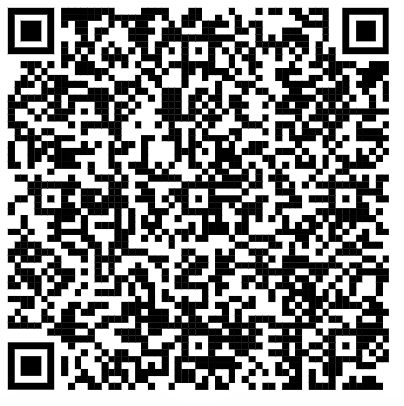
Feedback form:

