Slide 1


IMTA
CONFERENCE
2024
Inclusion in the Maths Classroom
Maynooth University

Slide 2


PROGRAMME
LUNCH
01
Your programme is digital. Please scan QR code or go to www.imta.com throughout the day
04
Lunch is served in the Phoenix Restaurant. Helpers will be on hand to direct you.
SPEAKERS
EVALUATION/CERTIFICATE
02
Talks will start on time. Please help by getting to each talk quickly.
05
Please ensure you complete the evaluation/contact details at end of day to get attendance certificate
REFRESHMENTS
FUN
03
Tea/Coffee will be served both upstairs and downstairs
06
Have a great day and have lots of fun!

Slide 3
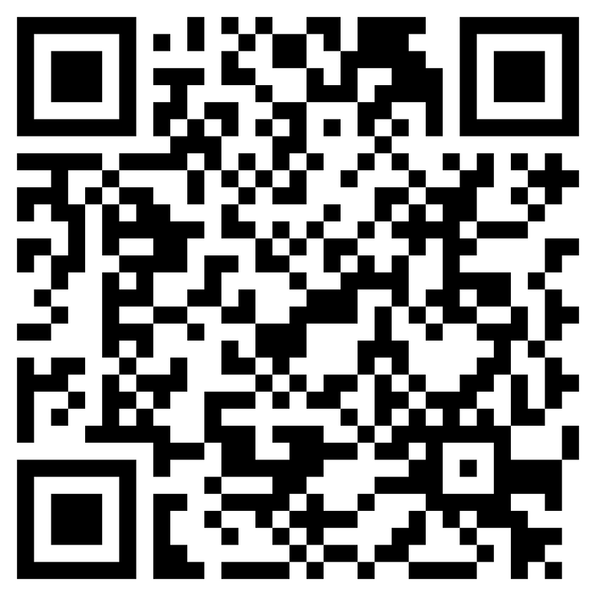
www.imta.ie
IMTA in 2024
The IMTA celebrates its 60th birthday in 2024
2444
>57%
MEMBERS
OF SCHOOLS
NATIONWIDE
ARE MEMBERS
SCAN FOR PROGRAMME
417
263,981
SCHOOLS
STUDENTS SUPPORTED
BY IMTA MEMBERS

Slide 4
PROGRAMME
Today’s programme can be found online at www.imta.ie or by scanning the QR Code

Slide 5
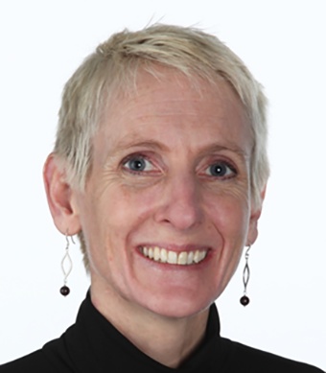
Scan for Programme
KEYNOTE SPEAKER - DR AIBHÍN BRAY
Dr Aibhín Bray is an Assistant Professor in Mathematics Education at the School of Education in Trinity College Dublin.
She previously worked as the co-ordinator of research for Trinity's widening participation programme: Trinity Access.
She holds a B.A. (Int) in Mathematics and Italian and an M.Sc. in Computer Science from University College Dublin, and a H.Dip. in Education and a Ph.D. in Technology and Mathematics Education from Trinity College Dublin.

Slide 6
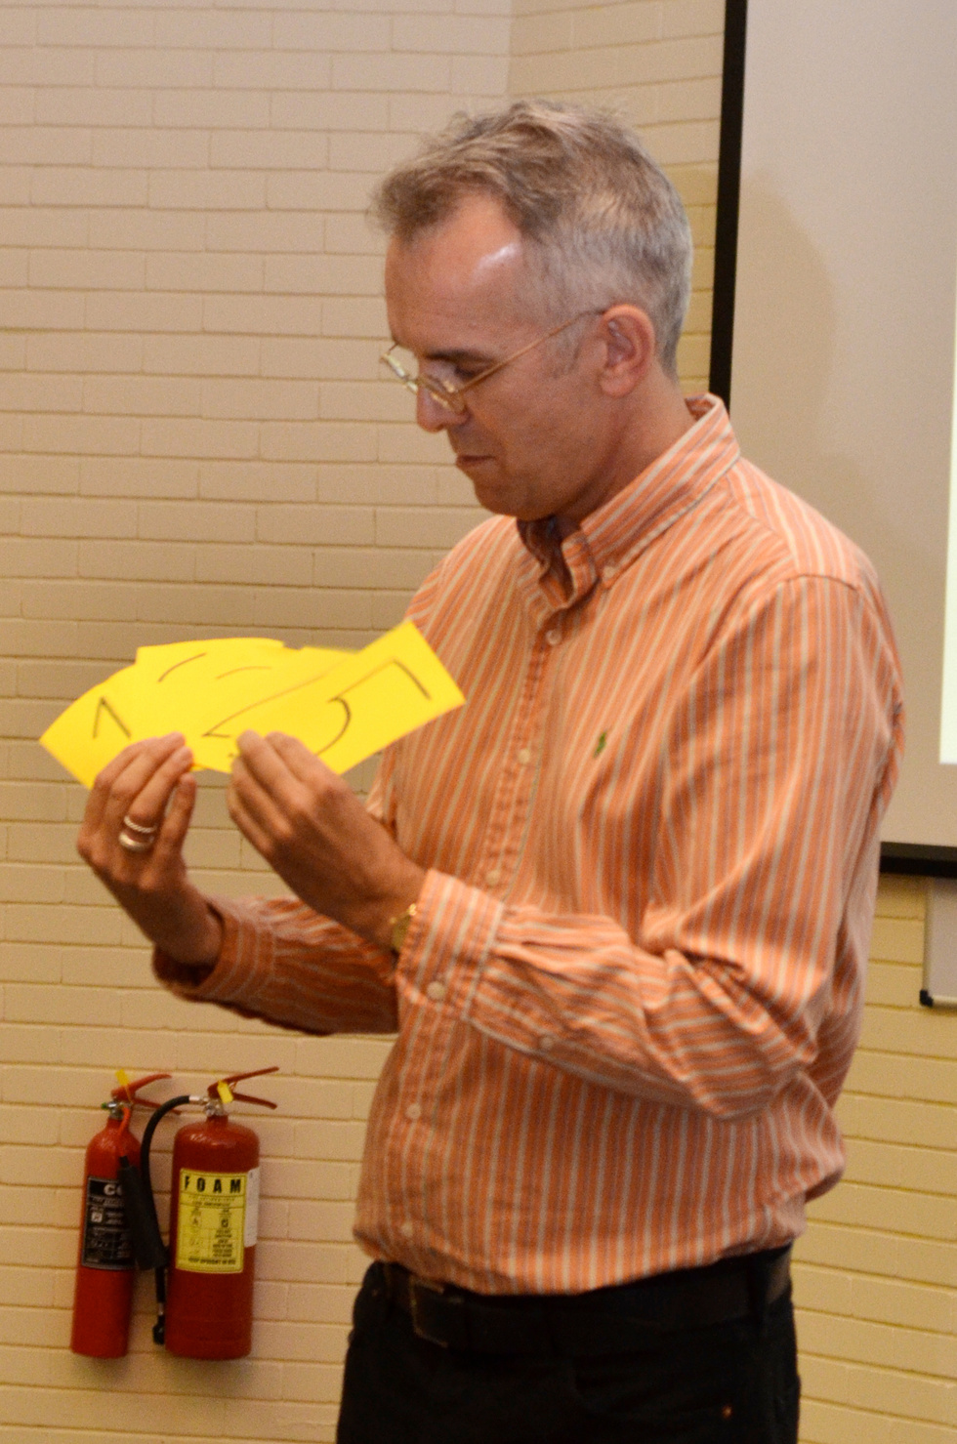
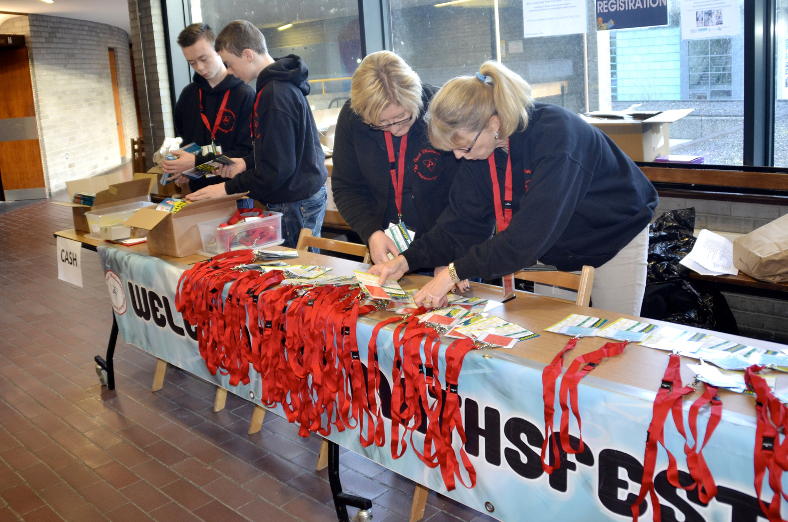
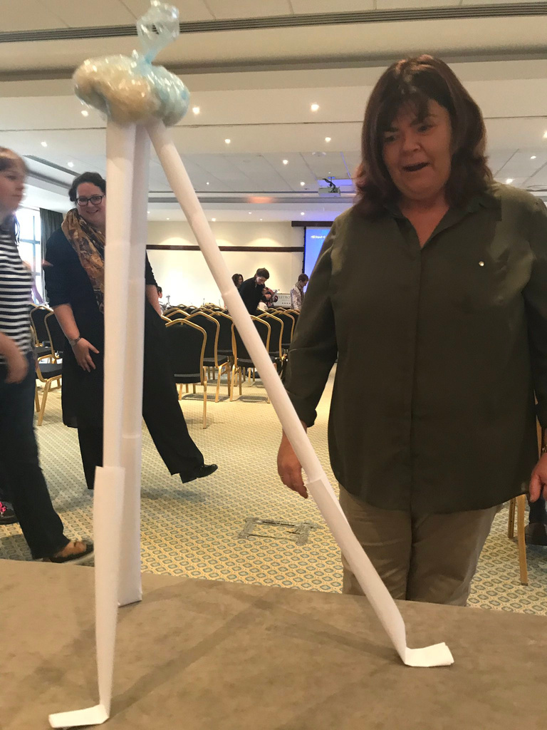
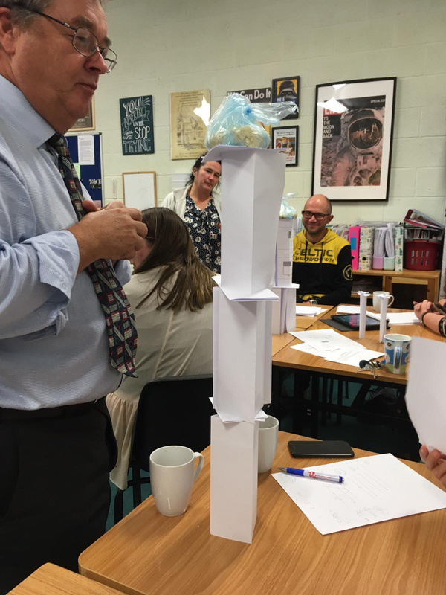
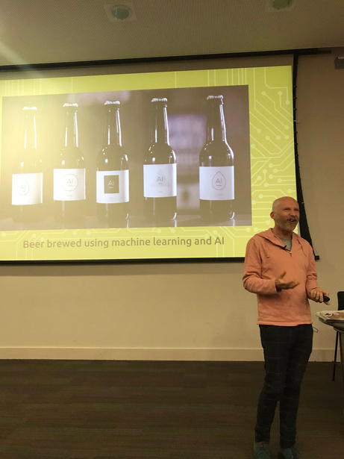
Teacher CPD

Slide 7
PROGRAMME
Today’s programme can be found online at www.imta.ie or by scanning the QR Code

Slide 8
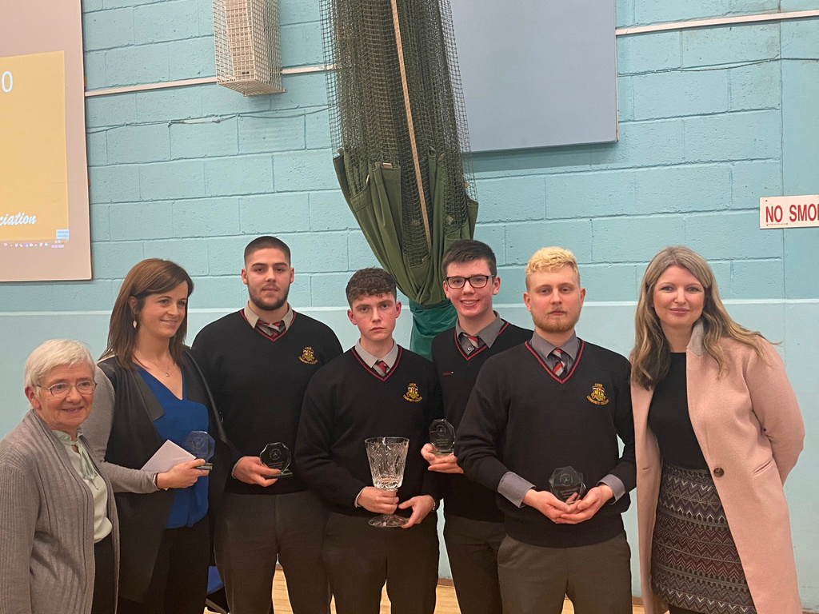
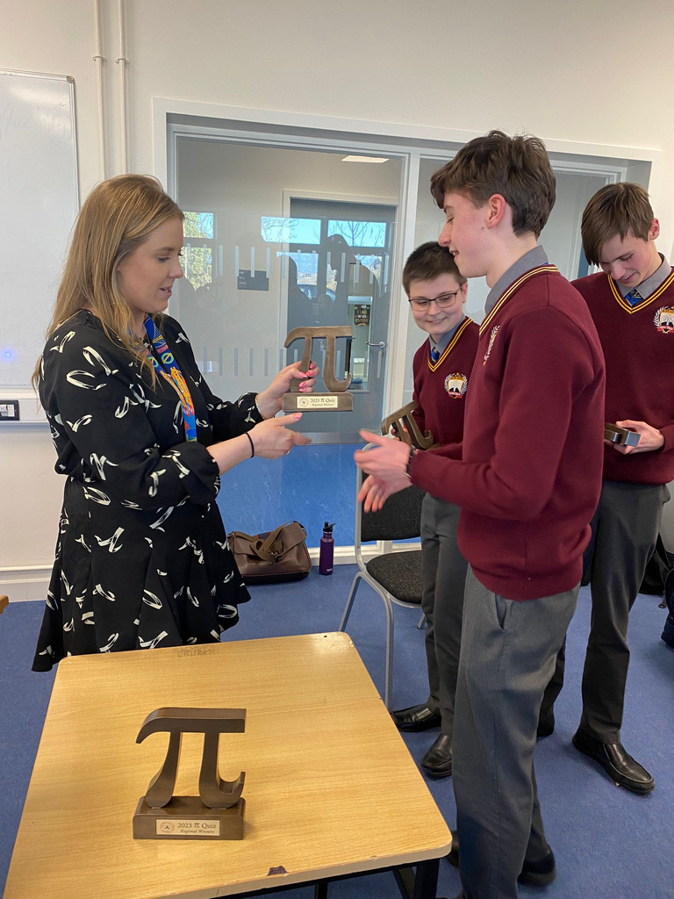
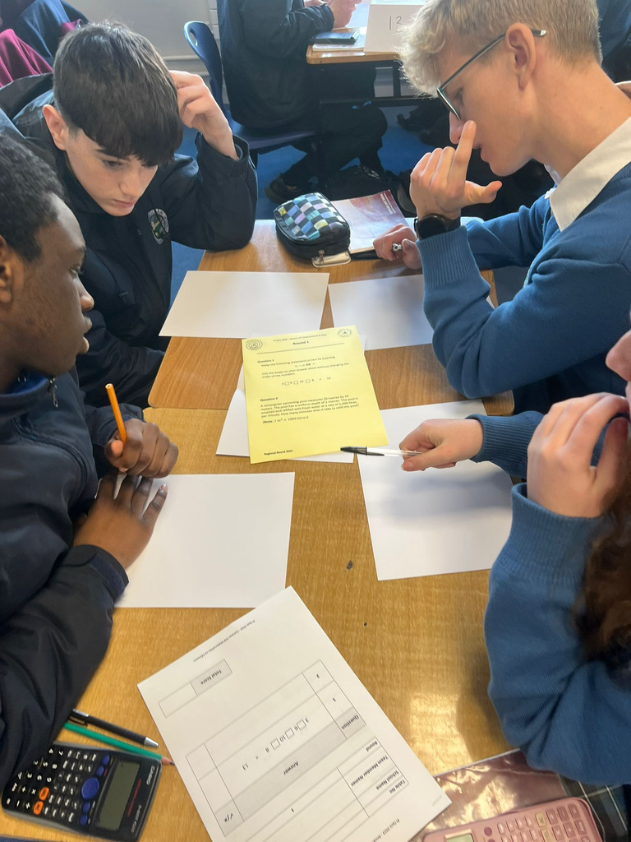
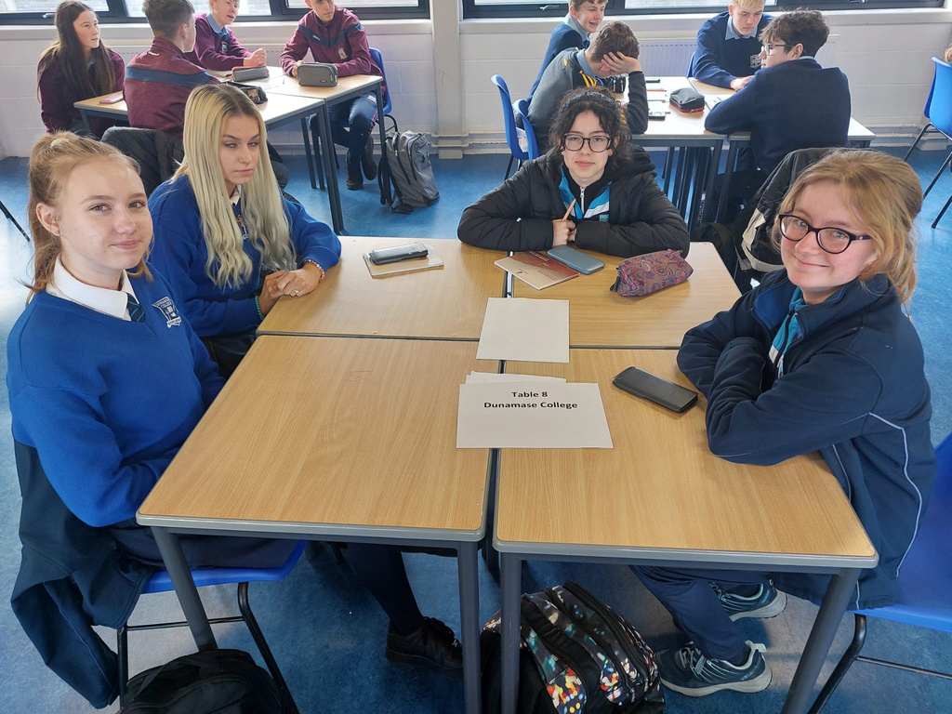
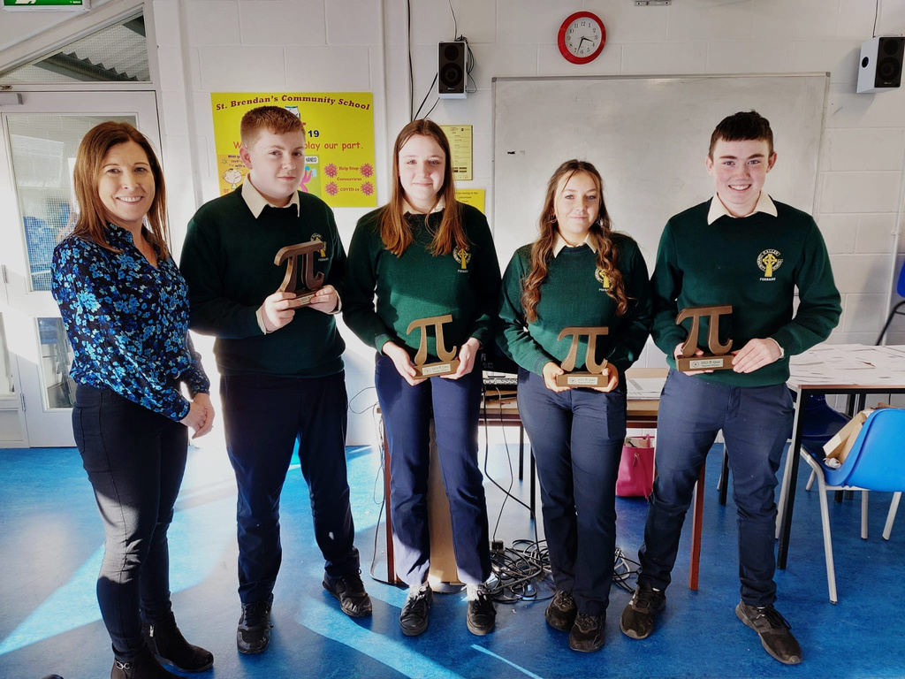

Slide 9
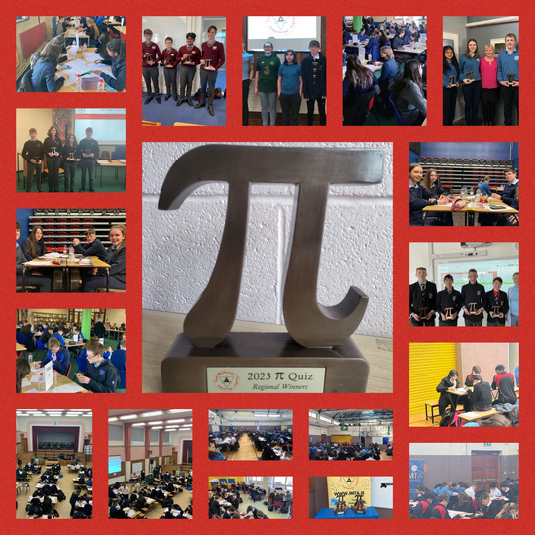
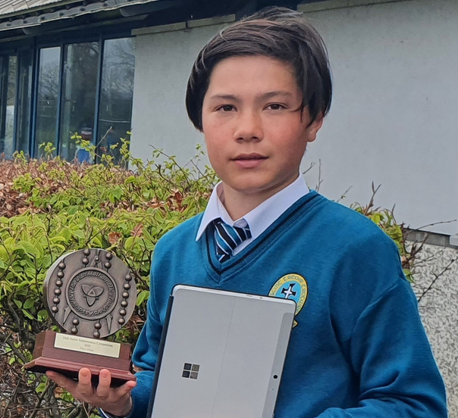
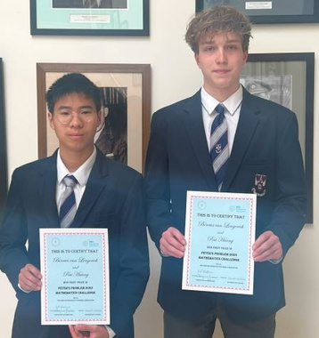
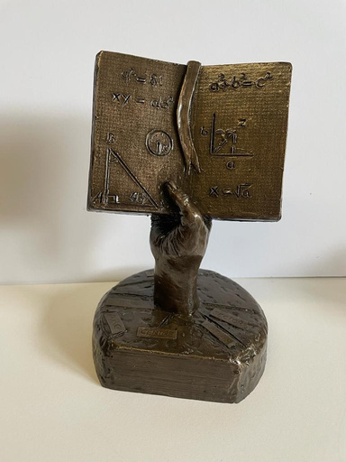
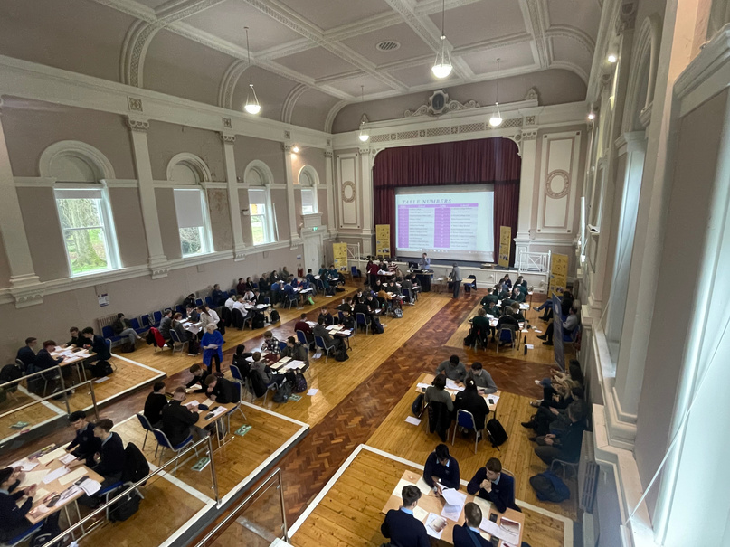
IMTA COMPETITIONS
Pi Quiz
something for everyone...
590 teams competed in 2023 from 231 schools across 36 regional centres
1st Year Competition
Peter’s Problem
15,312 entries in 2024 from 233 schools
532 entries in 2023
from 65 schools
Maggie Gough
Team Maths
18,700 entries in 2023 (2nd & 4th/5th Year Students)
193 teams competed in 2023 from 97 schools across 12 regional venues.

Slide 10
PROGRAMME
Today’s programme can be found online at www.imta.ie or by scanning the QR Code

Slide 11
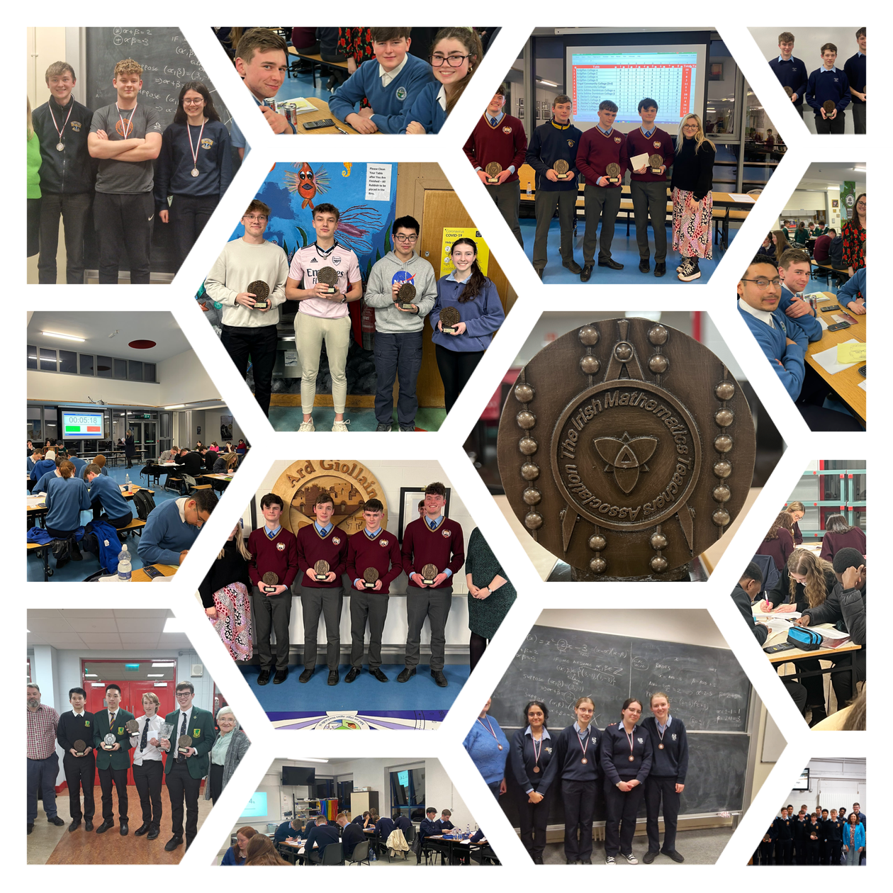
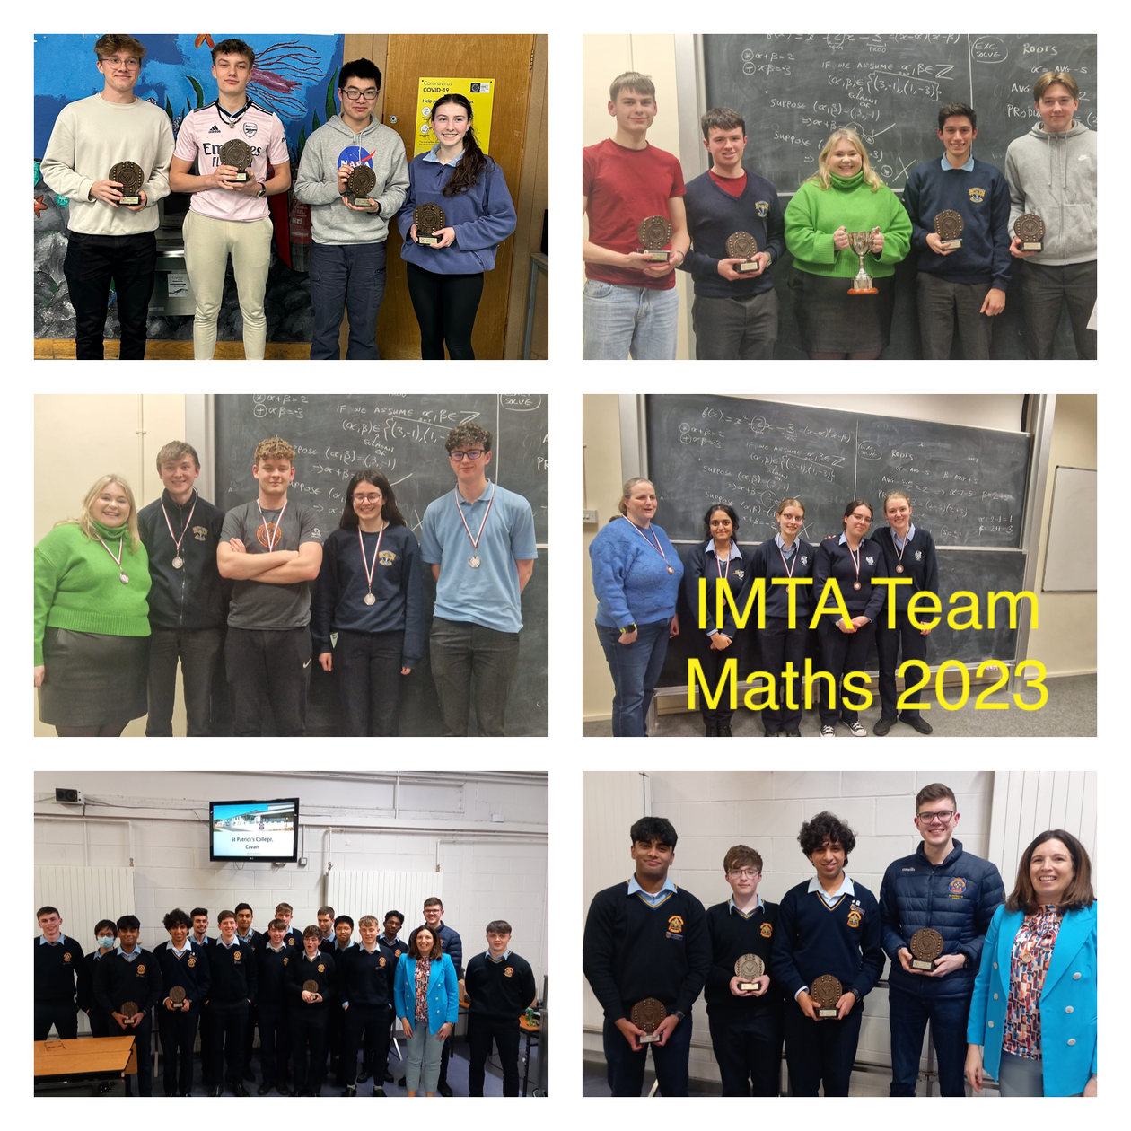
Student Competitions

Slide 12
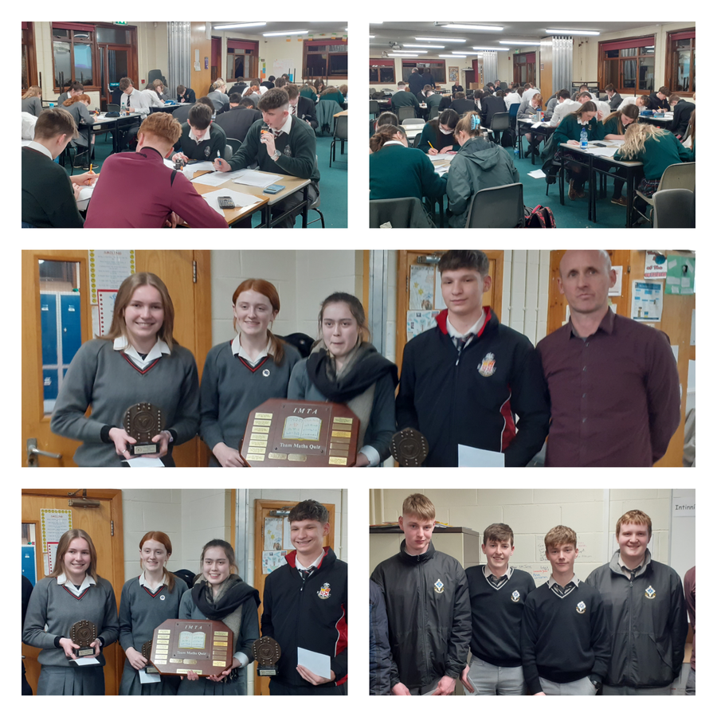
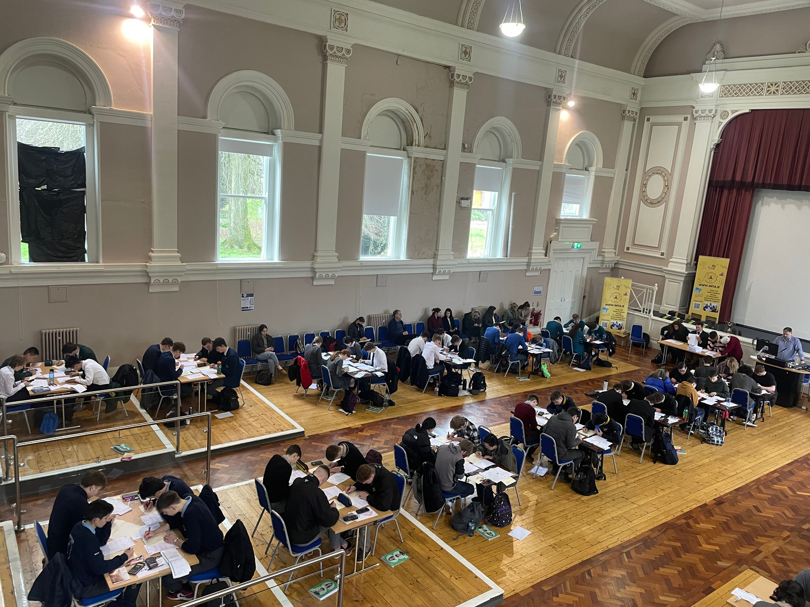
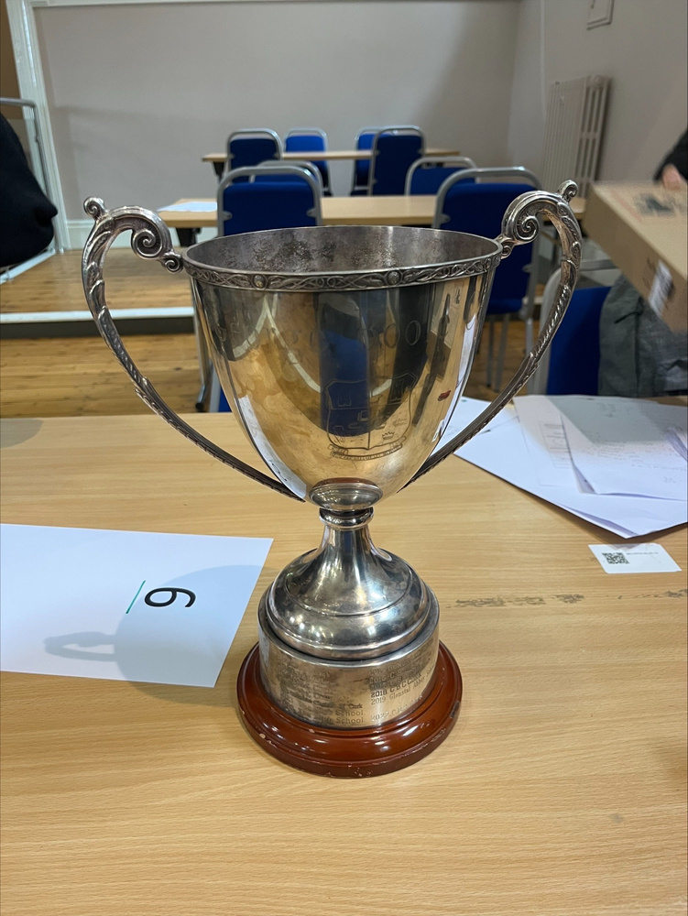
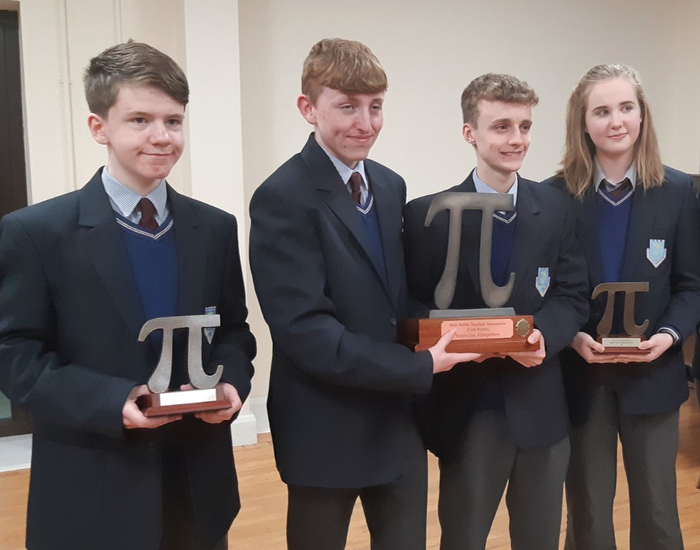
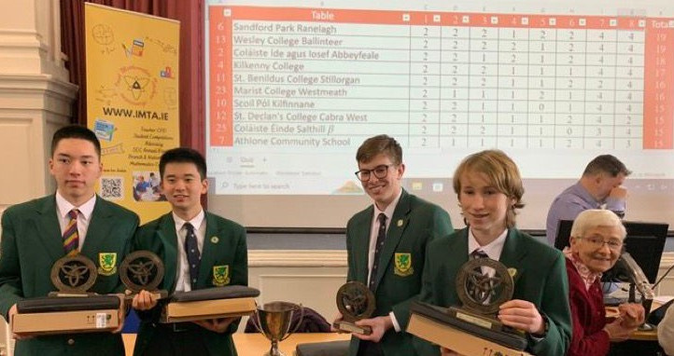
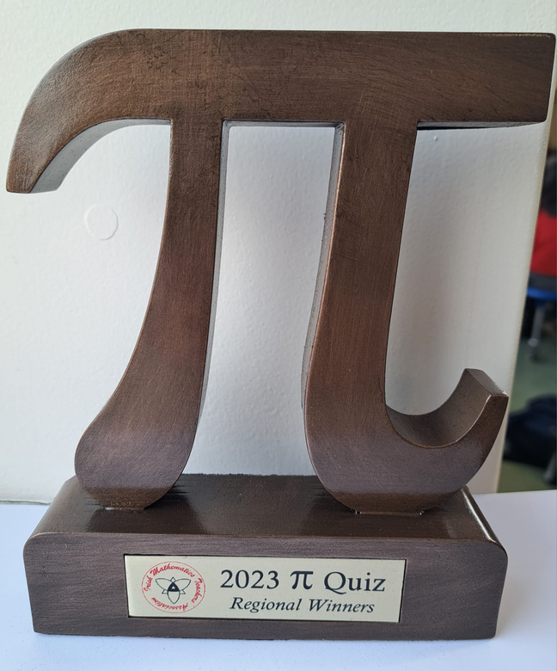

Slide 13
PROGRAMME
Today’s programme can be found online at www.imta.ie or by scanning the QR Code

Slide 15




THANKS TO OUR MANY SPONSORS

Slide 16
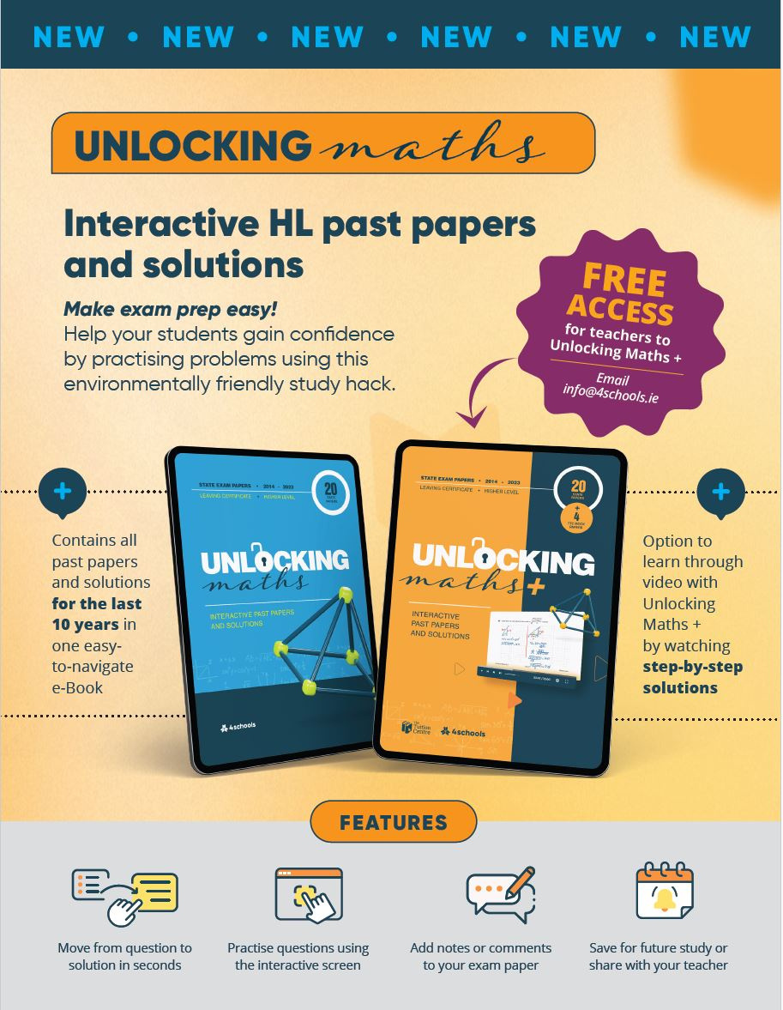

scan for programme

Slide 17
PROGRAMME
Today’s programme can be found online at www.imta.ie or by scanning the QR Code

Slide 18
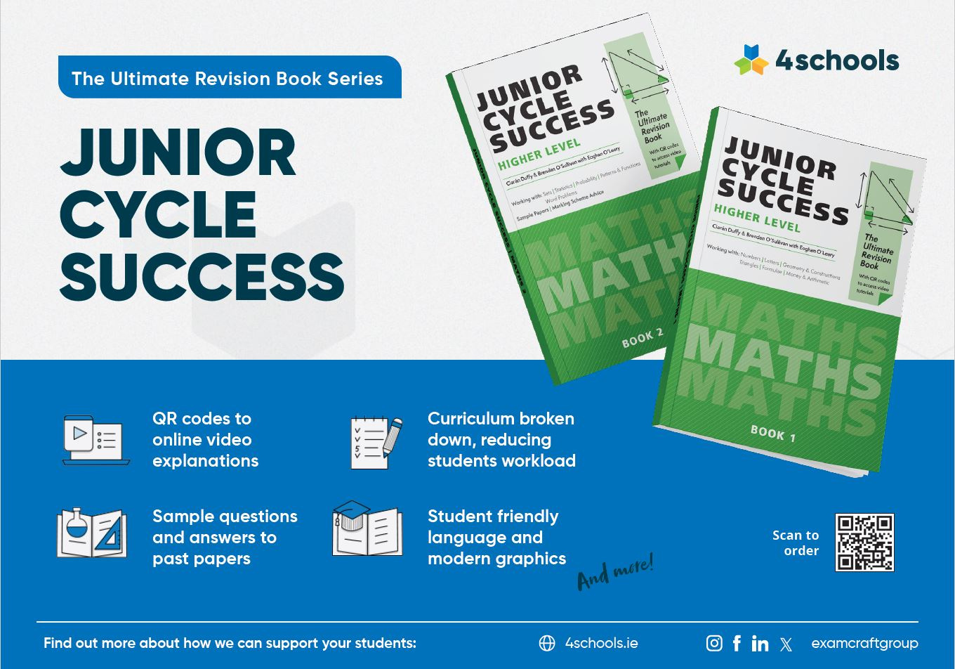

Slide 19

Scan for Programme

Slide 20
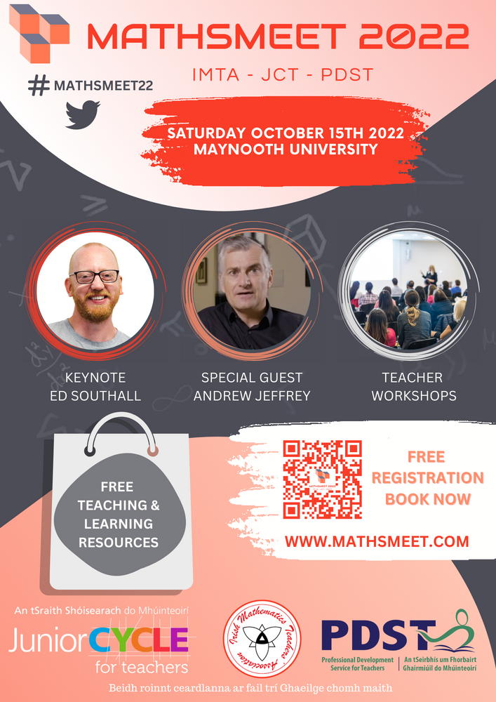

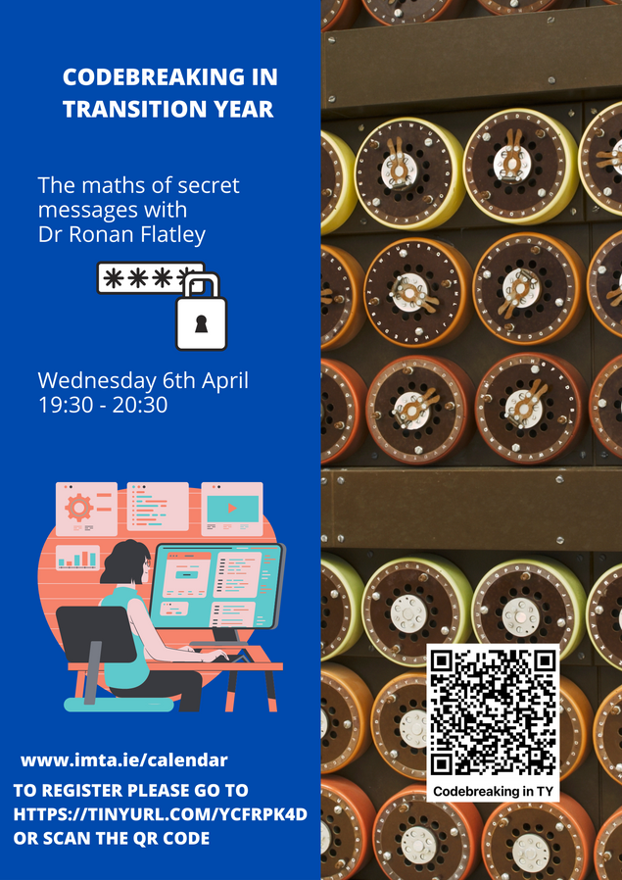
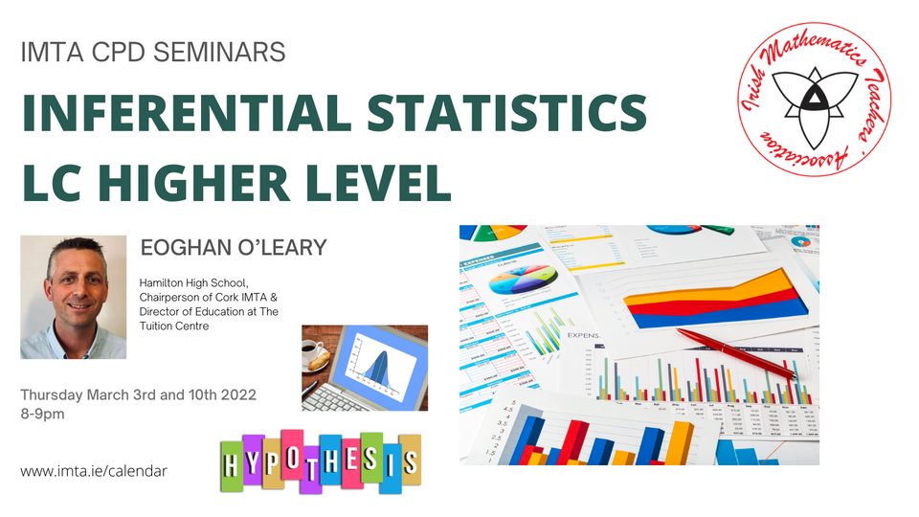
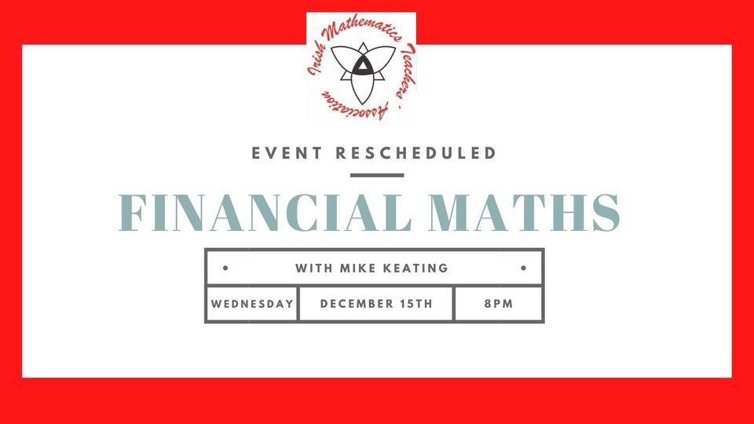
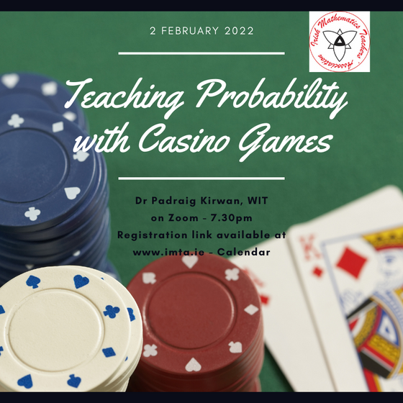
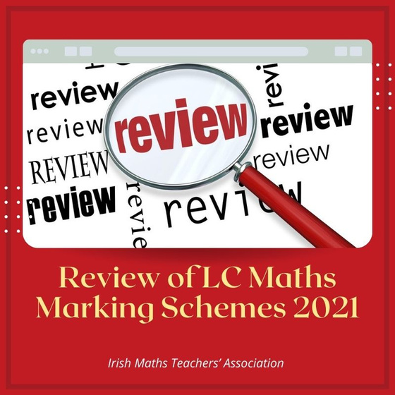
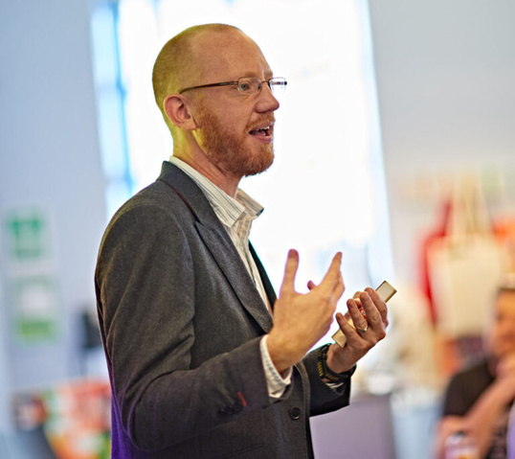
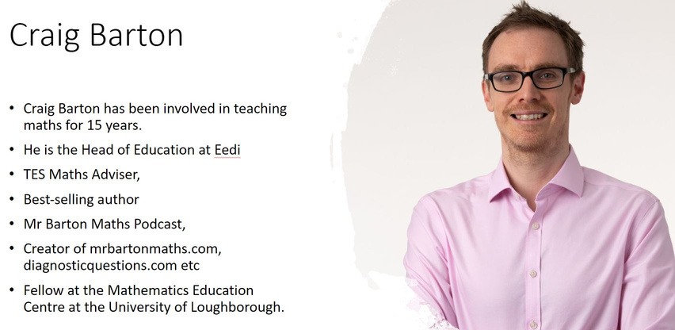

Slide 21
PROGRAMME
Today’s programme can be found online at www.imta.ie or by scanning the QR Code

Slide 22
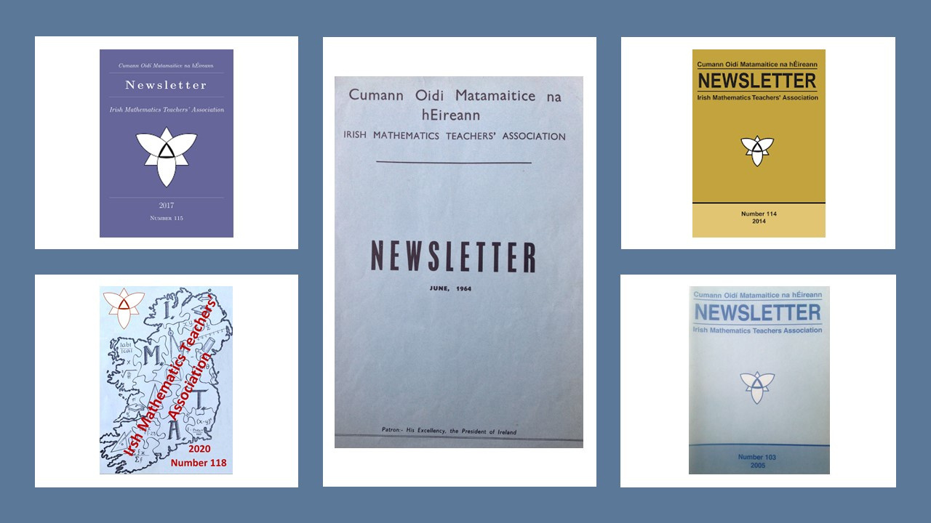

Slide 23
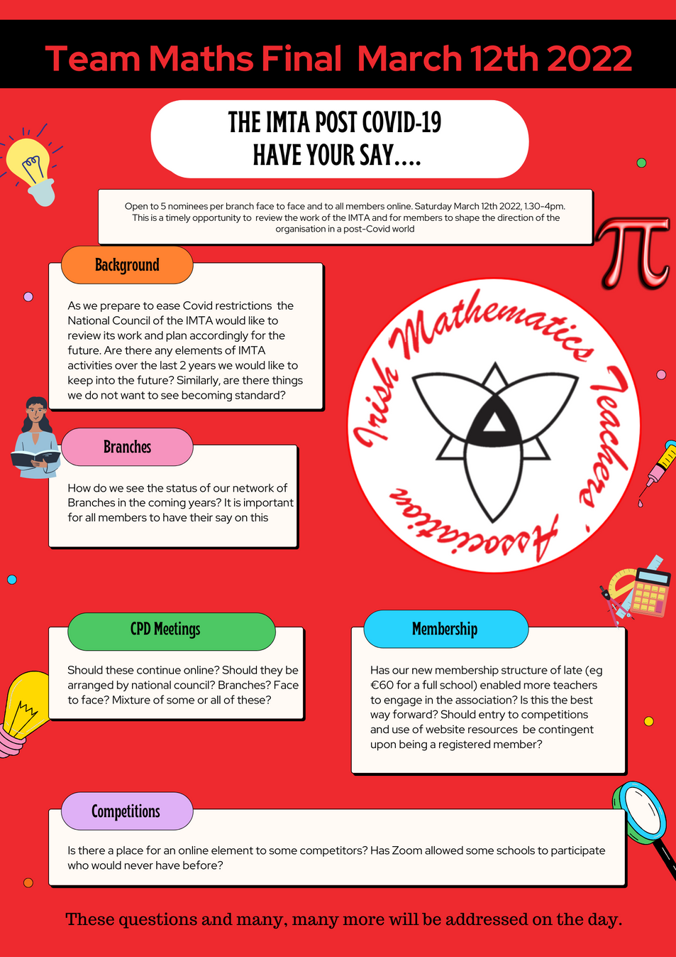
A Reflective Association
As part of the Team Maths Final 2022, we hosted a Review & Reflection of the work of the IMTA post-Covid and used it as an opportunity to take stock, asses what we have done and see where we are going as an organisation.
We had a blended session with participants face to face answering some thought-provoking questions coupled with members contributing via Zoom.
We used Mentimeter to gather answers to questions which both asked us what we do well, what we need to keep and more importantly where we fall down, in terms of our aims and objectives as set out in our constitution.

Slide 24
PROGRAMME
Today’s programme can be found online at www.imta.ie or by scanning the QR Code

Slide 25
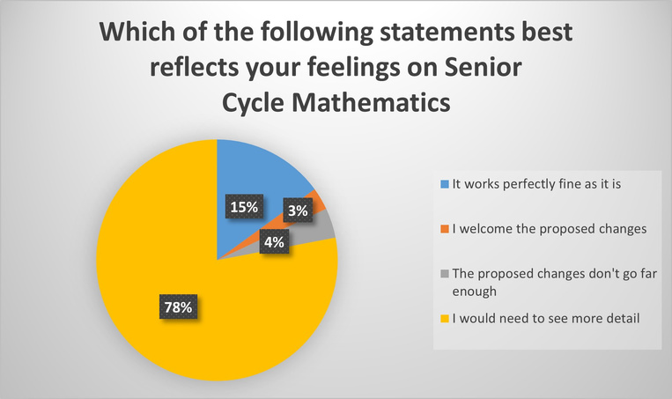
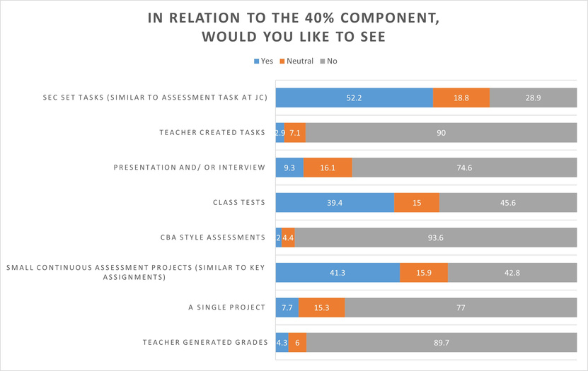

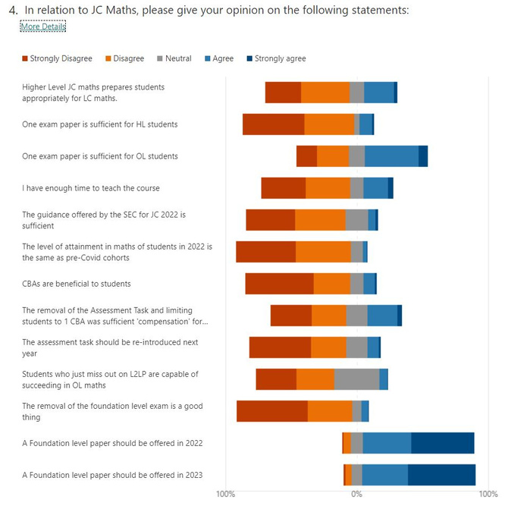
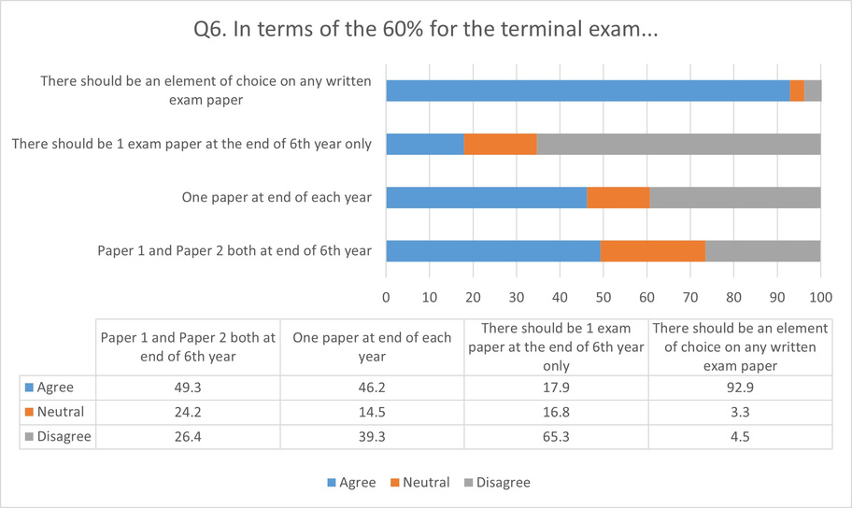
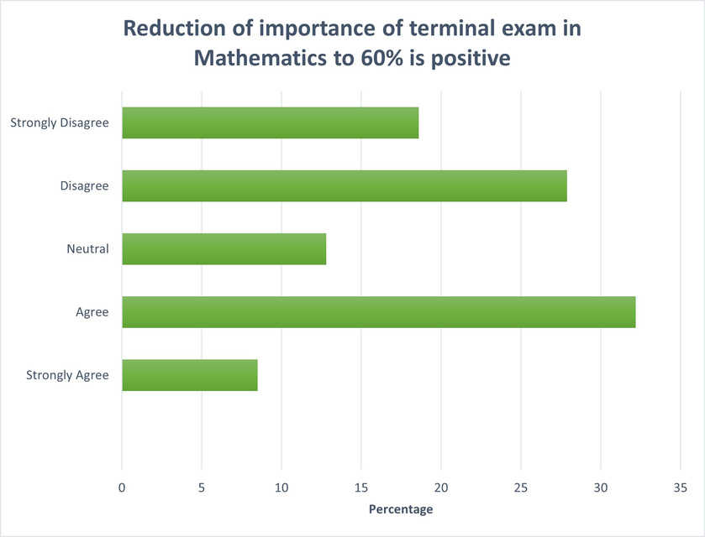
Advocacy
Gathering Views of
Teachers & Students

Slide 26
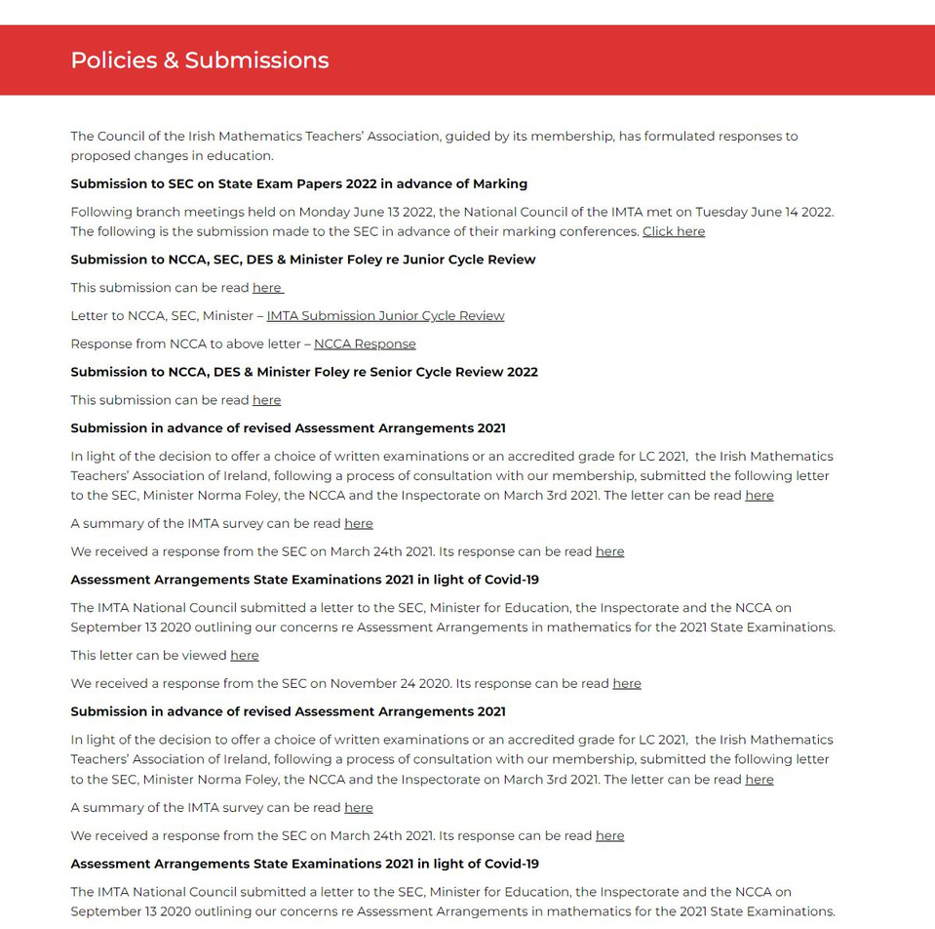
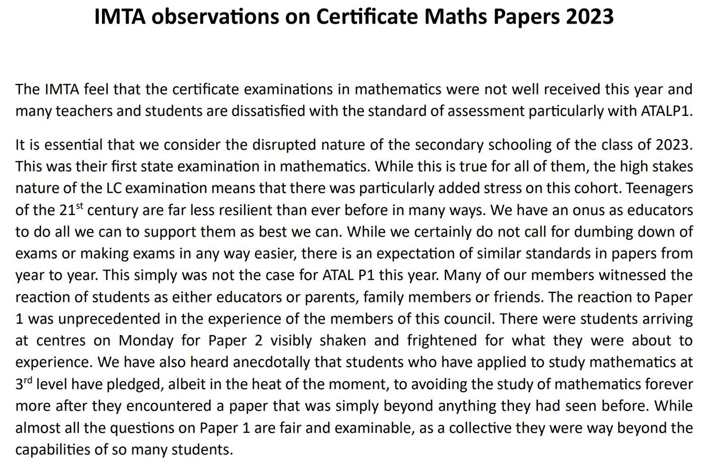
Recent IMTA submissions

Slide 27
PROGRAMME
Today’s programme can be found online at www.imta.ie or by scanning the QR Code

