Slide 1


Teacher Professional Learning in Mathematics Education
Eoghan Long

Slide 2
Layout
Introduction
Forms of Professional Development (PD) in Mathematics
Case Study: Applied Mathematics PD Programme
Research Study Methodology
Findings
Discussion
Conclusion

Slide 3

Introduction
PD has been part of Irish Education for many years but Harford (2010) described teachers’ experience of it as fragmented (reactive rather than proactive).
Significant PD in Mathematics since 2010 with an emphasis on transforming pedagogy to focus on problem solving and real-life context.
Lack of research regarding the optimum design in an Irish context or reviews of national PD programmes for specification reform from a teacher’s perspective.

Slide 4

Introduction: Why focus on PD?
There may be significant reform at Junior and Senior Cycle but without effective PD, objectives may not be met.
Johnson et al. (2019) found that Irish mathematics teachers were still struggling to implement reform pedagogies years after the completion of the Project Maths PD programme.

Slide 5
PD: An International Perspective
Finland: PD viewed as a continuum throughout a teacher’s career and mainly consists of teacher led research-based projects.
USA: three major trends in the transition away from short workshops, connecting professional development to evaluations and the increased use of video technology.
China and Israel: Mathematics teachers and researchers collaborating to analyse and improve pedagogy.
However, replicating policies without understanding cultural variations rarely leads to improvements (Burdett and O’Donnell, 2016).

Slide 6
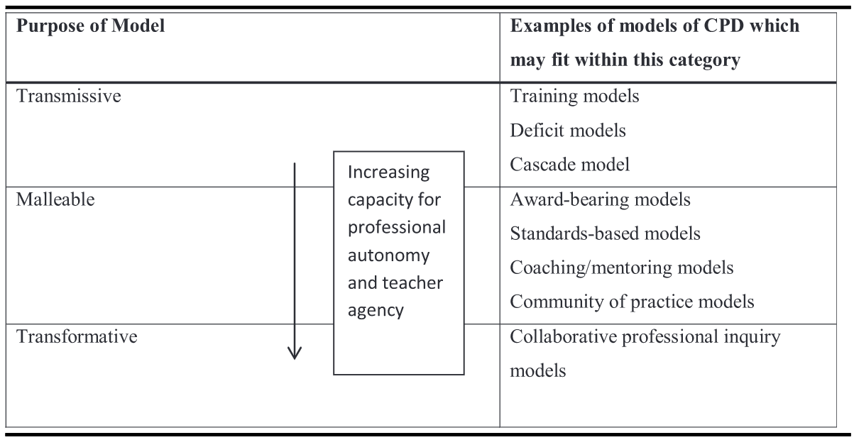
  Models of Professional Development
Kennedy’s (2014) Spectrum of CPD Models.

Slide 7
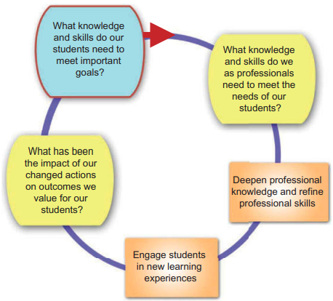
Models of Professional Development
Muijs et al. (2014) proposed a dynamic unified model

Slide 8

  PD in Irish Mathematics Education
Significant reform over the past 15 years led to 10 full-day workshops from 2010-2014 that focused on pedagogical approaches for contextual strands.
Upon programme completion, the NCCA (2014) stated that further PD was necessary suggesting a gap between the specifications’ pedagogical aims and the programme’s outcomes.
Lesson Study was introduced in 2014 to continue to improve methodologies and also strengthen professional learning communities.

Slide 9
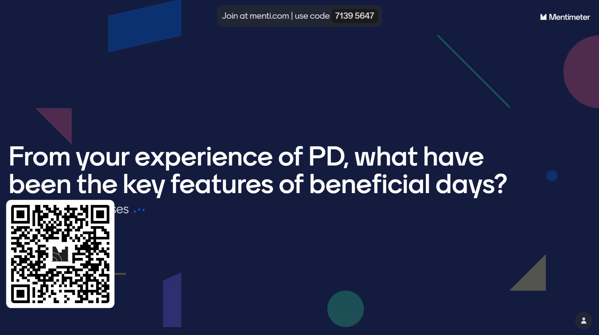

Slide 10
Research Study
An analysis of the national PD programme for the new Applied Mathematics specification.
RQ1: How should professional development in mathematics education be designed and delivered to promote the transformation of pedagogy?
RQ2: What methodologies utilised in professional development events are conducive to transforming teachers’ pedagogy?
RQ3: From the perspective of a professional development facilitator, what affects the development of teachers’ pedagogy and how should this be considered?

Slide 11
Background to Applied Maths Reform
First ever syllabus change or formal PD programme in the history of the subject.
Previously 2/3 of students studied it outside of school (IAMTA survey).
Previous assessment was one exam paper answer 6 out of 10 questions.
New assessment is one paper answer all questions (80%) and a modelling project (20%).
New specification focussed on mathematical modelling as the unifying strand through which all teaching, learning and assessment is conducted through.

Slide 12
Modelling-Based Teaching
Formulating Problems
refine
Evaluating Solutions
Translate to Mathematics
Mathematical Modelling
Computing Solutions

Slide 13




Research Study Methodology
Mixed methods approach with data from teachers who attended the Applied Mathematics PD programme.
17 interviewed teachers.
178 teachers completed a national survey from a convenience sample of 277.
Reflective journal from PD facilitator to record reflections and experiences.

Slide 14
Findings: Three themes
1. Opportunities and Challenges of Professional Development
3. The Power of Collaboration
2. Towards a Mathematical Modelling Focussed Pedagogy

Slide 15
Findings: Opportunities and Challenges of Professional Development
Teachers demonstrated a strong preference for Expert-Led Sample Approaches where they assume the role of the student and engage with designed activities.
After experiencing a sample approach from a student’s perspective, participants demonstrated a strong preference for space to collaboratively critique the approach from a teacher’s perspective.
“I like to be shown as well rather than, discovery learning sounds great, but you know I prefer, I need kind of a cold hard example first, and then let me try to do the same and replicate it.” (Participant)

Slide 16
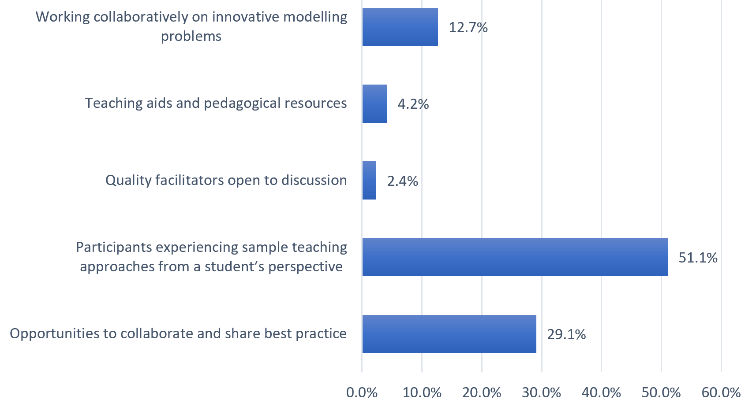
Frequency distribution of codes from “what works well in enhancing teaching methods?” (n = 165)

Slide 17
Findings: Opportunities to Collaborate and Share Best Practice
Teachers continued to stress the value in collaborating and sharing methodologies with other teachers.
Teachers stressed the value and trust that they have in methods that they know have been implemented in the classroom.
“Having those kind of discussions as structured activities works really well, when you draw on people's experience, you just have that open discussion.” (Participant)

Slide 18
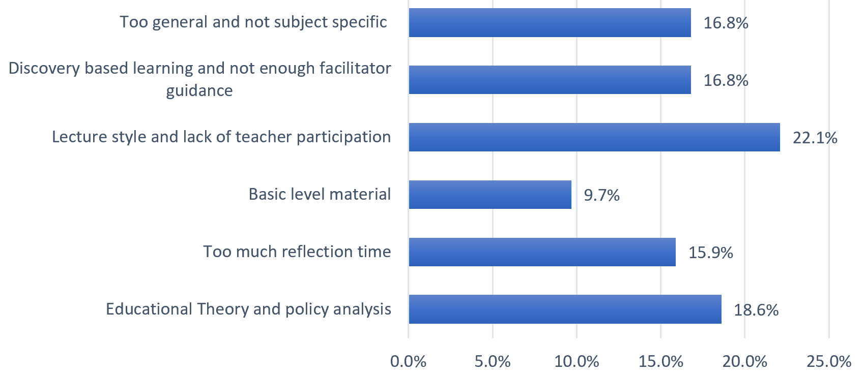
Findings: Issues with PD
Teacher perspectives on what does not work well in enhancing teaching methods (n = 144)

Slide 19
Findings: Issues with PD
General educational theory was a common area that interviewed teachers did not find helpful
Participants also shared that sessions with too much focus on learning outcomes and policies are not very productive.
Teachers conveyed annoyance when they are expected to lead the creation of tasks and develop units of work in a ‘discovery-based learning’ approach.
“They spent half the first day talking about theories of education, about constructivism and things like that, and in fairness I did my dip… I’m thinking “what are they teaching me this for?”, you know I want to be there to talk about the subject.” (Participant)

Slide 20
Towards a Mathematical Modelling Focussed Pedagogy
There was a noticeable shift in teachers’ confidence and perception of themselves when events focussed on pedagogy development.
Many felt that a combination of the professional development that they received and the experience of having taught a full cycle of the specification has enhanced their confidence.
“Teachers have regularly displayed anxiety and lack of confidence in learning new pedagogy with a noticeable vulnerability in their tone when speaking about it.” (Reflective Journal)

Slide 21
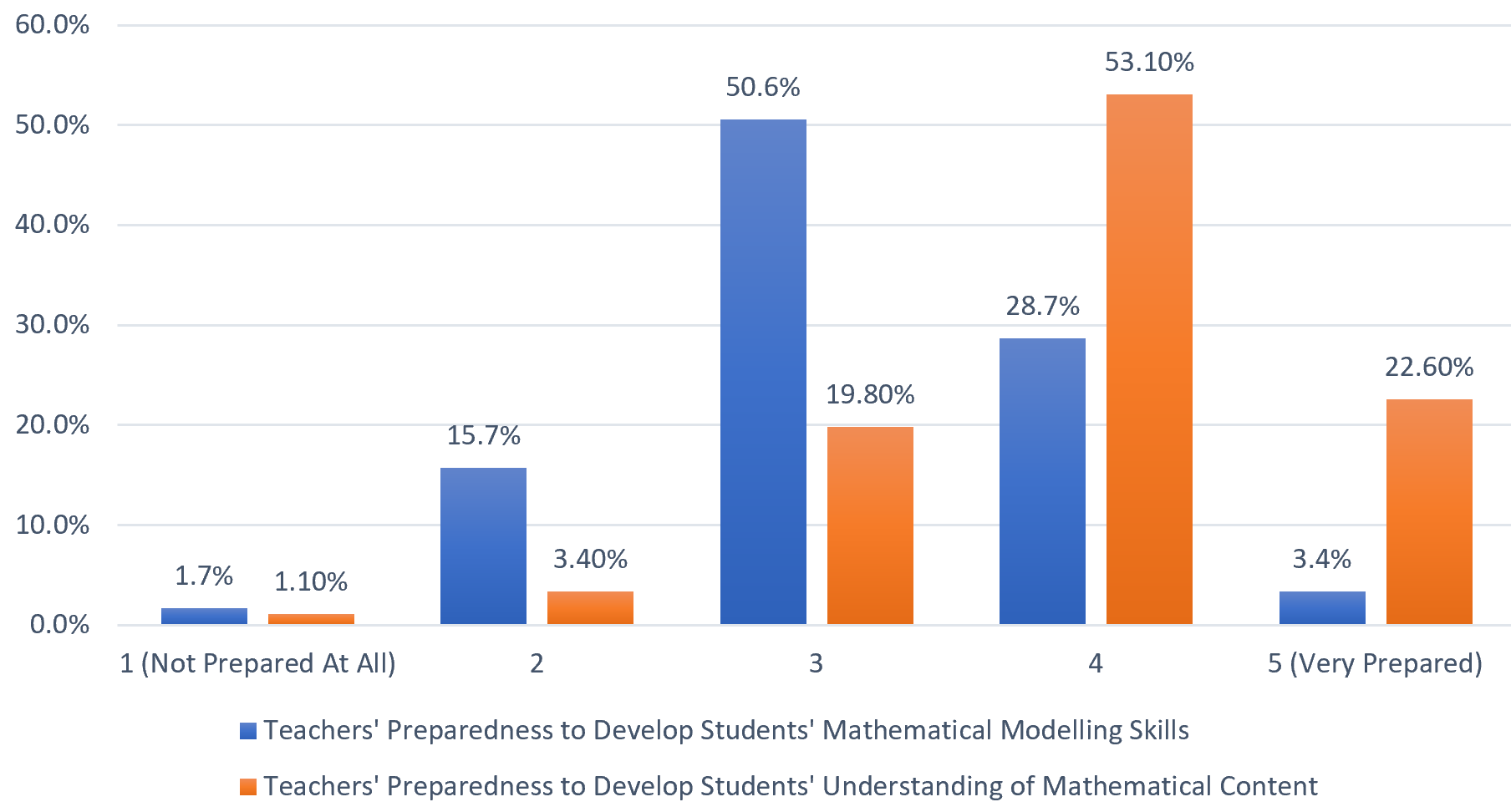
Towards a Mathematical Modelling Focussed Pedagogy
Teacher responses to preparedness to develop students’ mathematical modelling skills (n = 178) and develop understanding of mathematical content (n = 177)

Slide 22
Difficulties in Altering Pedagogy
Dominant theme being ‘inexperience with teaching mathematical modelling’.
Others stated that they had not changed their pedagogy, like one participant that she had continued to teach without much emphasis on modelling, then found the modelling project difficult and that her students were not prepared for it:
“I even had guidance counsellors telling me they had people in with them crying over the project and all this, so they were all stressed with the project. So, I’m not very confident with the mathematical modelling stuff.” (Participant)

Slide 23
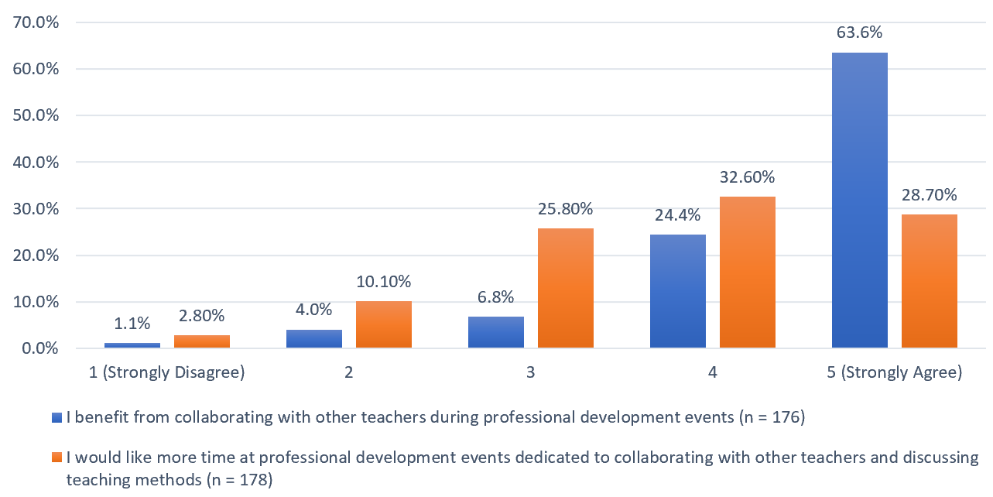
The Power of Collaboration
Teachers’ views on collaboration in professional development

Slide 24
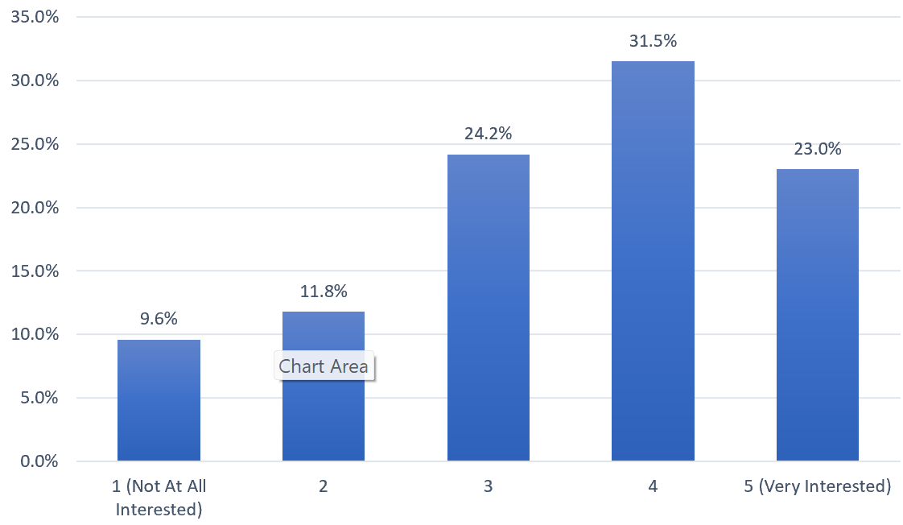
A Collaborative Inquiry Model
Teachers’ interest in working “collaboratively to explore a particular teaching approach, try it out in the classroom and then discuss how it went?” (n = 178)

Slide 25
A Collaborative Inquiry Model
While there was a clear interest in this model of PD, the overwhelming theme was that it should take place during the school day with a participant making the point:
Interviewees also highlighted the need for a semiformal leader to keep it on task and operate efficiently.
“the elephant in the room is time. I think it's an awful lot for people to give up evenings. It's an awful lot for people to give up weekends and I think you know something, I think it would need to be during school time.” (Participant)

Slide 26

Discussion
85.9% of surveyed teachers were in favour of an expert-led model which contrasts published literature in favour of teacher-led inquiry models (Finland and Kennedy (2014)).
The findings highlight the role of prior knowledge and how familiarity with concepts affects confidence and dependence on experts.
Collaboration was a key feature of what teachers’ preferred in PD design which is in line with the Chinese and Israel Action Research models as well as LAOS (DoE, 2022).

Slide 27

Discussion
Teachers found adopting a modelling-based pedagogy challenging which agrees with Johnson et al.’s (2019) finding.
Those who did not embrace modelling and continued to teach in a didactic fashion then found themselves and their students struggling with the coursework.

Slide 28

Discussion
For developing new teaching methodologies (modelling-based approach) an expert-led approach agrees with Muijs et al. (2014) who outlines the importance of acknowledging context and teachers’ prior knowledge.
The findings demonstrated high interest levels for an inquiry-based model but teachers emphasised that its design features would be critical to its success (time).
Teachers also expressed a preference for in-person collaboration due to being able to demonstrate and communicate easier which contradicts many current approaches.

Slide 29
Conclusions
Conclusion 1: We Want to Learn but Need Support
Conclusion 2: None of Us is as Smart as All of Us
Conclusion 3: The Complexity of Professional Development

Slide 30




Recommendations
Recommendation 1: A New Continuum for Professional Development
Expert-led
Development of Teachers’ Research skills
)
Teacher-led
Expert-led sample pedagogical approaches with regular collaborative activities and reflection
Expert supported with enhanced teacher autonomy and agency through collaborative lesson and task design
Regular use of communities of practice and peer coaching. Expert available for guidance
Teacher-led collaborative inquiry models as a natural part of teachers’ practice. Expert removed

Slide 31
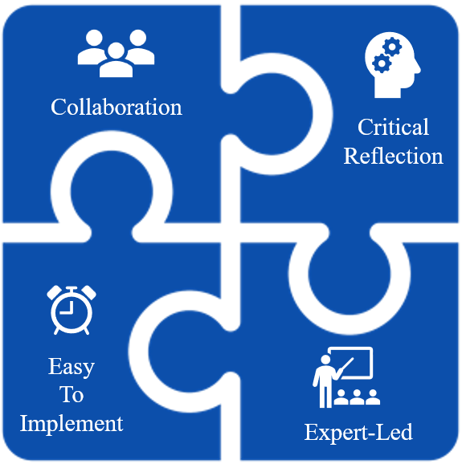
Recommendations
Recommendation 2: Key Design Elements for Independent Events

Slide 32


Recommendations
Recommendation 3: Collaboration Knows no Boundaries
Communities of Practice
Use of an online community (The Teaching Council’s T-REX)

Slide 33

Recommendations
Recommendation 4: Reallocation of Funding
Substitution funding is only allocated to one-day workshops which significantly decreases the uptake of other models
More funding for other models of PD such as coaching and collaborative events during the school day.

Slide 34
Recommendations
Recommendation 5: Future Research
Further research is needed to implement and review the proposed continuum and independent event design.
These results relate to Irish Applied Mathematics Teachers and further work should be conducted for other teachers and wider subjects to enhance the overall level of professional development.

Slide 35

Questions??

