Slide 1
IMTA National Meet 2024
Maynooth University
February 2024

Slide 2
The influence of the Growth Zone Model on students’ mathematical resilience

Slide 3
Who am I?
Ciara Mc Kevitt, Mathematics and Applied Mathematics Teacher in Castleblayney Co Monaghan
Part-time PhD student in University of Galway, under the supervision of Associate Professor Cornelia Connolly

Slide 4
Presentation Outline
Mathematical Resilience and Mathematical Anxiety definitions
Mathematical Resilience Scale
Mathematical Anxiety Scale
Causes of Mathematical Anxiety
Growth Zone Model
Study timeline
What is next

Slide 5
Mathematical Anxiety and Resilience
Richardson and Suinn (1972) define mathematical anxiety as;
“a feeling of tension and anxiety that interferes with the manipulation of numbers and the solving of mathematical problems in a wide variety of ordinary life and academic situations”
Mathematics resilience is defined by Johnston-Wilder and Lee (2010) as
“a positive affective stance to mathematics”.

Slide 6






Mathematical Resilience Scale (Kooken, et al., 2013)
Developed in 2013 by Janice Kooken
23 item scale categorised into 3 sections; Value, Struggle and Growth
5-point Likert scale; 1 being strongly disagree, 3 being undecided and 5 being strongly agree
Half of the scores are reversed and summed together
Each participant is awarded a score which indicates the level of resilience
Lowest score is 23, highest score is 115

Slide 7
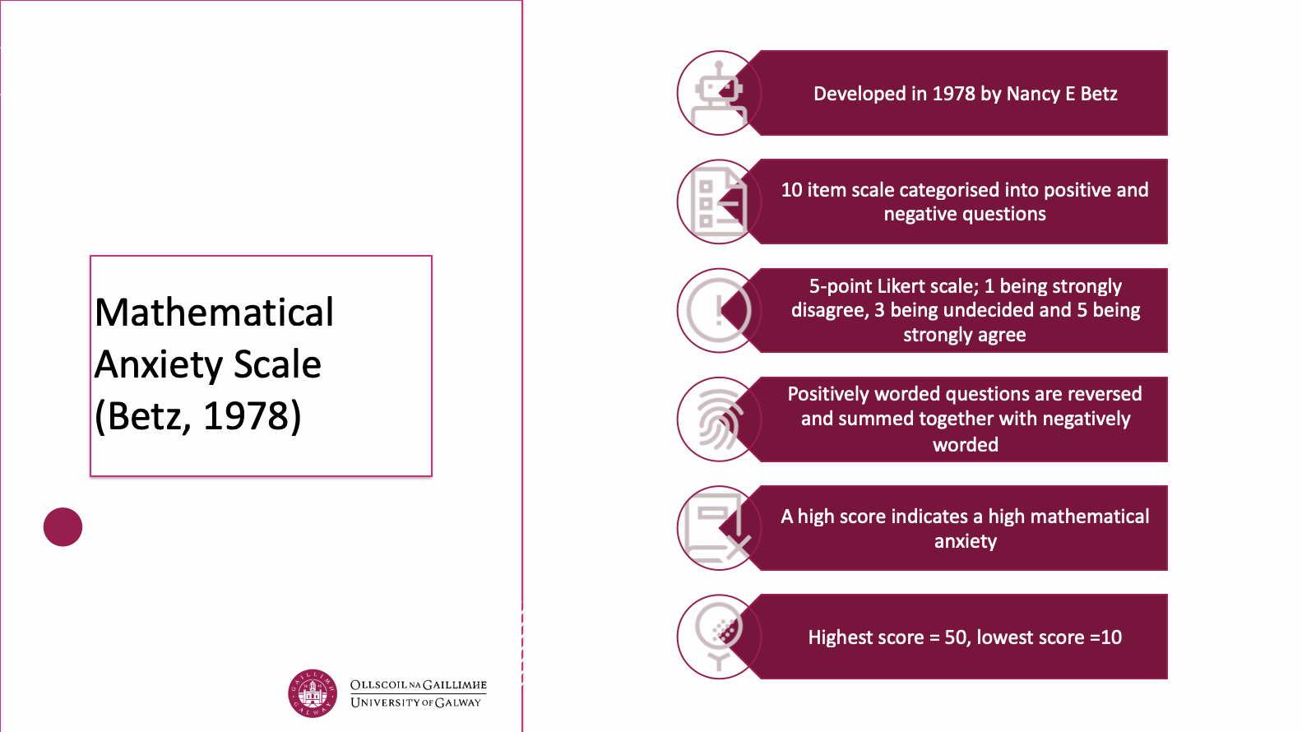

Slide 8
Issues and Causes of Mathematical Anxiety
Parent/Teacher involvement in the teaching and learning of mathematics
Fear of wrongness and/or embarrassment during class time
Stereotypical pressure put on students' performance
Test Anxiety
Comparison of peers
Perceived uselessness

Slide 9
Growth Zone Model
Offers a framework to understand emotions encountered when carrying out Maths tasks
Consists of 3 different zones; comfort zone, growth zone and anxiety zone
Colours represent common feelings in each of the sections in the model
Encourage students to identify how they feel during mathematical activities
Encourage students to identify moments when they fell in the growth zone and discuss their feelings
Then do similar in each consecutive zones

Slide 10
The comfort Zone: Students who are at ease and quite familiar with the content being taught appear in the comfort zone of the model
The Growth Zone: Students who are challenging themselves just beyond their understanding appear in the growth zone of the model.
The Panic Zone: Students who are overwhelmed by trying tasks too difficult or beyond their capabilities lie in the panic zone
Optimal learning takes place in the growth zone - therefore, it is important that we as educators get students into this zone and encourage them to stay there

Slide 11
The ultimatum of utilising the Growth Zone Model in the classroom to create a holistic learning environment that minimises mathematical anxiety whilst fostering resilience creating confident successful problem solvers

Slide 12
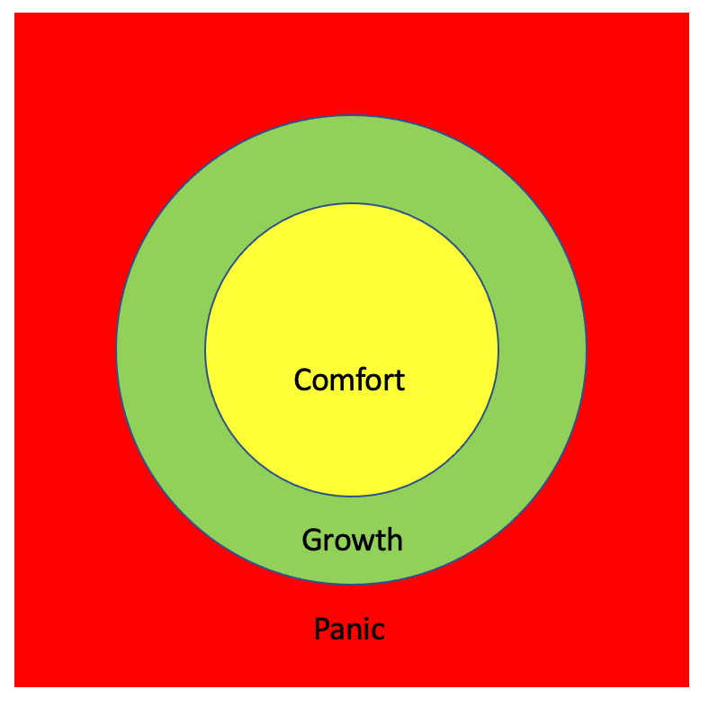
Adapted from Johnston-Wilder (2010)

Slide 13
What is a Tangram Puzzle?
Tangrams are made up of 7 flat shapes; a big triangle, a medium triangle, two small triangles, a square, and two different-sized parallelograms.
You arrange the shapes to make different images such as animals, buildings, people etc essentially like a jigsaw

Slide 14
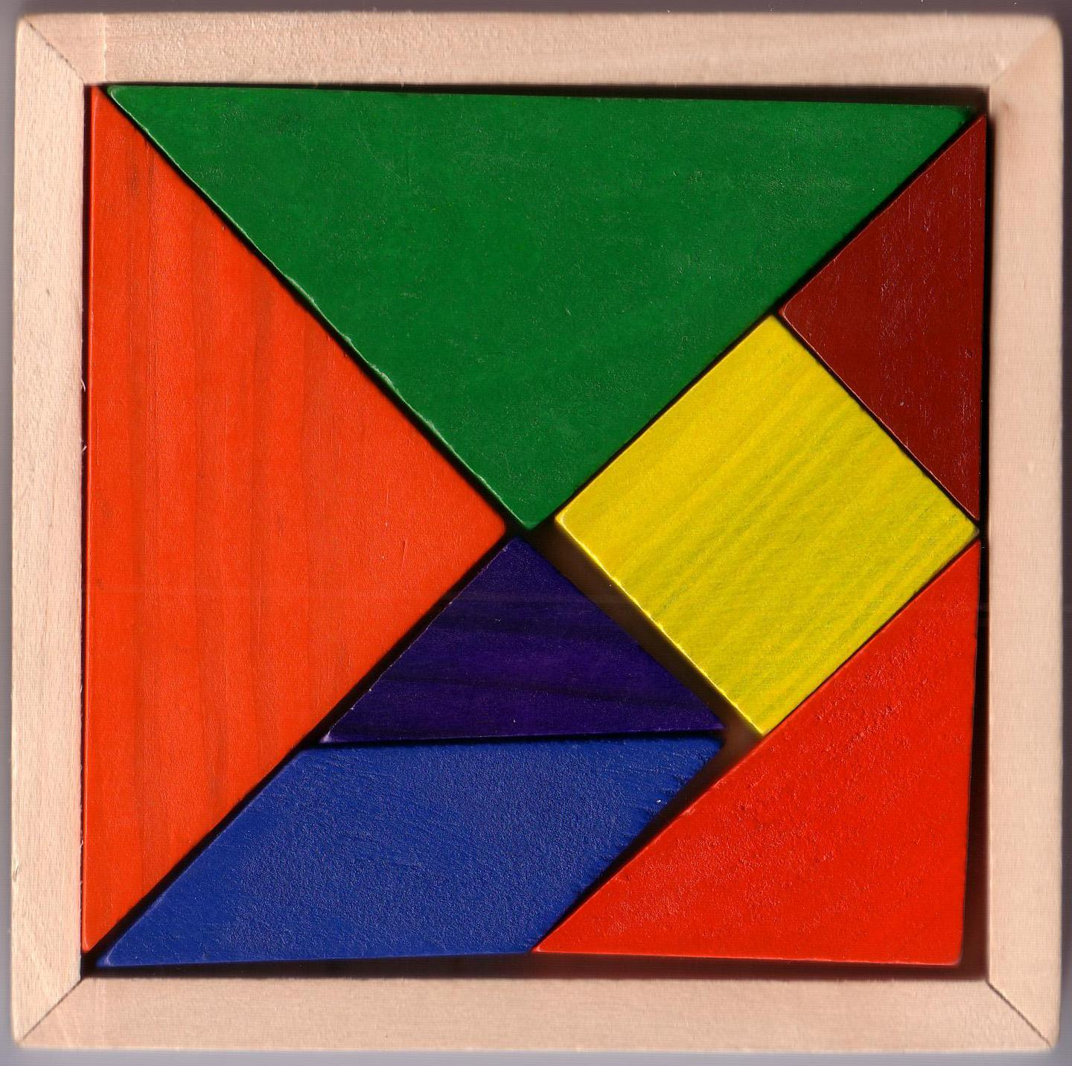
Growth Zone Challenge…
Our goal is to complete a Tangram puzzle within a given time limit, emphasizing perseverance, creativity, and collaboration.
Each group will receive a set of Tangram puzzle pieces.
Work together collaboratively to arrange the pieces to form any specific shape or design.
Time limit: 4 minutes

Slide 15
Activity
Create a square, so that all of the pieces fit together snugly with no gaps or overlaps.
Remember, the square must have four equal sides and four right angles.
You have 4 minutes to make the square

Slide 16
Activity
Create a square, so that all of the pieces fit together snugly with no gaps or overlaps.
Remember, the square must have four equal sides and four right angles.
You have 4 minutes to make the square

Slide 17


Slide 18
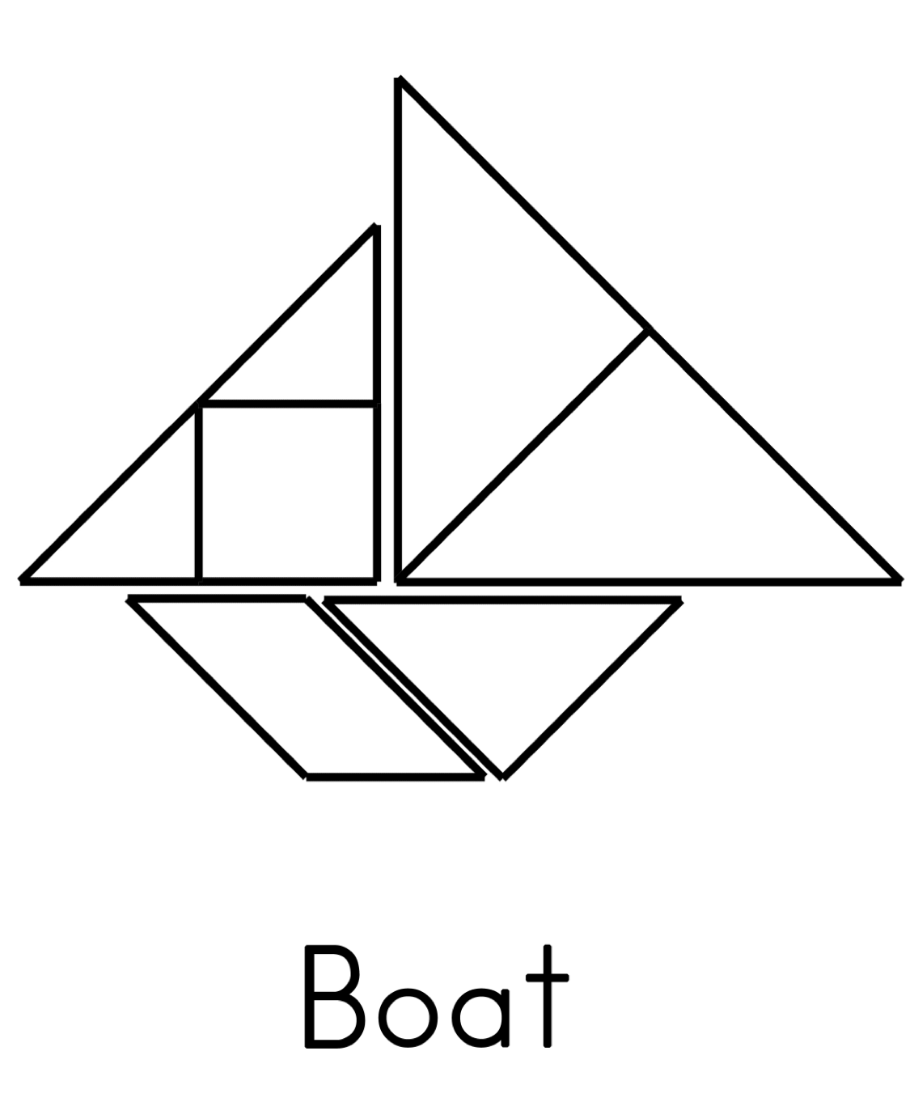

Slide 19
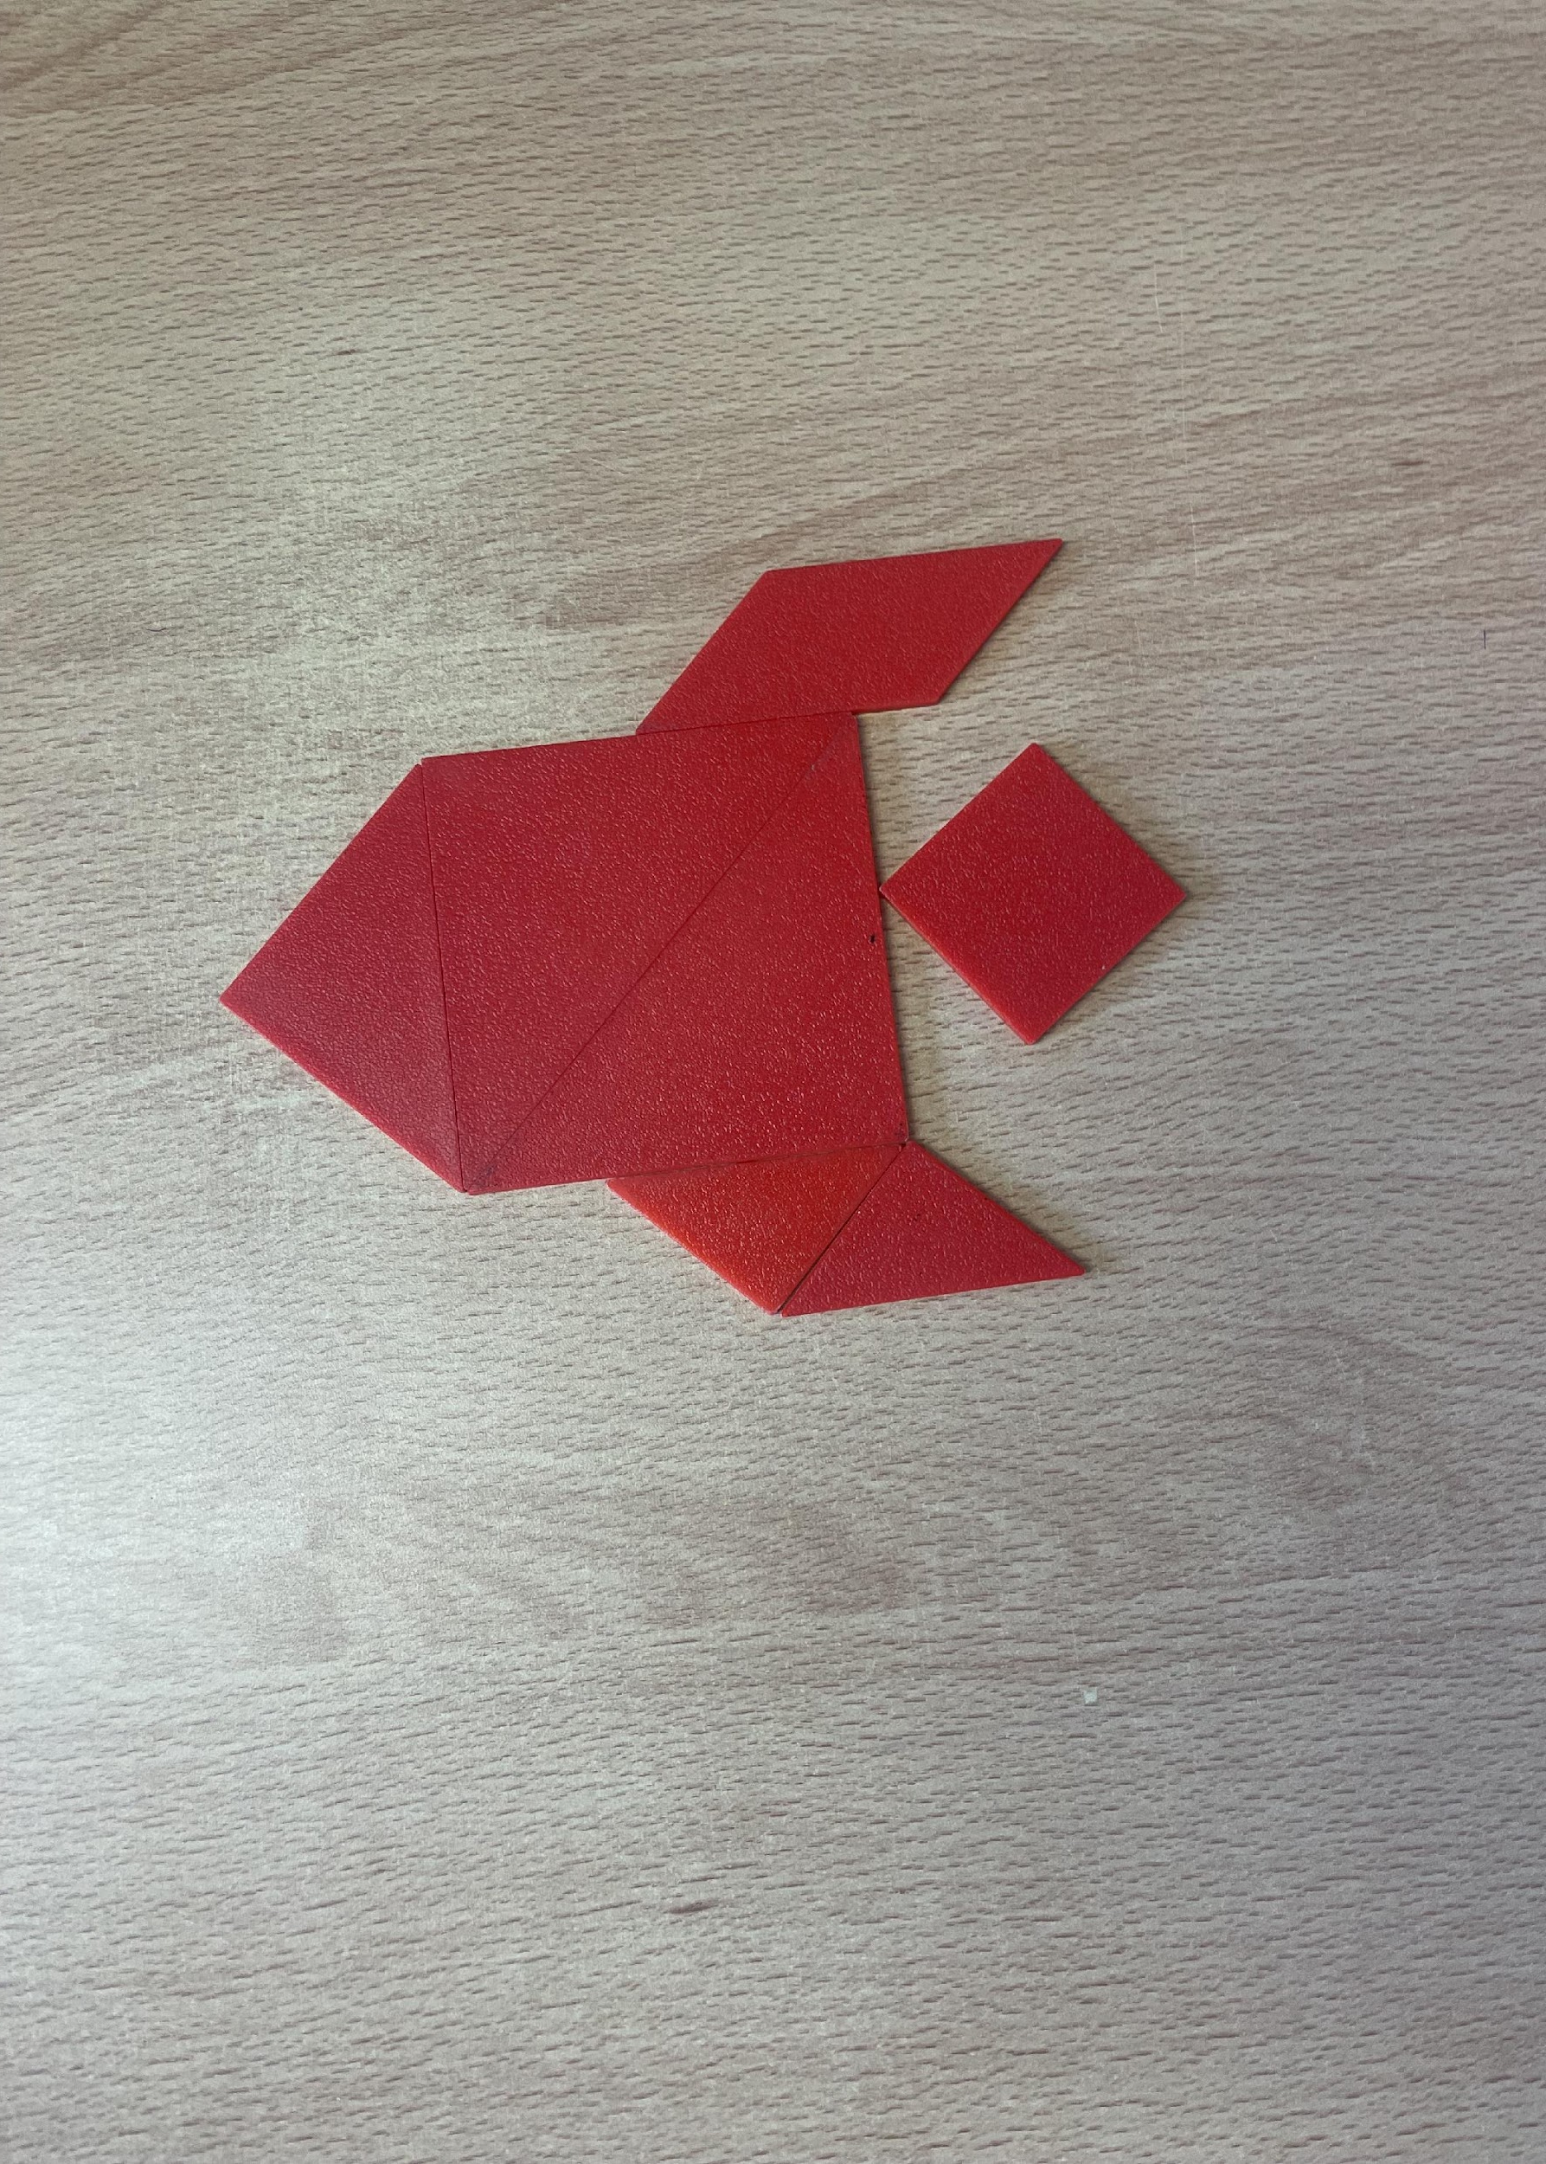
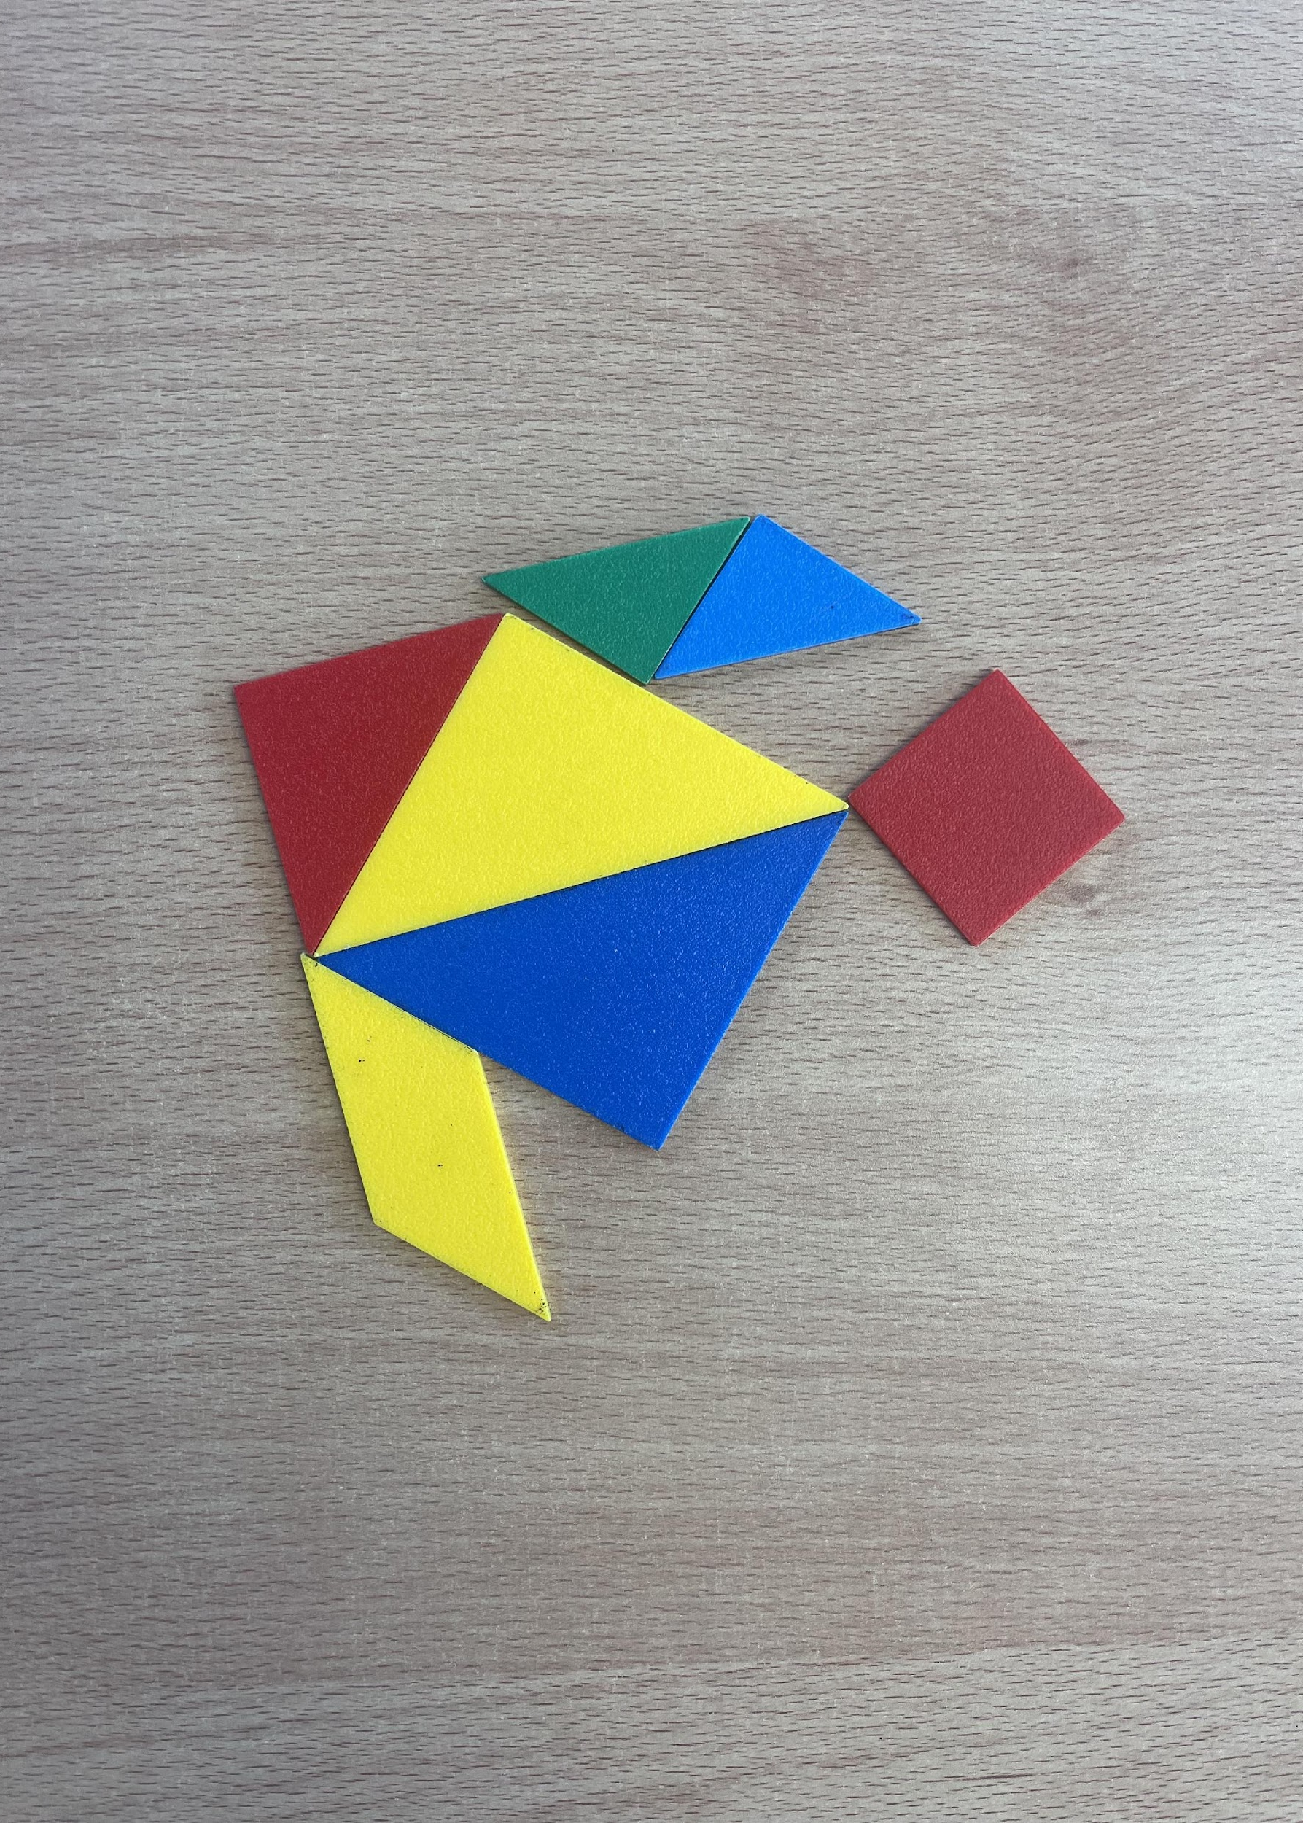
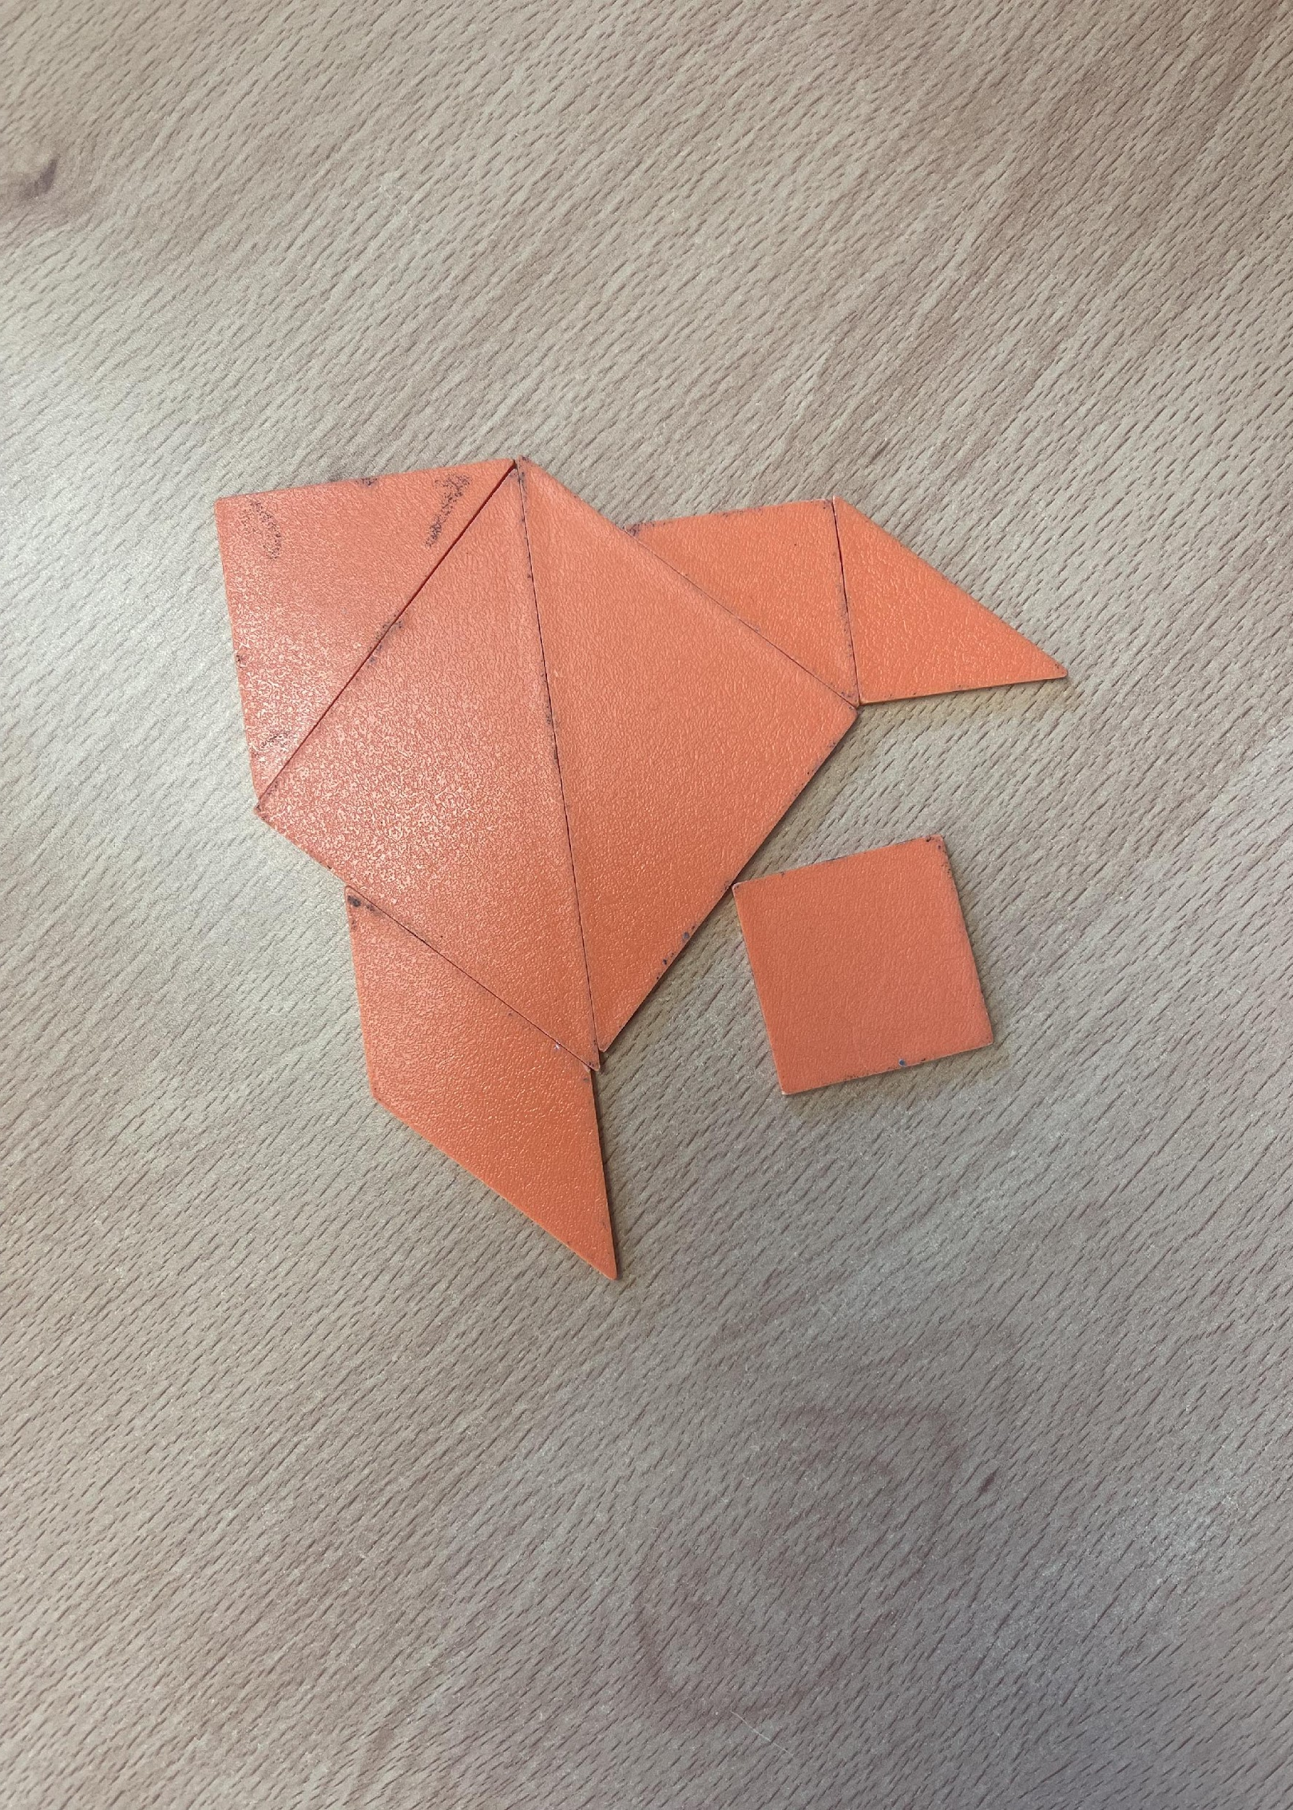
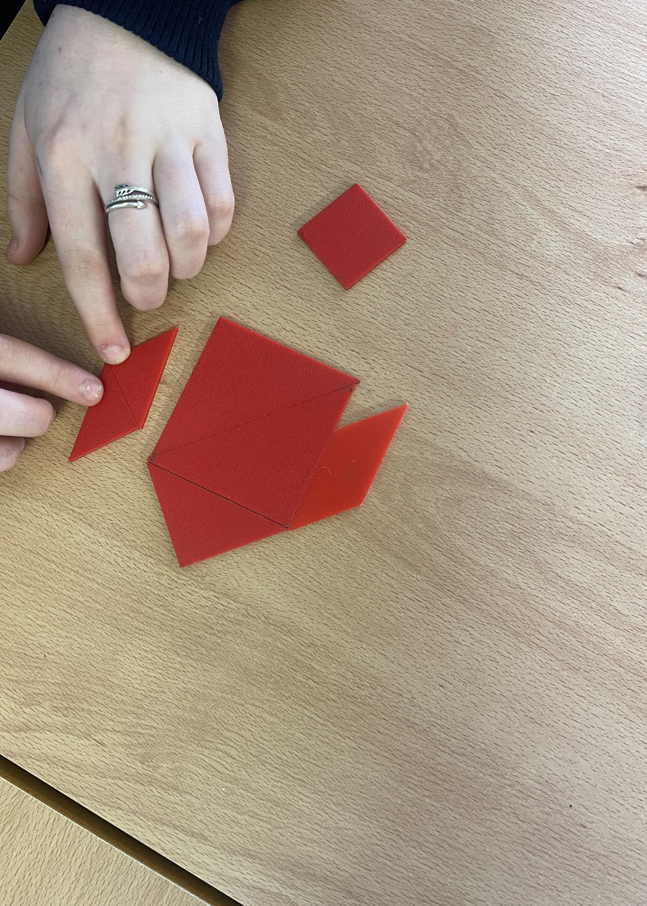
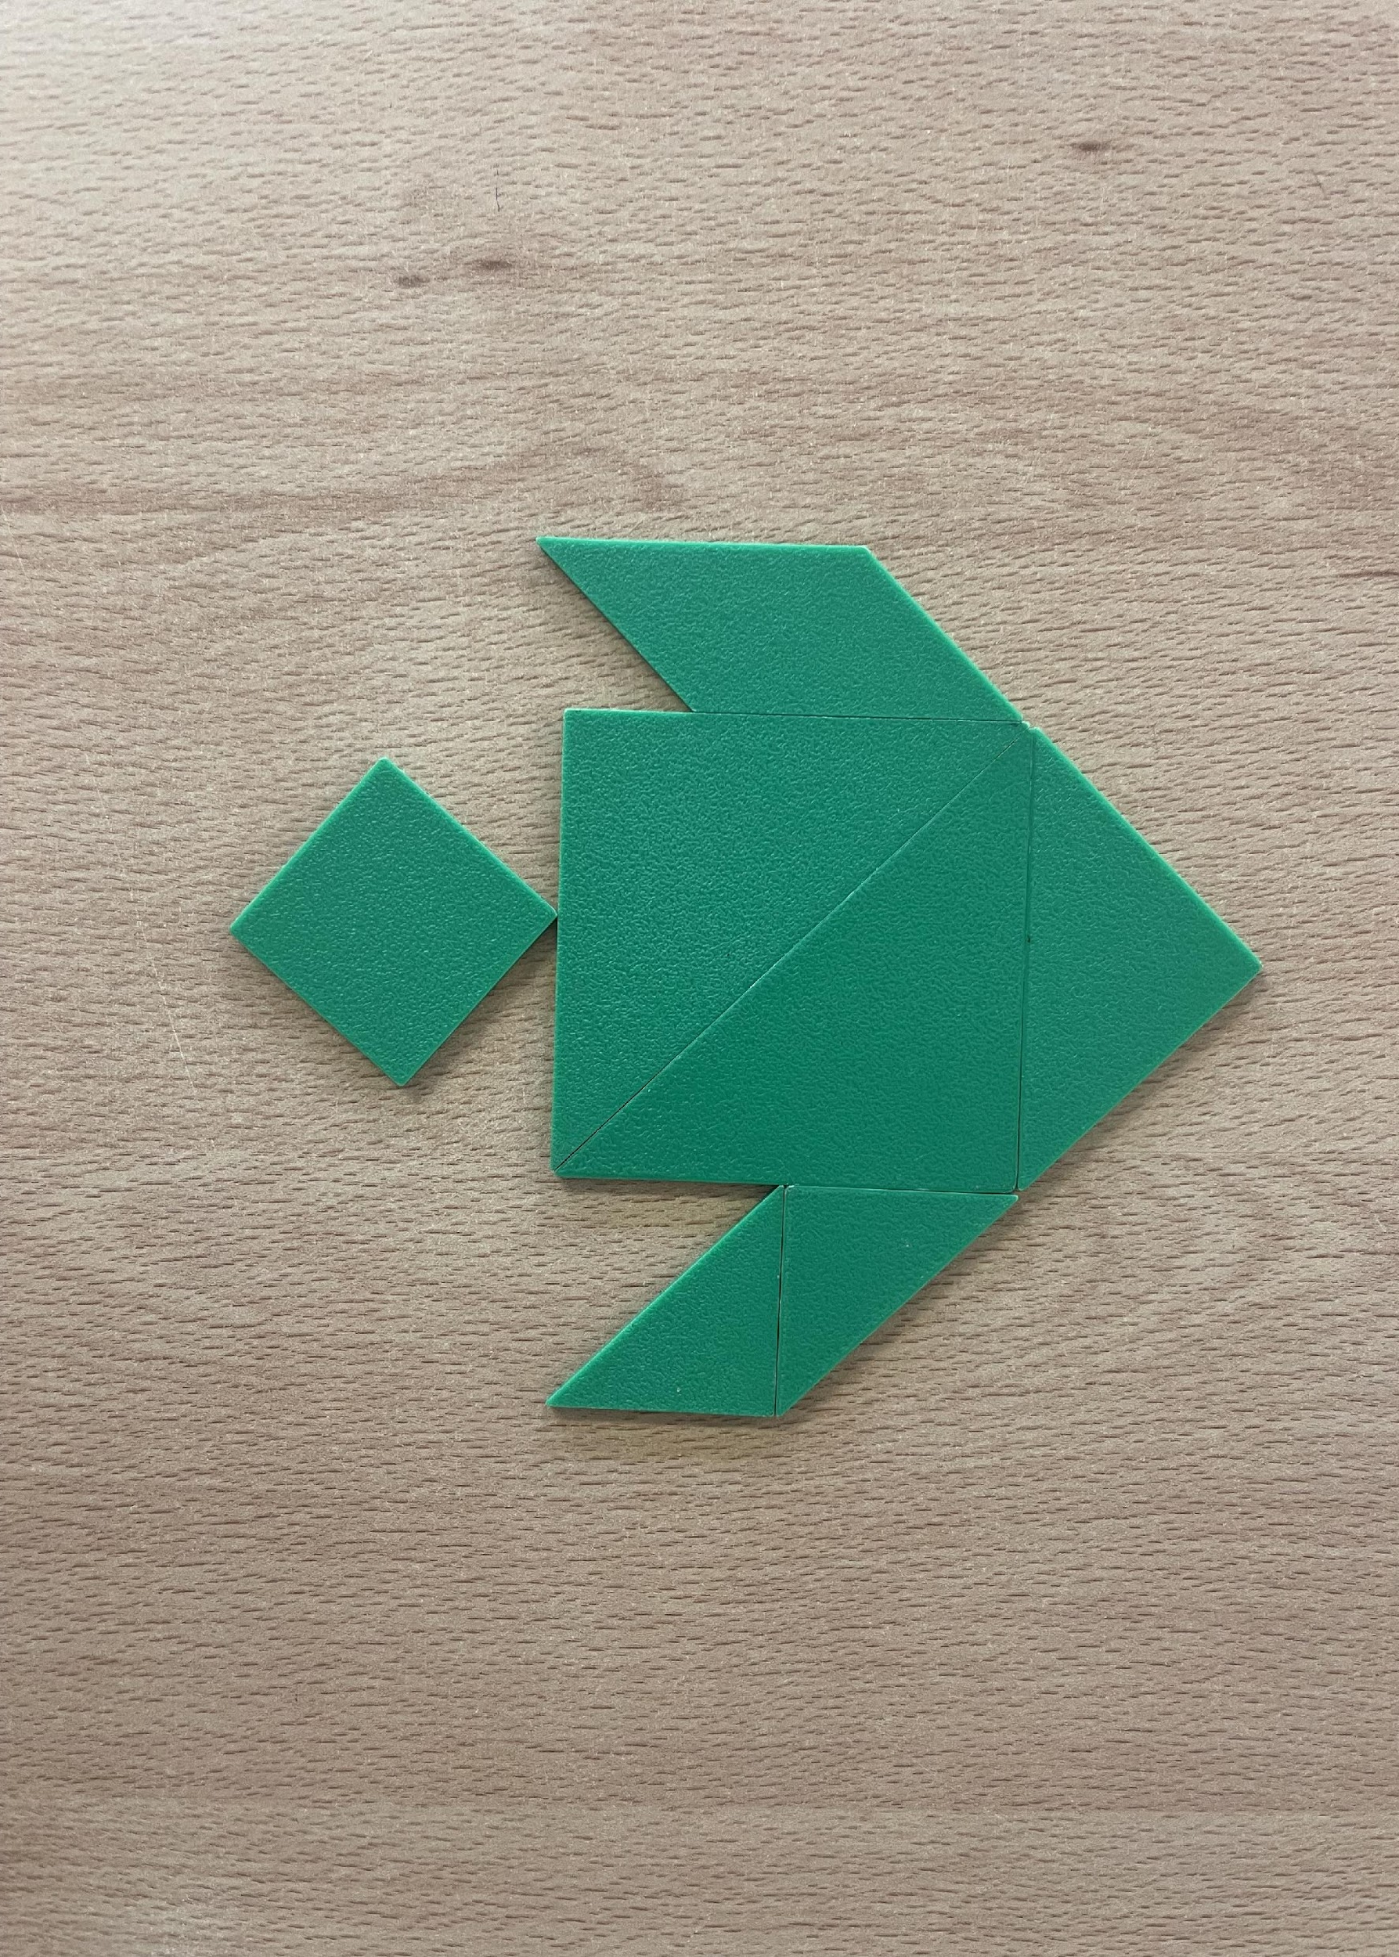

Slide 20
Why did I pick Tangrams?
Tangrams have a low barrier to entry, making them accessible to students of varying mathematical abilities. The puzzles can be simple or complex, allowing for differentiation based on students' skill levels.
Tangrams offer opportunities for differentiated learning experiences. Teachers can adjust the complexity of the puzzles or provide scaffolding to support struggling students while challenging advanced learners with more complex configurations.
They are fun!
Perfect for collaborative learning

Slide 21
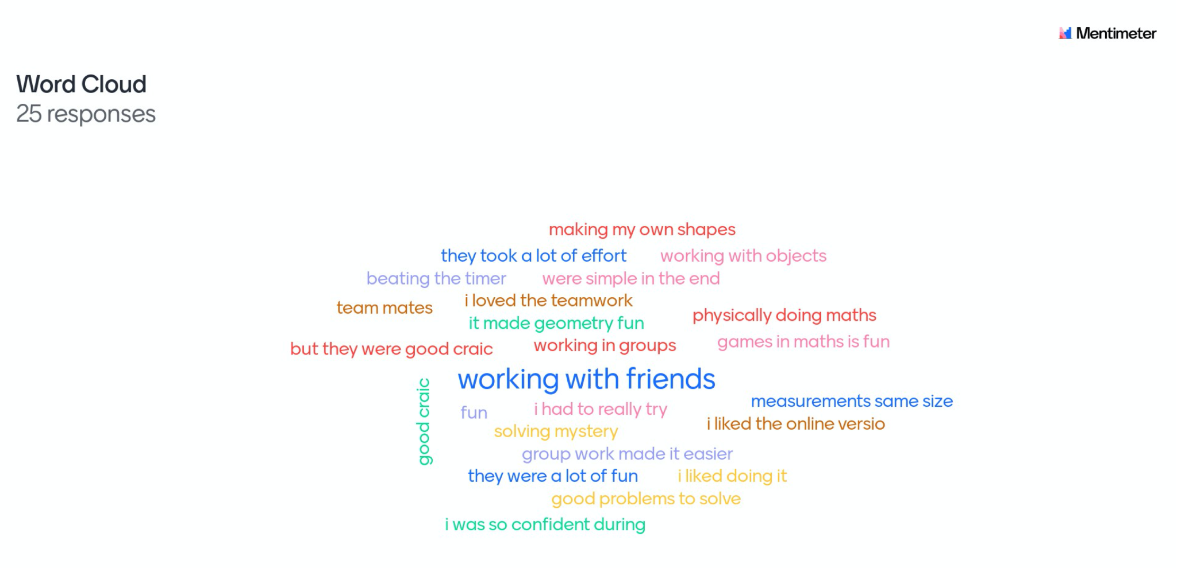

Slide 22
Table 3.1: Research Instruments and the Mixed Methods Approach in this Research Study
This study follows an action research methodology and adopts a mixed methods approach
Students engage in 2 surveys both pre- and post-intervention, reflective journals, semi-structured interviews
Another source of data was scoring from educational games
Methodology
Reflect
Plan
Instrument | Qualitative | Quantitative
Pre and Post-Survey |  | X
Journaling | X
Gaming score |  | X
Interviews | X
Observe
Act

Slide 23
Intervention
The intervention lasted 8 weeks; at the beginning of the intervention the students engaged in the MAS and MRS
The teacher introduced the concept of the Growth Zone Model; explaining each section and the importance of challenging ourselves in order to develop our skills
Students recorded feelings and emotions in reflective journals about their current mindset towards maths
Each individual then set goals for the intervention - this entailed “Mathalutions”

Slide 24
Students engaged in semi-structured interview and teacher observations
Based on students needs targeted learning initiatives were implemented in the classroom for example scaffolded learning, collaboration and technology enhanced learning tools
The main message delivered throughout is that mistakes are learning opportunities
Growth Zone Challenges were used as a weekly incentive - not necessarily on the course curriculum
Praising students for their effort as oppose to their ability

Slide 25
The final week of the intervention
The students will resit the intervention survey and any shifts in results will be noted
Students will share their experiences highlighting success yet, also discussing moment of anxiety and coping mechanisms
Each student will write down an area for further improvement beit content related or psychologically related

Slide 26
Findings so far…
What is next …
12 of 25 (48%) students scores showed they have felt/feel maths anxiety
3 of 25 scores showed that they were mathematically resilient
Each student will write down an area for further improvement beit content related or psychologically related

Slide 27
Academic Year 2024/2025
Academic Year 2023/2024
Research Design
Reflection
Term one = Cycle 1
Term two = Cycle 2
Alterations to design
Reflection
Term one = Cycle 3
Term two = Cycle 4

Slide 28
What can you take from today?
To minimise mathematical anxiety we essentially have to approach the issue from a whole school approach
Other subject teachers must reduce their use of negative connotation around mathematics as this is highly influential on their students
Perhaps the Growth Zone Model is something that can be implemented in non-exam subject as it is applicable to all subjects

Slide 29
It is important that we as teachers identify the more manageable parts of the course and identify the more challenging parts so students know that they are growing and developing their skills
Constructive feedback on effort as oppose to ability
Reflective practice beit on homework and tests - another crucial part of resilience is reflecting on the teachers comments
Goal setting and robust individual student study plan

Slide 30
Upcoming conferences
Mathematical Resilience Network with Mary Immaculate College hosting a Mathematical Anxiety work for second level teachers in MIC Thurles on Saturday 9th March
Educational Studies Association of Ireland Conference 2024 in Maynooth University on 4th, 5th and 6th April

Slide 31
References
Lee, Clare and Johnston-Wilder, Sue (2018). Getting into and staying in the Growth Zone. NRICH
Johnston-Wilder, Sue and Lee, Clare (2010). Developing mathematical resilience. In: BERA Annual Conference 2010, 1-4 Sep 2010, University of Warwick.
Richardson, F. C., & Suinn, R. M. (1972). The Mathematics Anxiety Rating Scale: Psychometric data. Journal of Counseling Psychology, 19(6), 551–554.

Slide 32


Thank you
Questions? Feedback
@mckevitt_ciara
c.mckevitt1@universityofgalway.ie

