Slide 1

Teaching Through Problem Solving (TTP)

Slide 2



Outline for the session (50 mins)
  Opening task (10 mins)
  Some background (5 mins)
  Extending TTP (10 mins)
  Exploring/troubleshooting In your context (15 mins)
  Wrap up & Feedback (5 mins)

Slide 3
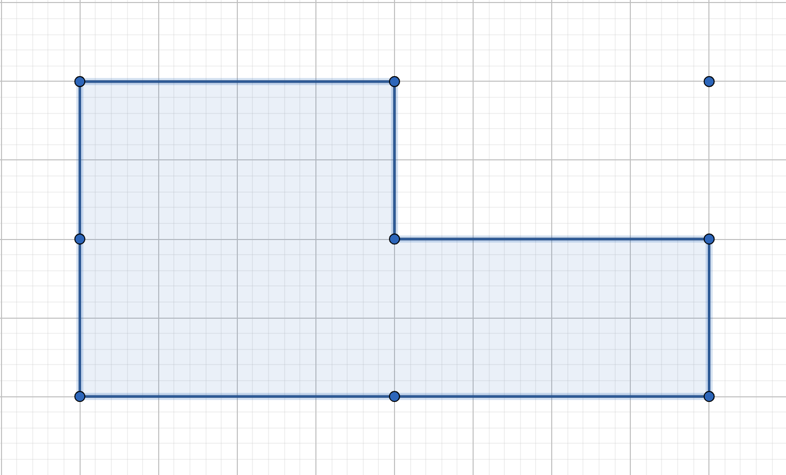
How would you calculate the area of this shape?
No Numbers; No counting
Tell me the strategy
Notes:
Firstly, can I get you into your pairs and threes again and tell me how you would calculate the area of this shape without using the numbers or counting boxes? And then see how many different ways you might be able to do it?
What is the pedagogical significance of the point in the top right?
What topics could be pulled in?

Slide 4
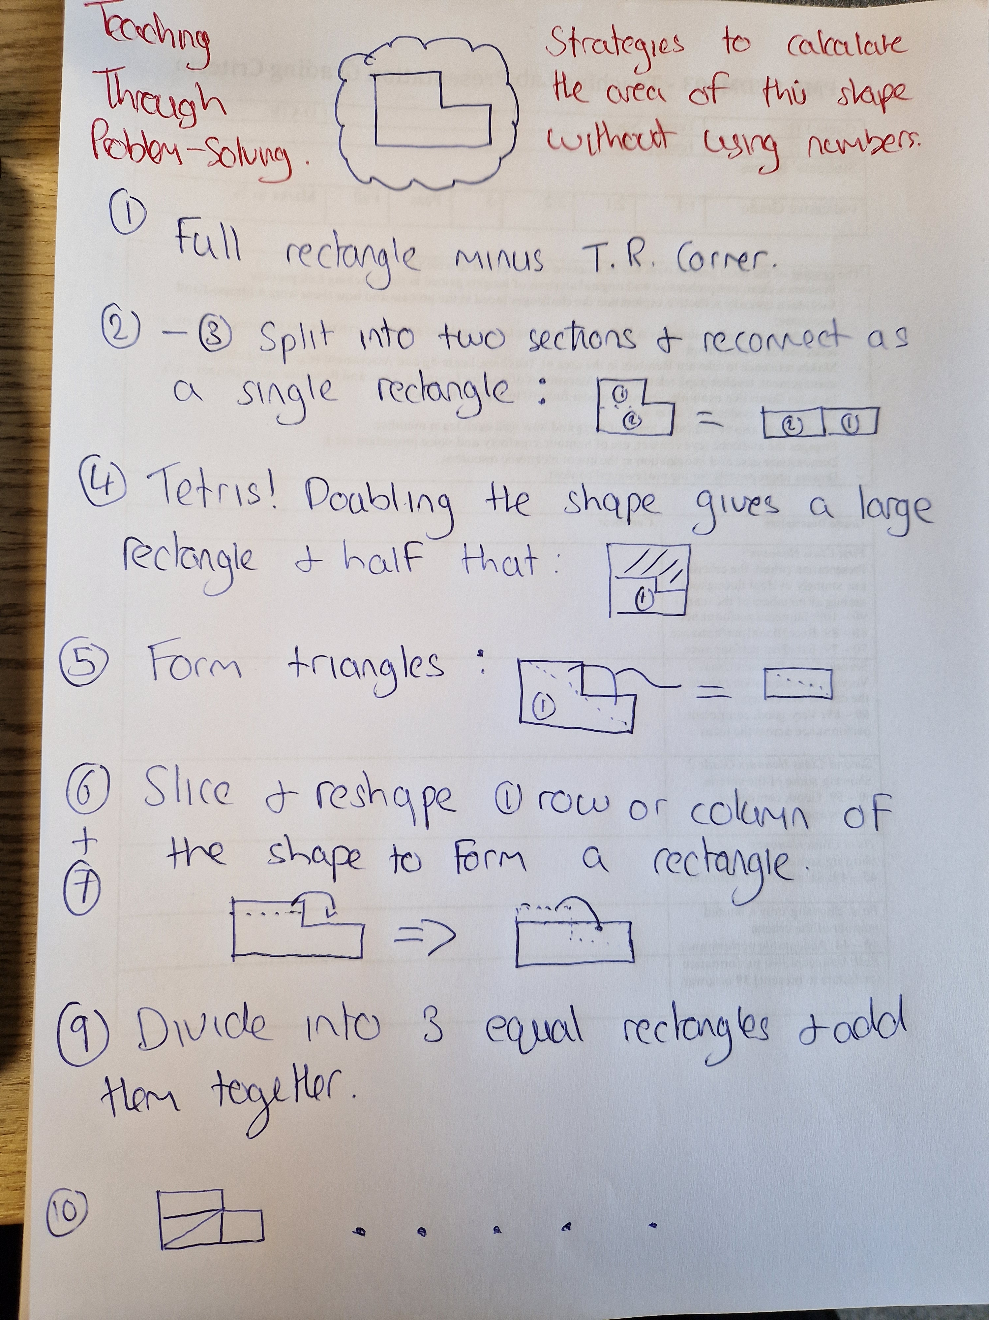

Slide 5

Teaching Through Problem Solving
Teaching Through Problem Solving (TTP) or Structured Problem Solving (SPS) is the predominant pedagogical approach to teaching maths in Japan. It follows a well-defined structure:
  Grasp The Problem
  Try to Solve
  Present and Discuss
  Summarise and Reflect
The Lesson Study Group at Mills College
Notes:
Cool, so what you’ve seen there is an example of a problem I might use to open a lesson if I were teaching through problem solving.
READ
So, suppose my students can calculate the area of triangles and squares, I could present them with that problem which we can discuss before they attempt to solve it, present their solutions for discuss before arguably the most important stage – summary and reflection.
In Japan, kids as young as 5 learn to summarise and reflect on their work so by the time they are 12 or 13 they have considerable experience of doing so and can go back in their copies to investigate potential avenues to explore solutions to problems.

Slide 6
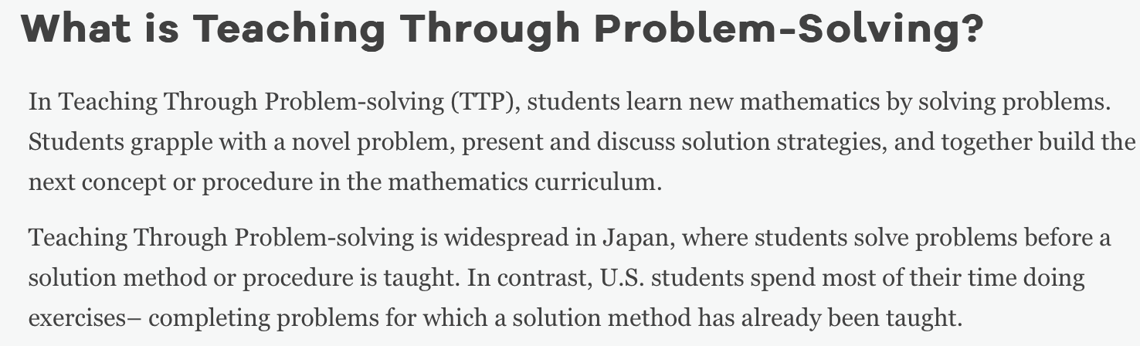

Slide 7
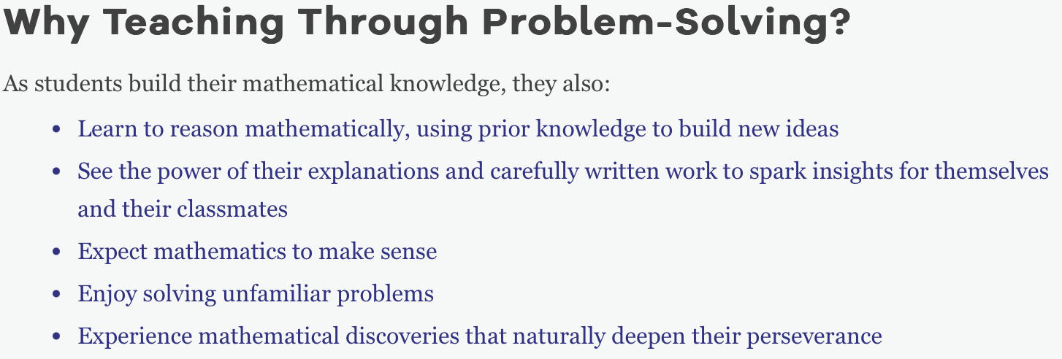

Slide 8
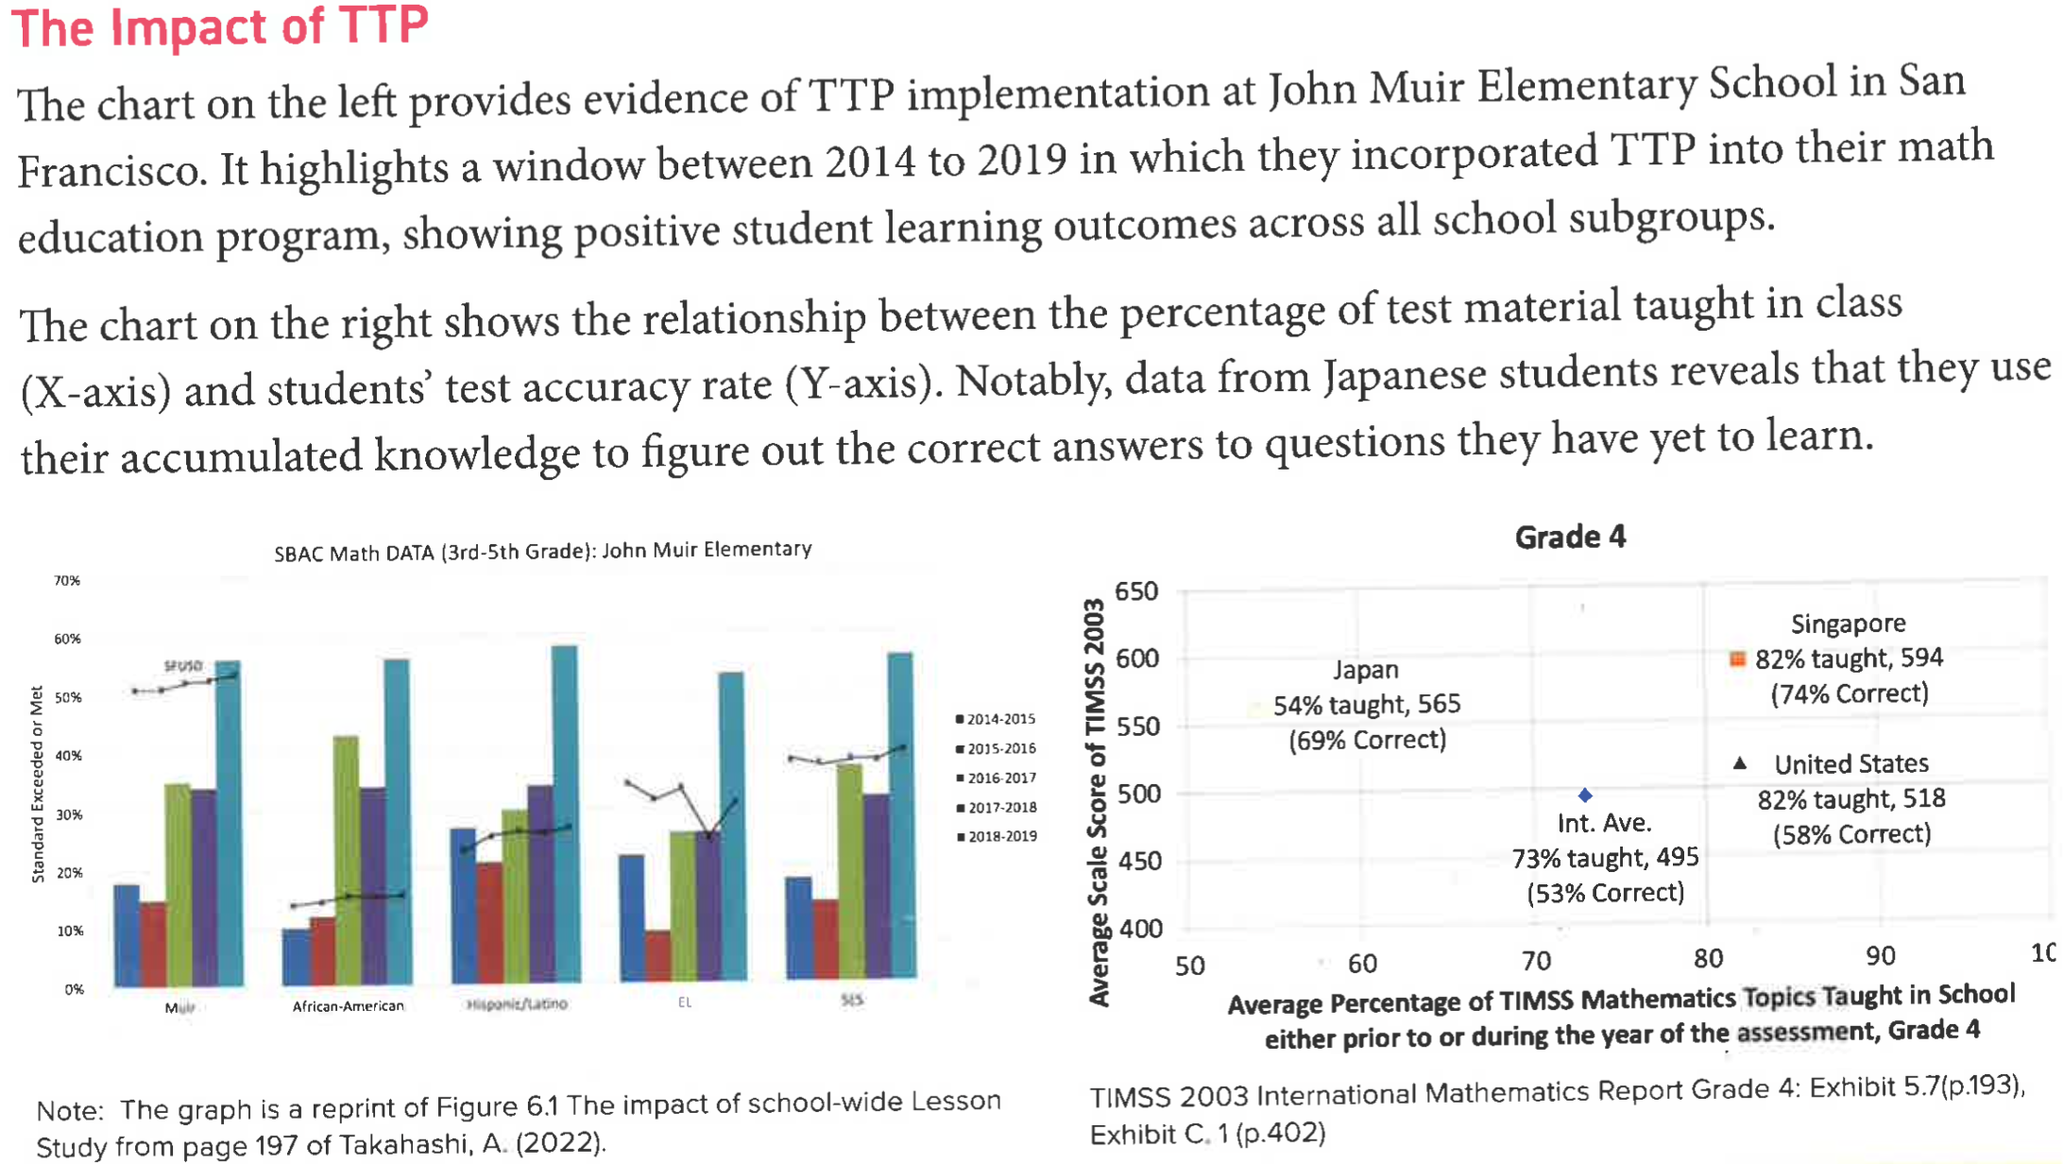

Slide 9
How suitable was this task?
What features does this problem have or lack?
What properties have been included or omitted?
What is the significance of these decisions?

Slide 10

What can we add to this task?
Context?
  Grass seed/flowers/trees
  Carpet/paint/tile
  Material
How do we want our students to present and discuss it?
  Reasonable expectations?
  Differ across groups?
How do I extend or scaffold it?
  Bridging steps
  Further conditions
  Other topics

Slide 11

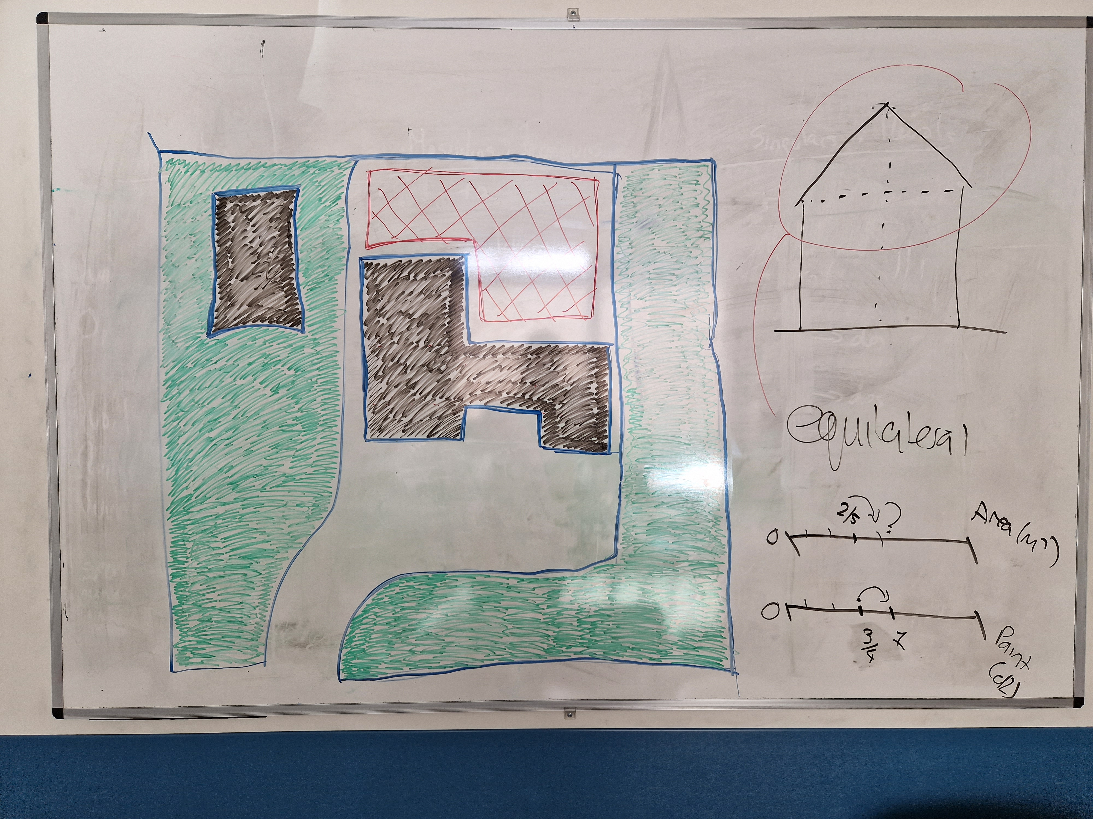

Slide 12
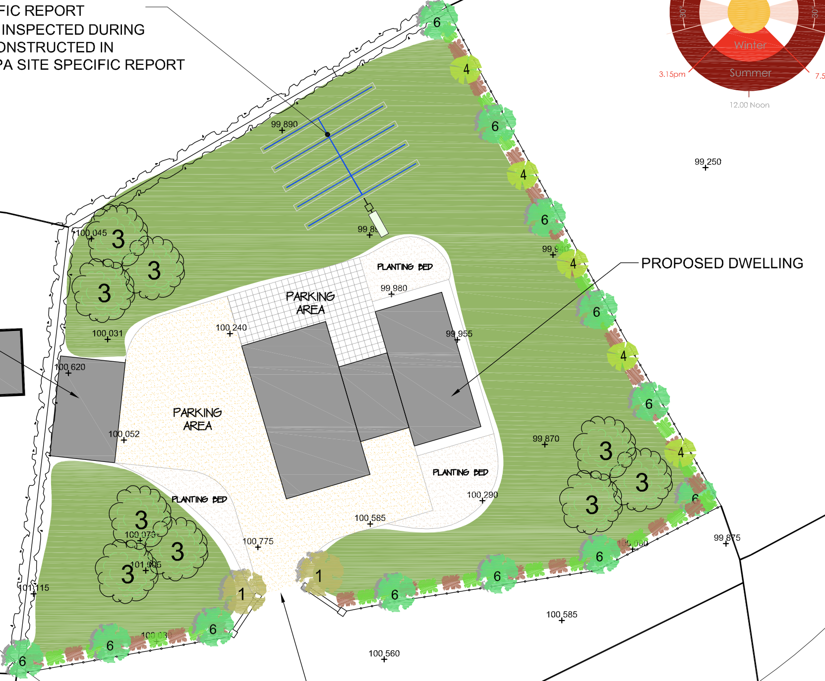

Slide 13

How would a TTP approach work in your setting?
What group would you choose and why?
What topic and problem would you use?
What do we need to consider?
  Location
  Timing
  SEN
  …

Slide 14


For the remainder of this workshop
Pair up, discuss a problem that might be suitable for TTP.

Slide 15


What’s your problem!?
$$\frac{3}{4}÷\frac{2}{5}$$

Slide 16
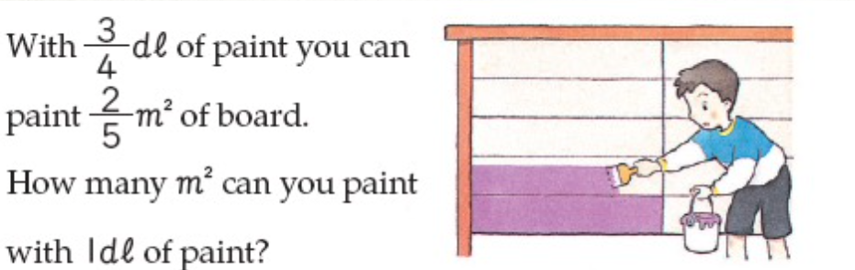
What’s your problem!?

Slide 17
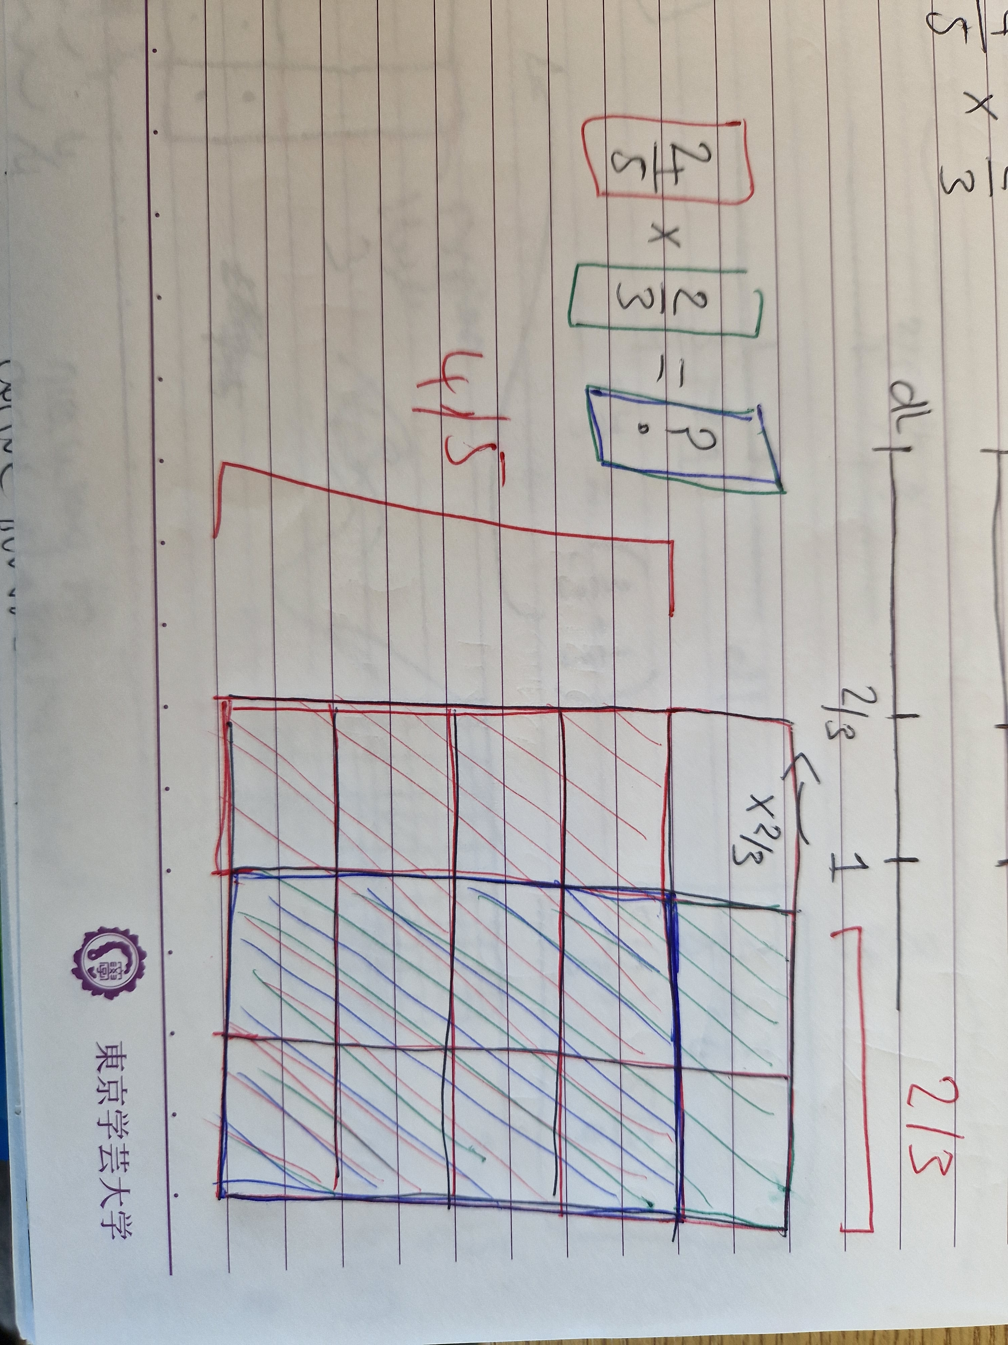
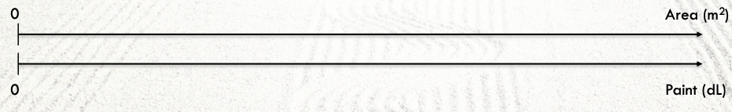
Development
Added context – paint. Any others?
Multiple solution techniques.
  Builds on previous work
  Multiple External representations (MER)
  Capable of scaffolding in multiple ways.

Slide 18


Your turn!
X
Diarmaid.hyland@mu.ie
Education Building – 210
Please ask (or email me) any questions, request slides, etc.

