Slide 1

Celebrating 60 years
of the
Irish Maths Teachers Association
1964-2024
WELCOME
Castleknock Hotel

Slide 2

www.imta.ie
IMTA in 2024
The IMTA celebrates its 60th birthday in 2024
2444
>57%
WHERE TO
IN 2064?
MEMBERS
OF SCHOOLS
NATIONWIDE
ARE MEMBERS
417
263,981
SCHOOLS
STUDENTS SUPPORTED
BY IMTA MEMBERS

Slide 3
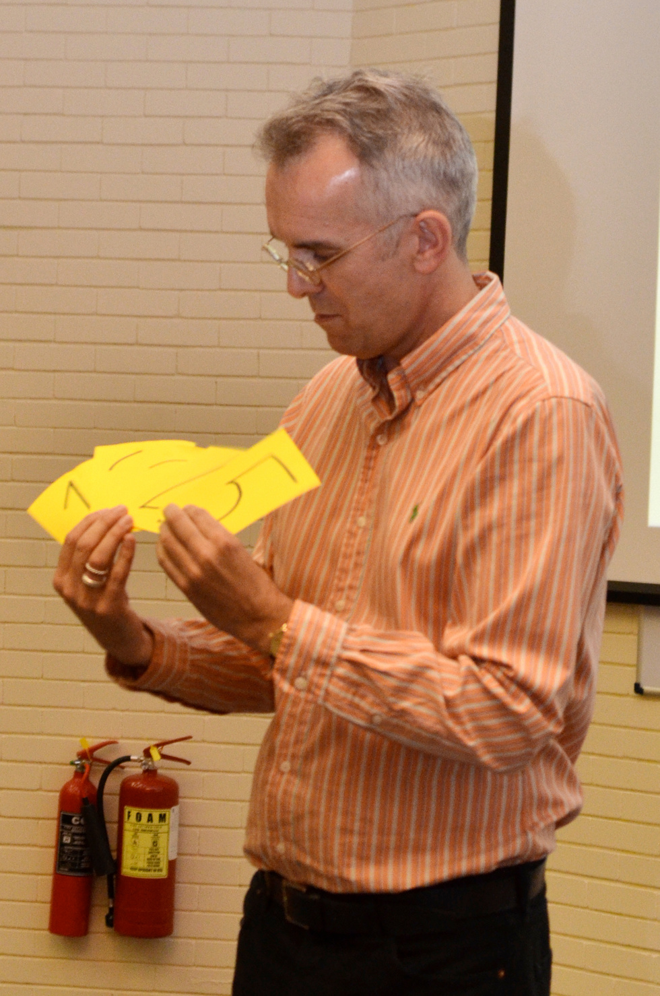
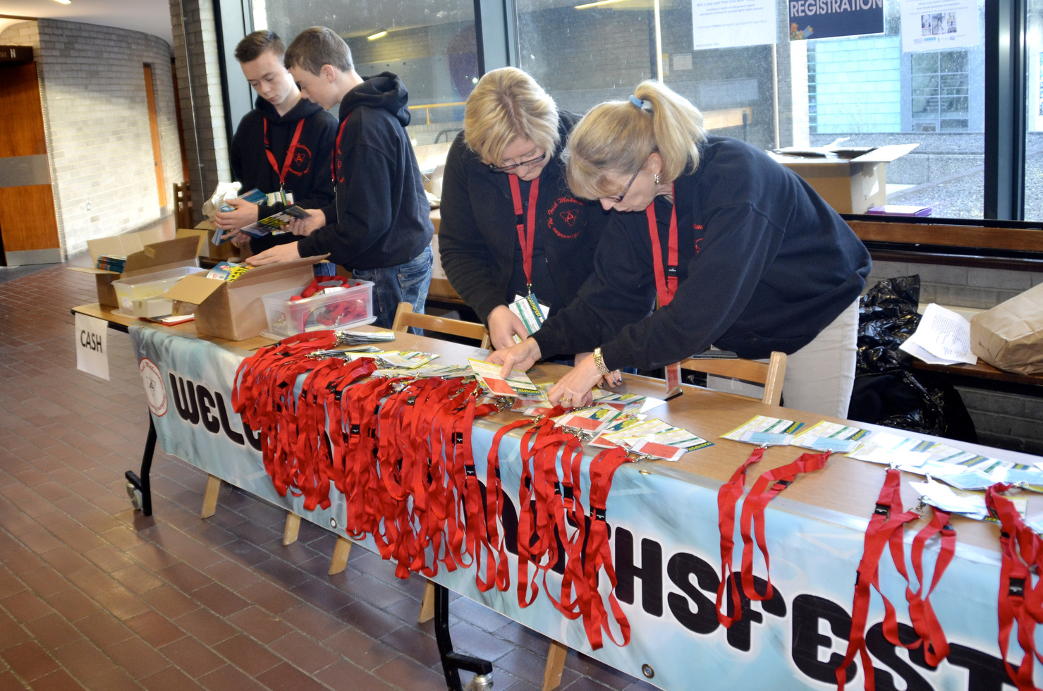
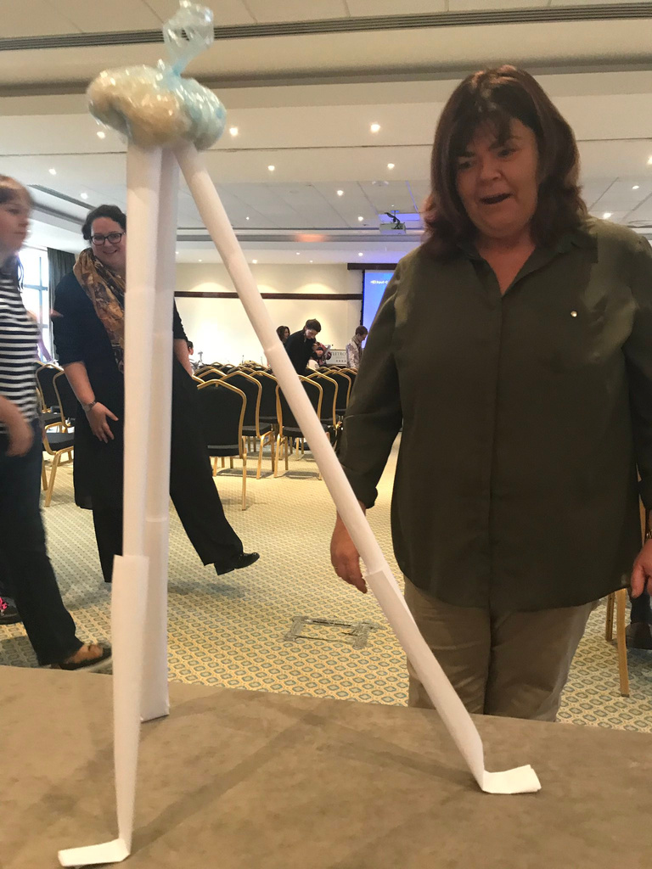
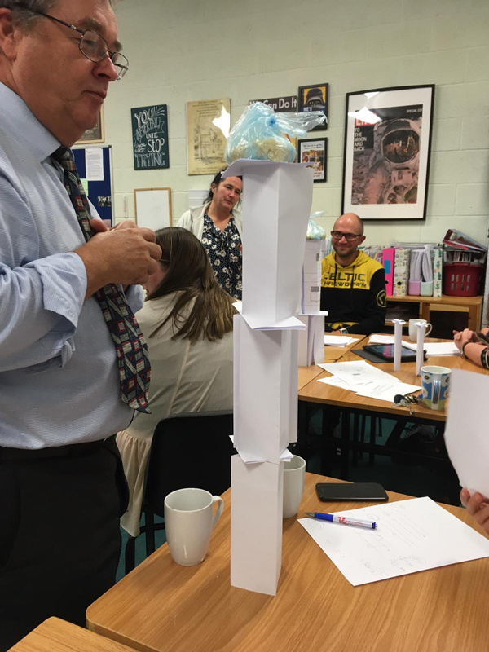
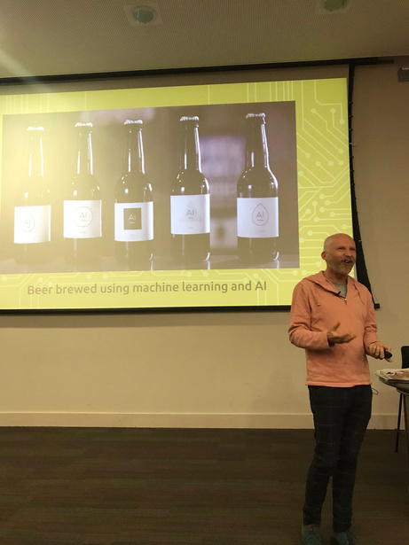
Teacher CPD

Slide 4
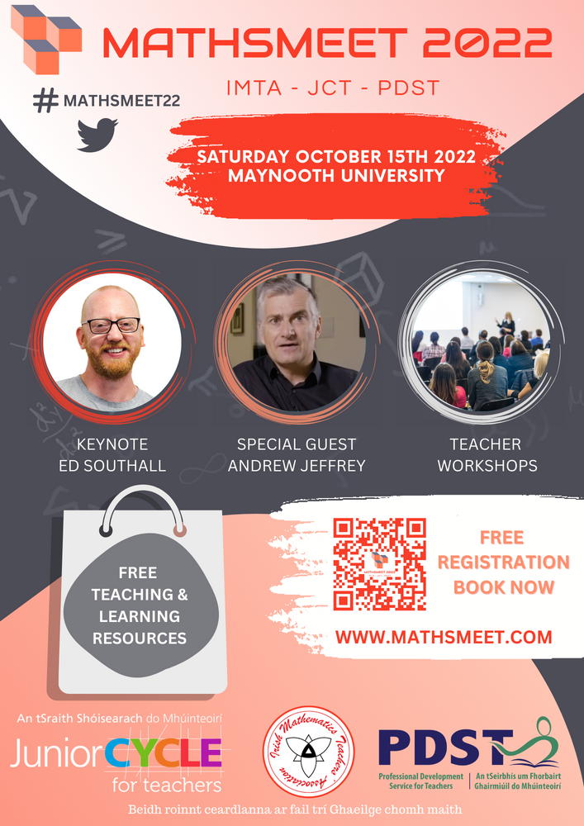

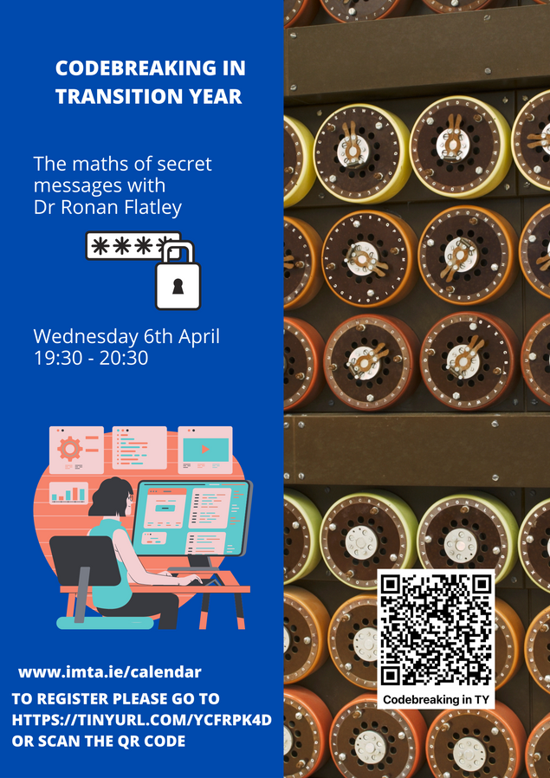
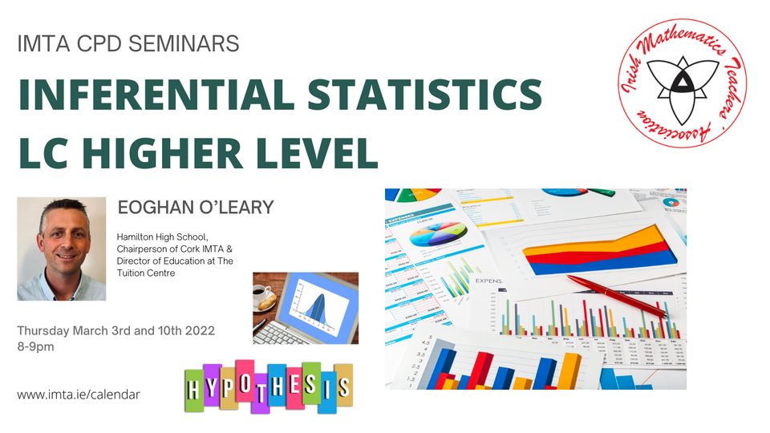
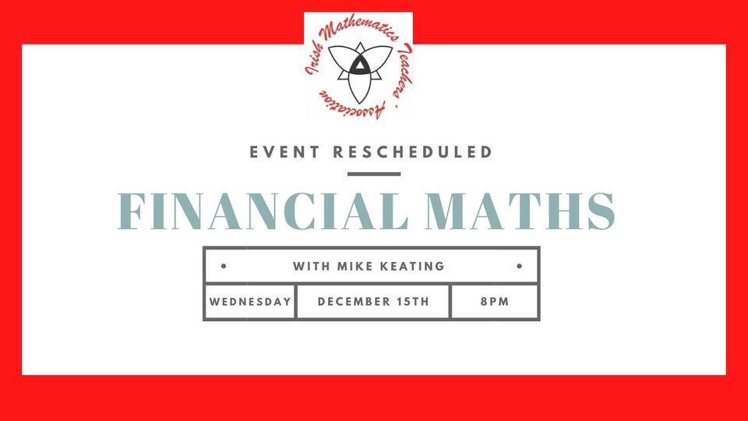
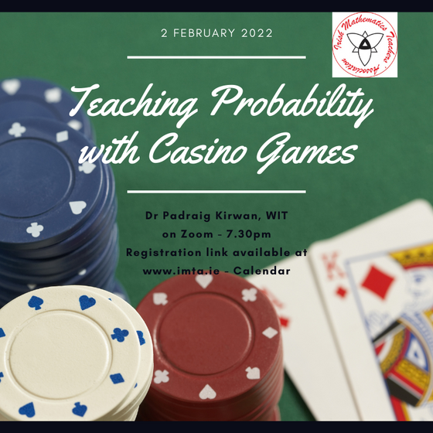
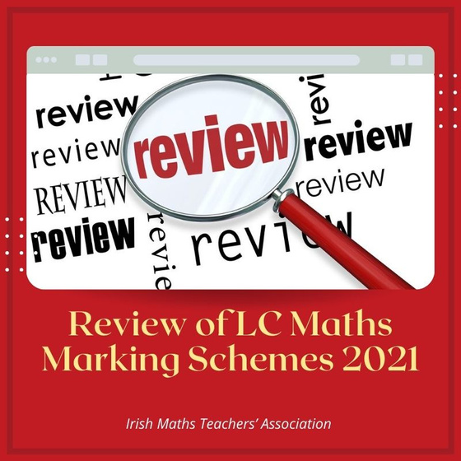
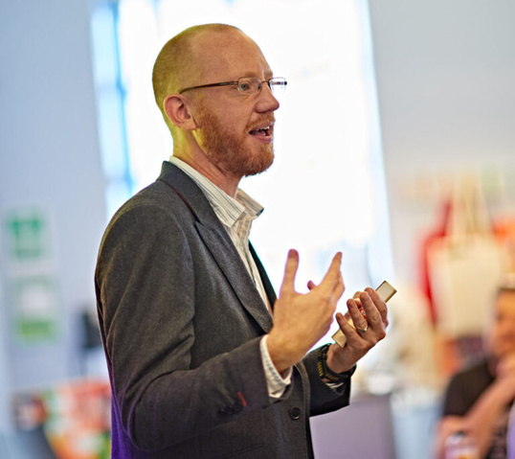
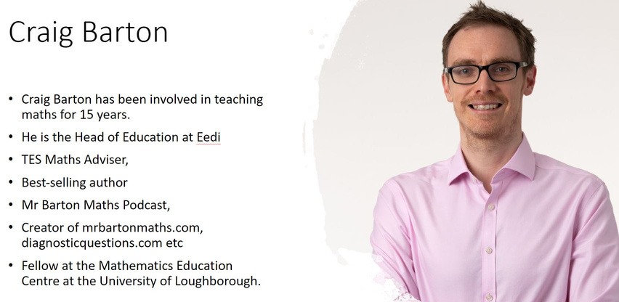

Slide 5
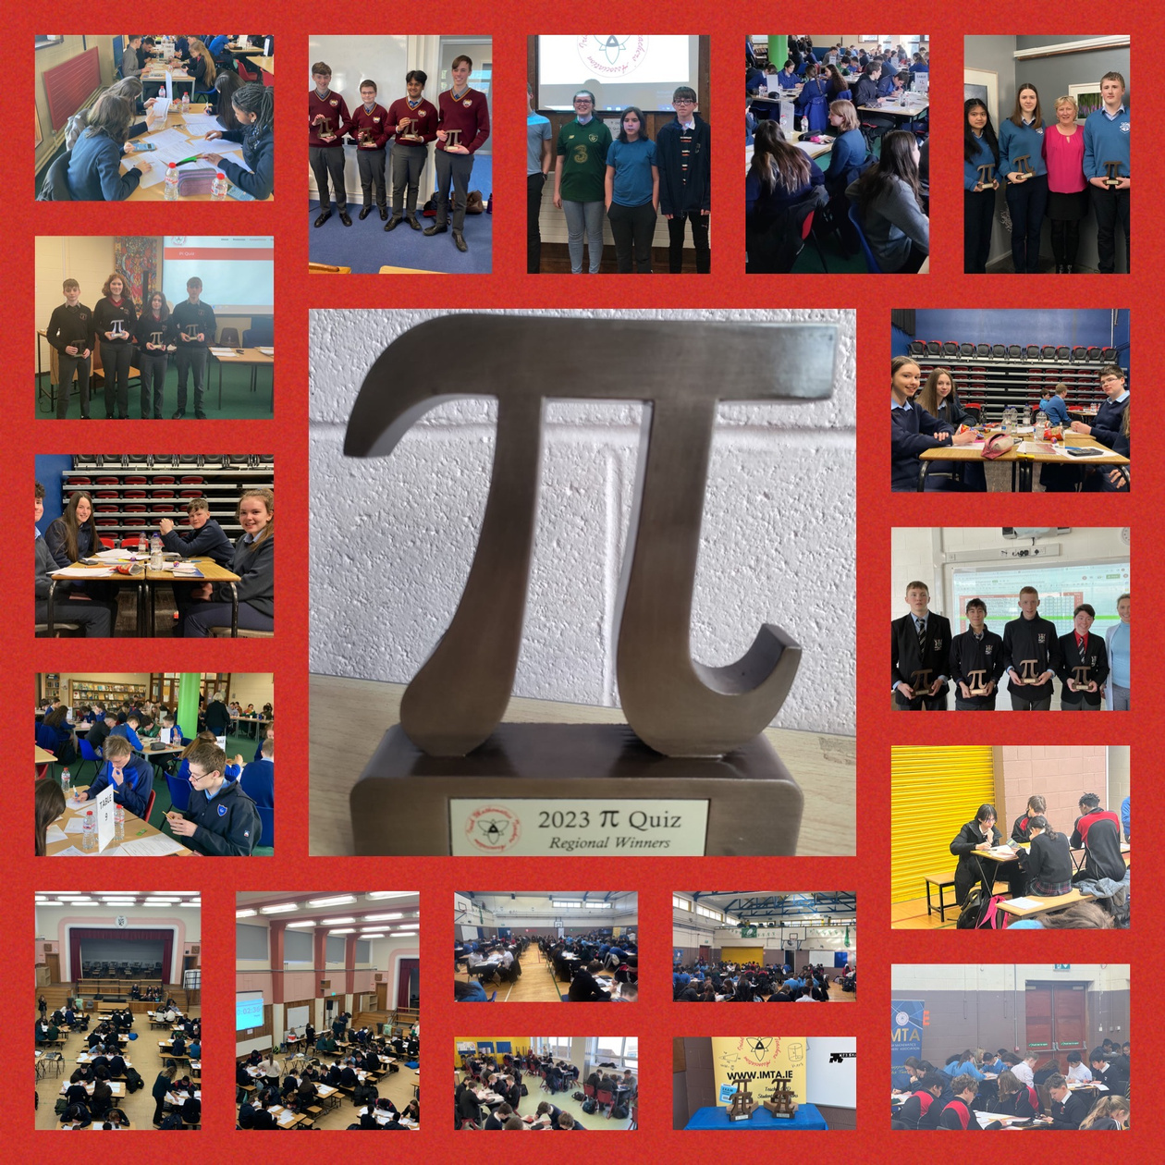
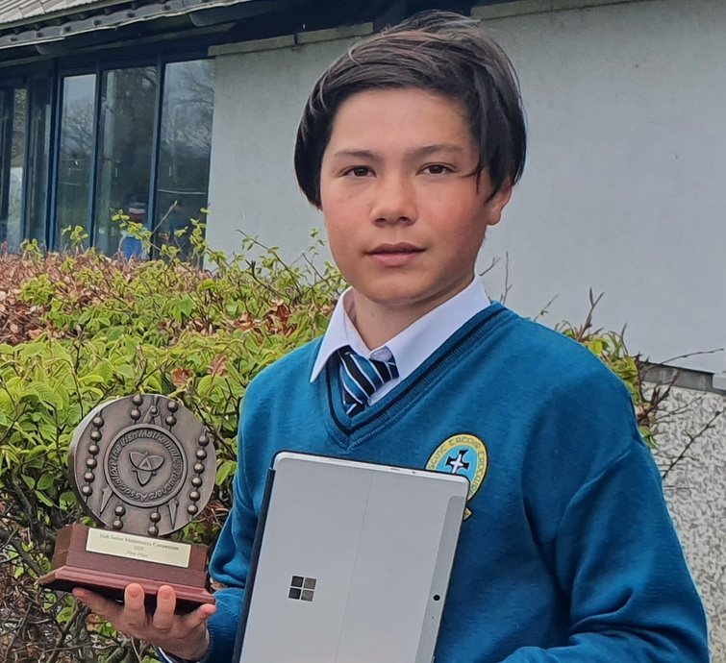
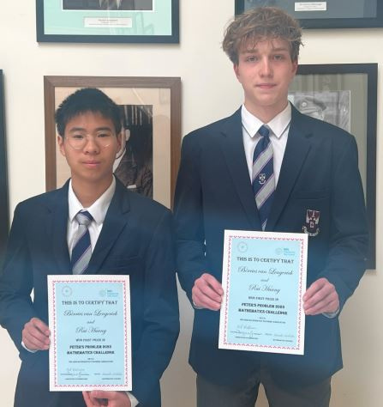
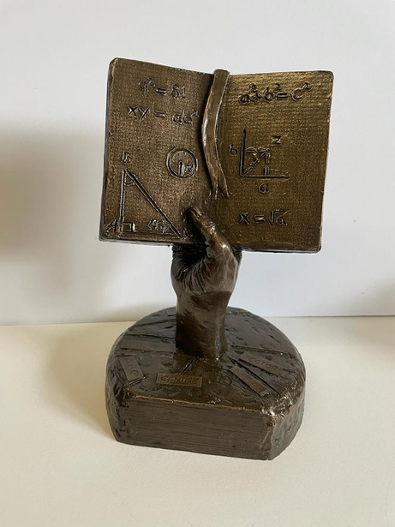
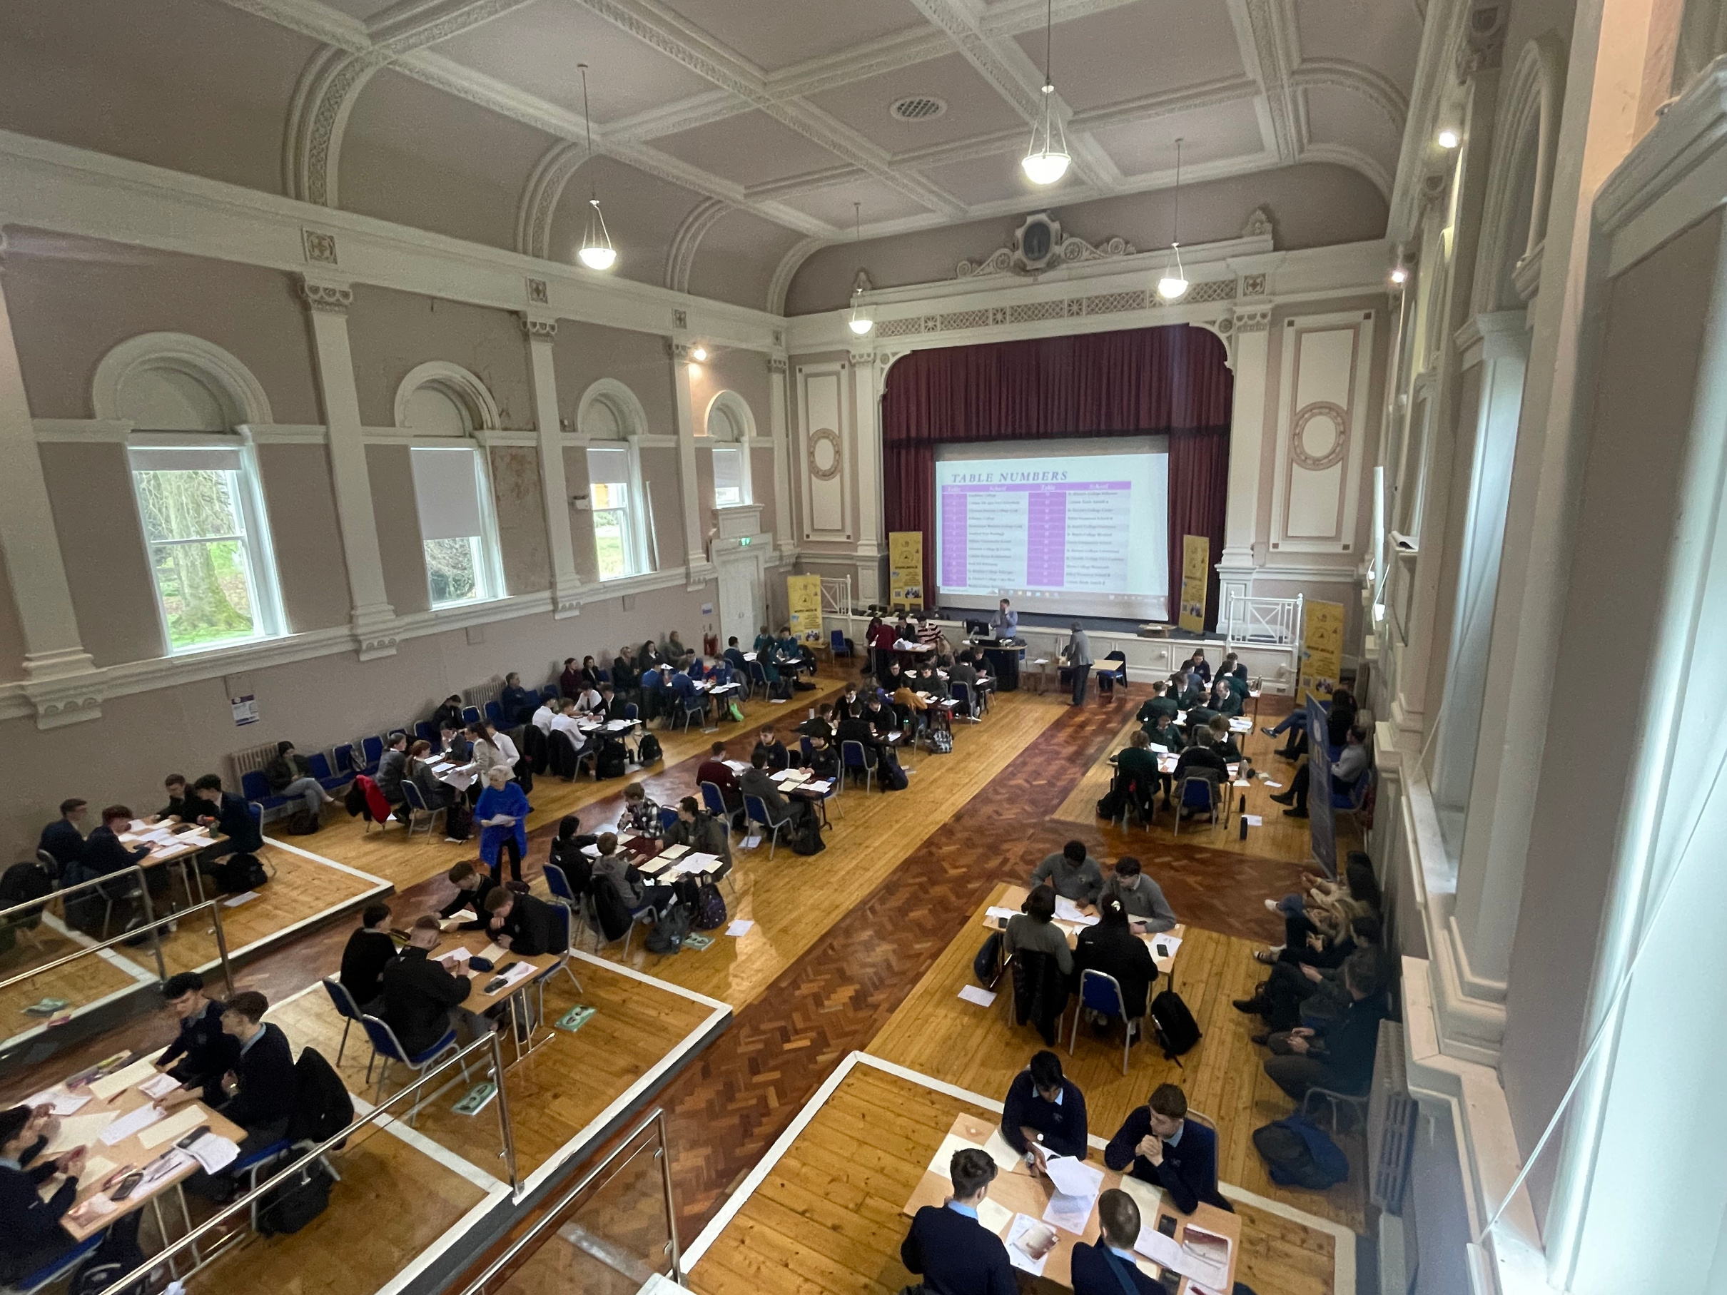
IMTA COMPETITIONS
Pi Quiz
something for everyone...
590 teams competed in 2023 from 231 schools across 36 regional centres
1st Year Competition
Peter’s Problem
15,312 entries in 2024 from 233 schools
532 entries in 2023
from 65 schools
Maggie Gough
Team Maths
18,700 entries in 2023 (2nd & 4th/5th Year Students)
193 teams competed in 2023 from 97 schools across 12 regional venues.

Slide 6
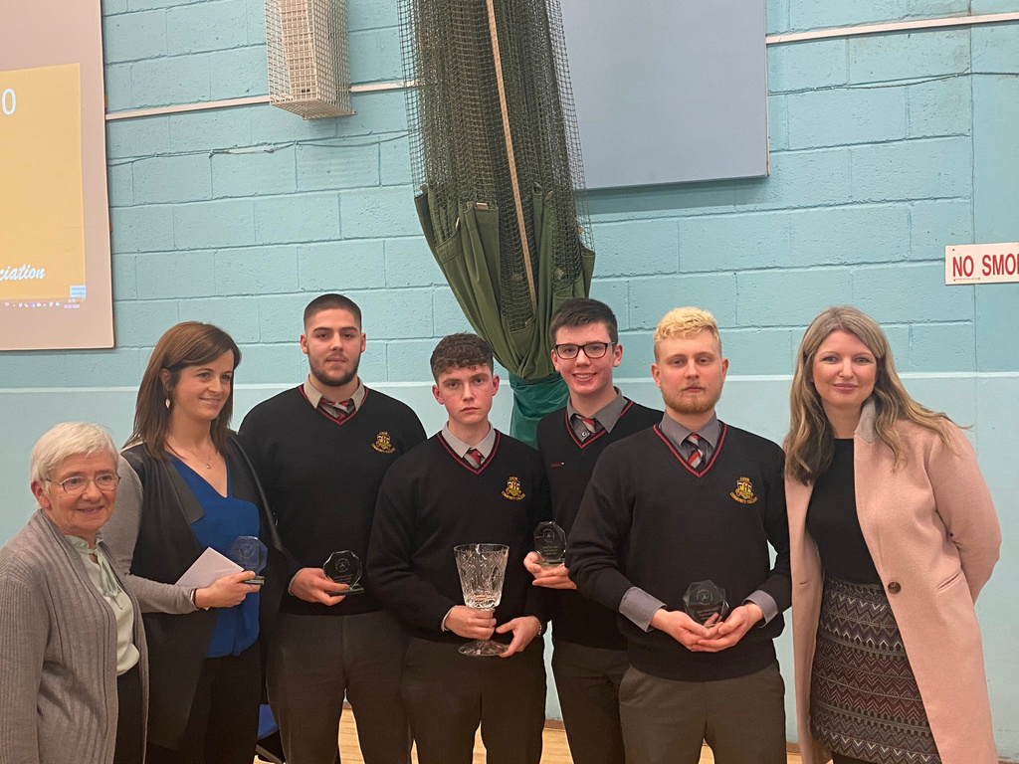
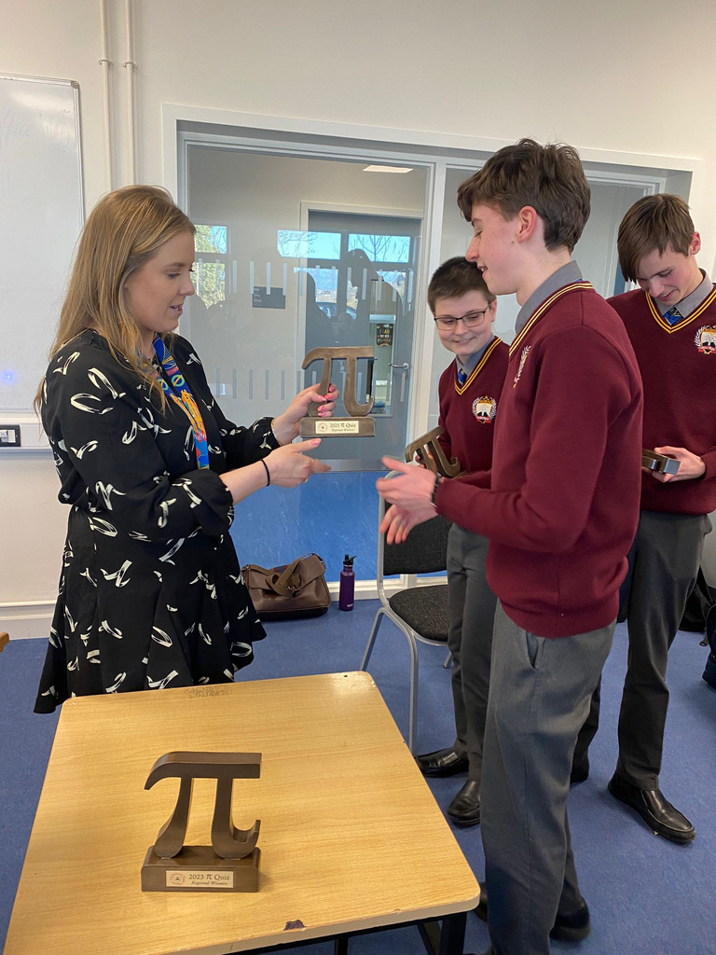
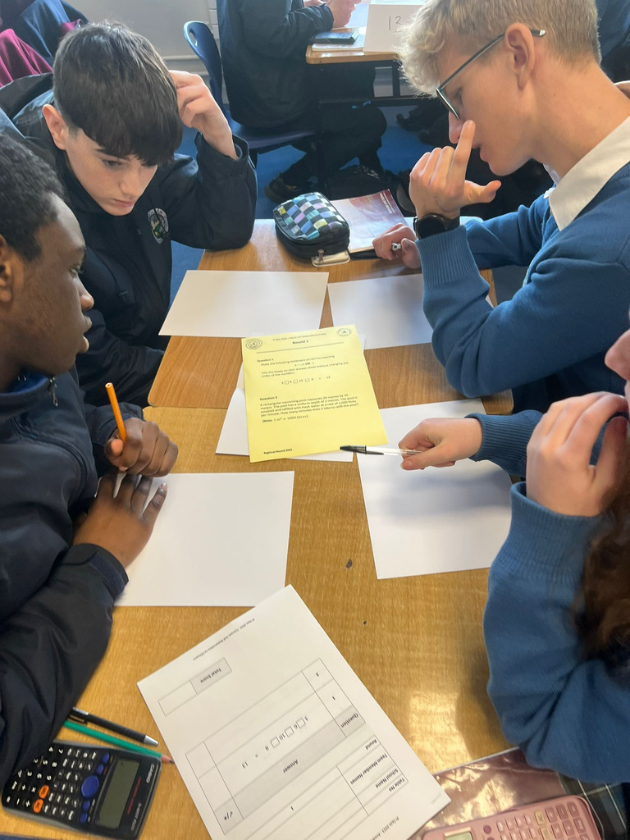
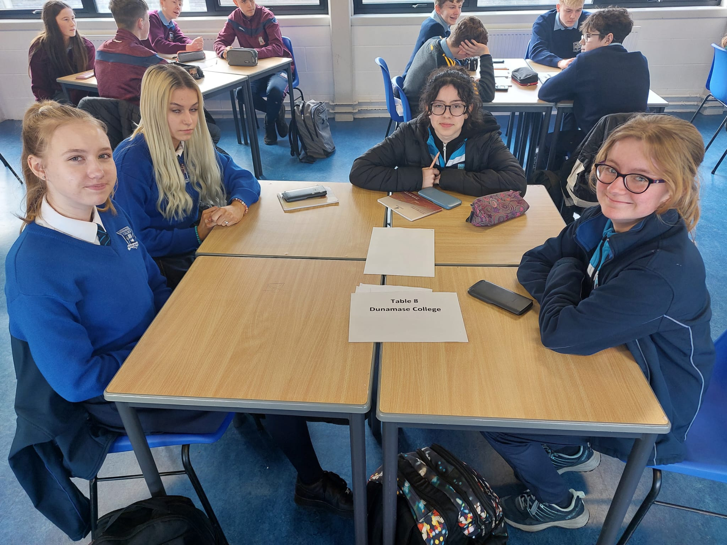
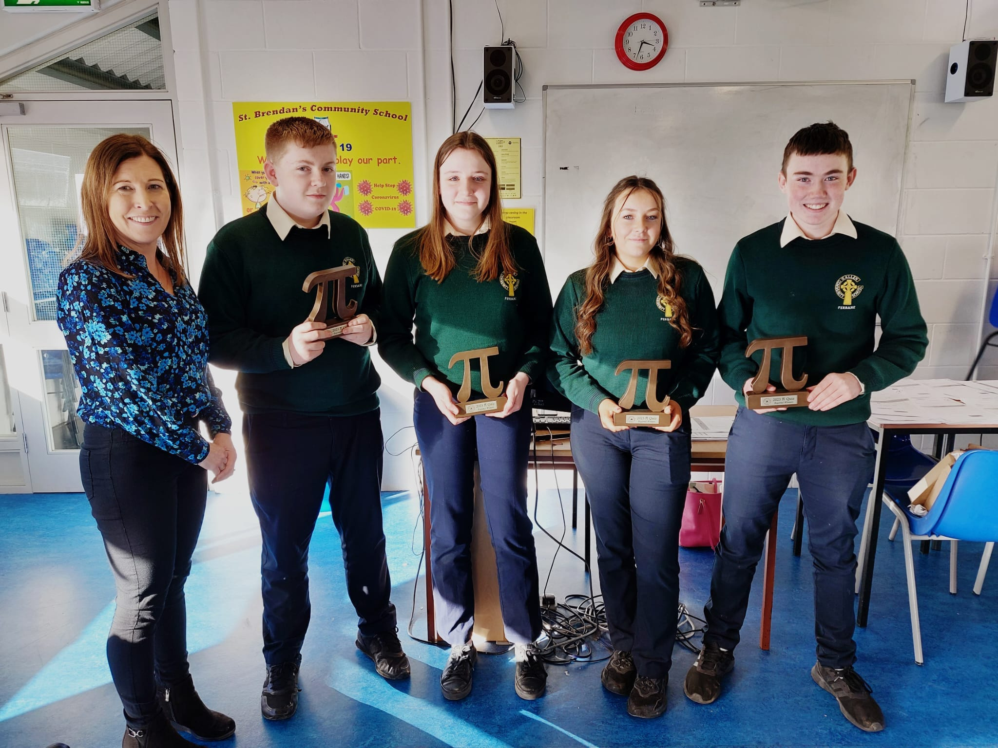

Slide 7
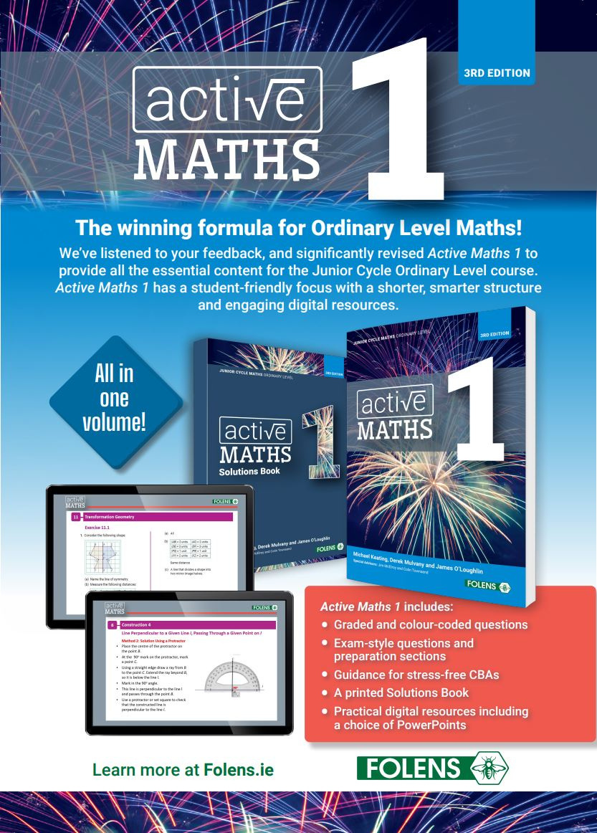
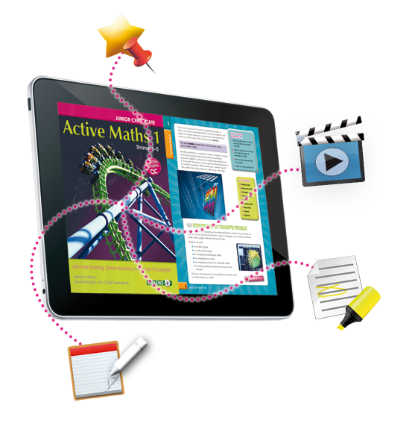

Thanks to our many sponsors

Slide 8
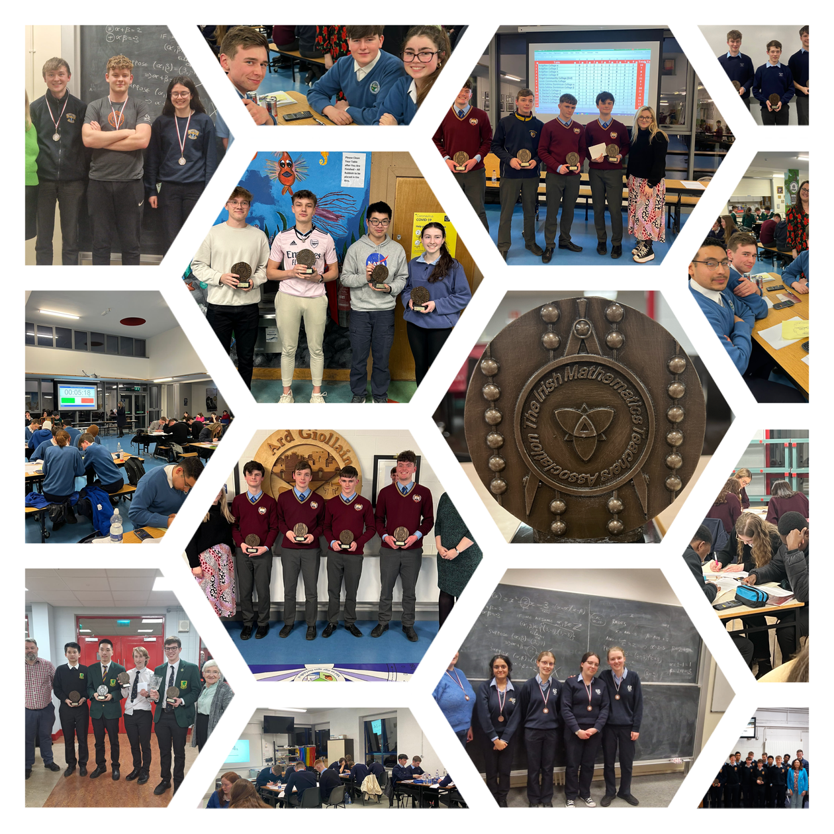
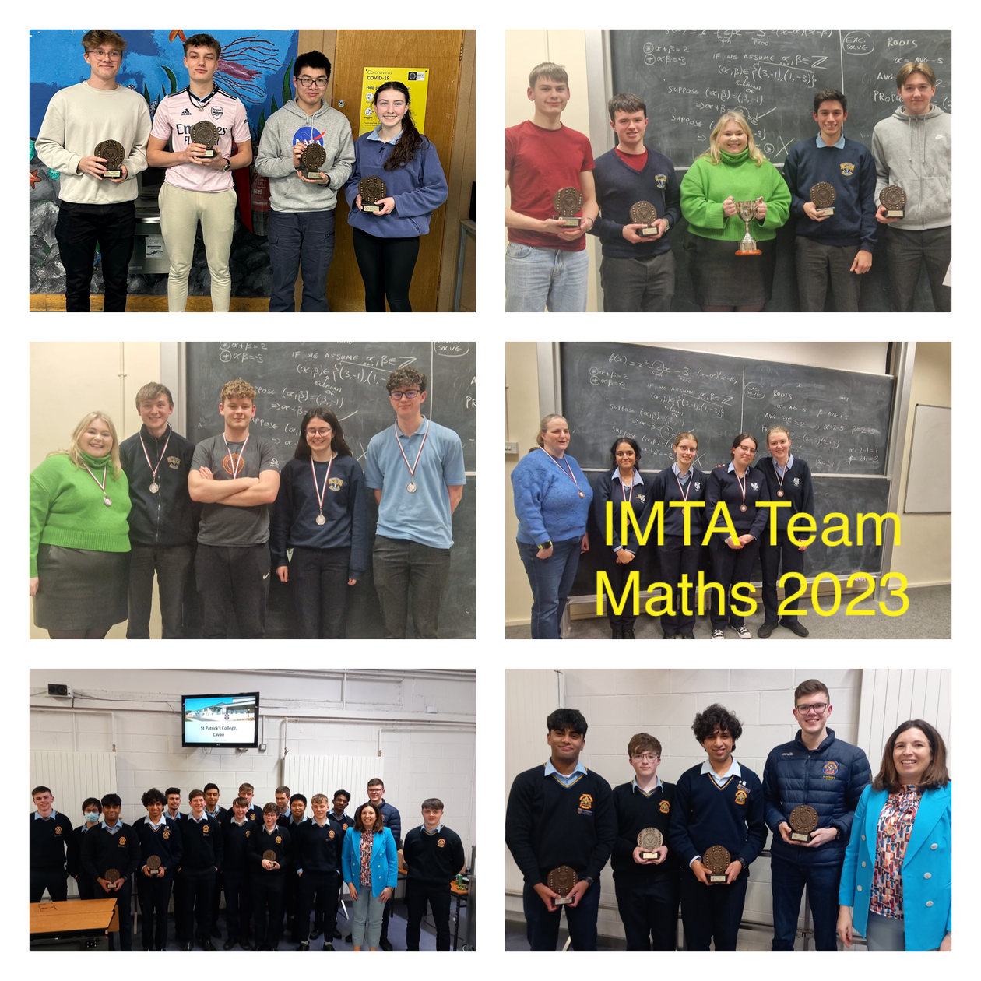
Student Competitions

Slide 9
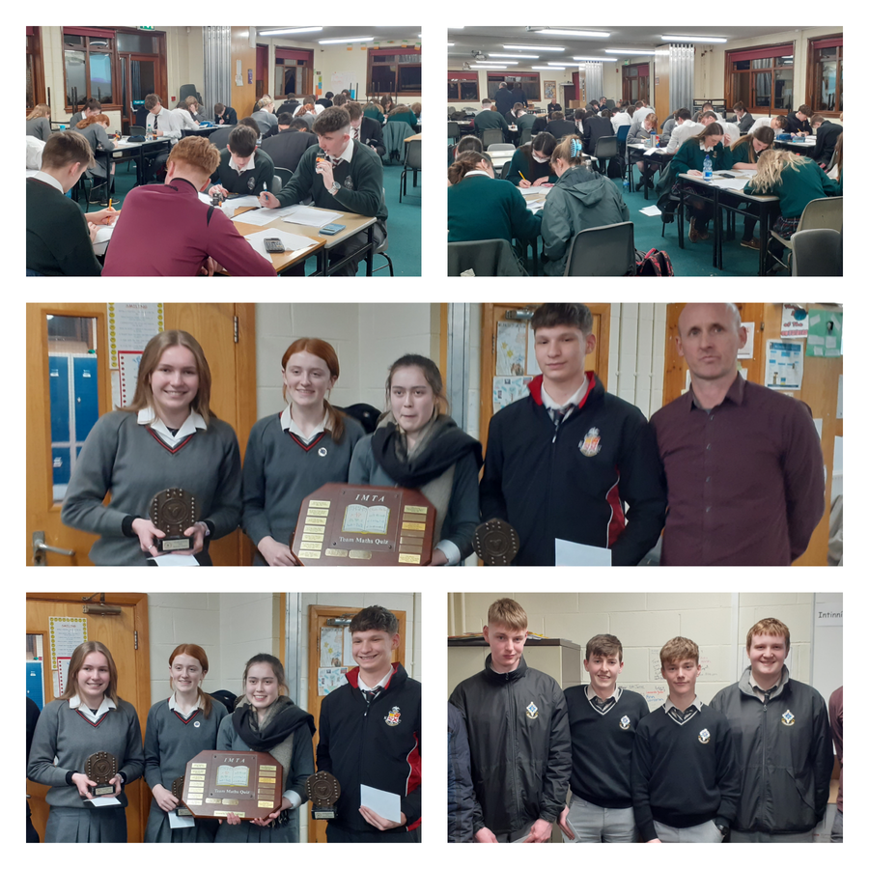
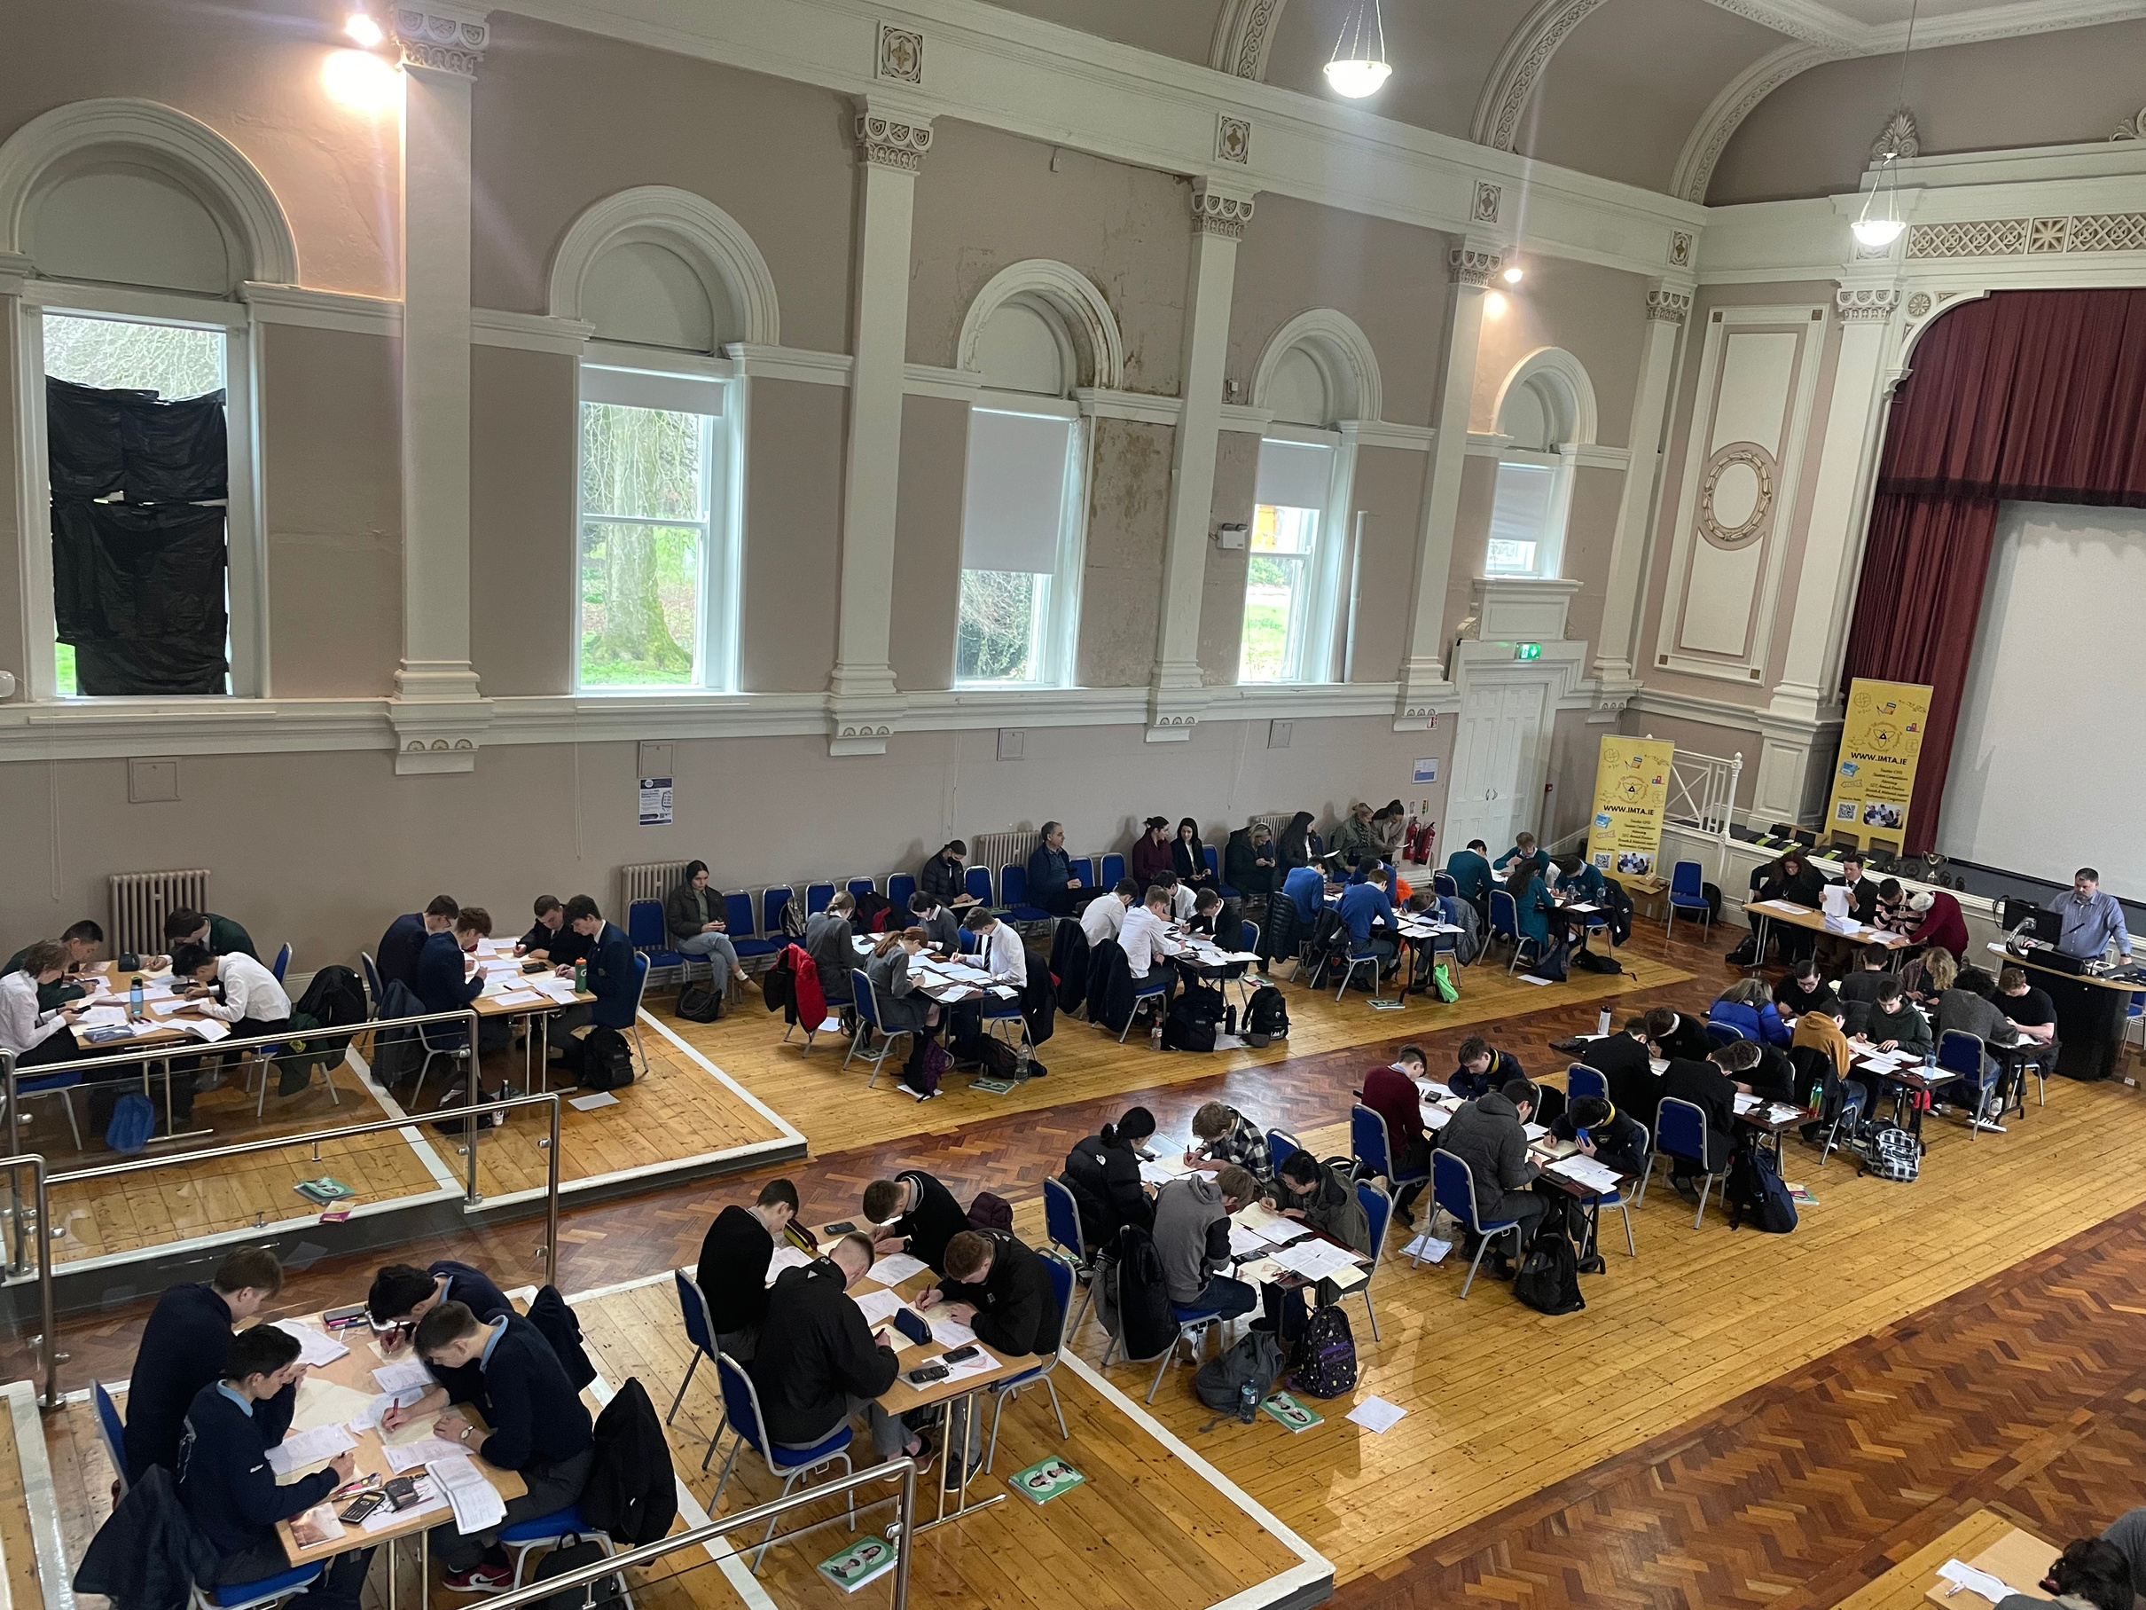
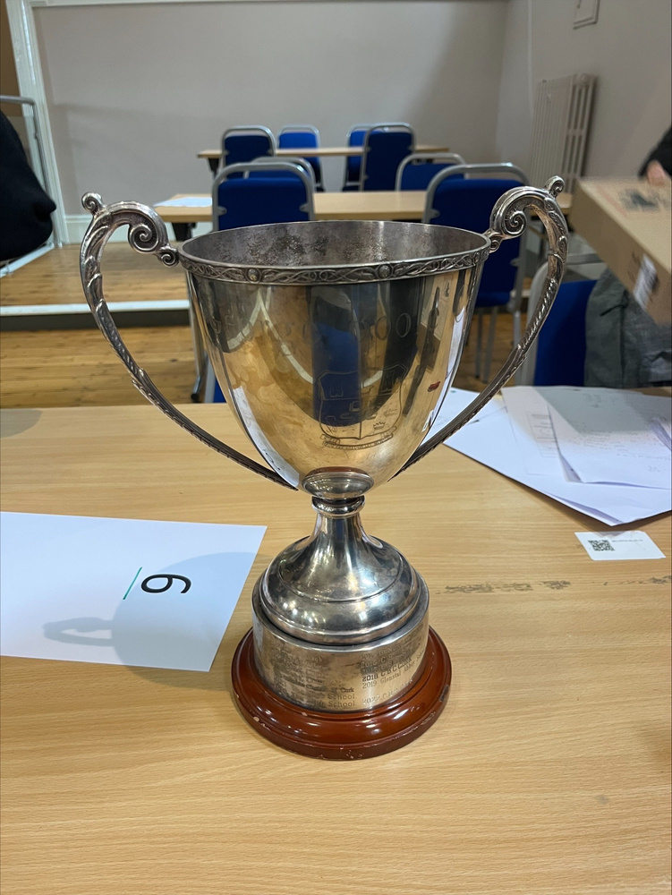
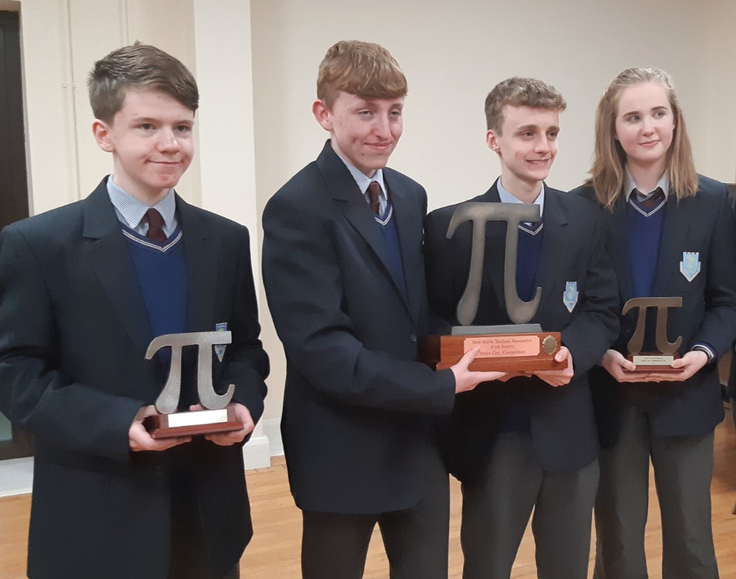
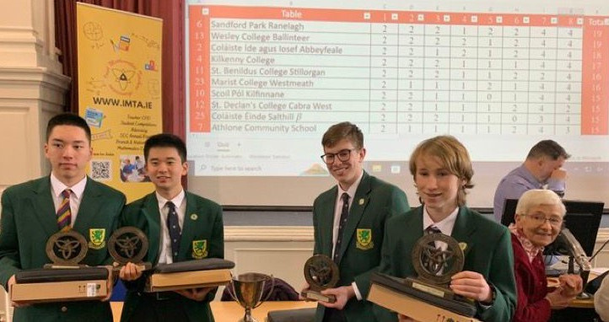
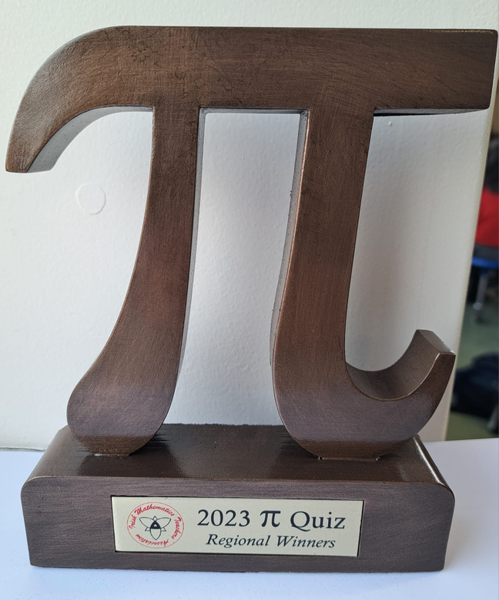

Slide 10

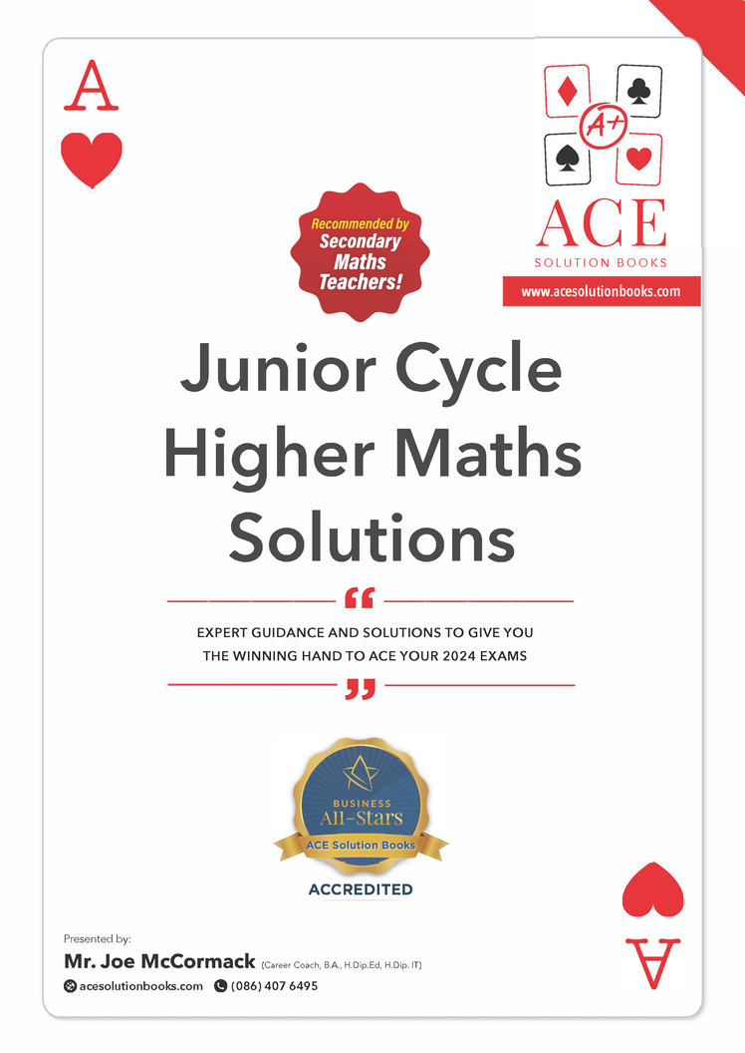

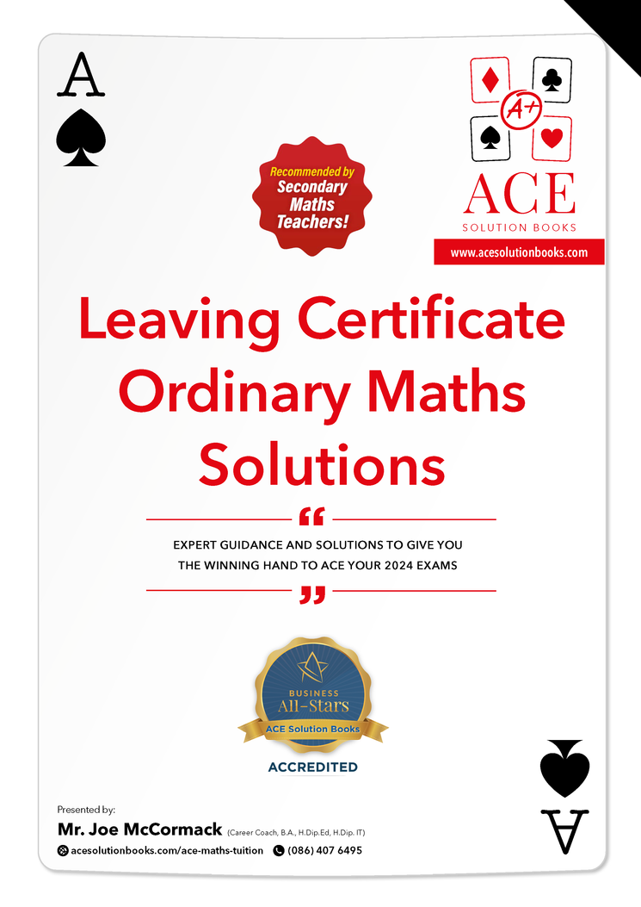
THANKS TO OUR MANY SPONSORS

Slide 11
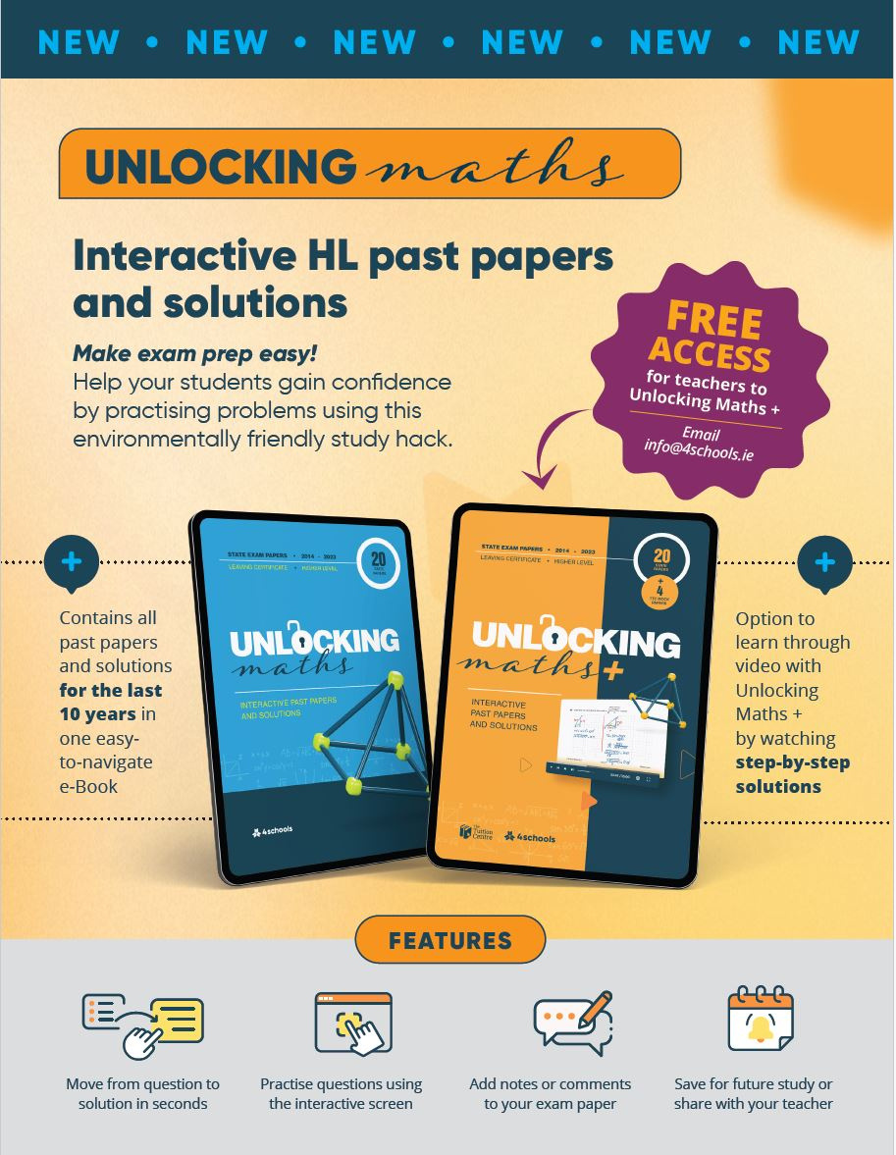

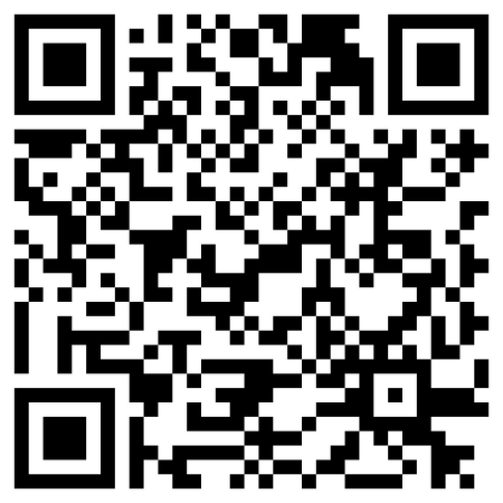
scan for programme

Slide 12
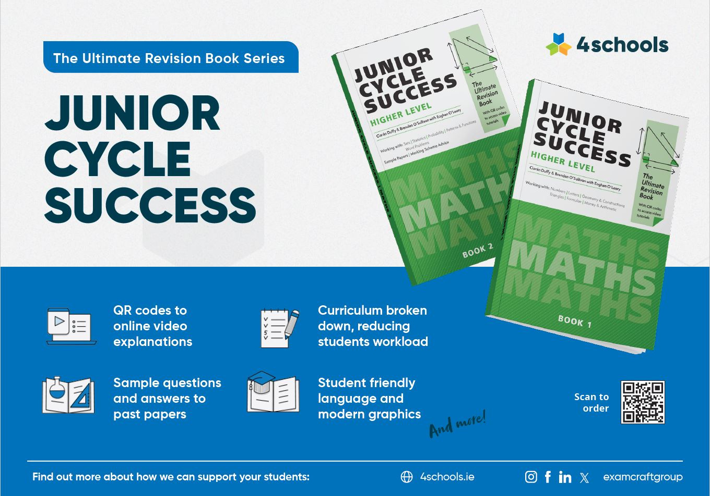

Slide 13
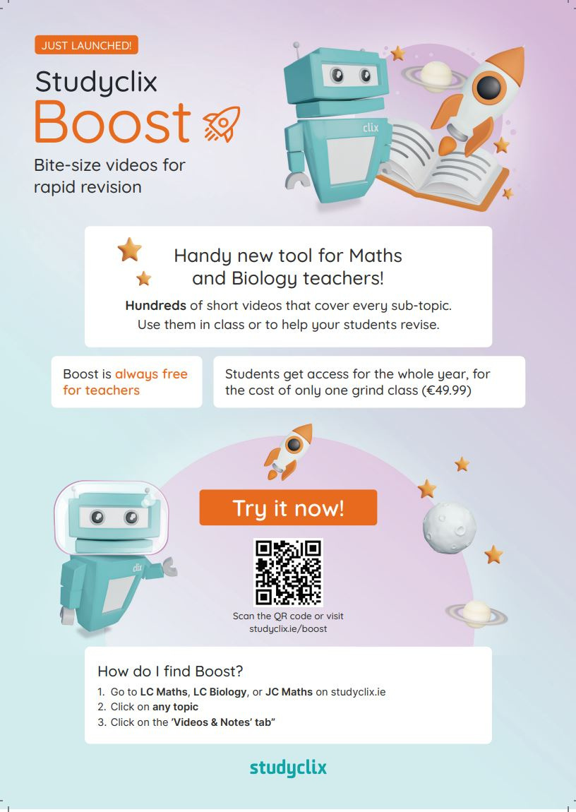




Slide 14
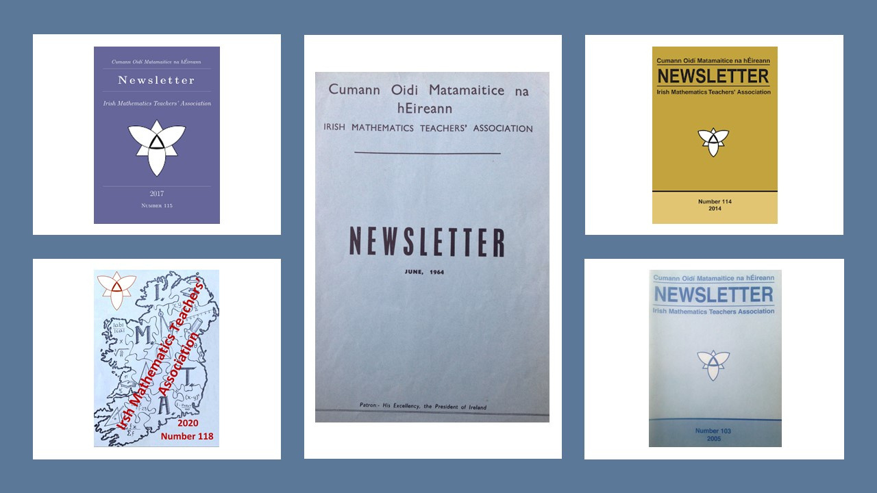

Slide 15
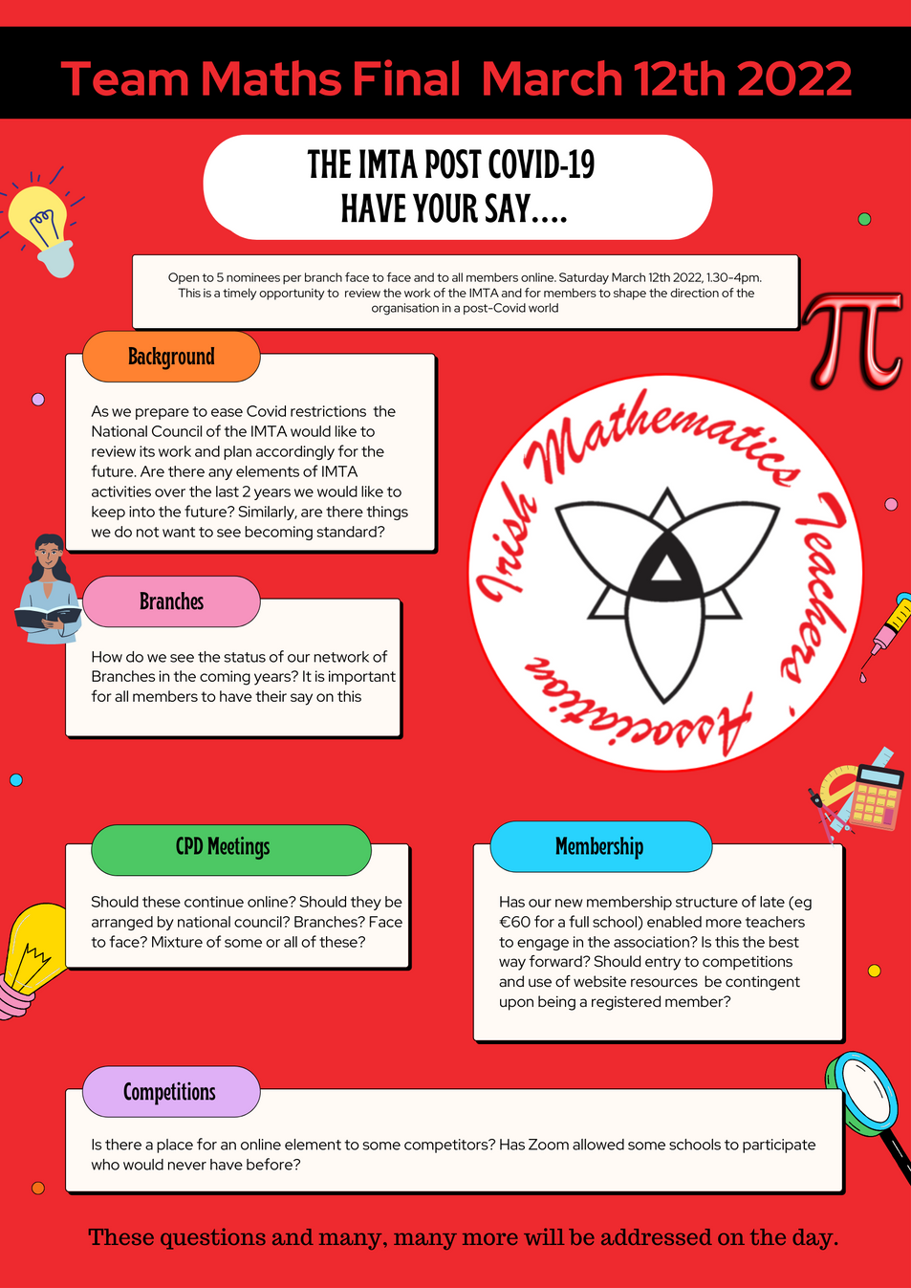
A Reflective Association
As part of the Team Maths Final 2022, we hosted a Review & Reflection of the work of the IMTA post-Covid and used it as an opportunity to take stock, asses what we have done and see where we are going as an organisation.
We had a blended session with participants face to face answering some thought-provoking questions coupled with members contributing via Zoom.
We used Mentimeter to gather answers to questions which both asked us what we do well, what we need to keep and more importantly where we fall down, in terms of our aims and objectives as set out in our constitution.

Slide 16
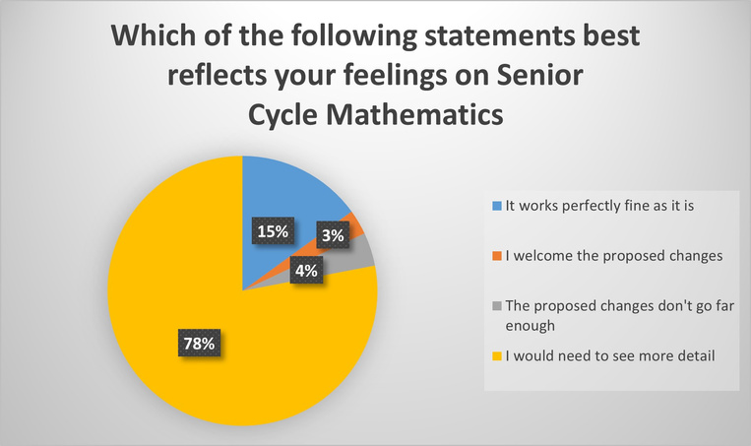
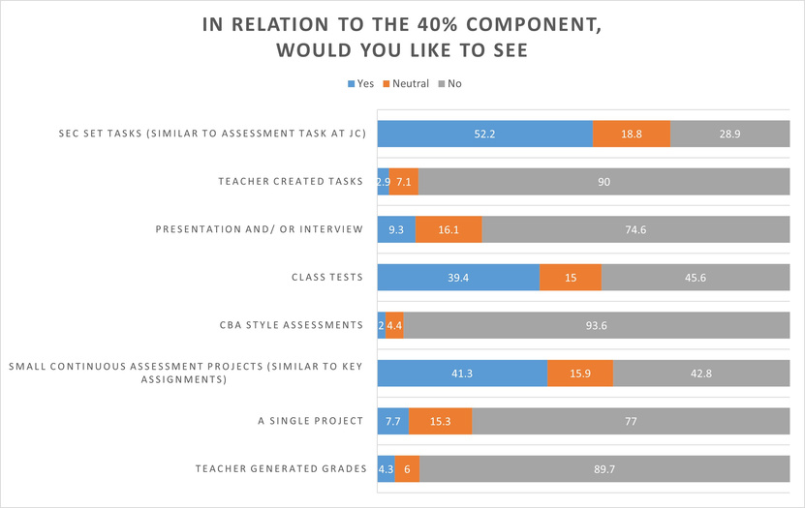

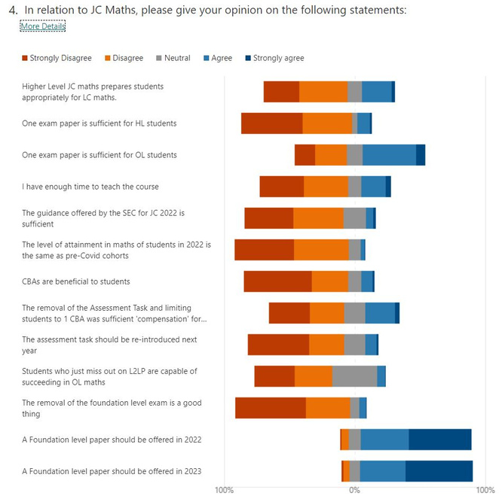
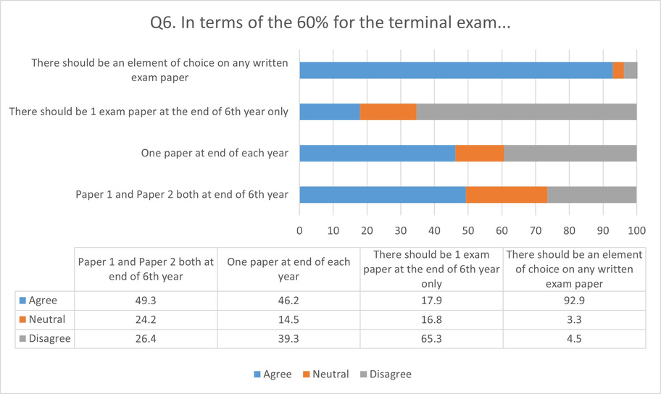
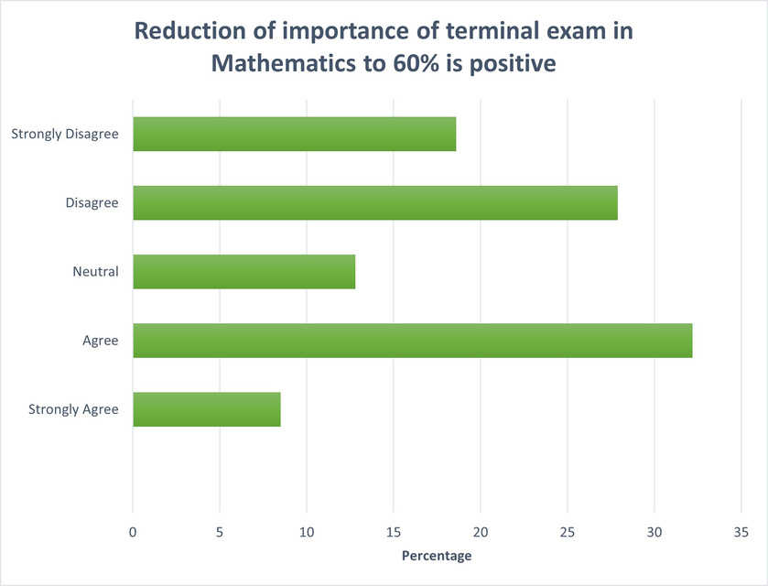
Advocacy
Gathering Views of
Teachers & Students

Slide 17
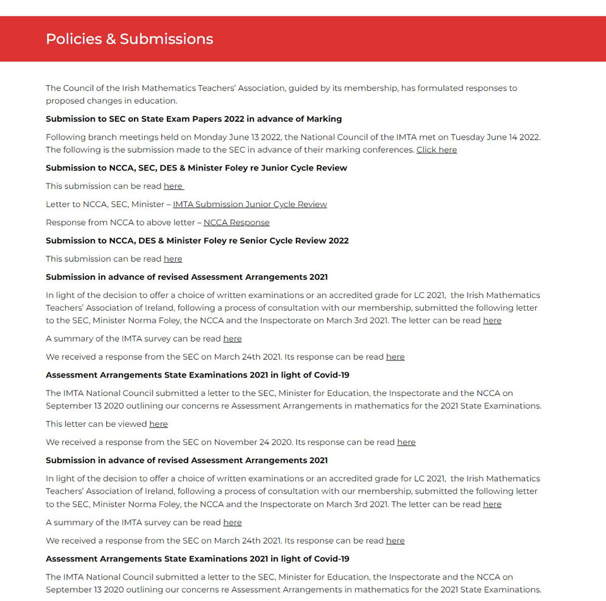
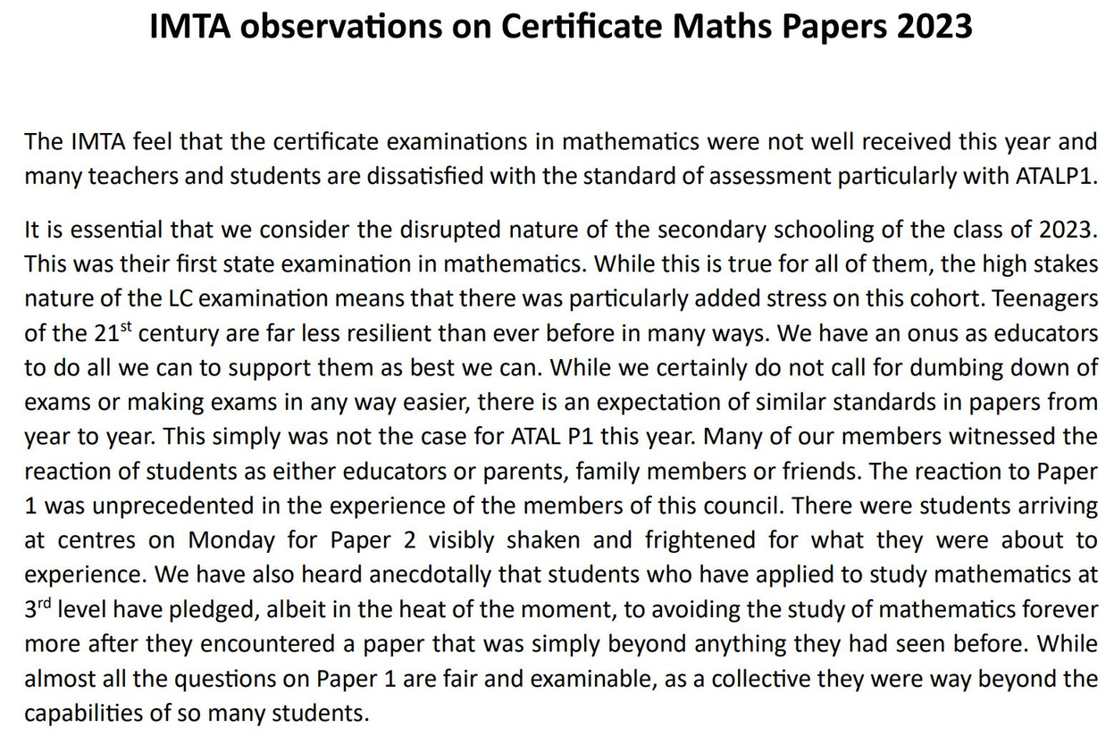
Recent IMTA submissions

Slide 18
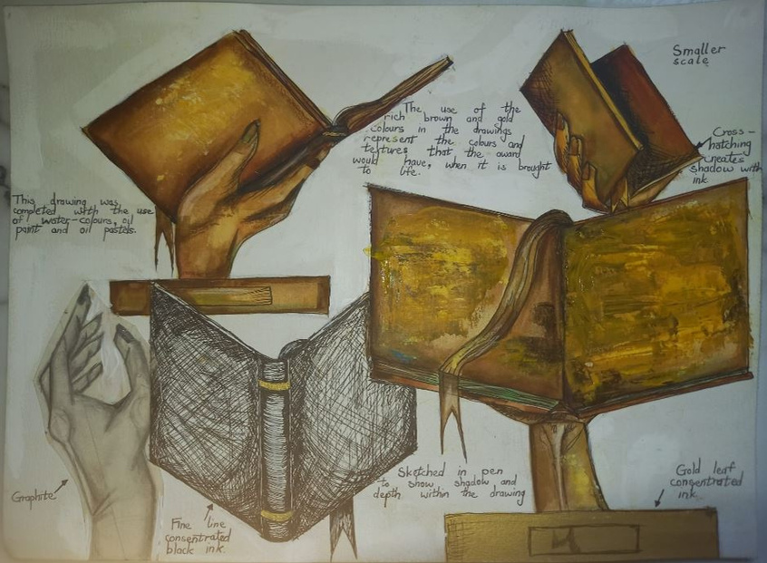
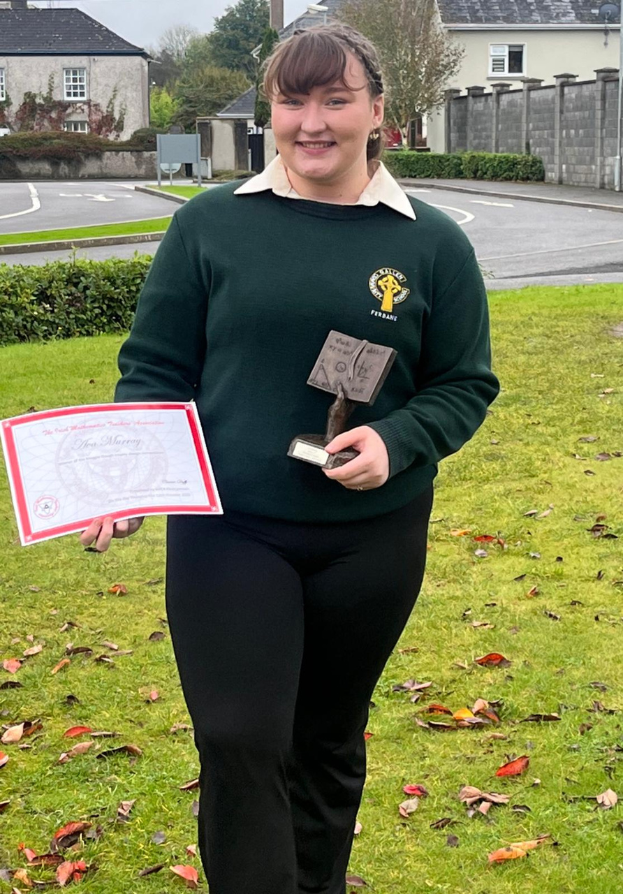


Slide 19



Slide 20


Slide 21


Slide 22



Slide 23


Slide 24



Slide 25


Slide 26


Slide 27


Slide 28


Slide 29



Slide 30



Slide 31



Slide 32


Slide 33


Slide 34




Slide 35


Slide 36




Slide 37




Slide 38


Slide 39


Slide 40



Slide 41


Slide 42


Slide 43




Slide 44




Slide 45


Slide 46



Slide 47


Slide 48


Slide 49


Slide 50


Slide 51


Slide 52


Slide 54


Slide 55


Slide 58


Slide 59


Slide 60


Slide 61


Slide 62


Slide 63


Slide 64


Slide 65


Slide 66


Slide 67






Slide 68



Slide 69


