Slide 1


a brief introduction to the What, Why, & How of
mags amond
@magsamond

Slide 2
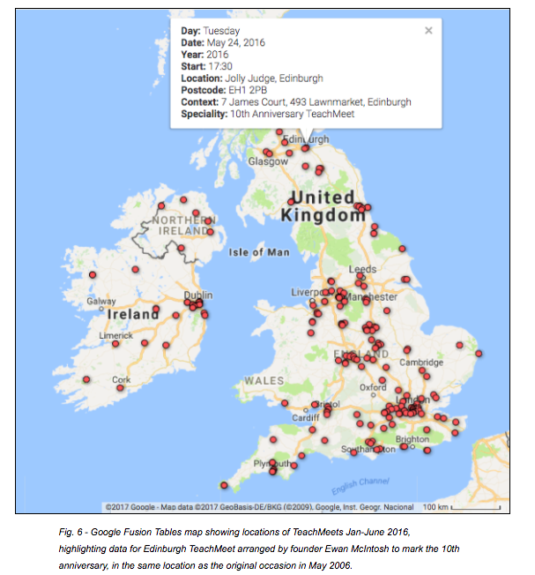
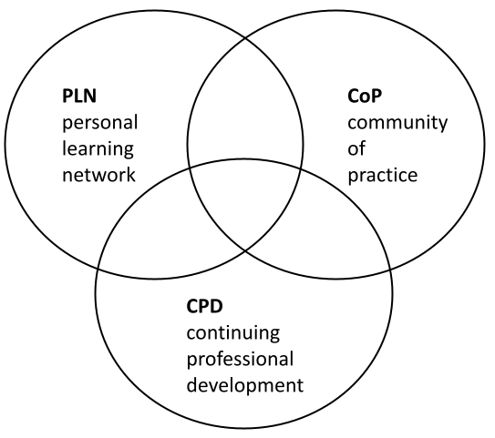
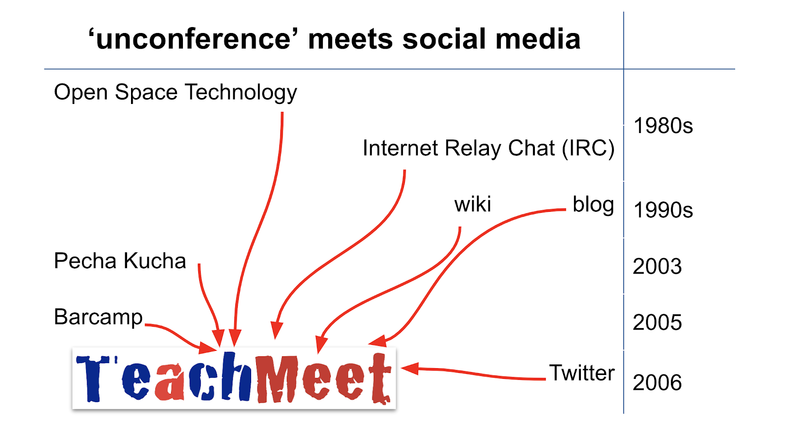
a brief introduction to the What, Why, & How of
CONTEXT
TeachMeet was started in Scotland in 2006 as a semi-formal event organised
by teachers
for teachers
in order to share practice and discuss ideas in a convivial atmosphere

Slide 3
a brief introduction to the What, Why, & How of
the indefinite definition of TeachMeet
Build your own definition - pick and mix a brick from each set !
a social
gathering
of teachers
to share
ideas
an informal
meeting
of educators
to discuss
resources
a peer-organised
event
of peers
to exchange
practice

Slide 4
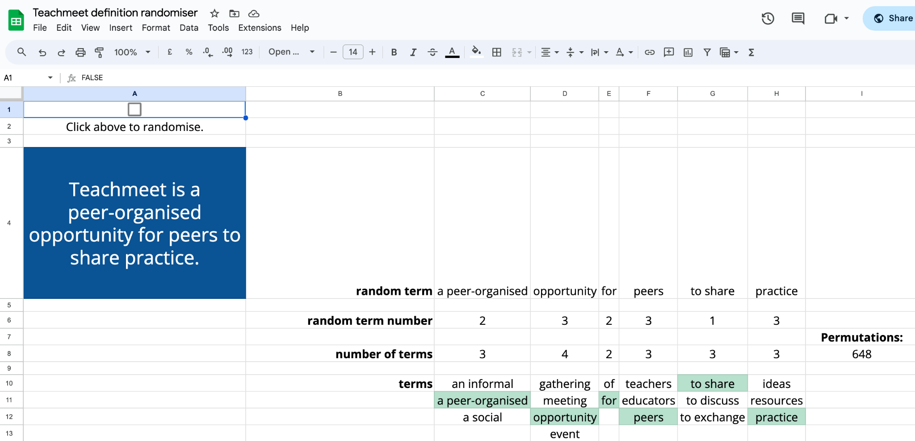
a brief introduction to the What, Why, & How of

Slide 5
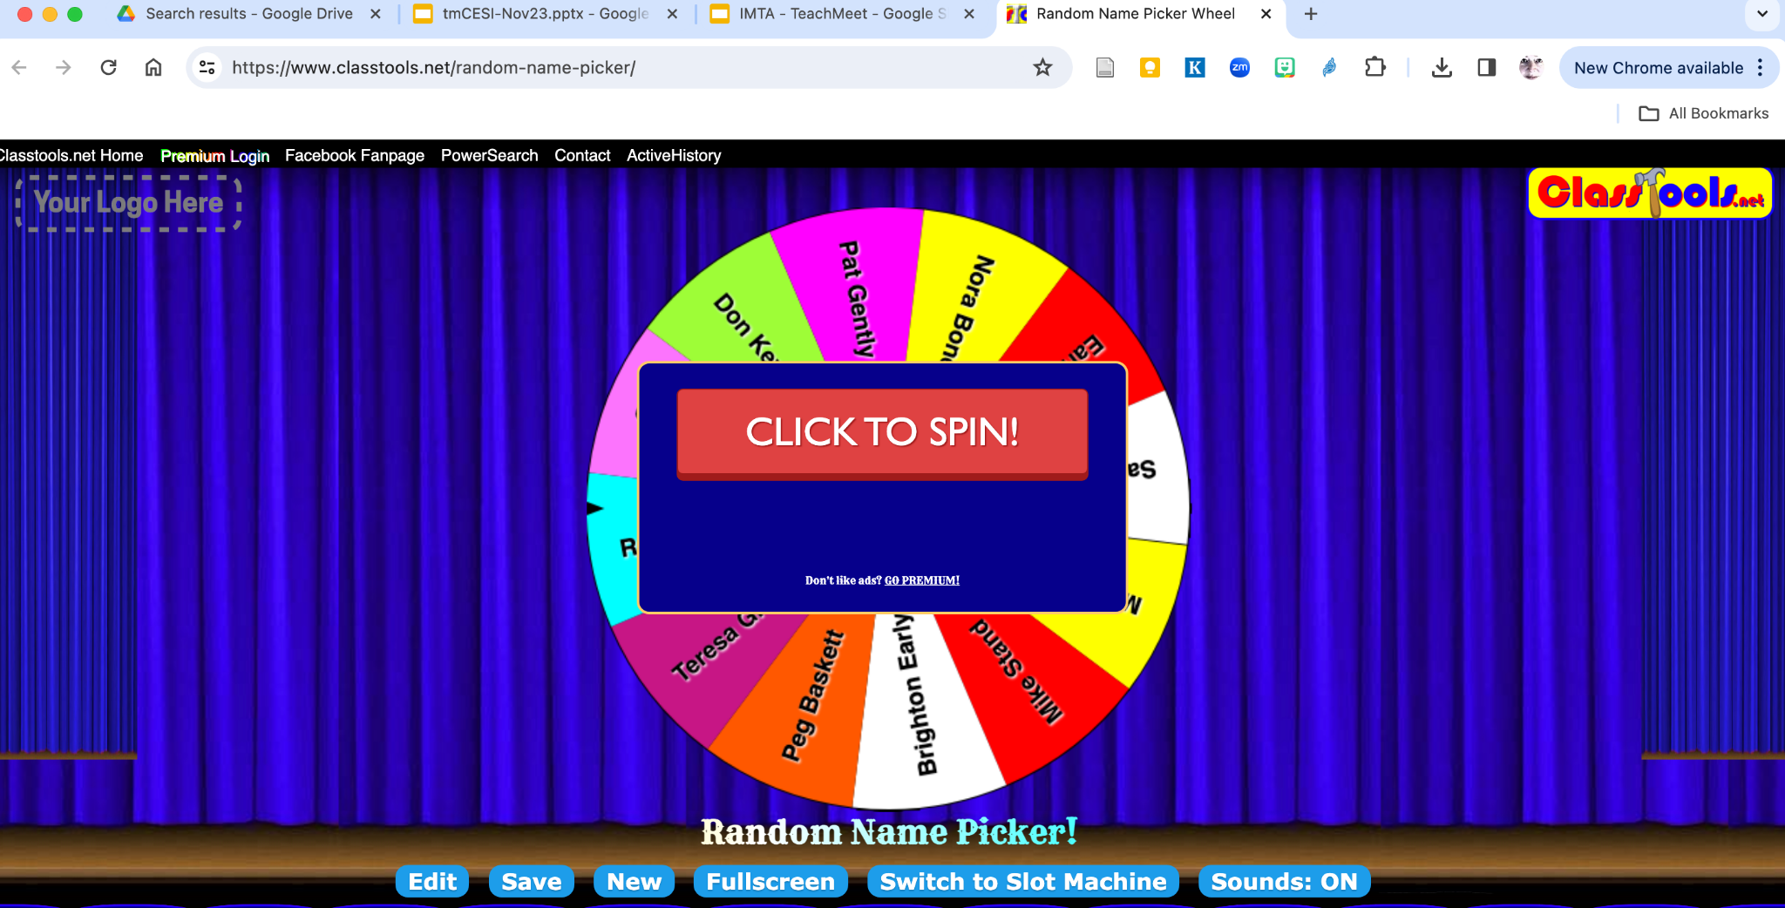
a brief introduction to the What, Why, & How of
https://www.classtools.net/random-name-picker/

Slide 6
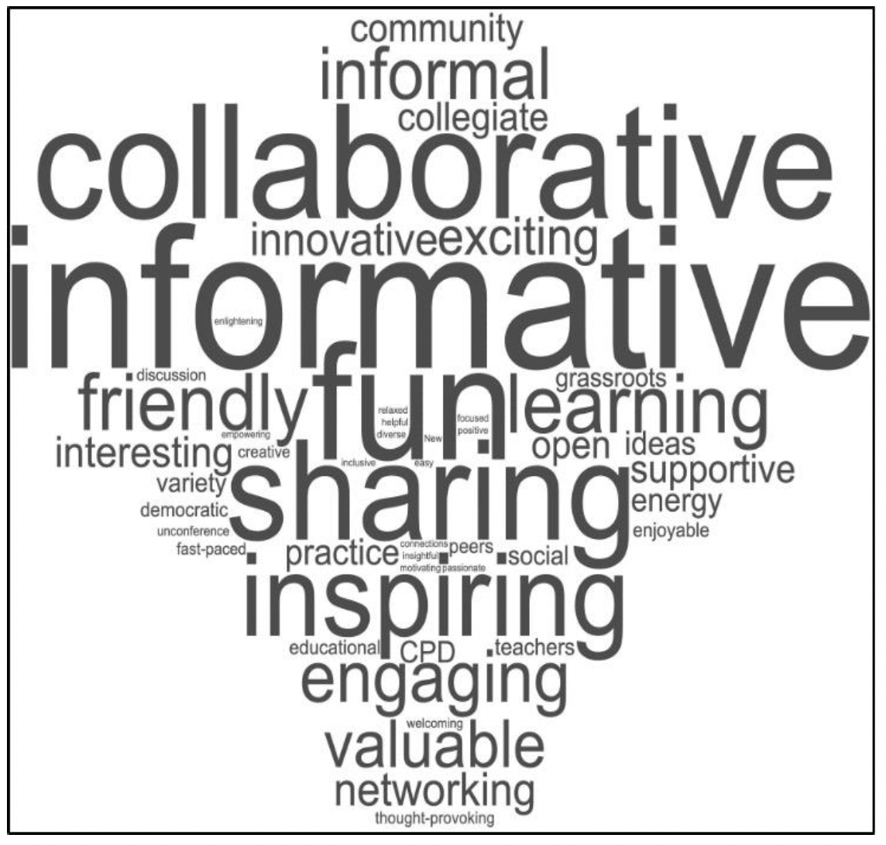
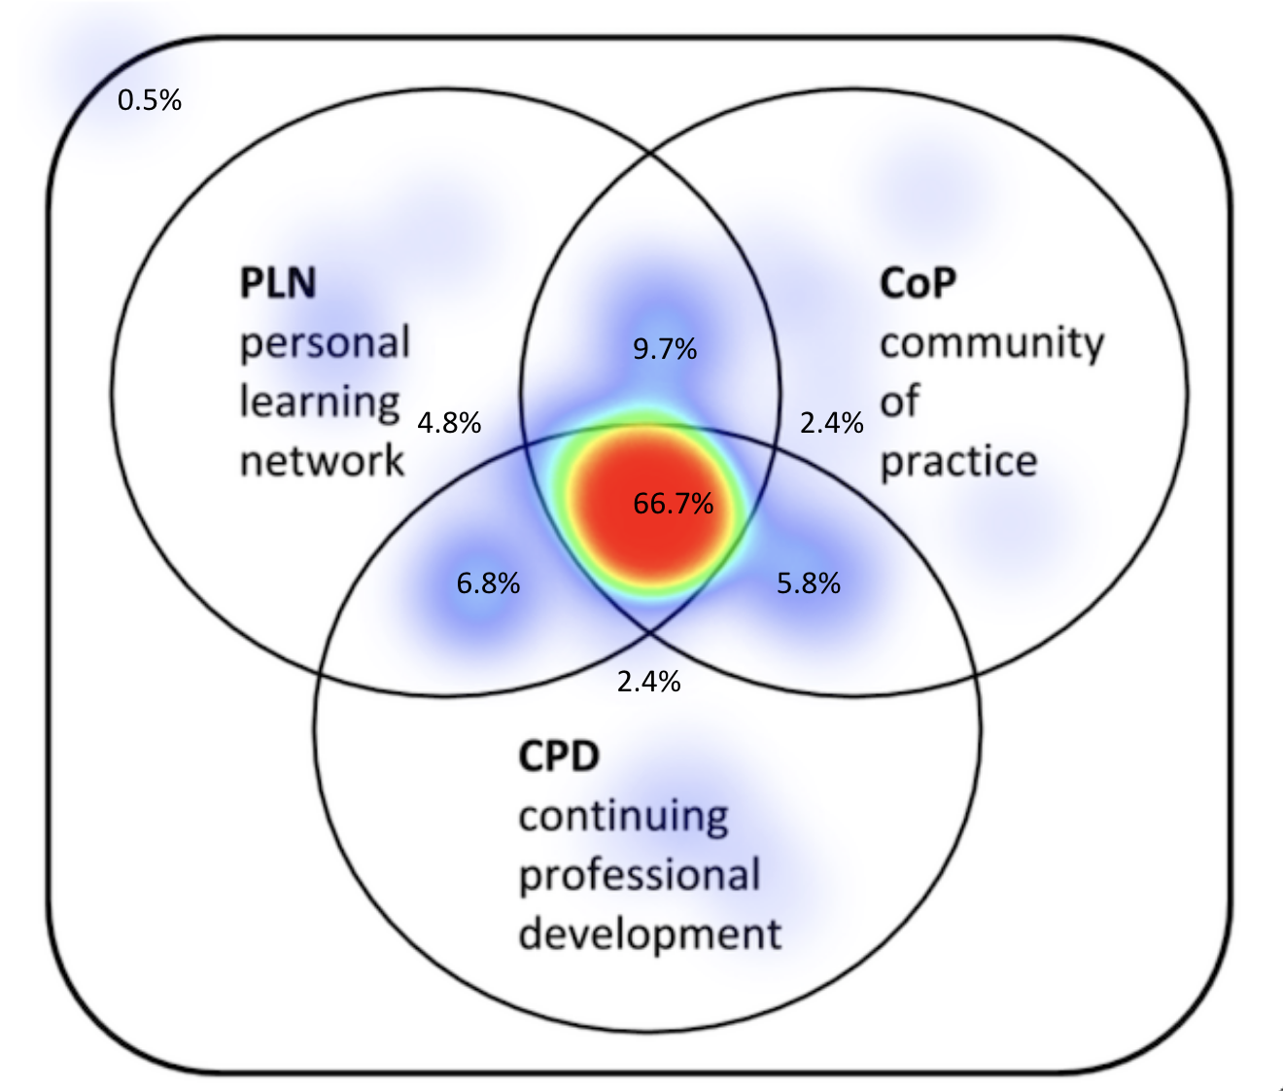
a brief introduction to the What, Why, & How of

Slide 7
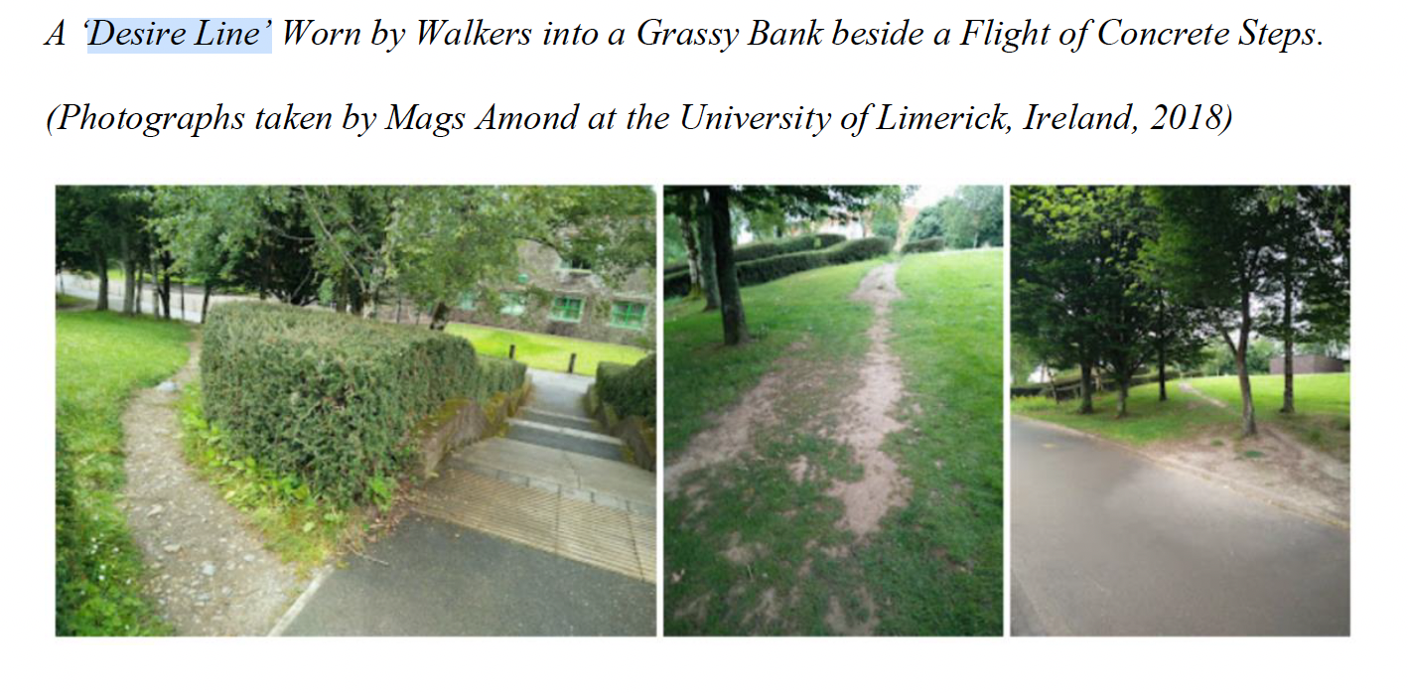
a brief introduction to the What, Why, & How of

Slide 8
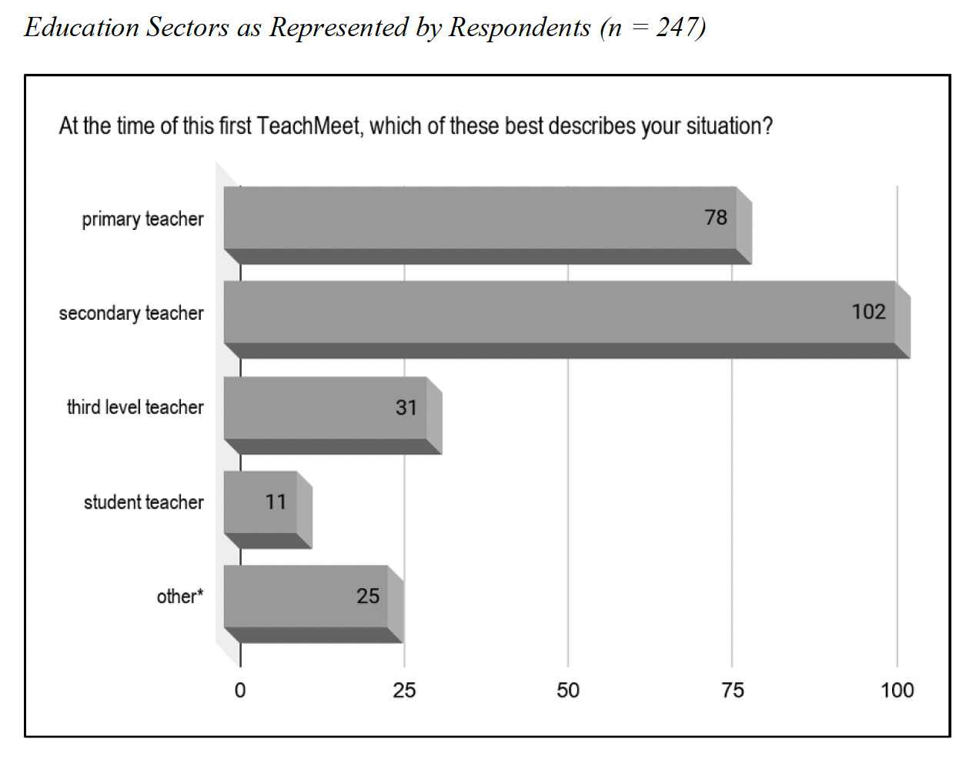
a brief introduction to the What, Who, Why, & How of

Slide 9
a brief introduction to the What, Who, Why, & How of

Slide 10
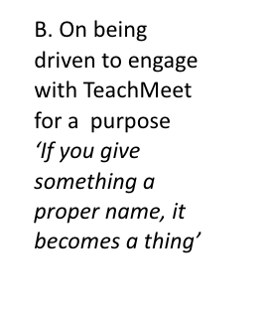
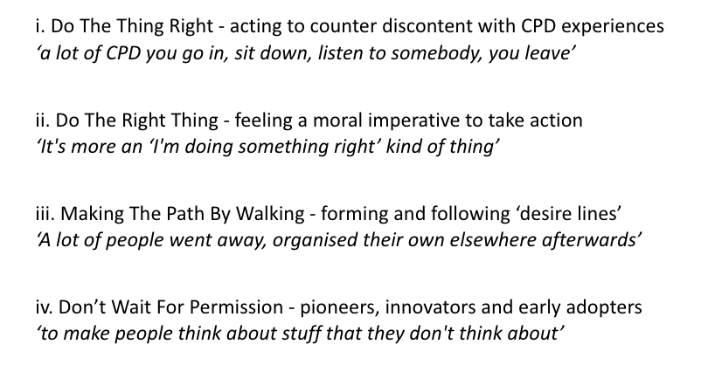
a brief introduction to the What, Why, & How of
A. On Personal, interpersonal, and social relational experience of TeachMeet matters ‘The essence is that they’re your peers, people just like you’ | i. Social, community, and personal networks have evolved among participants ‘learning is a communal process’
 | ii. Social interaction at events, skilfully mediated, is appreciated ‘an MC who can join the dots … put people at ease … give time out’
 | iii. Encouragement from professional mentors, colleagues, peers is formative ‘come along, this is how it works … come along ready to give a talk’
 | iv. Close Encounters Of A Personal Kind ‘the energy, passion in her voice definitely resonates with me now’
B. On being driven to engage with TeachMeet for a purpose ‘If you give something a proper name, it becomes a thing’ | i. Do The Thing Right - acting to counter discontent with CPD experiences ‘a lot of CPD you go in, sit down, listen to somebody, you leave’
 | ii. Do The Right Thing - feeling a moral imperative to take action ‘It's more an ‘I'm doing something right’ kind of thing’
 | iii. Making The Path By Walking - forming and following ‘desire lines’ ‘A lot of people went away, organised their own elsewhere afterwards’
 | iv. Don’t Wait For Permission - pioneers, innovators and early adopters ‘to make people think about stuff that they don't think about’
C. On TeachMeet as a forum for exchange of practice ‘I came out buzzing - it changed how I thought about teaching’ | i. ‘Spreagadh’: the spark that ignites transformation ‘see it, like it, bring it back to the classroom’
 | ii. The Bazaar - the mix: what’s there, and what’s not there ‘no keynote, everybody equal, everybody's voice recognized’
 | iii. The Black Box - getting a glimpse into another’s classroom ‘to be able to say to others, look, I'm trying this, what do you reckon?
D. On the future for TeachMeet - wishful thinking of the political sort ‘Nobody owns TeachMeet, it’s the community’ | i. Yes Please - keep it simple and keep it non-hierarchical ‘a face to face, open process’
 | ii. No Thanks - avoid commercialisation and appropriation ‘if it's not for teachers by teachers, it’s not TeachMeet, it's something else’
 | iii. Perhaps, Perhaps, Perhaps - evolving a place in CPD, and evolving online ‘we need to make sure that it remains as democratic as it needs to be’

Slide 11
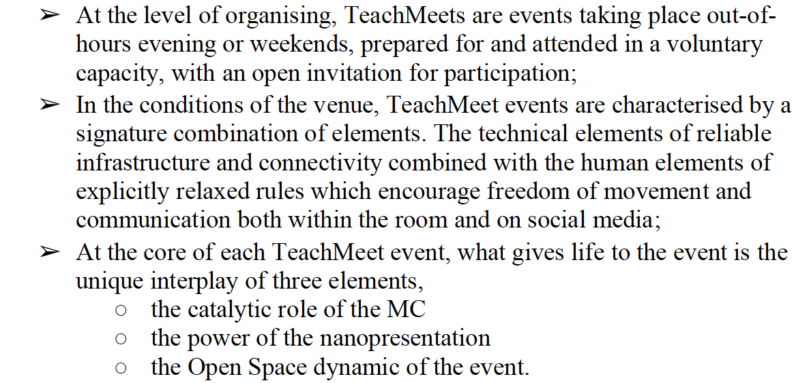
a brief introduction to the What, Why, & How of
gather a team of volunteers
decide on time, place, venue
send out a call for presenters
make the room comfortable
pick a catchy # for the socials
make the ‘tech’ invisible and reliable for participants
MC(s) - relax, stand back, support presenters, build in conviviality & chat
keep the presentations within time
make the atmosphere as social as possible

Slide 12

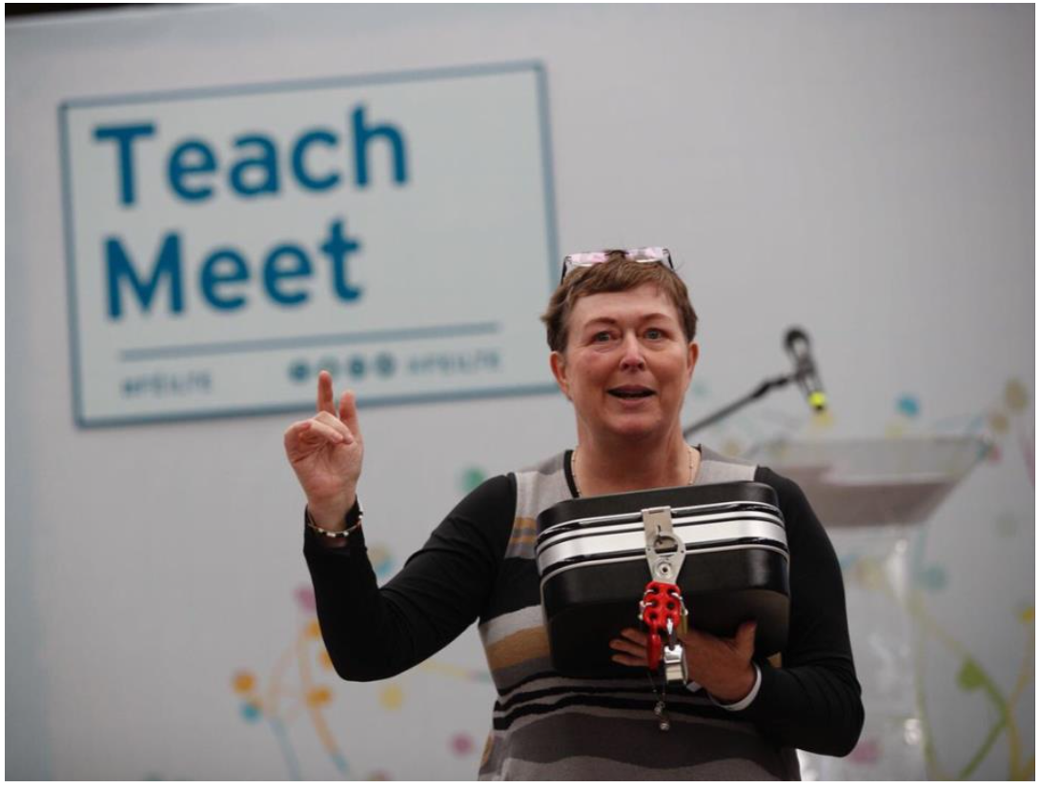


a brief introduction to the What, Why, How & Where of
Féilte
www.cesi.ie

Slide 13
thank you for listening
go raibh maith agaibh as bhur n-éisteacht liom
always happy to correspond:
mags.amond@gmail.com
@magsamond

